Slide 1

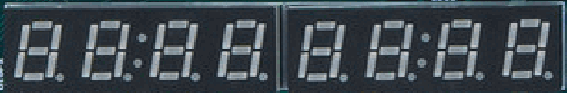
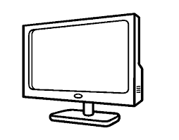
Address Decoder
Boot-ROM
Address[15:6]
Address[5:2]
Sys-Con
Timer
WB-Axi Bridge
VeeR EL2
5-1 Multiplexer
GPIO1-LEDsSw
UART

