Slide 1
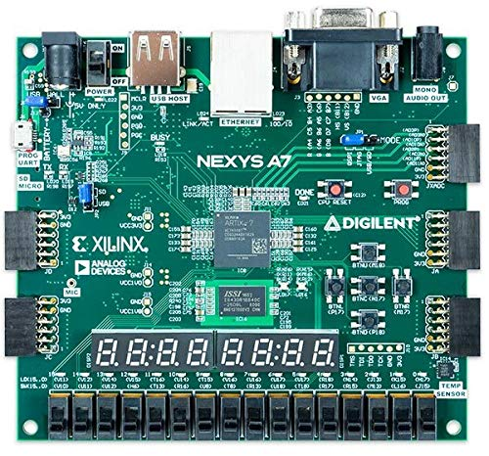
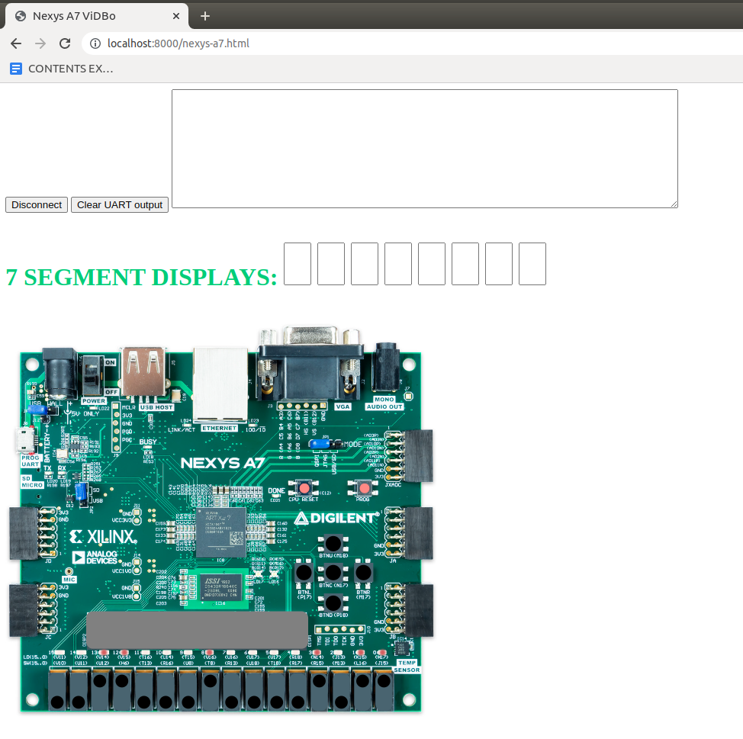
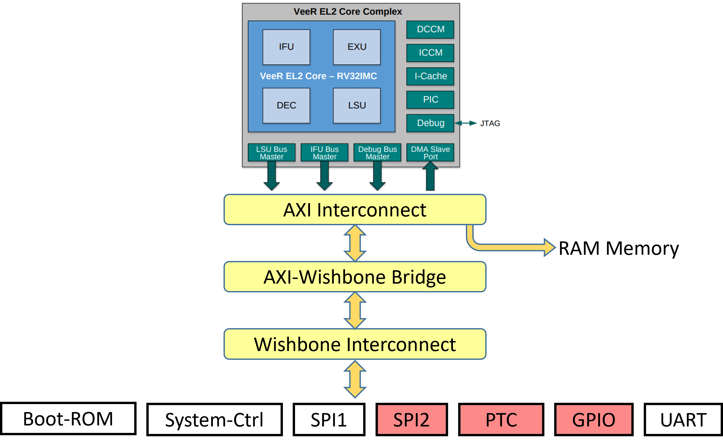
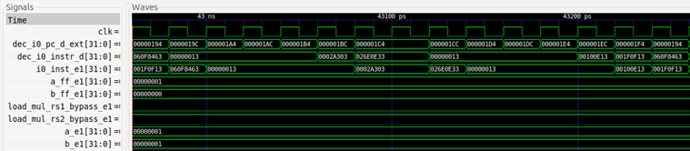
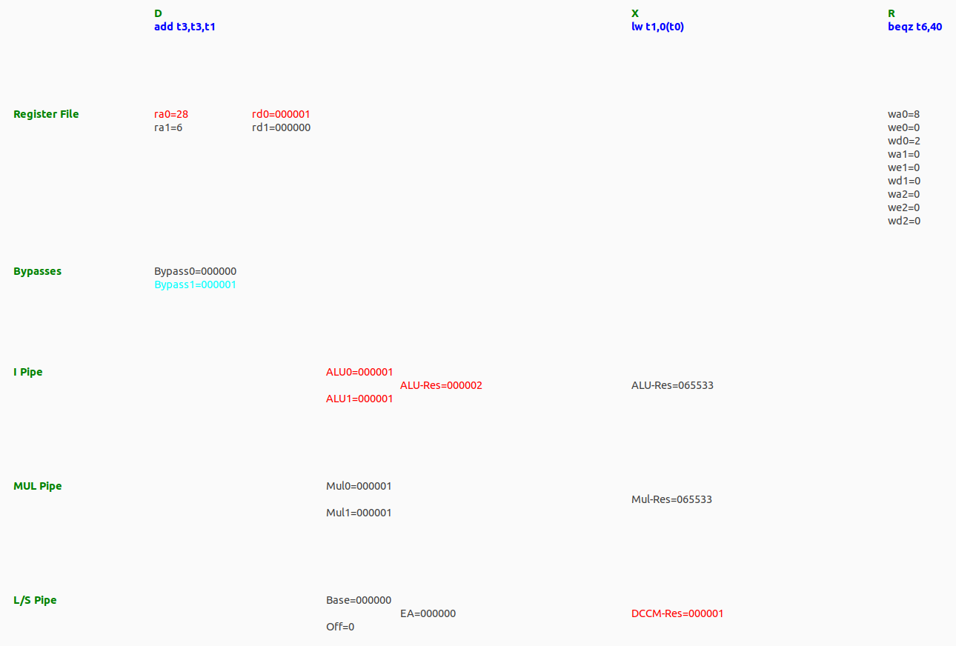
RVfpgaEL2-NexysA7
FRONT-END
BACK-END
RVfpgaEL2-ViDBo
VIVADO
rvfpganexys
VERILATOR
tb_ViDBo.cpp
veerwolf_core (VeeRwolf SoC)
RVfpgaEL2-Trace
VERILATOR
tb.cpp
rvfpgasim
RVfpgaEL2-Pipeline
VERILATOR
tb_PipelineSimulator.cpp

Slide 3
