Slide 1
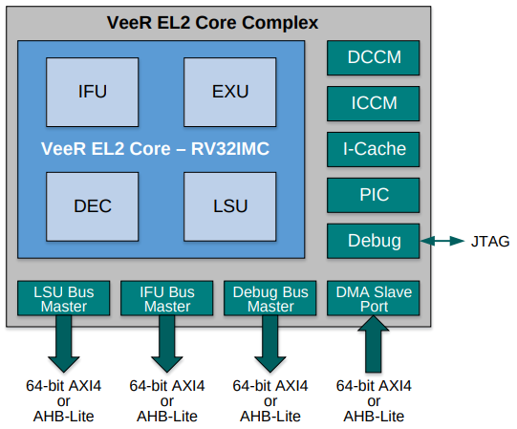
AXI Interconnect
RAM Memory
AXI-Wishbone Bridge
Wishbone Interconnect
Boot-ROM
System-Ctrl
SPI1
SPI2
PTC
GPIO
UART

Slide 2
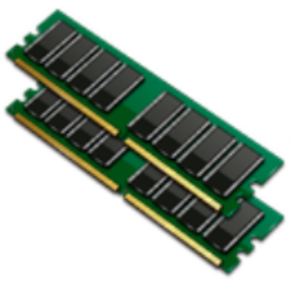
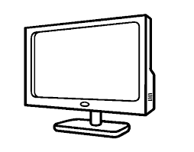


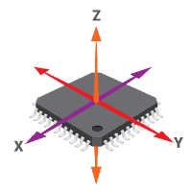
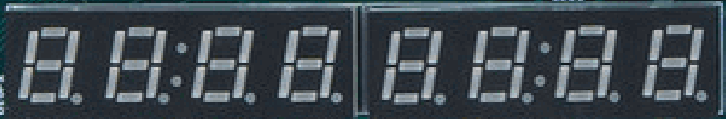
100 MHz
Clock Generator
25 MHz
VeeRwolfX SoC
bscan TAP
CDC
AXI Interconnect
RAM Memory
Lite DRAM controller
AXI-Wishbone Bridge
Wishbone Interconnect
Boot-ROM
System-Ctrl
SPI1
SPI2
Timer
GPIO
UART

