Slide 1

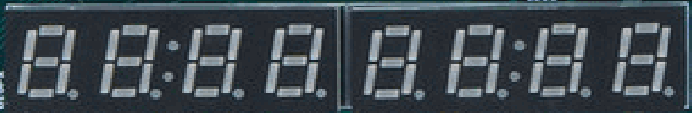

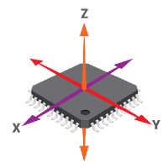

Address Decoder
Boot-ROM
Sys-Con
Address[15:6]
Address[5:2]
SPI1-Flash
SPI2-Accel
WB-Axi Bridge
VeeR EL2
7-1 Multiplexer
Timer
GPIO1-LEDsSw
UART

