Slide 1
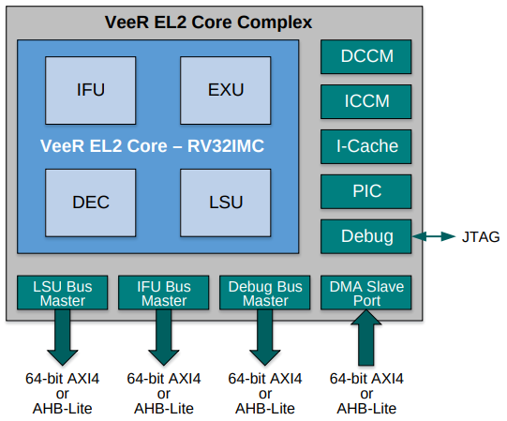
AXI Interconnect
RAM Memory
AXI-Wishbone Bridge
Wishbone Interconnect
Boot-ROM
System-Ctrl
SPI1
SPI2
PTC
GPIO
UART

Slide 2
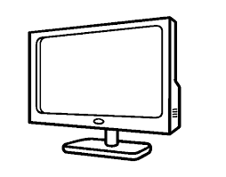

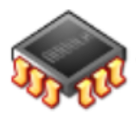
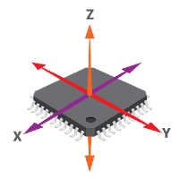
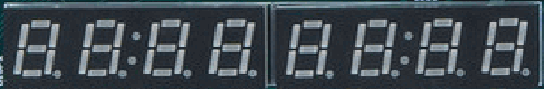
100 MHz
Clock Generator
25 MHz
VeeRwolfX SoC
bscan TAP
AXI Interconnect
RAM Memory
AXI-Wishbone Bridge
Wishbone Interconnect
Boot-ROM
System-Ctrl
SPI1
SPI2
Timer
GPIO
UART

