Slide 1
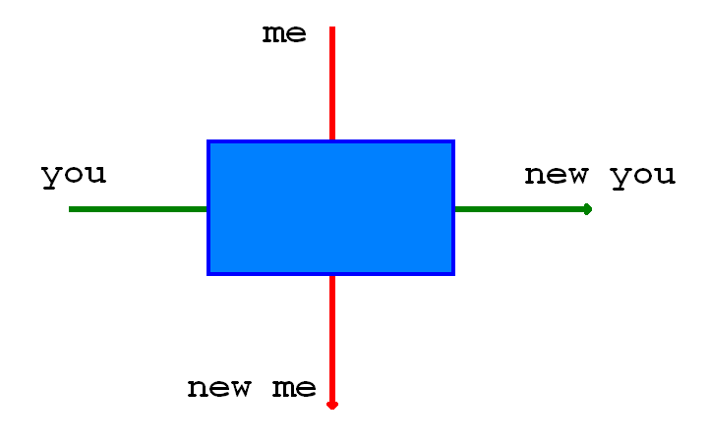

Slide 2
Insert cowboy picture here

