Slide 1
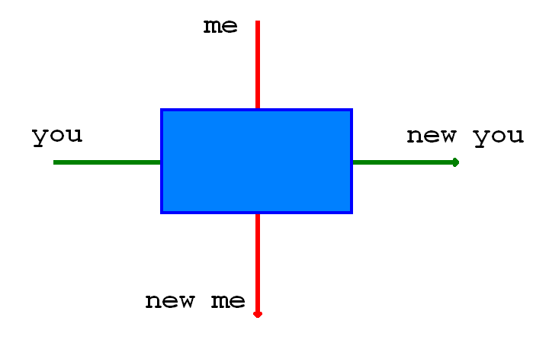

Slide 2
Insert picture of johnson

Slide 3
Insert cowboy picture here

