Slide 1
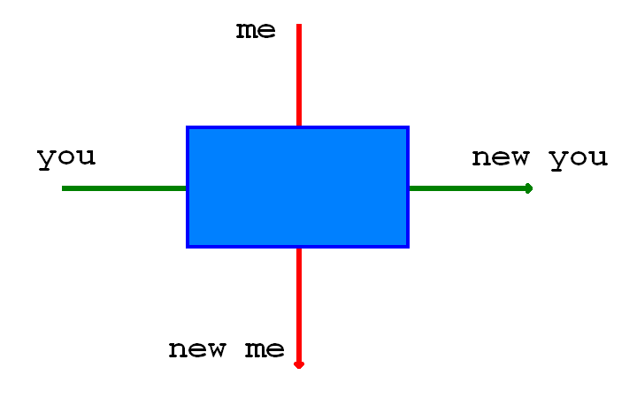

Slide 2
Insert picture of johnson

Slide 3
JohnsonsSystem
has
Teller
Receipt
creates
AccountReference
has
Account
creates
has (balance)
SystemClock
knows
Money

Slide 4
Insert cowboy picture here

