Slide 1
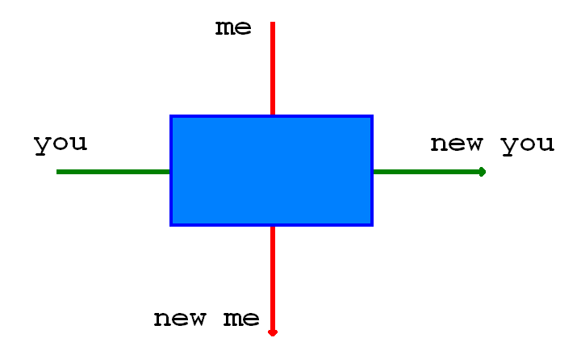

Slide 2
what to expect

Slide 3
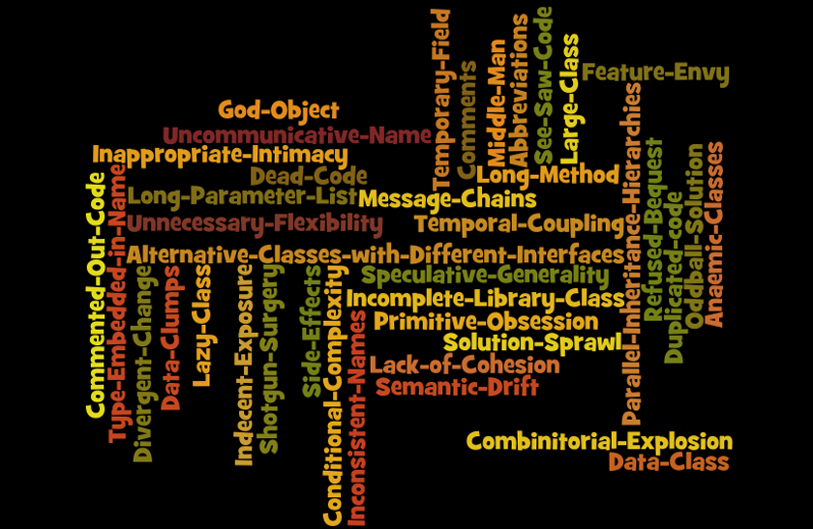

Slide 4
Object Calesthenics
Use only one level of indentation per method
Don’t use the else keyword
Wrap all primitives and strings
Use only one dot per line
Don’t abbreviate
Keep all entities small
Don’t use any classes with more than two instance variables
Use first-class collections
Don’t use any getters/setters/properties
Jeff Bay in The ThoughtWorks Anthology

