Slide 1
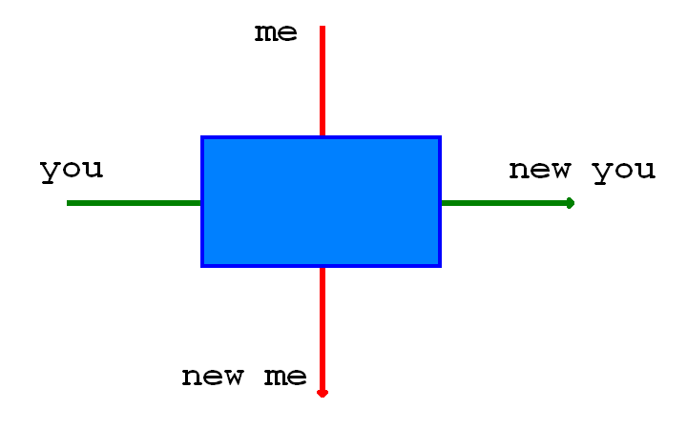

Slide 2
code smells

Slide 3
“any symptom in the source code of a program that possibly indicates a deeper problem”
http://en.wikipedia.org/wiki/Code_smell

Slide 4
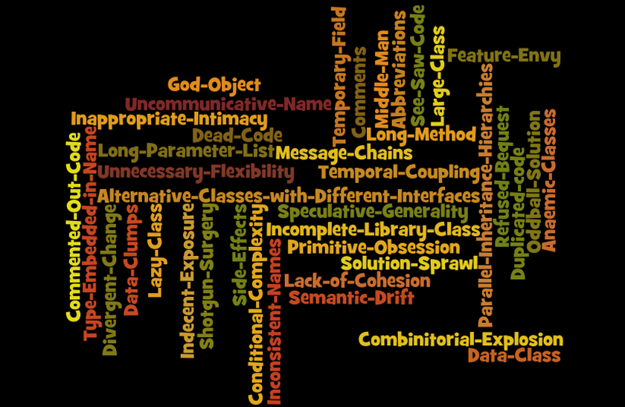

Slide 5
hide and seek

