Slide 1
Texty text

Slide 2
1 & 2

Slide 3
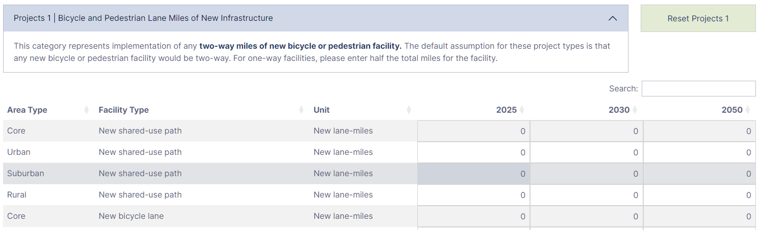
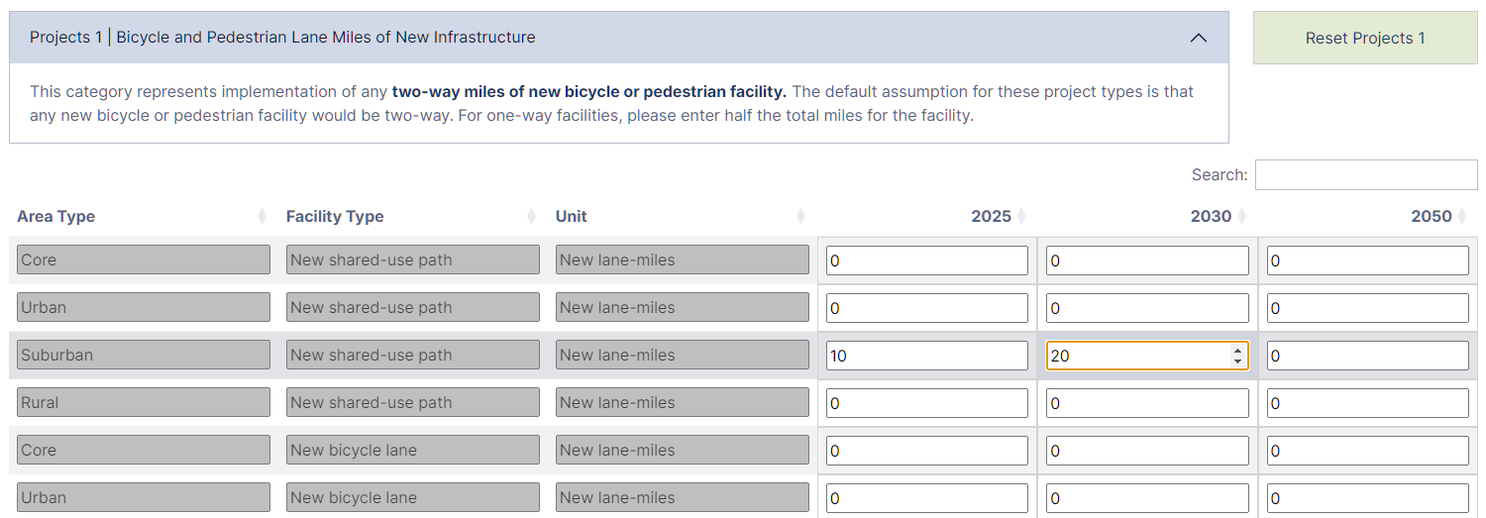
Double-click the value (here a ‘0’) to begin editing
3 & 4
Hit CTRL + Enter to finish entering, or Esc to cancel

Slide 4
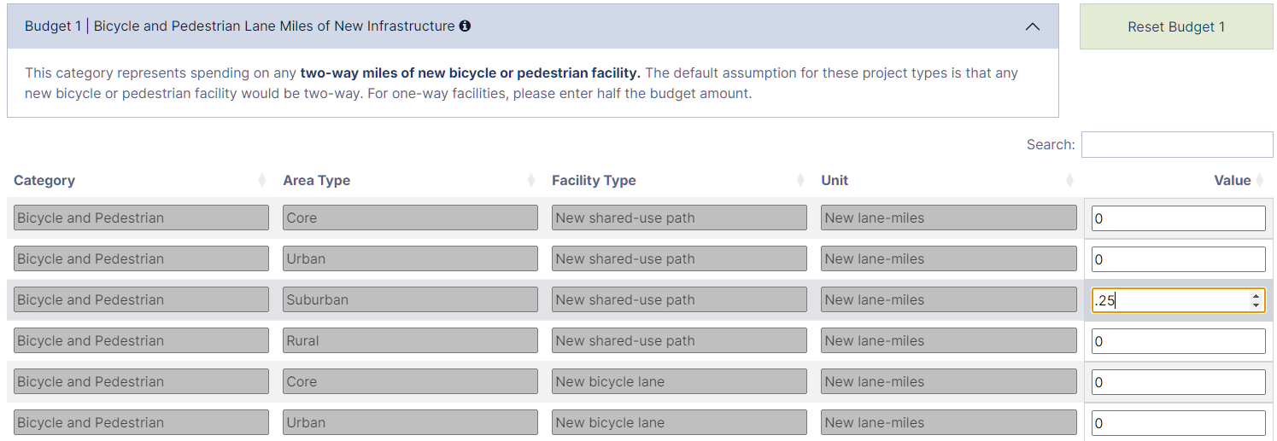
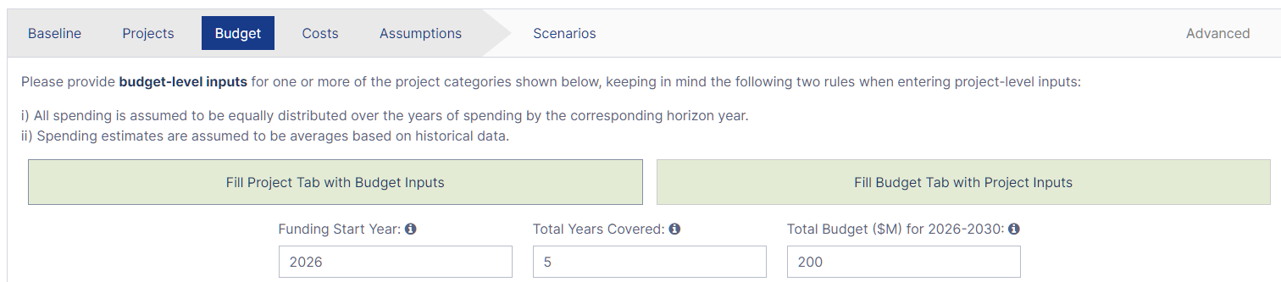
5&6
Similarly, in Budget Mode, double-click cells to begin editing.

Slide 5
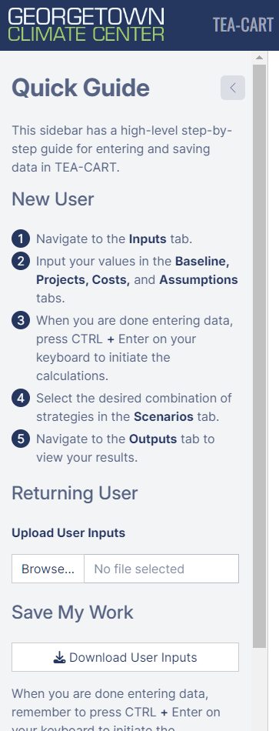
7

Slide 6
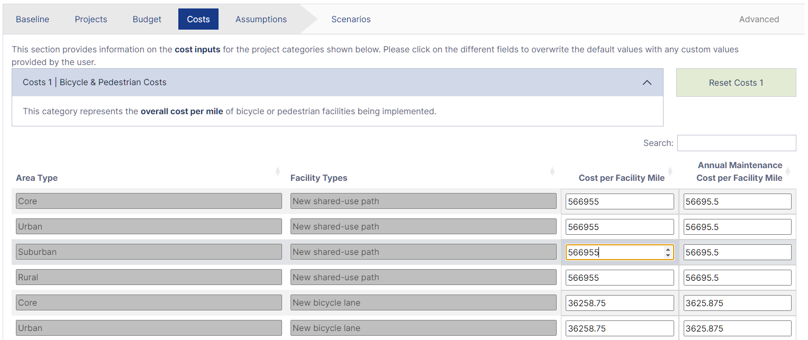
8
Default values can be changed.

Slide 7
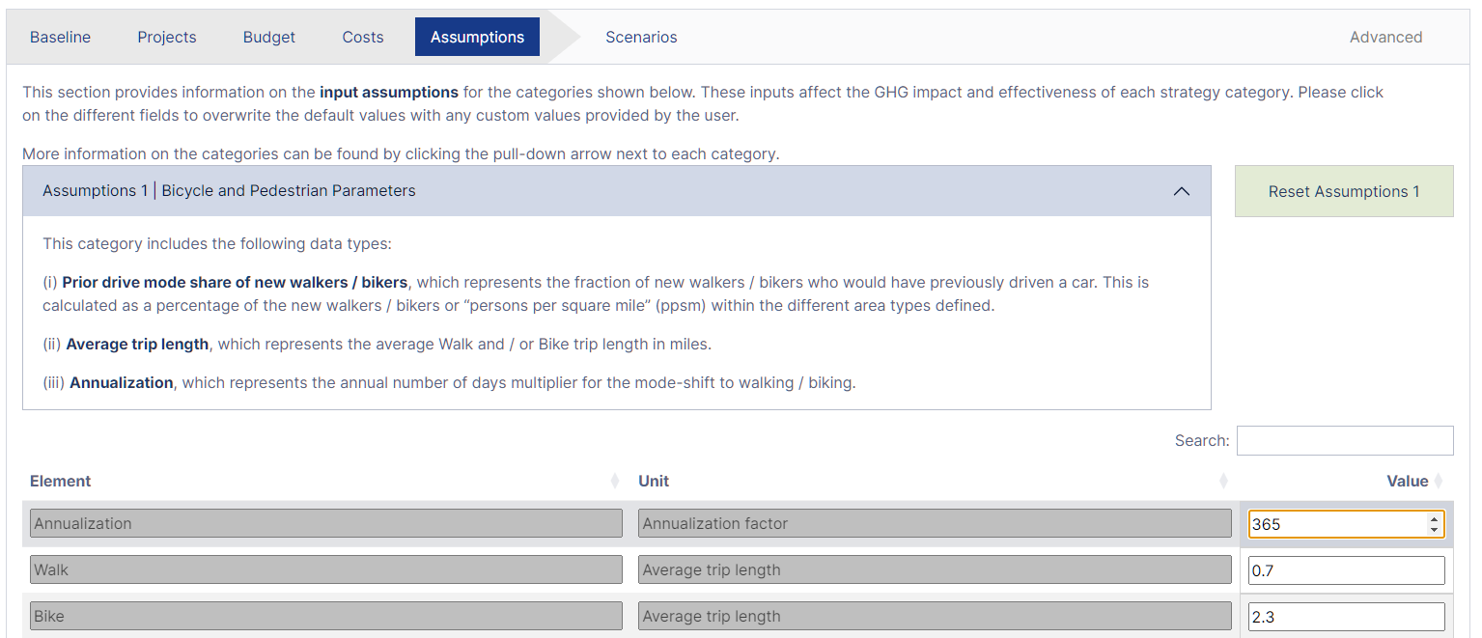
9
Default values can be changed.

Slide 8
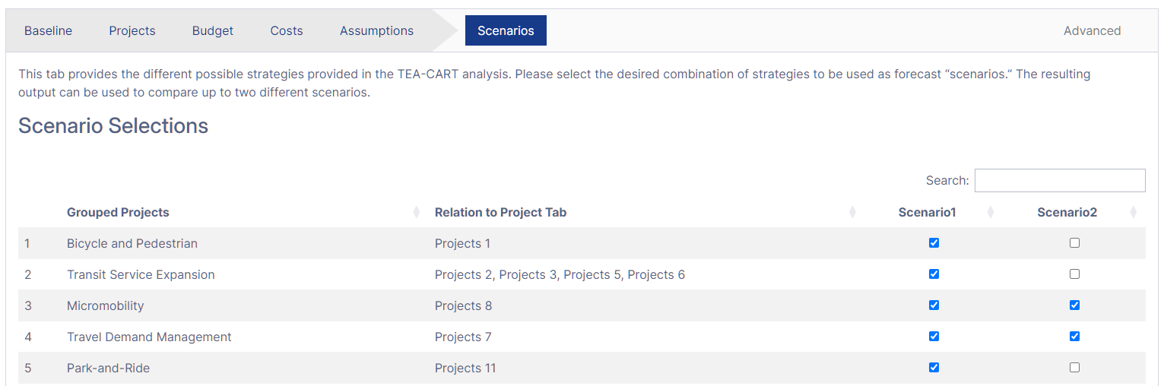
10
By default, all project types will be selected under Scenario 1. Click checkboxes to add or remove project types.

Slide 9
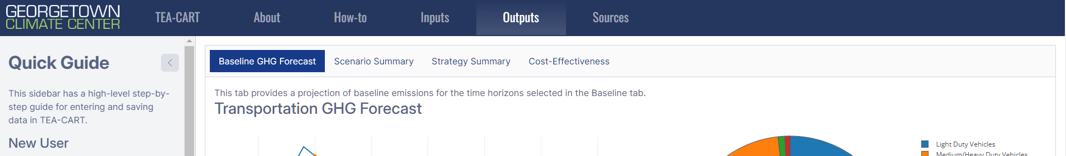
11

Slide 10
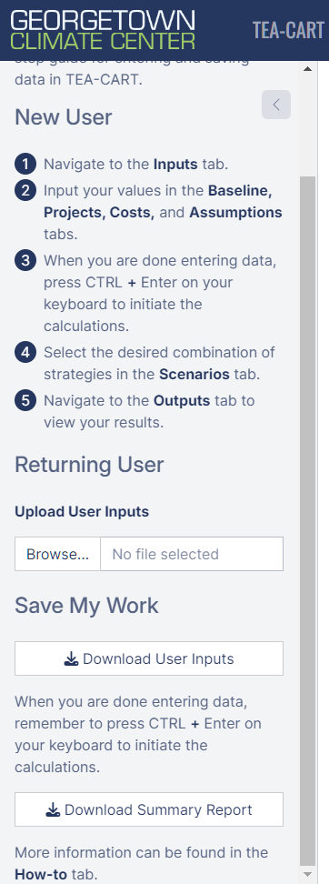
12

