Slide 1
DOT Precipitation Frequency Preliminary Outputs / Comparison
Michael Lindgren
July 9, 2019
Scenarios Network for Alaska + Arctic Planning

Slide 2
NOAA Atlas 14 Precip Frequencies

Slide 3
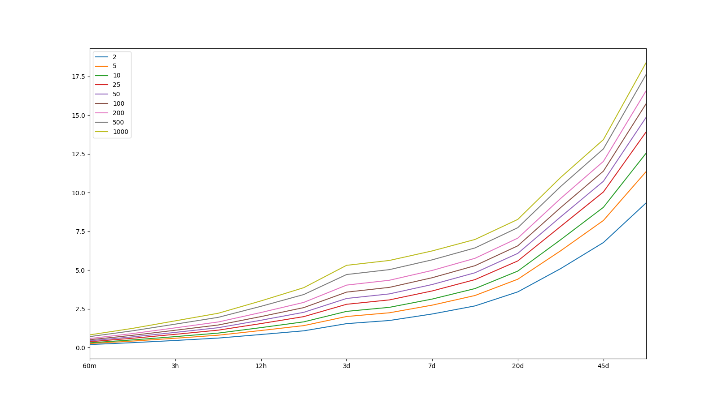
Atlas 14 Data – Precip Freq

Slide 4
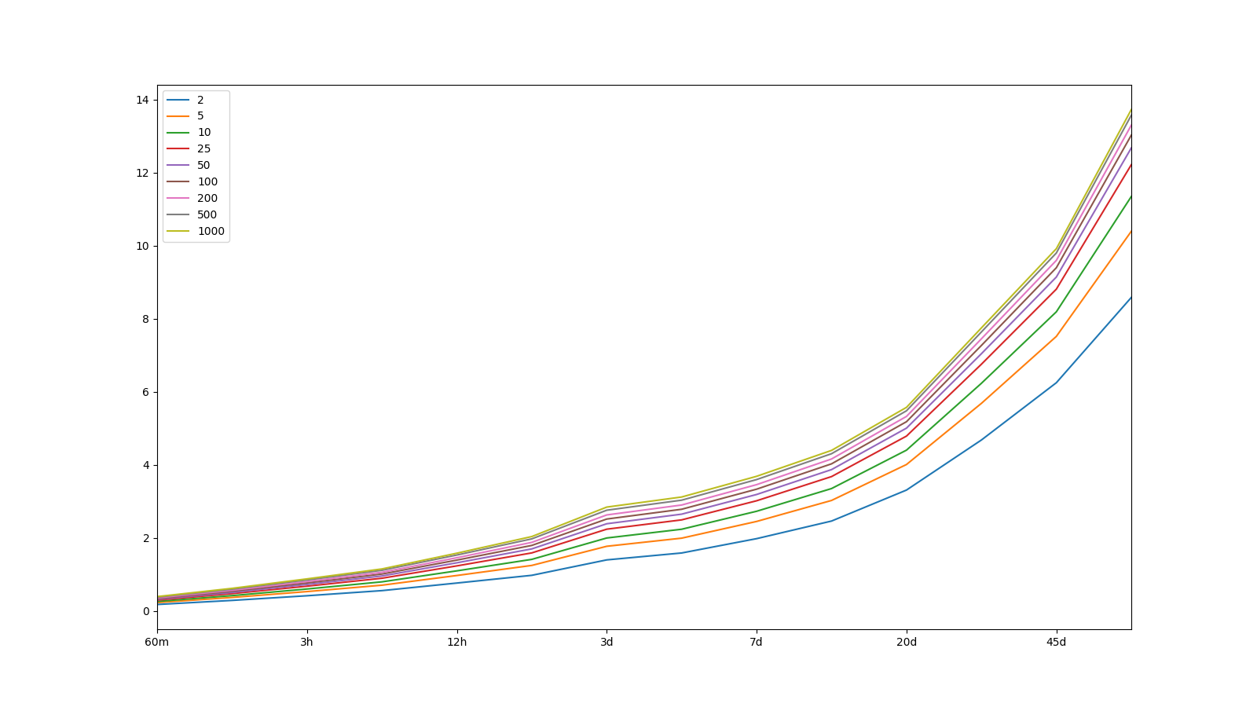
Atlas 14 Data – Precip Freq – lower bound

Slide 5
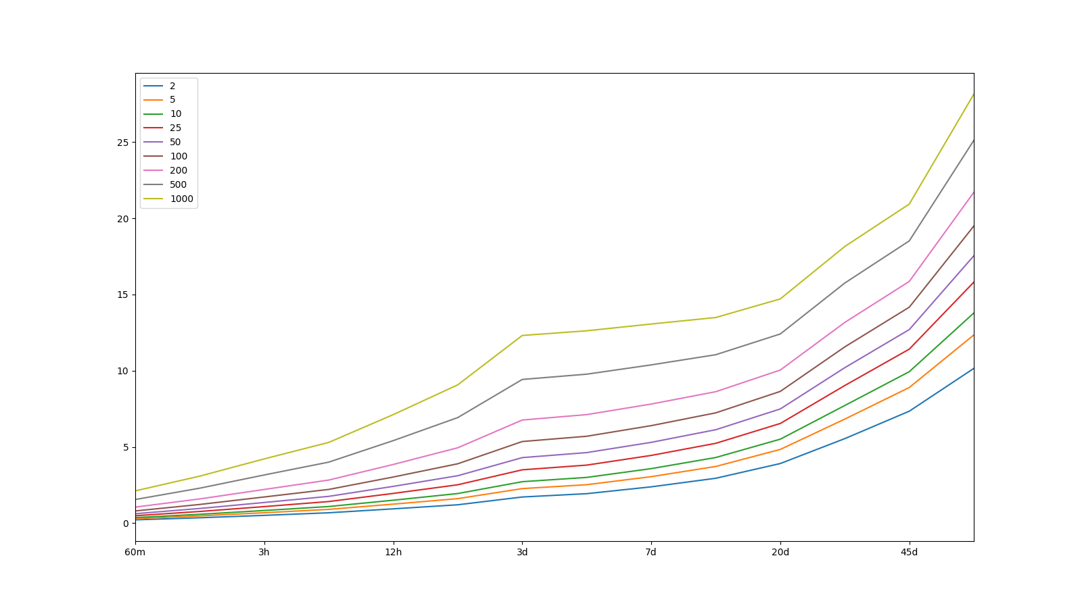
Atlas 14 Data – Precip Freq – upper bound

Slide 6
WRF-Derived Precip Frequencies

Slide 7
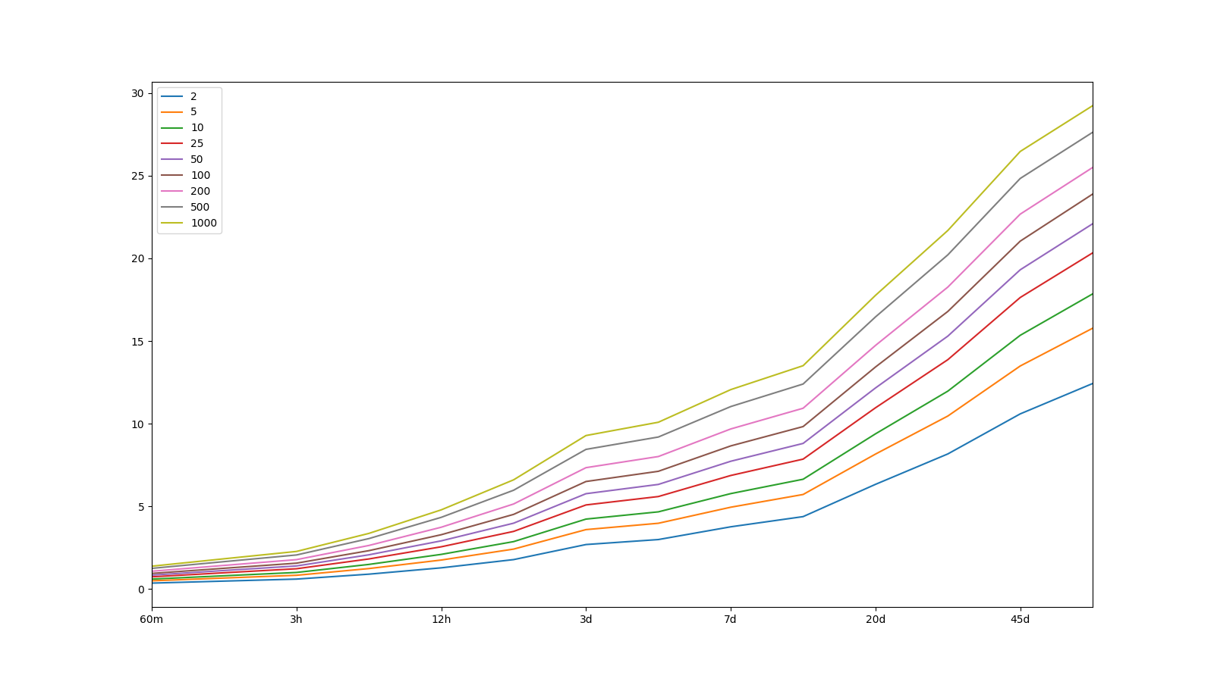
WRF-derived Data – Precip Freq

Slide 8
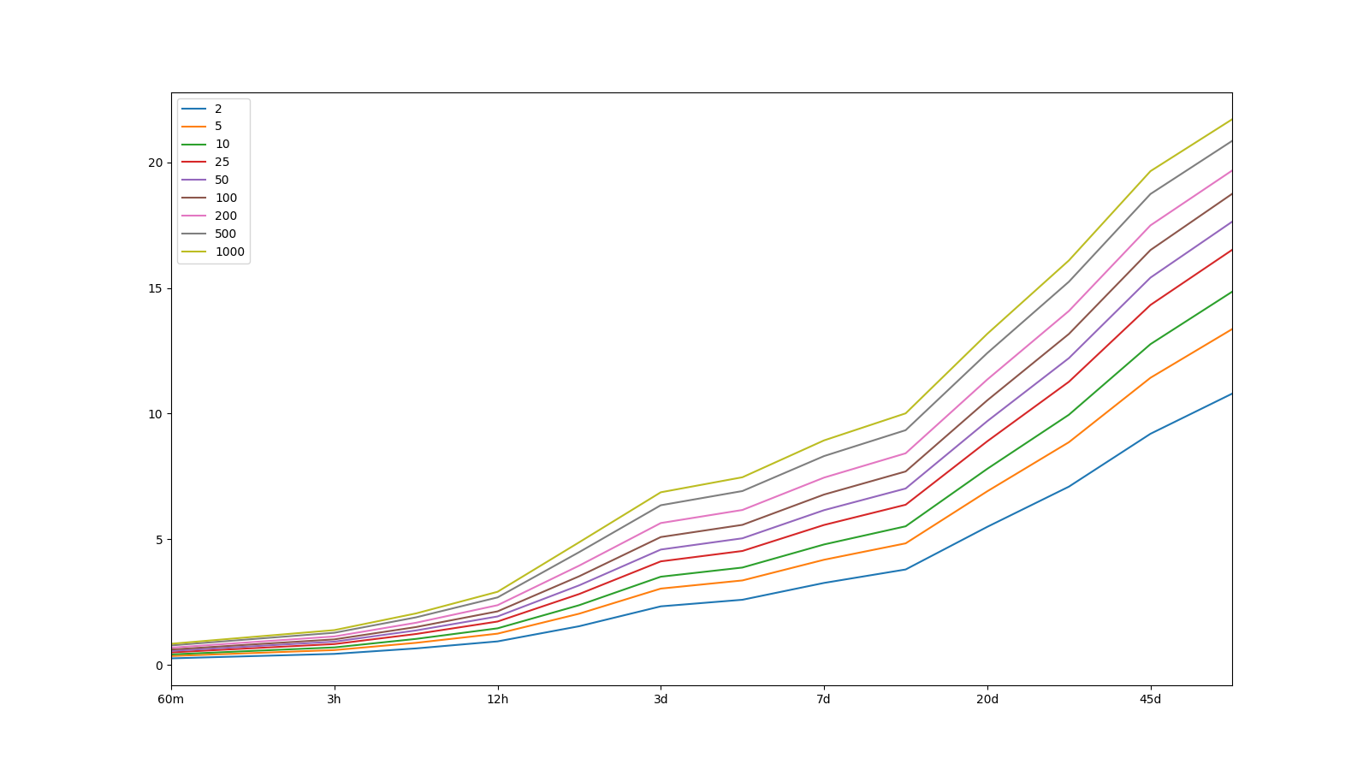
WRF-derived Data – Precip Freq – lower bound

Slide 9

WRF-derived Data – Precip Freq – upper bound

Slide 10
Differences Between Groups

Slide 11
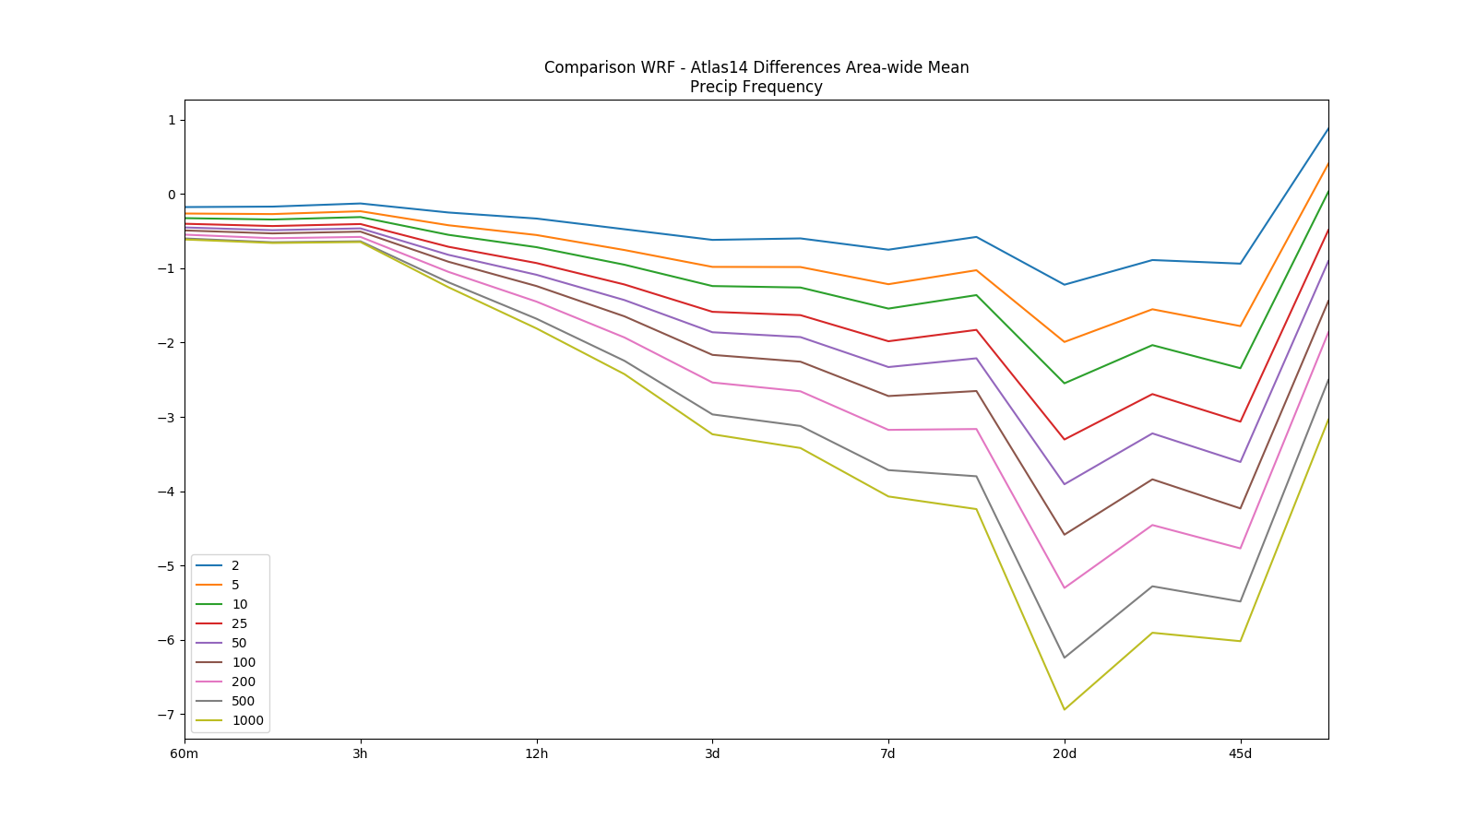

Slide 12
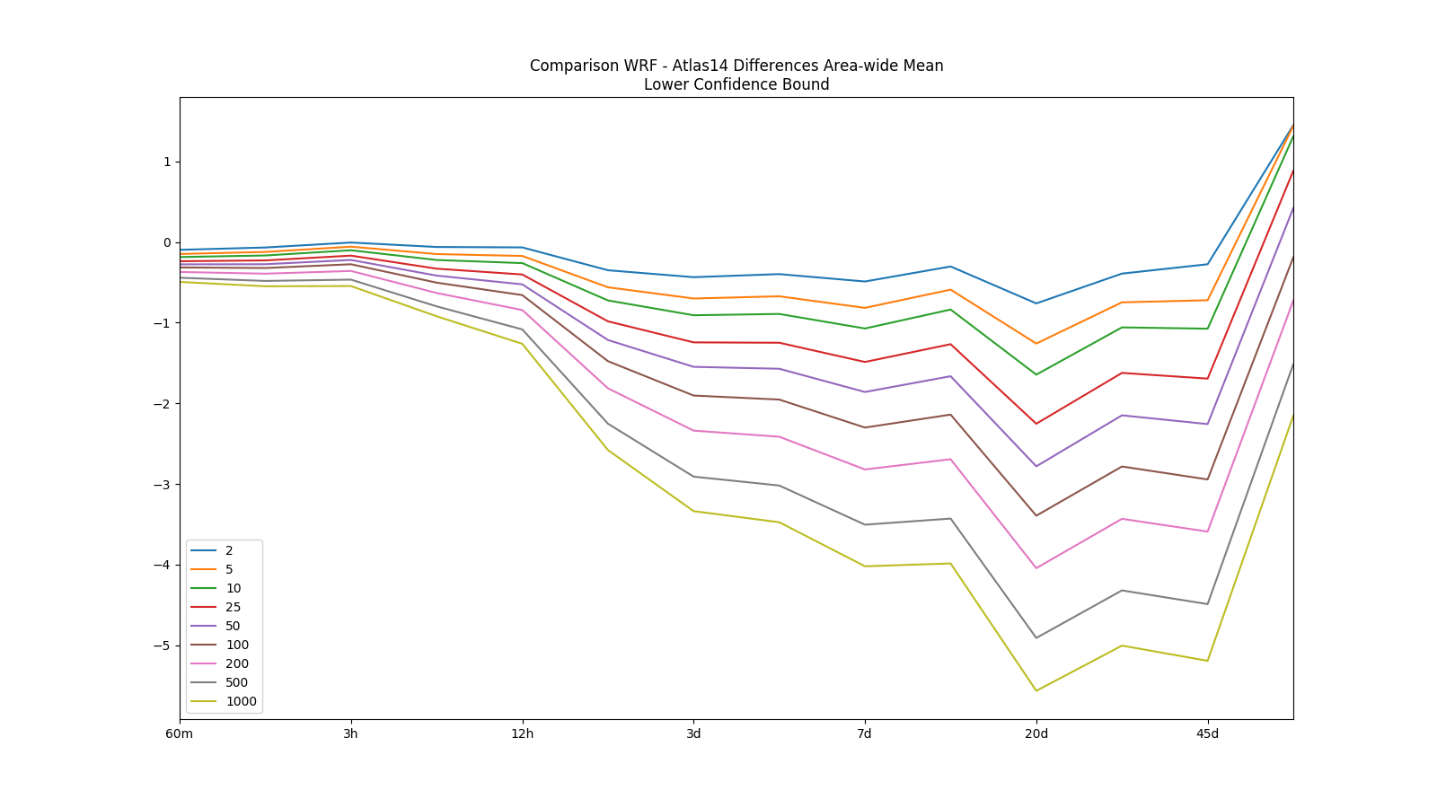

Slide 13
