Slide 1
DOT Precipitation Frequency Preliminary Outputs / Comparison
Michael Lindgren
July 23, 2019
Scenarios Network for Alaska + Arctic Planning

Slide 2
NOAA Atlas 14 Precip Frequencies

Slide 3
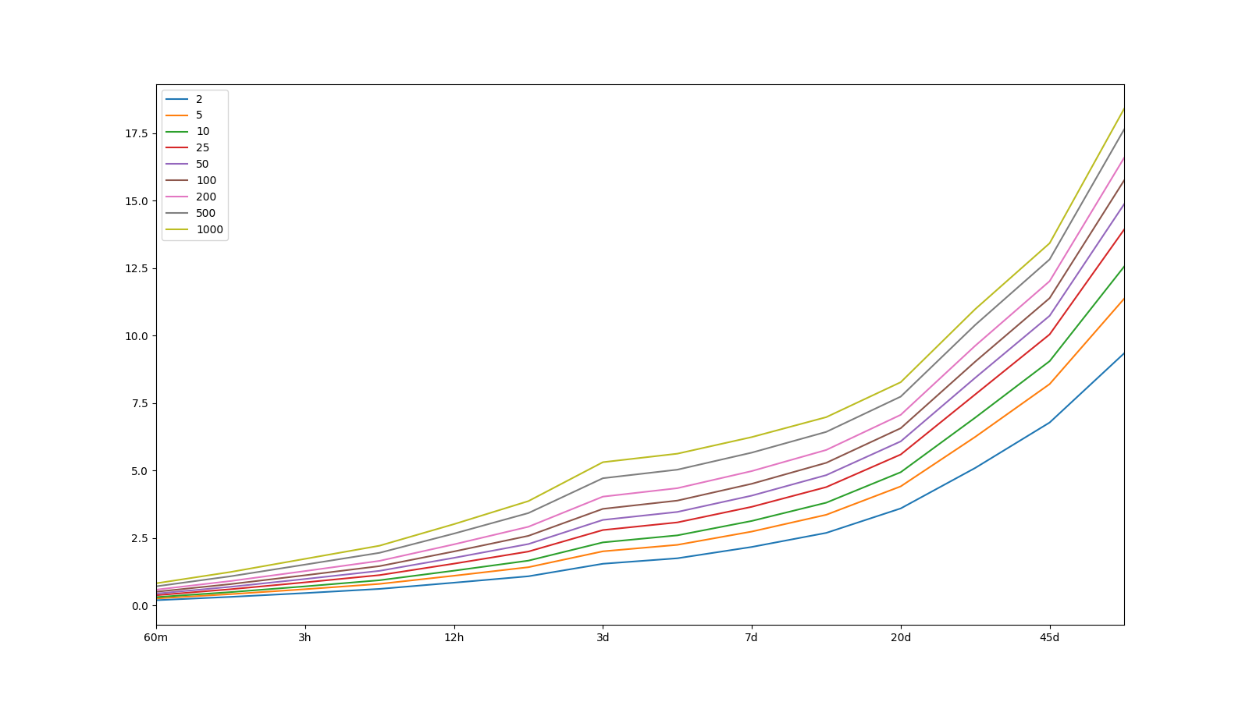
Atlas 14 Data – Precip Freq

Slide 4
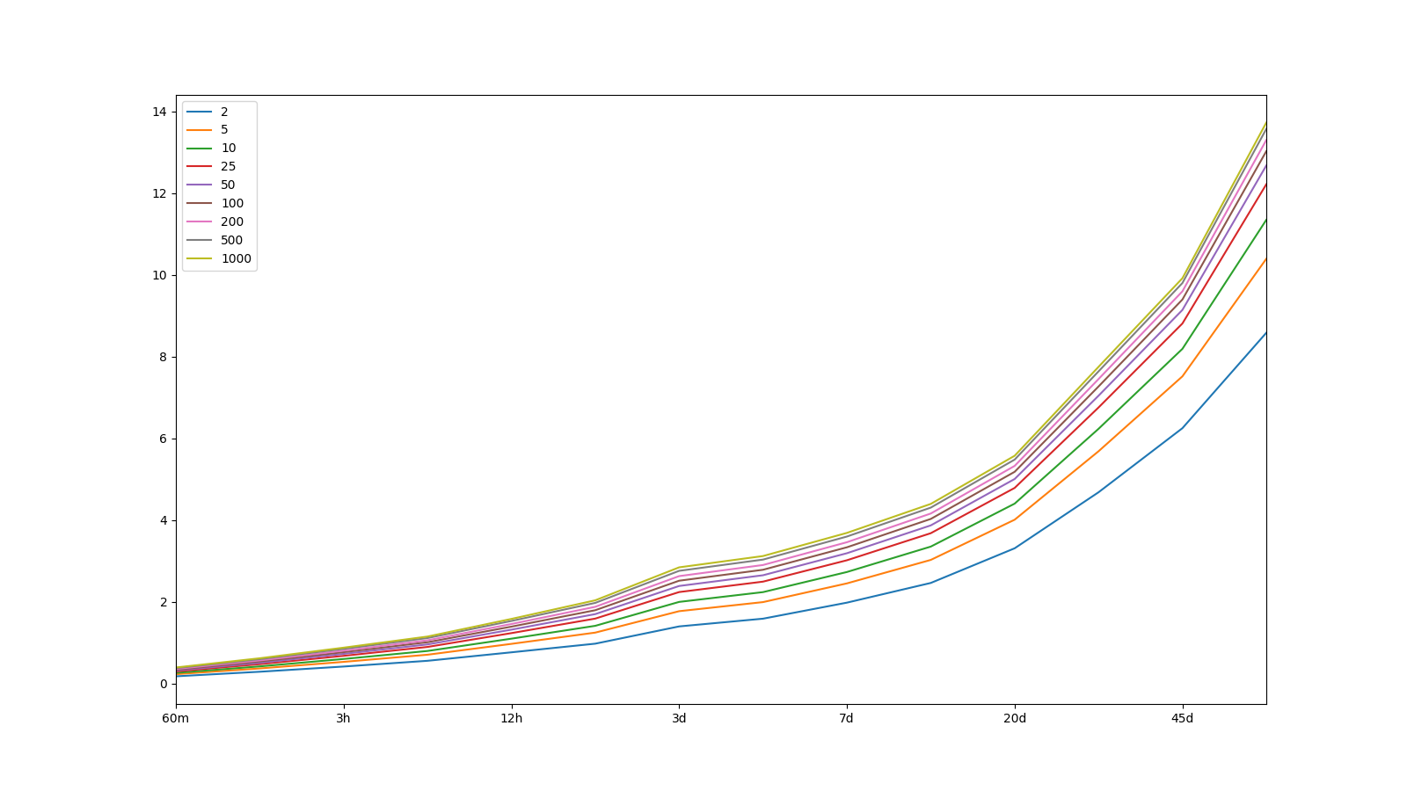
Atlas 14 Data – Precip Freq – lower bound

Slide 5
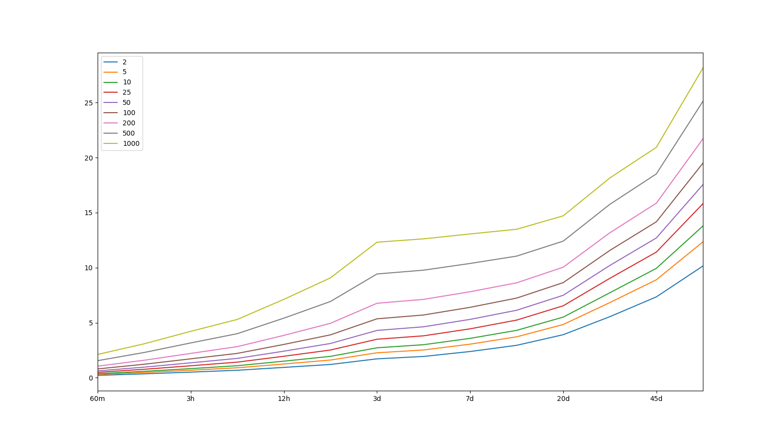
Atlas 14 Data – Precip Freq – upper bound

Slide 6
WRF-Derived Precip Frequencies

Slide 7
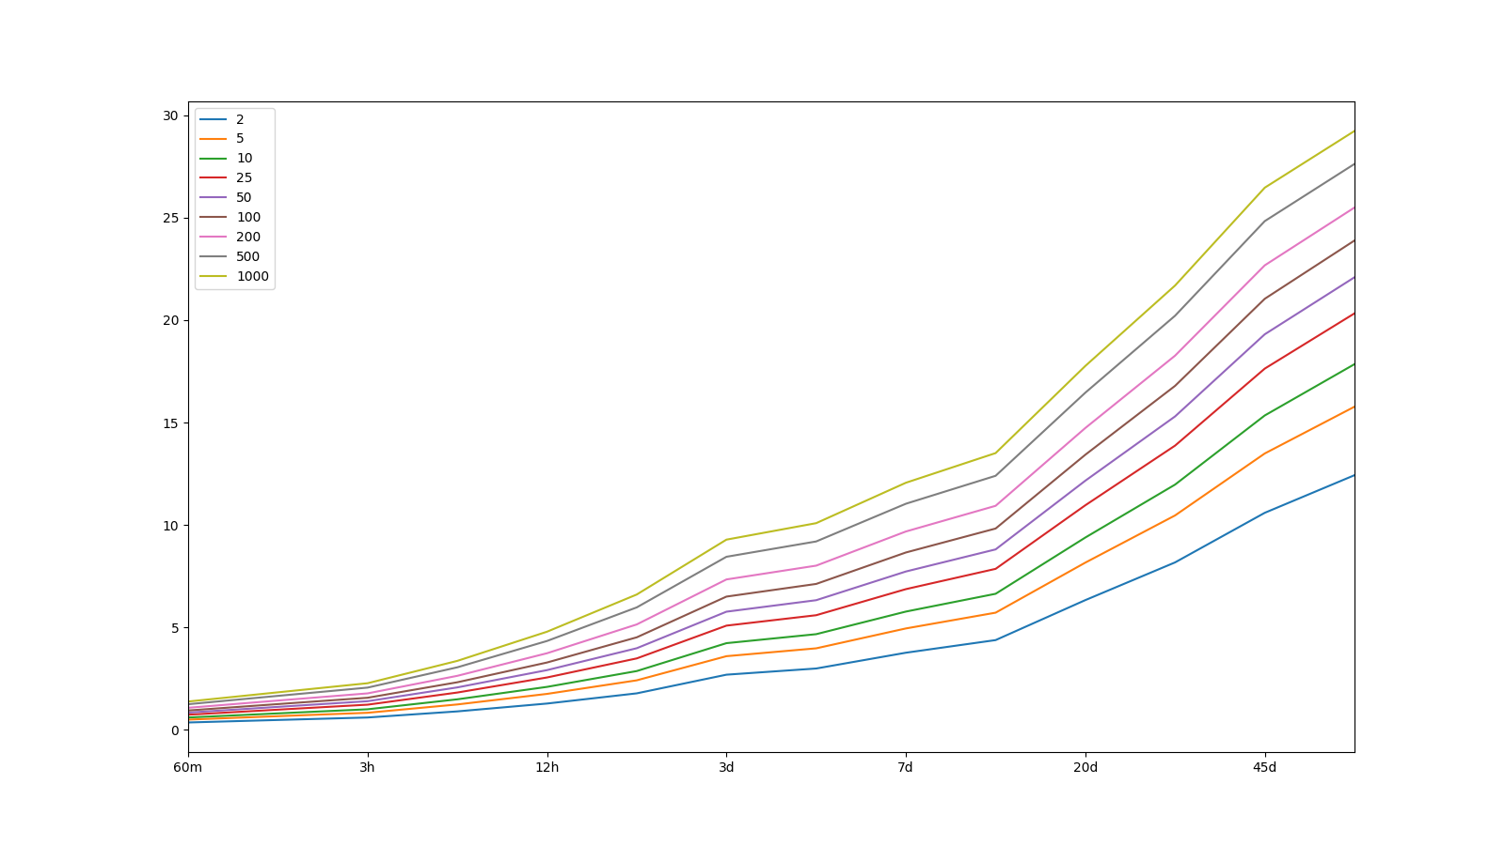
WRF-derived Data – Precip Freq

Slide 8
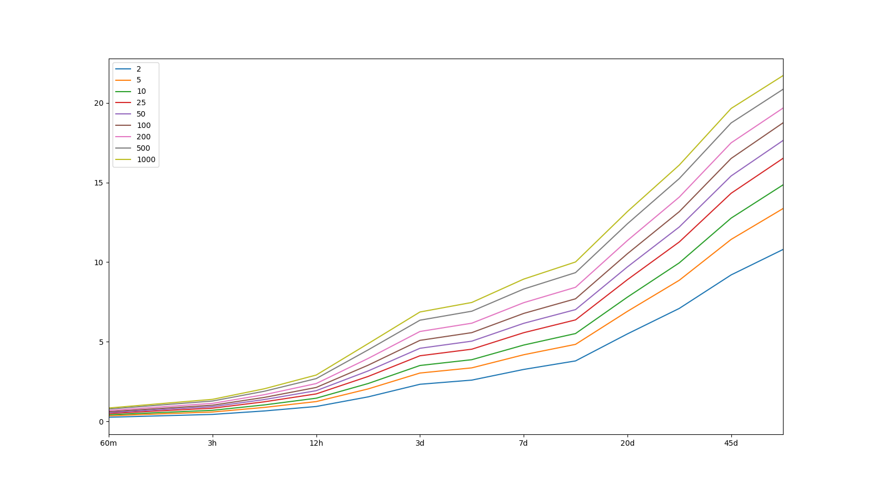
WRF-derived Data – Precip Freq – lower bound

Slide 9

WRF-derived Data – Precip Freq – upper bound

Slide 10
Differences Between Groups

Slide 11
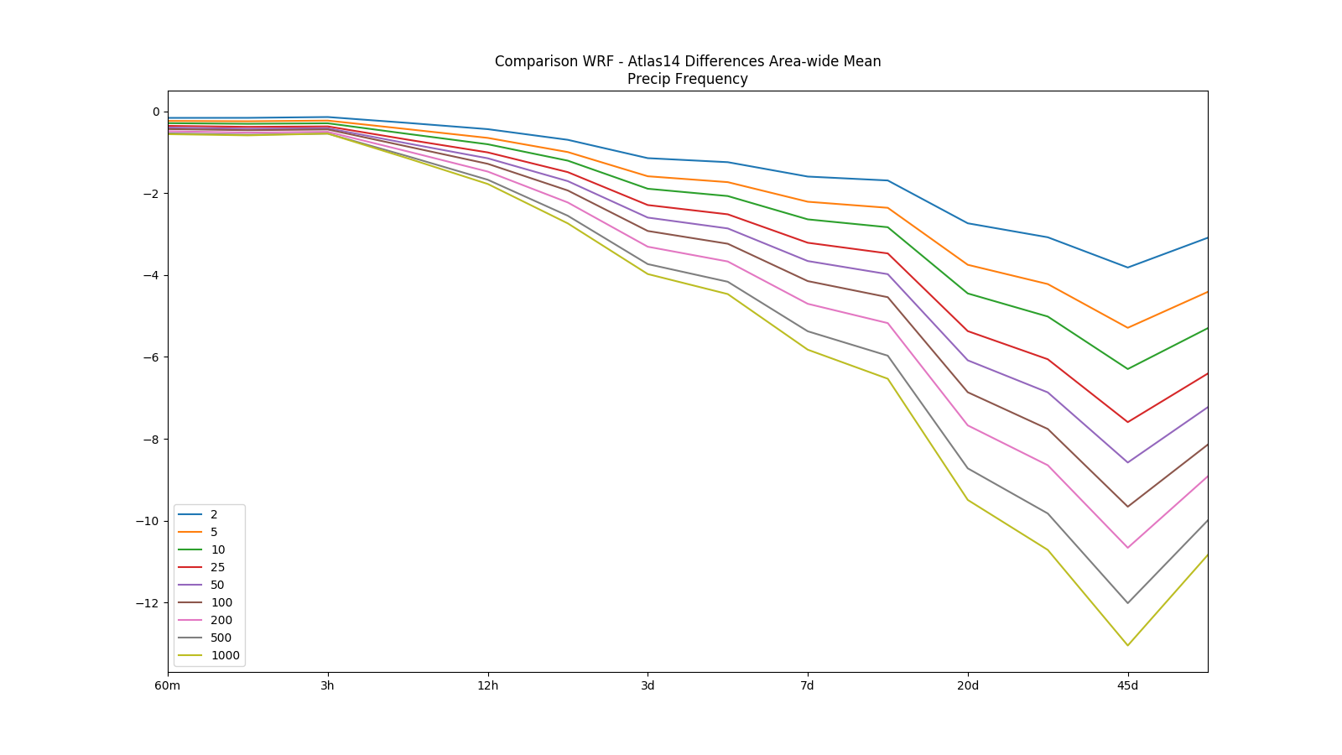

Slide 12
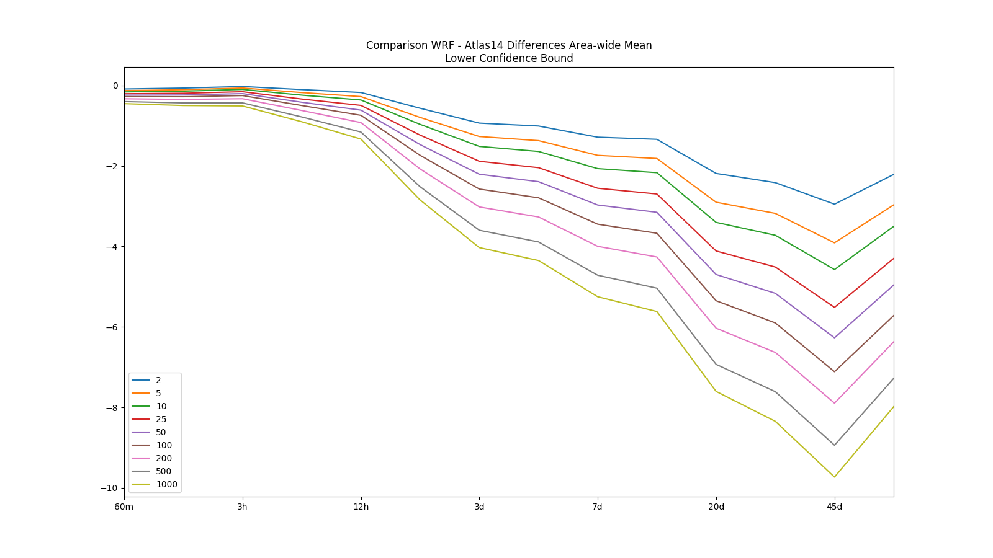

Slide 13
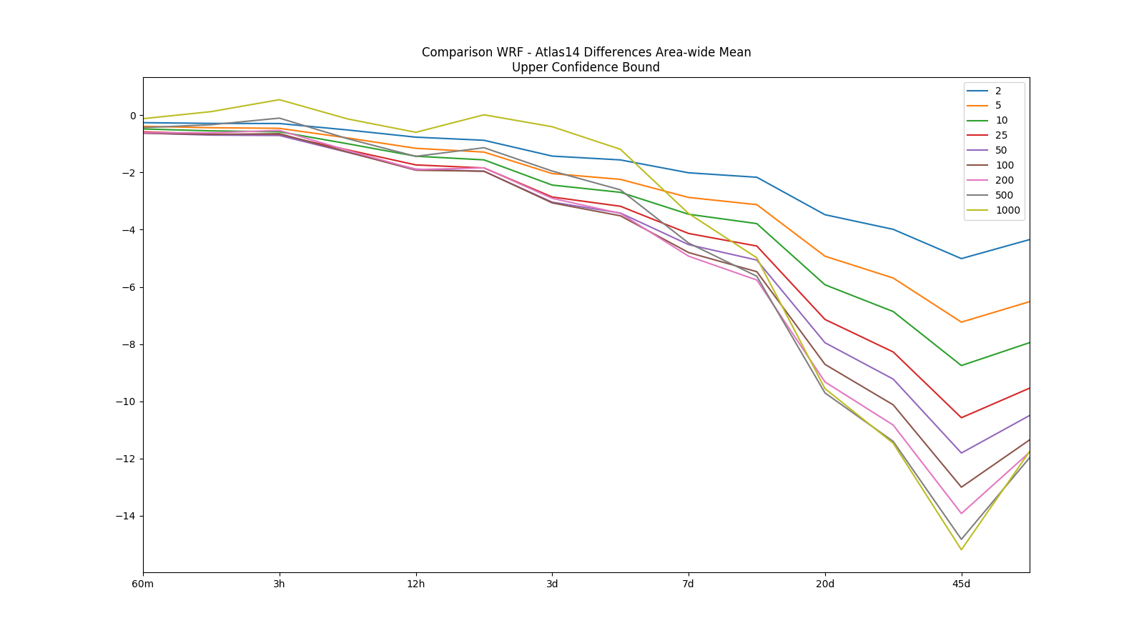

Slide 14
Differences Between Groups
Communities

Slide 15
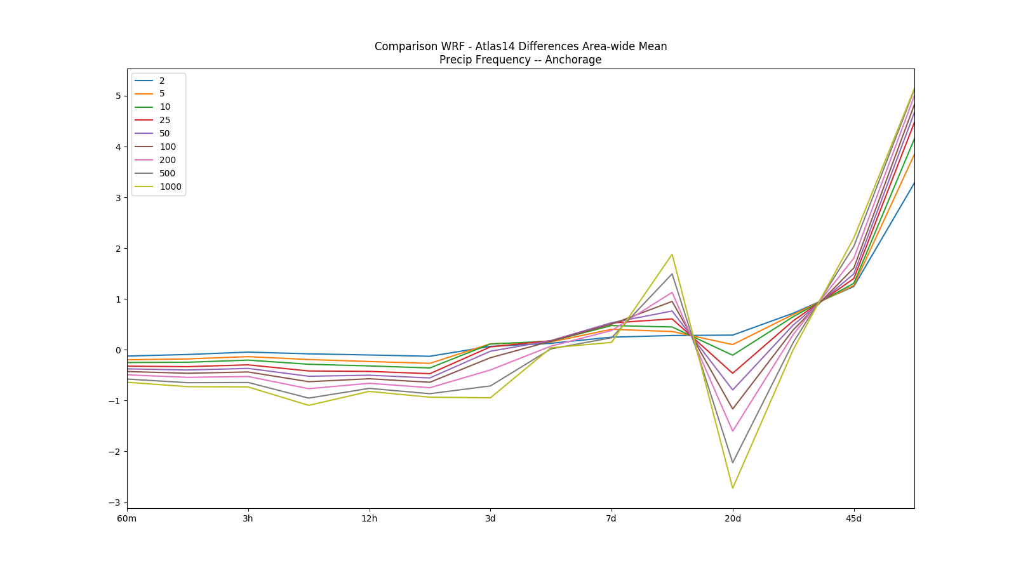

Slide 16
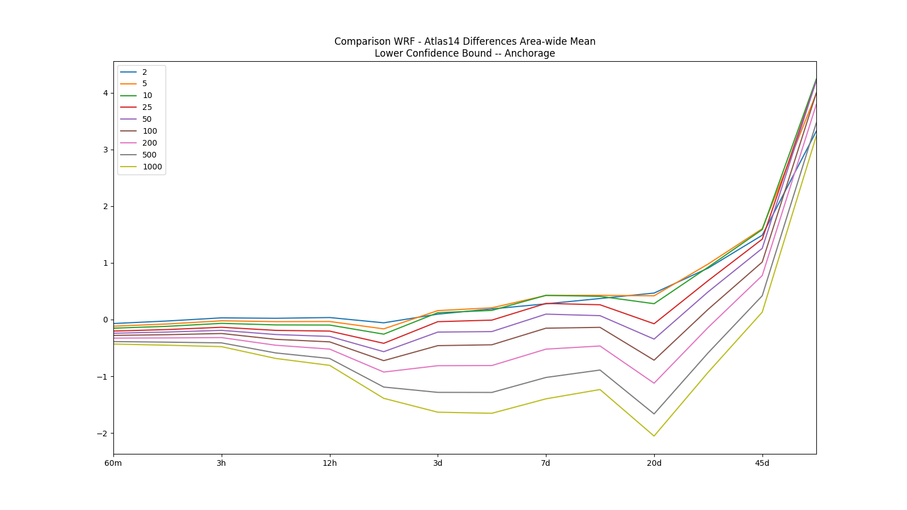

Slide 17
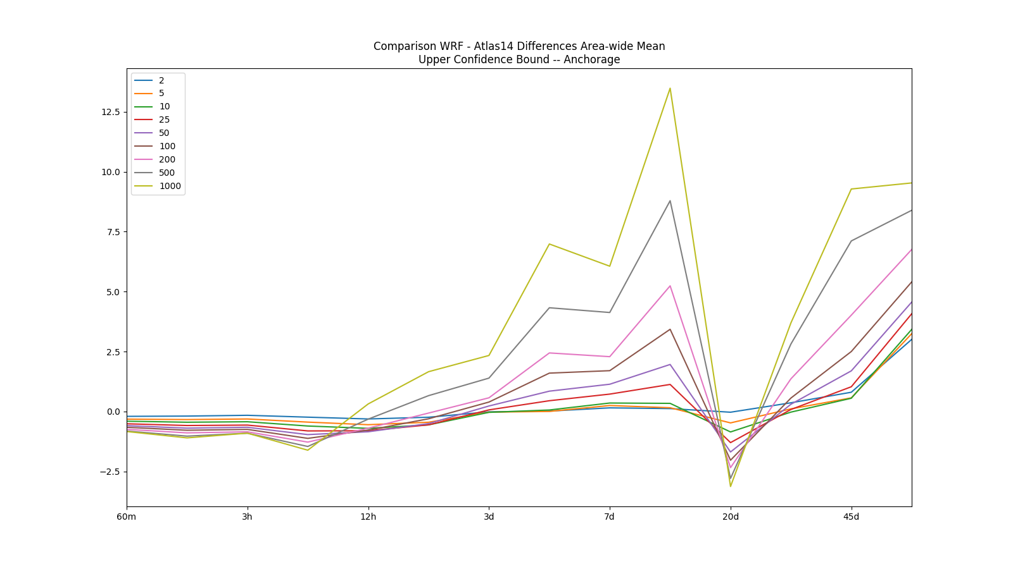

Slide 18
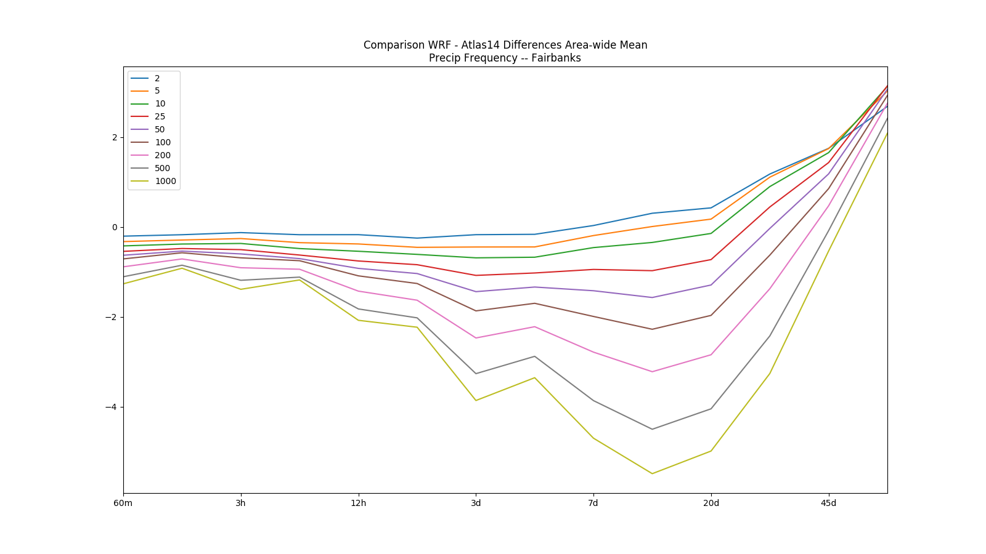

Slide 19
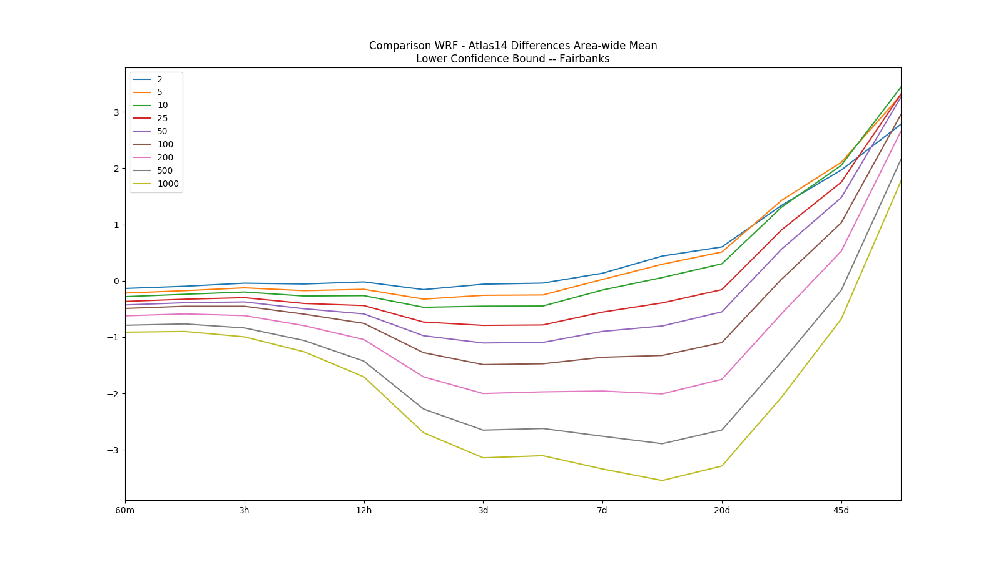

Slide 20
