Slide 1
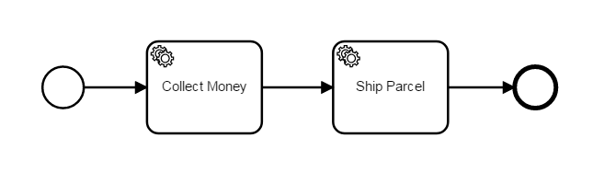
{
"paymentMethod":
"unknown",
"price":
42.65,
"items": [
"shoes",
"racket"
]
}
{
"paymentMethod":
„credit",
"price":
42.65,
"items": [
"shoes",
"racket"
]
}

Slide 2
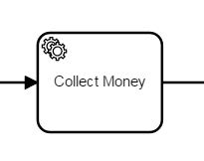
{
"paymentMethod":
"unknown",
"price":
42.65,
"items": [
"shoes",
"racket"
]
}
{
"paymentMethod":
„credit",
"price":
42.65,
"items": [
"shoes",
"racket"
]
}
{
"paymentMethod":
"unknown",
"price":
42.65,
"items": [
"shoes",
"racket"
]
}
{
"paymentMethod":
„credit",
"price":
42.65,
"items": [
"shoes",
"racket"
]
}
Job Worker

Slide 3
{
"paymentMethod":
"unknown",
„price":
42.65,
"items": [
"shoes",
"racket"
]
}
{
"paymentMethod":
„credit",
„price":
42.65,
"items": [
"shoes",
"racket"
]
}
{
„total":
42.65
}
{
"paymentMethod":
„credit„
}
Job Worker

