Slide 1
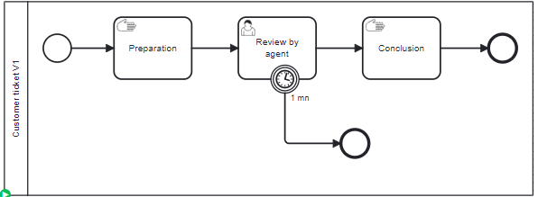
Application
CanaryApps
ZeebeGateway
Create CustomerTickets
Create CustomerTickets
version 1
version 2

Slide 2
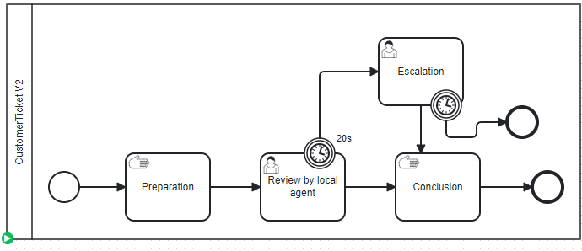
Application
CanaryApps
ZeebeGateway
Create CustomerTickets version 1
Create CustomerTickets
version 1
Rule: 20% V2
80% V1
Create CustomerTickets version 2
version 2

