Slide 1
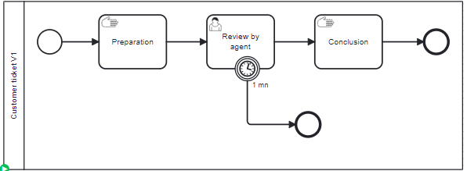
Application
CanaryApps
ZeebeGateway
Create CustomerTickets
Create CustomerTickets
version 1

Slide 2
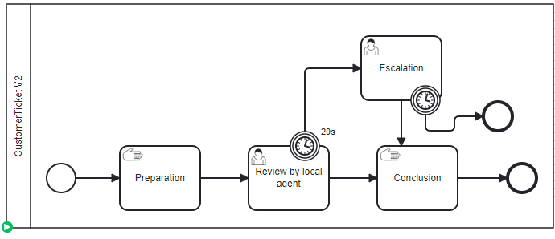
Application
CanaryApps
ZeebeGateway
Create CustomerTickets version 1
Create CustomerTickets
version 1
Rule: 20% V2
80% V1
Create CustomerTickets version 2
version 2

Slide 3
Version 1 (Blue environment)
Application
Create CustomerTickets
Version 2 (Green environment)

Slide 4
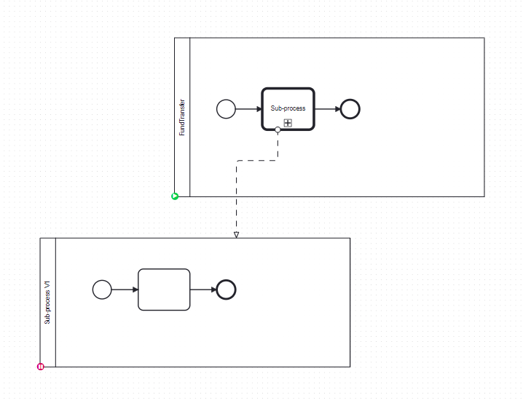
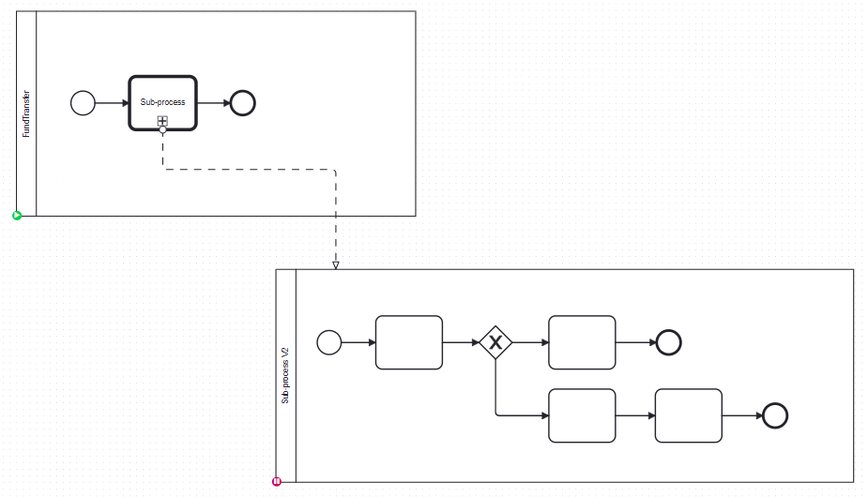
Application
CanaryApps
80%: subprocessToCall=V1
Create CustomerTickets
20%: SubprocessToCall=V2

Slide 5
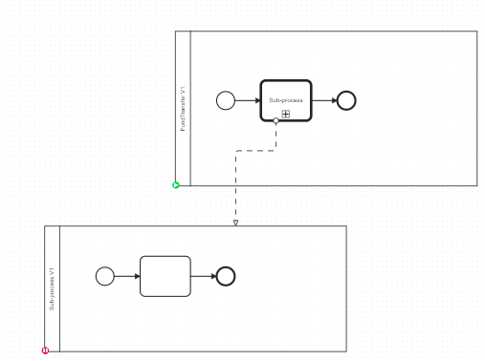
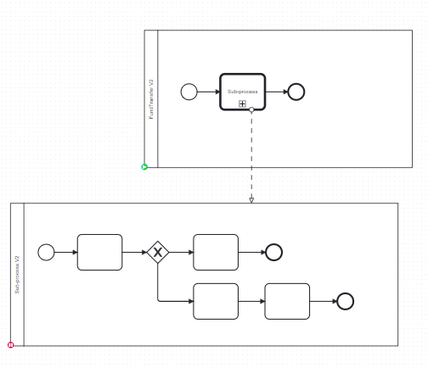
Application
CanaryApps
80%: Parent V1
Create CustomerTickets
20%: Parent V2

Slide 6
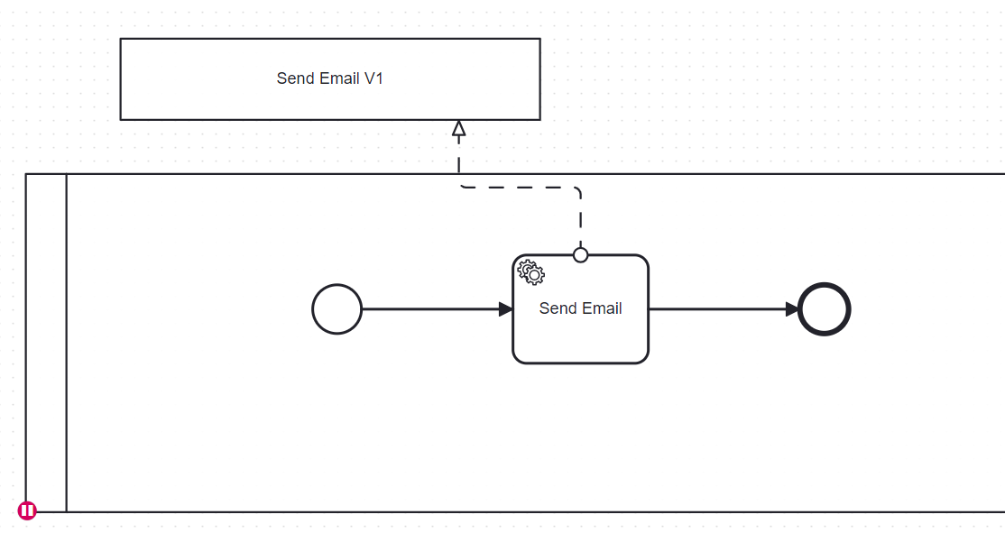
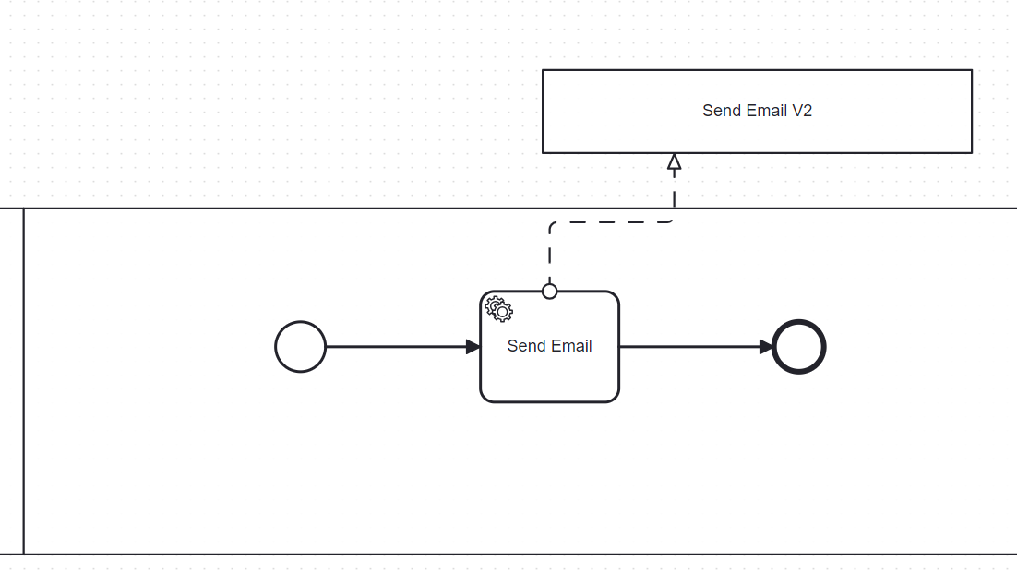
Application
CanaryApps
80%: jobTypeToUse=Email-V1
Create CustomerTickets
20%: jobTypeToUse=Email-V2

