Slide 1
Java 8
Parameswari Ettiappan

Slide 2
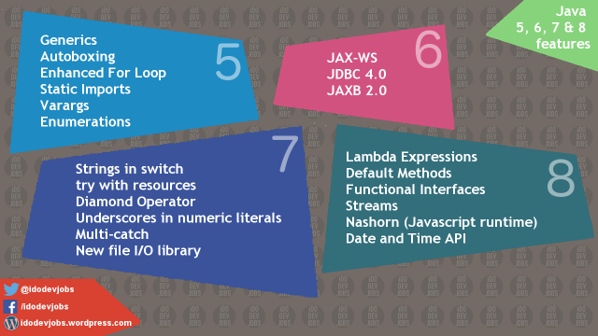

Slide 3
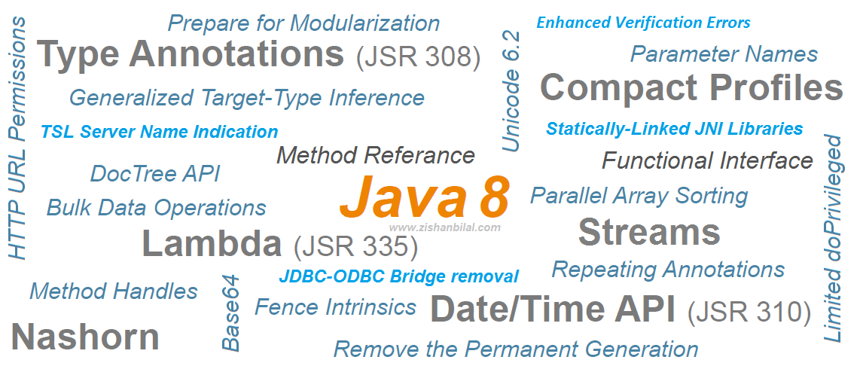

Slide 4
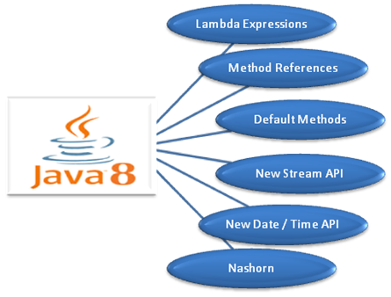

Slide 5
Java 8 Features
Java Programming Languages
Lambda Expressions, a new language feature
Method references provide easy-to-read lambda expressions for methods that already have a name.
Default methods enable new functionality to be added to the interfaces of libraries and ensure binary compatibility with code written for older versions of those interfaces.
Repeating Annotations provide the ability to apply the same annotation type more than once to the same declaration or type use.
Type Annotations provide the ability to apply an annotation anywhere a type is used, not just on a declaration. Used with a pluggable type system, this feature enables improved type checking of your code.
Improved type inference.
Method parameter reflection.

Slide 6
Java 8 Features
Collections
Classes in the new java.util.stream package provide a Stream API to support functional-style operations on streams of elements.
The Stream API is integrated into the Collections API, which enables bulk operations on collections, such as sequential or parallel map-reduce transformations.
Performance Improvement for HashMaps with Key Collisions

Slide 7
Java 8 Features
Concurrency
Classes and interfaces have been added to the java.util.concurrent package.
Methods have been added to the java.util.concurrent.ConcurrentHashMap class to support aggregate operations based on the newly added streams facility and lambda expressions.
Classes have been added to the java.util.concurrent.atomic package to support scalable updatable variables.

Slide 8
Java 8 Features
Concurrency
Methods have been added to the java.util.concurrent.ForkJoinPool class to support a common pool.
The java.util.concurrent.locks.StampedLock class has been added to provide a capability-based lock with three modes for controlling read/write access.

Slide 9
Java 8 Features
Networking
The class java.net.URLPermission has been added.
In the class java.net.HttpURLConnection, if a security manager is installed, calls that request to open a connection require permission.

Slide 10
Java 8 Features
JDBC
The JDBC-ODBC Bridge has been removed.
JDBC 4.2 introduces new features.
Java DB
JDK 8 includes Java DB 10.10.

Slide 11
Java 8 Features
HotSpot
Hardware intrinsics were added to use Advanced Encryption Standard (AES).
The UseAES and UseAESIntrinsics flags are available to enable the hardware-based AES intrinsics for Intel hardware.
The hardware must be 2010 or newer Westmere hardware. For example, to enable hardware AES, use the following flags:
-XX:+UseAES -XX:+UseAESIntrinsics

Slide 12
Java 8 Features
HotSpot
To disable hardware AES use the following flags:
-XX:-UseAES -XX:-UseAESIntrinsics
Removal of PermGen.
Default Methods in the Java Programming Language are supported by the byte code instructions for method invocation.

Slide 13
Java 8 Features
Compact Profiles contain predefined subsets of the Java SE platform and enable applications that do not require the entire Platform to be deployed and run on small devices.

Slide 14
Java 8 Features
Security
client-side TLS 1.2 enabled by default
New variant of AccessController.doPrivileged that enables code to assert a subset of its privileges, without preventing the full traversal of the stack to check for other permissions
Stronger algorithms for password-based encryption
SSL/TLS Server Name Indication (SNI) Extension support in JSSE Server

Slide 15
Java 8 Features
Security
Support for AEAD algorithms
KeyStore enhancements, including the new Domain KeyStore type java.security.DomainLoadStoreParameter, and the new command option -importpassword for the keytool utility
SHA-224 Message Digests
Enhanced Support for NSA Suite B Cryptography
Better Support for High Entropy Random Number Generation

Slide 16
Java 8 Features
Security
New java.security.cert.PKIXRevocationChecker class for configuring revocation checking of X.509 certificates
64-bit PKCS11 for Windows
New rcache Types in Kerberos 5 Replay Caching

Slide 17
Java 8 Features
Security
Support for Kerberos 5 Protocol Transition and Constrained Delegation
Kerberos 5 weak encryption types disabled by default
Unbound SASL for the GSS-API/Kerberos 5 mechanism
SASL service for multiple host names

Slide 18
Java 8 Features
Security
JNI bridge to native JGSS on Mac OS X
Support for stronger strength ephemeral DH keys in the SunJSSE provider
Support for server-side cipher suites preference customization in JSSE

Slide 19
Java 8 Features
JavaFX
The new SwingNode class enables developers to embed Swing content into JavaFX applications.
The new UI Controls include the DatePicker and the TreeTableView controls.
The javafx.print package provides the public classes for the JavaFX Printing API.

Slide 20
Java 8 Features
JavaFX
The 3D Graphics features now include 3D shapes, camera, lights, subscene, material, picking, and antialiasing.
The WebView class provides new features of HTML5 including Web Sockets, Web Workers, and Web Fonts.
Enhanced text support including bi-directional text and complex text scripts such as Thai and Hindi in controls, and multi-line, multi-style text in text nodes.
Support for Hi-DPI displays has been added in this release.

Slide 21
Java 8 Features
JavaFX
The CSS Styleable* classes became public API.
The new ScheduledService class allows to automatically restart the service.
JavaFX is now available for ARM platforms. JDK for ARM includes the base, graphics and controls components of JavaFX.

Slide 22
Java 8 Features
Tools
The jjs command is provided to invoke the Nashorn engine.
The java command launches JavaFX applications.
The java man page has been reworked.

Slide 23
Java 8 Features
Tools
The jdeps command-line tool is provided for analyzing class files.
Java Management Extensions (JMX) provide remote access to diagnostic commands.
The jarsigner tool has an option for requesting a signed time stamp from a Time Stamping Authority (TSA).

Slide 24
Java 8 Features
Javac tool
The javac tool now has support for checking the content of javadoc comments for issues that could lead to various problems, such as invalid HTML or accessibility issues, in the files that are generated when javadoc is run.
Javadoc tool
The javadoc tool supports the new DocTree API that enables you to traverse Javadoc comments as abstract syntax trees.
The javadoc tool supports the new Javadoc Access API that enables you to invoke the Javadoc tool directly from a Java application, without executing a new process.

Slide 25
Java 8 Features
Internationalization
Unicode Enhancements, including support for Unicode 6.2.0
Adoption of Unicode CLDR Data and the java.locale.providers System Property
New Calendar and Locale APIs
Ability to Install a Custom Resource Bundle as an Extension

Slide 26
Java 8 Features
Deployment
For sandbox applets and Java Web Start applications, URLPermission is now used to allow connections back to the server from which they were started. SocketPermission is no longer granted.
The Permissions attribute is required in the JAR file manifest of the main JAR file at all security levels.

Slide 27
Java 8 Features
Date-Time Package - a new set of packages that provide a comprehensive date-time model.
Scripting
Nashorn Javascript Engine
Pack200
Pack200 Support for Constant Pool Entries and New Bytecodes Introduced by JSR 292
JDK8 support for class files changes specified by JSR-292, JSR-308 and JSR-335

Slide 28
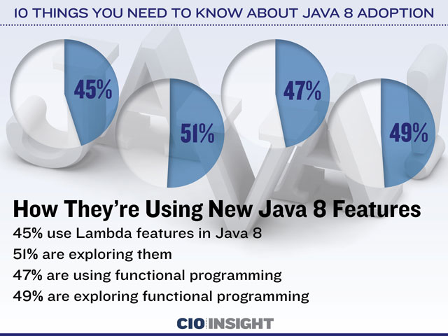

Slide 29
Executor framework
A task is a logical unit of work, and typically a thread is used to represent and execute a task.
A few aspects of a task are as follows:
How it is created.
• How it is submitted for execution.
• How it is executed. Is it executed synchronously or asynchronously?
• The time at which it is executed. Is it executed immediately upon submission or queued?
• Which thread executes it? Is it executed in the thread that submits it or in another thread?
• How do we get the result of a task when it is finished executing?
• How do we know the error that occurs during its execution?
• Does it depend on other tasks to finish its execution?

Slide 30
Executor framework
A task may be represented as a Runnable. You create tasks as follows:
MyTask task1 = new MyTask();
MyTask task2 = new MyTask();
MyTask task3 = new MyTask();
To execute the tasks, you use threads as follows:
Thread t1 = new Thread(task1);
Thread t2 = new Thread(task2);
Thread t3 = new Thread(task3);
t1.start();
t2.start();
t3.start();

Slide 31
Executor framework
Drawbacks in previous approach
If you want to get the result of a task execution, you have to write additional code.
how many threads should be created to execute a group of tasks?
Managing number of tasks?
Creating a thread per task has the following disadvantages:
Creating and destroying threads has overhead and it takes time, which in turn delays the start of the execution of the tasks.
• Each thread consumes resources. If the number of threads is more than the available CPUs, other threads will be sitting idle and will be consuming resources.
• Each platform has a limit of how many maximum threads it can support. If an application exceeds that limit, it may even crash!

Slide 32
Executor framework
Another approach is to create one thread and let it handle the execution of all tasks.
This is another extreme case which has the following disadvantages:
• Having one thread executing all tasks makes it a sequential executor.
• This policy is deadlock-prone if one task submits another task and it depends on the result of
the task it has submitted.
• If you have long-running tasks, other tasks waiting for their execution seem to be unresponsive because of the long time it will take to start the pending tasks.

Slide 33
Executor framework
The executor framework attempts to solve all of these aspects of a task execution.
The framework provides a way to separate task submission from task execution.
You create a task and submit it to an executor.
The executor takes care of the execution details of the task.
It provides configurable policies to control many aspects of the task execution.

Slide 34
Executor framework
public interface Executor {
void execute (Runnable command);
}
// Get an executor instance.
Executor executor = Executors.newCachedThreadPool();
// Submit three tasks to the executor
executor.execute(task1);
executor.execute(task2);
executor.execute(task3);

Slide 35
Executor framework
The executor framework provides a class library to select the policies on the thread usage to execute the tasks.
You can choose to run all tasks in one thread, in a fixed number of threads, or in a variable number of threads.
In fact, you can choose a thread pool to execute your tasks, and the thread pool is configurable as to how many threads will be in the pool and how those threads will be maintained.
In any case, all threads in the pool are reused as they become available.

Slide 36
Executor framework
Using a thread pool to execute the submitted tasks has two important advantages:
The overhead of creating and destroying new threads is reduced.
The executor reuses the threads from the thread pool.
If a thread is available in the thread pool at the time of a task submission, the task may
start immediately.
This eliminates the time delay between the thread creation and the task execution.

Slide 37
Executor framework
It is important to mention another interface called ExecutorService at this point.
It provides some advanced features of an executor, which include managing the shutdown of the executor and checking the status of the submitted tasks.
It inherits the Executor interface.
Some of the important methods of this interface are shutdown(),
shutdownNow(), submit(), and awaitTermination().

Slide 38
Executor framework
It is important that you shut down the executor when it is no longer needed.
The executor framework creates non-daemon threads to execute the tasks.
Generally, when a thread is done executing a task, it is not destroyed.
Rather it is kept in the thread pool for reuse in the future. (Whether a thread is destroyed or kept depends on the thread pool configuration).
A Java application will not exit if some non-daemon threads are still alive.
Therefore, if you forget to shut down the executor, your application may never exit.

Slide 39
Executor framework
You specify the type of thread pool that the executor should use to manage the tasks at the time you create the executor.
All tasks that you submit to an executor are queued in a queue known as the work queue.
As a thread becomes available, it removes a task from the work queue and executes it.
When a thread is done executing a task, depending on your thread pool type, your executor either destroys the thread or puts it back into the pool so it can be reused to execute another task.

Slide 40
Executor framework
newCachedThreadPool():
It returns an ExecutorService object.
The thread pool reuses the previously created threads if they are available.
Otherwise, it creates a new thread to execute a task.
It destroys and removes idle threads from the pool.
The thread pool has characteristics of expanding and shrinking depending on the workload.

Slide 41
Executor framework
newFixedThreadPool(int nThreads):
It returns an ExecutorService object.
The thread pool maintains a fixed number of threads.
At any time, the thread pool will have the maximum nThread number of threads.
If a task arrives in the work queue and all threads are busy executing other tasks, the task has to wait for its execution until a thread becomes available.
If a thread is terminated because of an unexpected failure during a task execution, it is replaced with a new thread.

Slide 42
Executor framework
newSingleThreadExecutor():
It returns an ExecutorService object.
The thread pool maintains only one thread to execute all tasks.
It guarantees that only one task will be executed at a time.
If the lone thread dies unexpectedly, it is replaced with a new one.

Slide 43
Executor framework
How do you get the result of a task when it is complete?
The task that can return a result upon its execution has to be represented as an instance of the Callable<V> interface.
The type parameter V is type of the result of the task.
The run() method of the Runnable interface cannot return a value and it cannot throw any checked exception.
The Callable interface has a call() method.
It can return a value of any type. It allows you to throw an exception.

Slide 44
Executor framework
Scheduling a Task
The executor framework lets you schedule a task that will run in future.
You can run a task to execute after a given delay or periodically.
Scheduling a task is done using an object of the ScheduledExecutorService interface
which you can get using one of the static factory methods of the Executors class.
You can also use the concrete implementation of this interface, which is the ScheduledThreadPoolExecutor class.

Slide 45
The Fork/Join Framework
The fork/join framework is an implementation of the executor service whose focus is to solve those problems efficiently, which may use the divide-and-conquer algorithm by taking advantage of the multiple processors or multiple cores on a machine.
The framework helps solve the problems that involve parallelism.
Typically, the fork/join framework is suitable in a situation where
• A task can be divided in multiple subtasks that can be executed in parallel.
• When subtasks are finished, the partial results can be combined to get the final result.

Slide 46
The Fork/Join Framework
The fork/join framework creates a pool of threads to execute the subtasks.
When a thread is waiting on a subtask to finish, the framework uses that thread to execute other pending subtasks of other threads.
The technique of an idle thread executing other thread’s task is called work-stealing.
The framework uses the work-stealing algorithm to enhance the performance.

Slide 47
The Fork/Join Framework
The following four classes in the java.util.concurrent package are central to learning the fork/join framework:
• ForkJoinPool
• ForkJoinTask
• RecursiveAction
• RecursiveTask

Slide 48
The Fork/Join Framework
An instance of the ForkJoinPool class represents a thread pool.
An instance of the ForkJoinTask class represents a task.
The ForkJoinTask class is an abstract class.
It has two concrete subclasses: RecursiveAction and RecursiveTask.
Java 8 added an abstract subclass of the ForkJoinTask class that is called CountedCompleter.
The framework supports two types of tasks:
a task that does not yield a result and a task that yields a result.
An instance of the RecursiveAction class represents a task that does not yield a result. An instance of the RecursiveTask class represents a task that yields a result.

Slide 49
The Fork/Join Framework
Both classes, RecursiveAction and RecursiveTask, provide an abstract compute() method.
Your class whose object represents a fork/join task should inherit from one of these classes and provide an implementation for the compute() method.
if (Task is small) {
Solve the task directly.
}
else {
Divide the task into subtsaks.
Launch the subtasks asynchronously (the fork stage).
Wait for the subtasks to finish (the join stage).
Combine the results of all subtasks.
}

Slide 50
The Fork/Join Framework
The following two methods of the ForkJoinTask class provide two important features during a task execution:
• The fork() method launches a new subtask from a task for an asynchronous execution.
• The join() method lets a task wait for another task to complete.

Slide 51
The Fork/Join Framework
Steps in Using the Fork/Join Framework
Step 1: Declaring a Class to Represent a Task
public class MyTask extends RecursiveTask<Long> {
// Code for your task goes here
}
Step 2: Implementing the compute() Method
public class MyTask extends RecursiveTask<Long> {
public Long compute() {
// Logic for the task goes here
}
}

Slide 52
The Fork/Join Framework
Step 3: Creating a Fork/Join Thread Pool
You can create a pool of worker threads to execute your task using the ForkJoinPool class.
The default constructor of this class creates a thread of pool, which has the same parallelism as the number of processors available on the machine.
ForkJoinPool pool = new ForkJoinPool();
Step 4: Creating the Fork/Join Task
You need to create an instance of your task.
MyTask task = MyTask();

Slide 53
The Fork/Join Framework
Step 5: Submitting the Task to the Fork/Join Pool for Execution
You need to call the invoke() method of the ForkJoinPool class, passing your task as an argument.
The invoke() method will return the result of the task if your task returns a result.
The following statement will execute your task:
long result = pool.invoke(task);

Slide 54
Collection API
Performance Improvement for HashMaps with Key Collisions.
Here's a list of the new methods:
- Iterable.forEach(Consumer)
- Iterator.forEachRemaining(Consumer)
- Collection.removeIf(Predicate)
- Collection.spliterator()
- Collection.stream()
- Collection.parallelStream()
- List.sort(Comparator)
- List.replaceAll(UnaryOperator)
- Map.forEach(BiConsumer)

Slide 55
Collection API
- Map.replaceAll(BiFunction)
- Map.putIfAbsent(K, V)
- Map.remove(Object, Object)
- Map.replace(K, V, V)
- Map.replace(K, V)
- Map.computeIfAbsent(K, Function)
- Map.computeIfPresent(K, BiFunction)
- Map.compute(K, BiFunction)
- Map.merge(K, V, BiFunction)
- Map.getOrDefault(Object, V)

Slide 56
JDBC 4.2
JDBC 4.2, which is part of Java SE 8, introduces the following features:
Addition of REF_CURSOR support.
Addition of java.sql.DriverAction Interface
Addition of the java.sql.SQLType Interface
Addition of the java.sql.JDBCType Enum
Add Support for large update counts
Rowset 1.2: Lists the enhancements for JDBC RowSet.

Slide 57
JDBC 4.2 Changes to the existing interfaces
java.sql.Driver
java.sql.DriverManager
java.sql.DatabaseMetaData
java.sql.Date
java.sql.Time
java.sql.TimeStamp
java.sql.Statement
java.sql.CallableStatement
java.sql.PreparedStatement
java.sql.ResultSet
java.sql.SQLInput
java.sql.SQLOutput
java.sql.Types
javax.sql.DataSource and javax.sql.XADataSource
java.sql.SQLXML

Slide 58
Lambda Expressions
A lambda expression is an unnamed block of code (or an unnamed function) with a list of formal parameters and a body.
Sometimes a lambda expression is simply called a lambda.
The body of a lambda expression can be a block statement or an expression.
An arrow (->) is used to separate the list of parameters and the body.
The term “lambda” in "lambda expression" has its origin in Lambda calculus that uses the Greek letter lambda (l) to denote a function abstraction.

Slide 59
Lambda Expressions

Slide 60
Lambda Expressions

Slide 61
Lambda Expressions
// Takes an int parameter and returns the parameter value incremented by 1
(int x) -> x + 1
// Takes two int parameters and returns their sum
(int x, int y) -> x + y
// Takes two int parameters and returns the maximum of the two
(int x, int y) -> { int max = x > y ? x : y;
return max;
}
// Takes no parameters and returns void
() -> { }

Slide 62
Lambda Expressions
// Takes no parameters and returns a string "OK"
() -> "OK"
// Takes a String parameter and prints it on the standard output
(String msg) -> { System.out.println(msg); }
// Takes a parameter and prints it on the standard output
msg -> System.out.println(msg)
// Takes a String parameter and returns its length
(String str) -> str.length()

Slide 63
Why Do We Need Lambda Expressions
A lambda expression is a block of code that can be passed around to execute.
It is a common feature for some programming languages, such as Lisp, Python, Scala, etc.
But before Java 8, we can not do the same in Java.
If we want a block of code to be executed, we need to create an object and pass the object around, such as using the strategy design pattern.
From Java 8, lambda expressions enable us to treat functionality as method argument and pass a block of code around.

Slide 64
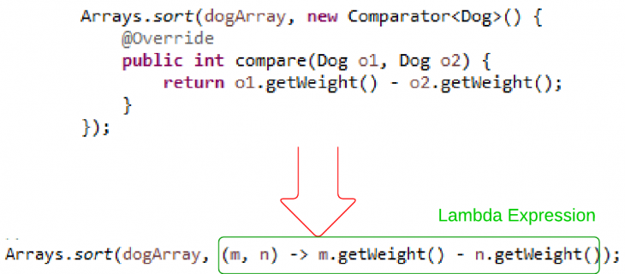
Why Do We Need Lambda Expressions

Slide 65
Syntax for Lambda Expressions
(<LambdaParametersList>) -> { <LambdaBody> }
A lambda expression consists of a list of parameters and a body that are separated by an arrow (->).
The list of parameters is declared the same way as the list of parameters for methods.
The list of parameters is enclosed in parentheses, as is done for methods.
The body of a lambda expression is a block of code enclosed in braces.
Like a method's body, the body of a lambda expression may declare local variables;
use statements including break, continue, and return; throw exceptions, etc.

Slide 66
Syntax for Lambda Expressions
Unlike a method, a lambda expression does not have four parts.
A lambda expression does not have a name.
• A lambda expression does not have a return type.
It is inferred by the compiler from the context of its use and from its body.
• A lambda expression does not have a throws clause. It is inferred from the context of its use and its body.
• A lambda expression cannot declare type parameters. That is, a lambda expression
cannot be generic.

Slide 67
Omitting Parameter Types
You can omit the declared type of the parameters.
The compiler will infer the types of parameters from the context in which the lambda expression is used.
// Types of parameters are declared
(int x, int y) -> { return x + y; }
// Types of parameters are omitted
(x, y) -> { return x + y; }

Slide 68
Omitting Parameter Types
// A compile-time error
(int x, y) -> { return x + y; }

Slide 69
Declaring a Single Parameter
// Declares the parameter type
(String msg) -> { System.out.println(msg); }
// Omits the parameter type
(msg) -> { System.out.println(msg); }
// Omits the parameter type and parentheses
msg -> { System.out.println(msg); }

Slide 70
Declaring a Single Parameter
The following lambda expression will not compile:
// Omits parentheses, but not the parameter type, which is not allowed.
String msg -> { System.out.println(msg); }

Slide 71
Declaring No Parameters
If a lambda expression does not take any parameters, you need to use empty parentheses.
// Takes no parameters
() -> { System.out.println("Hello"); }
It is not allowed to omit the parentheses when the lambda expression takes no parameter.
The following declaration will not compile:
-> { System.out.println("Hello"); }

Slide 72
Parameters with Modifiers
You can use modifiers, such as final, in the parameter declaration for explicit lambda expressions. The following two
lambda expressions are valid:
(final int x, final int y) -> { return x + y; }
(int x, final int y) -> { return x + y; }
The following lambda expression will not compile because it uses the final modifier in parameter declarations, but omits the parameter type:
(final x, final y) -> { return x + y; }

Slide 73
Declaring Body of Lambda Expressions
The body of a lambda expression can be a block statement or a single expression.
A block statement is enclosed in braces; a single expression is not enclosed in braces.
When a block statement is executed the same way as a method’s body.
A return statement or the end of the body returns the control to the caller of the lambda expression.
When an expression is used as the body, it is evaluated and returned to the caller.
If the expression evaluates to void, nothing is returned to the caller.
The following two lambda expressions are the same; one uses a block statement
and the other an expression:

Slide 74
Declaring Body of Lambda Expressions
// Uses a block statement. Takes two int parameters and returns their sum.
(int x, int y) -> { return x + y; }
// Uses an expression. Takes a two int parameters and returns their sum.
(int x, int y) -> x + y

Slide 75
Declaring Body of Lambda Expressions
The following two lambda expressions are the same; one uses a block statement as the body and the other an expression that evaluates to void:
// Uses a block statement
(String msg) -> { System.out.println(msg); }
// Uses an expression
(String msg) -> System.out.println(msg)

Slide 76
List of Functional Interfaces

Slide 77
Iterating with for each

Slide 78
iterating w/lambdas, type inference
List<Integer> numbers =
Arrays.asList(1, 2, 3, 4, 5, 6, 7, 8, 9, 10);
numbers.forEach(value -> System.out.println(value));

Slide 79
method references
List<Integer> numbers =
Arrays.asList(1, 2, 3, 4, 5, 6, 7, 8, 9, 10);
numbers.forEach(System.out::println);

Slide 80
transforms using map
List<Integer> numbers =
Arrays.asList(1, 2, 3, 4, 5, 6, 7, 8, 9, 10);
numbers.stream()
.map(value -> value * 2)
.forEach(System.out::println);

Slide 81
filtering
List<Integer> numbers =
Arrays.asList(1, 2, 3, 4, 5, 6, 7, 8, 9, 10);
numbers.stream()
.filter(value -> value % 2 == 0)
.forEach(System.out::println);

Slide 82
filtering v2
List<String> names = Arrays.asList(
"Bob", "Tom", "Jeff", "Scott", "Jennifer", "Steve");
final Function<String, Predicate<String>> startsWithLetter =
letter -> name -> name.startsWith(letter);
names.stream()
.filter(startsWithLetter.apply("J"))
.forEach(System.out::println);

Slide 83
Streams
Stream.iterate(1, number -> number + 1)
.map(number -> number * number)
.limit(25)
.forEach(number -> System.out.print(number + " "));
// 1 4 9 16 25 36 49 64 ... 529 576 625

Slide 84
finding with Optional
List<String> names = Arrays.asList(
"Bob", "Tom", "Jeff", "Scott", "Jennifer", "Steve");
Optional<String> firstS = names.stream()
.filter(name -> name.startsWith("S"))
.findFirst();
System.out.println(firstS.orElse("None found"));

Slide 85
reducers
List<String> names = Arrays.asList(
"Bob", "Tom", "Jeff", "Scott", "Jennifer", "Steve");
Optional<String> longestName = names.stream()
.reduce((name1, name2) ->
name1.length() >= name2.length() ? name1 : name2);
if (longestName.isPresent()) {
System.out.println(longestName.get());
}

Slide 86
sum reducer
List<Integer> numbers =
Arrays.asList(1, 2, 3, 4, 5, 6, 7, 8, 9, 10);
long sum =numbers.stream() .mapToInt(value->value*value).sum();
System.out.println(sum);

Slide 87
parallelization
numbers.parallelStream()
.filter(number -> isPerfect(number))
.forEach(System.out::println);

Slide 88
Iterating with foreach
List<Integer> numbers =
Arrays.asList(1, 2, 3, 4, 5, 6, 7, 8, 9, 10);
numbers.forEach(new Consumer<Integer>() {
@Override
public void accept(Integer integer) {
System.out.println(integer);
}
});

Slide 89
Threads

Slide 90
Threads

Slide 91
Threads
Process = address space + resources + threads

Slide 92
Object Monitor

Slide 93
New Thread Concurrency Packages
The package java.util.concurrent and its two subpackages,
java.util.concurrent.atomic and
java.util.concurrent.locks,

Slide 94
New Thread Concurrency Packages
We can broadly categorize these concurrency features into four categories:
• Atomic variables
• Locks
• Synchronizers
• Concurrent collections

Slide 95
Atomic Variables
To share an updateable variable among threads, synchronization is used.
Synchronization among multiple threads used to be achieved using the synchronized keyword and it was based on an object’s monitor.
If a thread is not able to acquire an object’s monitor, that thread is suspended and it has to be resumed later.
This way of synchronization (suspending and resuming) uses a great deal of system resources.
The problem is not in the locking and unlocking mechanism of the monitor lock; rather it is in suspending and resuming the threads.
If there is no contention for acquiring a lock, using the keyword synchronized to synchronize threads does not hurt much.

Slide 96
Atomic Variables
An atomic variable uses a lock-free synchronization of a single variable.
If program needs to synchronize on more than one shared variable, you still need to use the old synchronization methods.
By lock-free synchronization, multiple threads can access a shared variable safely using no object monitor lock.
JDK takes advantage of a hardware instruction called “compare-and-swap" (CAS) to implement the lock-free synchronization for one variable.

Slide 97
Atomic Variables
CAS is based on three operands: a memory location M, an expected old value O, and a new value N.
If the memory location M contains a value O, CAS updates it atomically to N; otherwise, it does not do anything.
CAS always returns the current value at the location M that existed before the CAS operation started.

Slide 98
Atomic Variables
CAS(M, O, N) {
currentValueAtM = get the value at Location M;
if (currentValueAtM == O) {
set value at M to N;
}
return currentValueAtM;
}

Slide 99
Atomic Variables
CAS takes an optimistic approach by assuming that there are no other threads updating the value at location M; if the location M contains value O, update it to N;
if the value at location M is not O, do not do anything.
Therefore, if multiple threads attempt to update the value at location M
to different values simultaneously, only one thread will succeed and others will fail.
The synchronization using locks takes a pessimistic approach by assuming that other threads may be working with location M and acquires a lock before it starts working at location M, so that other threads will not access location M while one is working with it.

Slide 100
Atomic Variables
Atomic variable classes are named like AtomicXxx, and can be used to execute multiple instructions on a single variable atomically without using any lock.
Here, Xxx is replaced with different words to indicate different classes that are used for different purposes; for example, the AtomicInteger class is used to represent an int variable, which is supposed to be manipulated atomically.
Twelve classes in the Java class library support read-modify-write operations on a single variable atomically.
They are in the java.util.concurrent.atomic package.

Slide 101
Atomic Variables
They can be classified into
1. Scalar
2. Array Classes
3. Field Updater
4.Compound Variable Classes

Slide 102
Atomic Variables
Scalar Variables
The AtomicInteger, AtomicLong, and AtomicBoolean classes support operations on primitive data types int, long, and boolean, respectively.
If you need to work with other primitive data types, use the AtomicInteger class.
You can use it directly to work with byte and short data types.
Atomic Arrays Classes
There are three classes called AtomicIntegerArray, AtomicLongArray, and AtomicReferenceArray that represent an array of int, long, and reference types whose elements can be updated atomically.

Slide 103
Atomic Variables
Atomic Field Updater Classes
There areThere are three classes called AtomicLongFieldUpdater, tomicIntegerFieldUpdater, and AtomicReferenceFieldUpdater that can be used to update a volatile field of a class atomically using reflection.
These classes have no constructors. To get a reference to an object of these classes, you need to use their factory method called newUpdater().
Atomic Compound Variable Classes
CAS works by asking “Is the value at location M still O?” If the answer is yes, it updates the value at location M from O to N. In a typical scenario, one thread may read the value from location M as O. By the time this thread tries to update the value from O to N, another thread has changed the value at location M from O to P, and back from P to O.

Slide 104
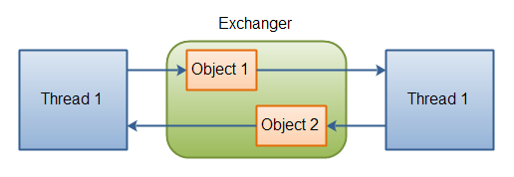
Exchanger

Slide 105
Concurrent hash map
Property | HashMap | Hashtable | ConcurrentHashMap
Null values/keys | allowed | not allowed | not allowed
Is thread-safe | no | yes | yes
Lock mechanism | Not applicable | Locks the whole map | Locks the portion
Iterator | fail-fast | fail-fast | fail-safe

Slide 106
Concurrent hash map
ConcurrentHashMap
You should use ConcurrentHashMap when you need very high concurrency in your project.
It is thread safe without synchronizing the whole map.
Reads can happen very fast while write is done with a lock.
There is no locking at the object level.
The locking is at a much finer granularity at a hashmap bucket level.
ConcurrentHashMap doesn’t throw a ConcurrentModificationException if one thread tries to modify it while another is iterating over it.
ConcurrentHashMap uses multitude of locks.

Slide 107
Synchronized hash map
SynchronizedHashMap
Synchronization at Object level.
Every read/write operation needs to acquire lock.
Locking the entire collection is a performance overhead.
This essentially gives access to only one thread to the entire map & blocks all the other threads.
It may cause contention.
SynchronizedHashMap returns Iterator, which fails-fast on concurrent modification.

Slide 108
Date API
Class | Description
LocalDate | a date, without time of day, offset or zone
LocalTime | the time of day, without date, offset or zone
LocalDateTime | the date and time, without offset or zone
OffsetDate | a date with an offset such as +02:00, without time of day or zone
OffsetTime | the time of day with an offset such as +02:00, without date or zone
OffsetDateTime | the date and time with an offset such as +02:00, without a zone

Slide 109
Date API
ZonedDateTime | the date and time with a time zone and offset
YearMonth | a year and month
MonthDay | month and day
Year/MonthOfDay/DayOfWeek/... | classes for the important fields
DateTimeFields | stores a map of field-value pairs which may be invalid
Calendrical | access to the low-level API
Period | a descriptive amount of time, such as "2 months and 3 days"

Slide 110
Nashorn and Shell Scripting
>jjs
Jjs>print (‘Hello Trainees’);

Slide 111
Java 8: From PermGen to Metaspace
Metaspace: A new memory space is born
The JDK 8 HotSpot JVM is now using native memory for the representation of class metadata and is called Metaspace; similar to the Oracle JRockit and IBM JVM's.
No more java.lang.OutOfMemoryError: PermGen space problems and no need for you to tune and monitor this memory space anymore…not so fast.

Slide 112
Java 8: From PermGen to Metaspace
PermGen space situation
This memory space is completely removed.
The PermSize and MaxPermSize JVM arguments are ignored and a warning is issued if present at start-up.
Metaspace memory allocation model
Most allocations for the class metadata are now allocated out of native memory.
The classes that were used to describe class metadata have been removed.

Slide 113
Java 8: From PermGen to Metaspace
Metaspace capacity
By default class metadata allocation is limited by the amount of available native memory (capacity will of course depend if you use a 32-bit JVM vs. 64-bit along with OS virtual memory availability).
A new flag is available (MaxMetaspaceSize), allowing you to limit the amount of native memory used for class metadata.
If you don’t specify this flag, the Metaspace will dynamically re-size depending of the application demand at runtime.

Slide 114
Java 8: From PermGen to Metaspace
Metaspace garbage collection
Garbage collection of the dead classes and classloaders is triggered once the class metadata usage reaches the “MaxMetaspaceSize”.
Proper monitoring & tuning of the Metaspace will obviously be required in order to limit the frequency or delay of such garbage collections.
Excessive Metaspace garbage collections may be a symptom of classes, classloaders memory leak or inadequate sizing for your application.

Slide 115
Java 8: From PermGen to Metaspace
Java heap space impact
Some miscellaneous data has been moved to the Java heap space. This means you may observe an increase of the Java heap space following a future JDK 8 upgrade.
Metaspace monitoring
Metaspace usage is available from the HotSpot 1.8 verbose GC log output.
Jstat & JVisualVM have not been updated at this point based on our testing with b75 and the old PermGen space references are still present.

Slide 116
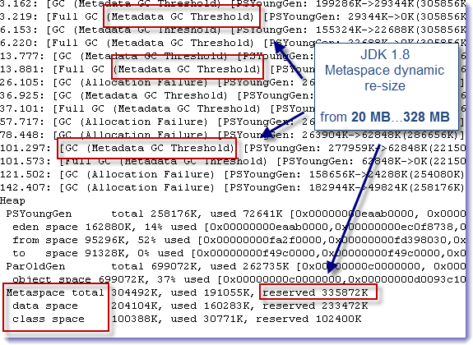

Slide 117
Annotations
Java 5 Annotations
public class Manager extends Employee {
@Override
public void setSalary(int salary) {
System.out.println("Manager.setSalary():" + salary);
}
}

Slide 118
Declaring an Annotation Type
<modifiers> @ interface <annotation-type-name> {
// Annotation type body goes here
}

Slide 119
Restriction #1
An annotation type cannot inherit from another annotation type
// Won't compile
public @interface WrongVersion extends BasicVersion {
int extended();
}

Slide 120
Every annotation type implicitly inherits the java.lang.annotation.Annotation interface
package java.lang.annotation;
public interface Annotation {
boolean equals(Object obj);
int hashCode();
String toString();
Class<? extends Annotation> annotationType();
}

Slide 121
Restriction #2
Method declarations in an annotation type cannot specify any parameters.
A method declares an element for the annotation type.
An element in an annotation type lets you associate a data value to an annotation’s instance.
A method declaration in an annotation is not called to perform any kind of processing.

Slide 122
Restriction #2
An element as an instance variable in a class having two methods, a setter and a getter, for that instance variable.
For an annotation, the Java runtime creates a proxy class that implements the annotation type (which is an interface).
Each annotation instance is an object of that proxy class.
The method you declare in your annotation type becomes the getter method for the value of that element you specify in the annotation.
The Java runtime will take care of setting the specified value for the annotation elements. Since the goal of declaring a method in an annotation type is to work with a data element, you do not need to (and are not allowed to) specify any parameters in a method declaration.

Slide 123
Restriction #2
// Won't compile
public @interface WrongVersion {
// Cannot have parameters
String concatenate(int major, int minor);
}

Slide 124
Restriction #3
Method declarations in an annotation type cannot have a throws clause.
A method in an annotation type is defined to represent a data element.
Throwing an exception to represent a data value does not make sense.
// Won't compile
public @interface WrongVersion {
int major() throws Exception; // Cannot have a throws clause
int minor(); // OK
}

Slide 125
Restriction #4
The return type of a method declared in an annotation type must be one of the following types:
• Any primitive type: byte, short, int, long, float, double, boolean, and char
• java.lang.String
• java.lang.Class
• An enum type
• An annotation type
• An array of any of the above mentioned type, for example, String[], int[], etc. The return
type cannot be a nested array. For example, you cannot have a return type of String[][] or
int[][].

Slide 126
Restriction #4
public @interface GoodOne {
Class element1(); // Any Class type
Class<Test> element2(); // Only Test class type
Class<? extends Test> element3(); // Test or its subclass type
}
The return type of Class needs a little explanation. Instead of the Class type, you can use a generic return type that will return a user-defined class type.
Suppose you have a Test class and you want to declare the return type of a method in an annotation type of type Test.

Slide 127
Restriction #5
An annotation type cannot declare a method, which would be equivalent to overriding a method in the Object class or the Annotation interface.

Slide 128
Restriction #6
An annotation type cannot be generic.

Slide 129
Default Value of an Annotation Element
<modifiers> @interface <annotation type name> {
<data-type> <element-name>() default <default-value>;
}
public @interface Version {
int major();
int minor() default 0; // Set zero as default value for minor
}

Slide 130
Default Value of an Annotation Element
@Version(major=1) // minor is zero, which is its default value
@Version(major=2) // minor is zero, which is its default value
@Version(major=2, minor=1) // minor is 1, which is the specified value
// Shows how to assign default values to elements of different types
public @interface DefaultTest {
double d() default 12.89;
int num() default 12;
int[] x() default {1, 2};
String s() default "Hello";
String[] s2() default {"abc", "xyz"};
Class c() default Exception.class;
Class[] c2() default {Exception.class, java.io.IOException.class};
}

Slide 131
Annotation Type and Its Instances
Version v = null; // Here, Version is an annotation type
A Class Implementing an Annotation Type
// DoNotUseIt.java
package com.jdojo.annotation;
import java.lang.annotation.Annotation;
public class DoNotUseIt implements Version {
// Implemented method from the Version annotation type
@Override
public int major() {
return 0;
}

Slide 132
Annotation Type and Its Instances
// Implemented method from the Version annotation type
@Override
public int minor() {
return 0;
}
// Implemented method from the Annotation annotation type,
// which is the supertype of the Version annotation type
@Override
public Class<? extends Annotation> annotationType() {
return null;
}

Slide 133
Using Annotations
public @interface PrimitiveAnnTest {
byte a();
short b();
int c();
long d();
float e();
double f();
boolean g();
char h();
}
@PrimitiveAnnTest(a=1, b=2, c=3, d=4, e=12.34F, f=1.89, g=true, h='Y')

Slide 134
String Types
public @interface Name {
String first();
String last();
}
@Name(first="John", last="Jacobs")
public class NameTest {
@Name(first="Wally", last="Inman")
public void aMethod() {
// More code goes here...
}
}

Slide 135
Class Types
public class DefaultException extends java.lang.Throwable {
public DefaultException() {
}
public DefaultException(String msg) {
super(msg);
}
}

Slide 136
Class Types
@Retention(RetentionPolicy.RUNTIME)
@Target(ElementType.METHOD)
public @interface TestCase {
Class<? extends Throwable> willThrow() default DefaultException.class;
}

Slide 137
Enum Type
public @interface Review {
ReviewStatus status() default ReviewStatus.PENDING;
String comments() default "";
// ReviewStatus enum is a member of the Review annotation type
public enum ReviewStatus {PENDING, FAILED, PASSED, PASSEDWITHCHANGES};
}

Slide 138
Enum Type
@Review()
// Leave status as Pending, but add some comments
@Review(comments="Have scheduled code review on June 3 2014")
// Fail the review with comments
@Review(status=ReviewStatus.FAILED, comments="Need to handle errors")

Slide 139
Annotation Type
public @interface Description {
Name name();
Version version();
String comments() default "";
}

Slide 140
Annotation Type
@Description(name=@Name(first="John", last="Jacobs"),
version=@Version(major=1, minor=2),
comments="Just a test class")
public class Test {
// Code goes here
}

Slide 141
Array Type Annotation Element
public @interface ToDo {
String[] items();
}
@ToDo(items={"Add readFile method", "Add error handling"})
public class Test {
// Code goes here
}

Slide 142
No Null Value in an Annotation
Using the following annotations will
result in compile-time errors:
@ToDo(items=null)
@Name(first=null, last="Jacobs")

Slide 143
Shorthand Annotation Syntax
public @interface Enabled {
boolean status() default true;
}
@Enabled
public class Test {
// Code goes here
}
@Enabled()
public class Test {
// Code goes here
}

Slide 144
Marker Annotation Types
public @interface Marker {
// No element declarations
}
A marker annotation type is an annotation type that does not declare any elements, not even one with a default value.
Typically, a marker annotation is used by the annotation processing tools, which generate boilerplate code based on the marker annotation type.

Slide 145
Marker Annotation Types
@Marker
public class Test {
// Code goes here
}

Slide 146
Meta-Annotation Types
Meta-annotations types are annotation types, which are used to annotate other annotation types.
The following annotation types are meta-annotation types:
• Target
• Retention
• Inherited
• Documented
• Repeatable
• Native
Meta-annotation types are part of the Java class library. They are declared in the package java.lang.annotation.

Slide 147
The Target Annotation Type

Slide 148
The Retention Annotation
An annotation can be retained at three levels.
• Source code only
• Class file only (the default)
• Class file and the runtime

Slide 149
The Retention Annotation
The Retention meta-annotation type is used to specify how an annotation instance of an annotation type should be retained by Java.
This is also known as the retention policy of an annotation type. If an annotation type has a “source code only” retention policy, instances of its type are removed when compiled into a class file.
If the retention policy is “class file only,” annotation instances are retained in the class file, but they cannot be read at runtime.
If the retention policy is “class file and runtime” (simply known as runtime), the annotation instances are retained in the class file and they are available for reading at runtime

Slide 150
The Inherited Annotation Type
The Inherited annotation type is a marker meta-annotation type.
If an annotation type is annotated with an Inherited meta-annotation, its instances are inherited by a subclass declaration.
It has no effect if an annotation type is used to annotate any program elements other than a class declaration.

Slide 151
The Inherited Annotation Type
public @interface Ann2 {
int id();
}
@Inherited
public @interface Ann3 {
int id();
}
Let’s declare two classes, A and B, as follows. Note that class B inherits class A.
@Ann2(id=505)
@Ann3(id=707)
public class A {
// Code for class A goes here
}

Slide 152
The Inherited Annotation Type
// Class B inherits Ann3(id=707) annotation from the class A
public class B extends A {
// Code for class B goes here
}

Slide 153
The Documented Annotation
The Documented annotation type is a marker meta-annotation type.
If an annotation type is annotated with a Documented annotation, the Javadoc tool will generate documentation for all of its instances.

Slide 154
The Repeatable Annotation
Prior to Java 8, it was not allowed to repeat an annotation in the same context. For example, the following repeated use
of the Version annotation would generate a compile-time error:
@Version(major=1, minor=1)
@Version(major=1, minor=2)
public class Test {
// Code goes here
}

Slide 155
Commonly Used Standard Annotations
Java API defines many standard annotation types.
They are defined in the java.lang package.
They are
• Deprecated
• Override
• SuppressWarnings
• FunctionalInterface

Slide 156
The FunctionalInterface Annotation Type
An interface with one abstract method declaration is known as a functional interface.
Previously, a functional interface was known as SAM (Single Abstract Method) type.
The compiler verifies all interfaces annotated with a @FunctionalInterface that the interfaces really contain one and only one abstract method.
A compile-time error is generated if the interfaces annotated with this annotation are not functional interfaces.
It is also a compile-time error to use this annotation on classes, annotation types, and enums.
The FunctionalInterface annotation type is a marker interface.

Slide 157
The FunctionalInterface
The following declaration of the Test class uses a @FunctionalInterface annotation, which will generate a compile-time error because a @FunctionalInterface annotation can only be used on interfaces.
@FunctionalInterface
public class Test {
public void test() {
// Code goes here
}
}

Slide 158
Annotating a Java Package
A package declaration appears as part of a top-level type declaration.
Further, the same package declaration occurs multiple times at different places.
Create a file, which should be named package-info.java, and place the annotated package declaration in it.
// package-info.java
@Version(major=1, minor=0)
package com.jdojo.annotation;

Slide 159
Annotating a Java Package
// package-info.java
@com.jdojo.myannotations.Author("John Jacobs")
@Reviewer("Wally Inman")
package com.jdojo.annotation;
import com.jdojo.myannotations.Reviewer;

