Slide 1
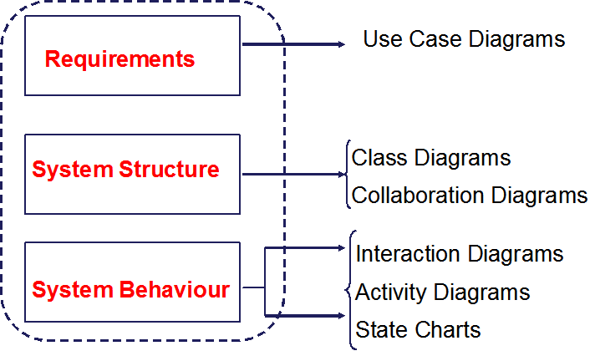
UML Basics
Process Model
Deployment Model
Design Model
Notes:
Copyright 2005 IBM Corp.

Slide 2
Contents -
  Models
    Use-case model
    Design model (Class diagram)
  Diagrams
    Use-case diagram and activity diagram
    Sequence diagram and communication diagram
    Component diagram and deployment diagram
    Topic diagram and browse diagram
  How many diagrams need to be created?

Slide 3
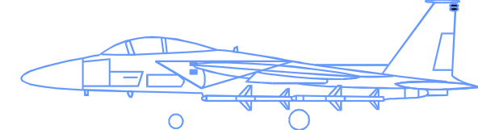

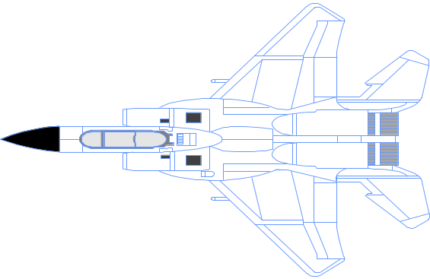

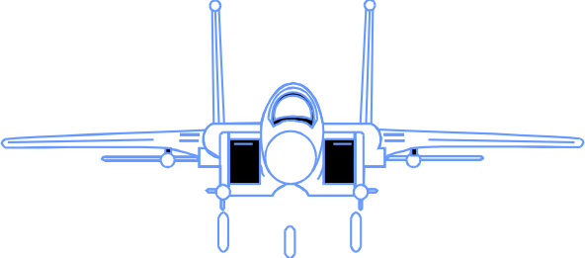
What Is a Model?
A model is “a complete description of a system from a particular perspective.” A model is a simplification of reality.
Notes:
Copyright 2005 IBM Corp.
According to Grady Booch, IBM Fellow, a model provides the blueprints of a system. Models may encompass detailed plans, as well as more general plans that give a 30,000-foot view of the system under construction. A good model includes those elements that are not relevant to the given level of abstraction. Every system may be described from different aspects using different models, and each model is therefore a semantically closed abstraction of the system. A model may be structural, emphasizing the organization of the system, or it may be behavioral, emphasizing the dynamics of the system.
Define what is meant by the term “model.”

Slide 4
Why Model?
Modeling achieves four aims:
  Helps you to visualize a system as you want it to be.
  Permits you to specify the structure or behavior of a system.
  Gives you a template that guides you in constructing a system.
  Documents the decisions you have made.
You build models of complex systems because you cannot comprehend such a system in its entirety.
You build models to better understand the system you are developing.
Notes:
Copyright 2005 IBM Corp.
According to Booch in The Unified Modeling Language User Guide, modeling achieves four aims:
1. Models help you to visualize a system, as you want it to be. A model helps the software team communicate the vision for the system being developed. It is difficult for a software team to have a unified vision of a system that is described only in specification and requirement documents. Models bring about understanding of the system.
2. Models permit you to specify the structure of behavior of a system. A model allows how to document system behavior and structure before coding the system.
3. Models give a template that guide you in constructing a system. A model is an invaluable tool during construction. It serves as a road map for a developer. Have you experienced a situation where a developer coded incorrect behavior because he or she was confused over the wording in a requirements document? Modeling helps alleviate that situation.
4. Models document the decisions you’ve made. Models are valuable tools in the long term because they give “hard” information on design decisions. You don’t need to rely on someone’s memory.
Sell the students on the value of visual modeling.
Clarify that you are discussing formal modeling, not modeling written on a white board or on the back of a napkin at lunch.

Slide 5
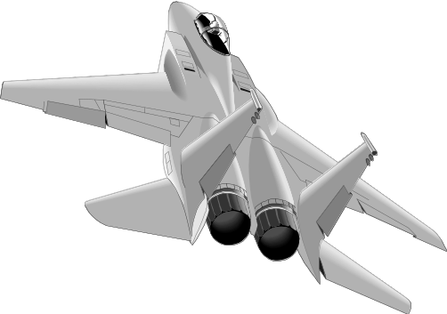

Importance of Modeling
Applications approaching like building paper airplanes
  Start coding from project requirements
  Work longer hours and create more code
  Lacks any planned architecture
  Doomed to failure
Modeling is a common thread to successful projects
Less Important
More Important

Slide 6
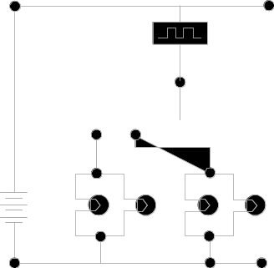
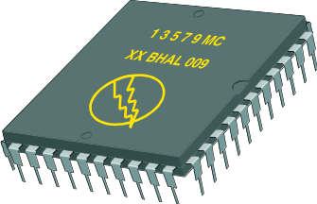
Four Principles of Modeling
The model you choose influences how the problem is attacked.
Every model may be expressed at different levels of precision.
The best models are connected to reality.
No single model is sufficient.
Process Model
Deployment Model
Design Model
Notes:
Copyright 2005 IBM Corp.
Modeling has a rich history in all the engineering disciplines.
The four basic principles of modeling are derived from this history.
The models you create profoundly influence how a problem is attacked and how a solution is shaped.
Every model may be expressed at different levels of precision.
The best models are connected to reality.
No single model is sufficient. Every non-trivial system is best approached through a small set of nearly independent models.
Demonstrate that there are guiding principles for visual modeling. It is not chaotic activity.
The four modeling principles are described in detail on the next four slides.
See the “UML User Guide” for a more detailed discussion on these four principles.

Slide 7

What Is the UML?
The UML is a language for
    Visualizing
    Specifying
    Constructing
    Documenting
the artifacts of a software-intensive system.
The Unified Modelling Language (UML) is an industry standard for object oriented design notation, supported by the Object Management Group (OMG).
Notes:
Copyright 2005 IBM Corp.
The software systems that you develop today are more complex than the human mind can comprehend. This is why you model systems. Your model selection profoundly influences how you attack the problem and shape the solution.
No single model is sufficient. Every complex system is best approached through a small set of nearly independent models.
Therefore, to increase comprehension, a common language like the Unified Modeling Language (UML) is used to express models.
A modeling language is a language whose vocabulary and rules focus on the conceptual and physical representation of a system. A modeling language like the UML is a standard language for software blueprints.
Introduce the UML. Remember many of your students have no idea what the UML really is.
The next four slides explain how the UML is a language for visualizing, specifying, constructing and documenting.

Slide 8
The UML Is a Language for Visualizing
Communicating conceptual models to others is prone to error unless everyone involved speaks the same language.
There are things about a software system you can’t understand unless you build models.
An explicit model facilitates communication.
Notes:
Copyright 2005 IBM Corp.
Typically, projects and organizations develop their own language for modeling systems, making it difficult for outsiders and new team members to understand what is going on.
Communicating these conceptual models to others is prone to error unless everyone involved speaks the same language. The UML offers a set of symbols that represents well-defined semantics. One developer can write a model in the UML, and another developer can interpret that model unambiguously.
There are things about a software system you can’t understand unless you build models that transcend the textual programming language. For example, the meaning of a class hierarchy can be inferred, but not directly grasped, by staring at the code for all the classes in the hierarchy. The UML is a graphical language that addresses this problem.
If the developer who cut the code never wrote down the models, the information would be lost forever. At best, the information would only be partially recoverable from the implementation after the developer has moved on. Writing models in the UML addresses this issue. An explicit model facilitates communication. (The Unified Modeling Language User Guide, Booch, 1999.)
Stress how the UML is designed to promote communication using pictures rather than text.
Using the UML allows the “light bulb” to go on in the minds of many people. Rather than trying to interpret a textual description of a system design, the UML offers a graphical representation of that same description.
In this case, a picture is truly worth a thousand words.

Slide 9
The UML Is a Language for Specifying
The UML builds models that are precise, unambiguous, and complete.
Notes:
Copyright 2005 IBM Corp.
In this context, specifying means to build models that are precise, unambiguous, and complete. In particular, the UML addresses the specification of all the important analysis, design, and implementation decisions that must be made to develop and deploy software-intensive systems. (The Unified Modeling Language User Guide, Booch, 1999.)
The UML can be used to specify detailed or general models.
Anyone who has worked on a project where miscommunication occurred appreciates this feature of the UML.
The UML allows the modeler to specify their intentions in a clear, unmistakable manner.

Slide 10
The UML Is a Language for Constructing
UML models can be directly connected to a variety of programming languages.
  Maps to Java, C++, Visual Basic, and so on
  Tables in a RDBMS or persistent store in an OODBMS
  Permits forward engineering
  Permits reverse engineering
Notes:
Copyright 2005 IBM Corp.
The UML is not a visual programming language. However, models using the UML can be directly connected to a variety of programming languages, making it possible to map from a model in the UML to a programming language or even to a database.
If it is best expressed graphically, it is done graphically in the UML. If it is best expressed textually, it is done in the programming language.
This mapping permits forward engineering: the generation of code from a UML model to a programming language. Reverse engineering is also possible: the reconstruction of a model from implementation back into the UML.
The UML was designed with forward and reverse engineering in mind.
Rational has partners who provide round-trip engineering for other languages.

Slide 11
The UML Is a Language for Documenting
The UML addresses documentation of system architecture, requirements, tests, project planning, and release management.
Use Case Diagram
Deployment Diagram
- À©µµ¿ì 95 : Å¬¶óÀÌ¾ðÆ®
ºÐ»ê È¯°æÀÇ ÇÏµå¿þ¾î¹× ³×Æ®¿÷À¸·ÎÀÇ Á¤º¸ ½Ã½ºÅÛ ¿¬°á ¸ðµ¨
- À©µµ¿ì NT: ÀÀ¿ë¼­¹ö
- À¯´Ð½º ¸Ó½Å: ÀÀ¿ë ¼­¹ö ¹× µ¥ÀÌÅ¸ ¼­¹ö, Åë½Å ¼­¹ö
- IBM ¸ÞÀÎÇÁ·¹ÀÓ: µ¥ÀÌÅ¸ ¼­¹ö, Åë½Å ¼­¹ö
Use Case 1
Window95
Windows95
Windows95
¹®¼­°ü¸®
Å¬¶óÀÌ¾ðÆ®.EXE
Windows
¹®¼­°ü¸® ¾ÖÇÃ¸´
Actor A
Use Case 2
Actor B
NT
Solaris
¹®¼­°ü¸® ¿£Áø.EXE
Alpha
Windows
ÀÀ¿ë¼­¹ö.EXE
UNIX
Use Case 3
NT
IBM
Mainframe
µ¥ÀÌÅ¸º£ÀÌ½º¼­¹ö
mainWnd
fileMgr :
document :
gFile
repository
FileMgr
DocumentList
Document
user
FileMgr
Document
add( )
name : int
fetchDoc( )
delete( )
docid : int
Æ¯Á¤¹®¼­¿¡ ´ëÇÑ º¸±â¸¦
1: Doc view request ( )
sortByName( )
get( )
numField : int
read() fill the
»ç¿ëÀÚ°¡ ¿äÃ»ÇÑ´Ù.
open( )
code..
2: fetchDoc( )
close( )
FileList
fList
read( )
sortFileList( )
3: create ( )
add( )
create( )
fillDocument( )
delete( )
1
4: create ( )
5: readDoc ( )
1
È­ÀÏ°ü¸®ÀÚ´Â ÀÐ¾î¿Â
6: fillDocument ( )
¹®¼­ÀÇ Á¤º¸¸¦ ÇØ´ç ¹®¼­
°´Ã¼¿¡ ¼³Á¤À» ¿äÃ»ÇÑ´Ù.
7: readFile ( )
Repository
rep
File
8: fillFile ( )
(from Persistence)
read( )
GrpFile
È­¸é °´Ã¼´Â ÀÐ¾îµéÀÎ
9: sortByName ( )
name : char * = 0
°´Ã¼µé¿¡ ´ëÇØ ÀÌ¸§º°·Î
º¸¿©ÁØ´Ù.
Á¤·ÄÀ» ½ÃÄÑ È­¸é¿¡
readDoc( )
read( )
readFile( )
open( )
create( )
fillFile( )
Sequence Diagram
Class Diagram
Notes:
Copyright 2005 IBM Corp.
Project artifacts are critical in controlling, measuring, and communicating about a system during its development and after its deployment.
The UML addresses the documentation of a system’s architecture and all of its details. The UML also provides a language for expressing requirements and for tests. Finally, the UML provides a language for modeling the activities of project planning and release management. (The Unified Modeling Language User Guide, Booch, 1999.)
This slide does not represent all the diagrams defined in the UML specification. For example, there is no graphic presented here for a composite structure diagram or a timing diagram. Composite structure is a more advanced modeling concept that is not covered in this course. The timing diagram is new to UML2 and will be introduced in a later module.
UML diagrams should be treated as formal project artifacts.
Each diagram created by a project team should be treated as an artifact.
The UML can help alleviate some of the paper crunch that many software teams experience.

Slide 12
History of the UML
UML 2.0
(2004)
UML 1.5
(March, ‘03)
UML 1.1
(Sept. ‘97)
UML 1.0
(Jan. ‘97)
UML 0.9
(June ‘96)
and
UML 0.91
(Oct. ‘96)
Public
Feedback
Unified Method 0.8
(OOPSLA ’95)
Booch ’93
OMT - 2
OOSE
Other
Methods
Booch ‘91
OMT - 1
Notes:
Copyright 2005 IBM Corp.
The UML 2.0 is defined by two complementary specifications, the Infrastructure and the Superstructure. The UML infrastructure defines foundational concepts that can be used in part or entirely by other specifications. The UML superstructure defines the complete UML. The superstructure specification is self contained and you won’t have to read the infrastructure specification unless you are concerned about configuring other specifications in parallel to UML.
The UML metamodel (a description of a model) is divided into two main packages, structure and behavior with two supporting packages, auxiliary elements and profiles.
• The structure package defines the static structure of the UML.
The behavior package defines the dynamic structure of the UML.
Each package is described by a chapter in the superstructure specification document.

Slide 13
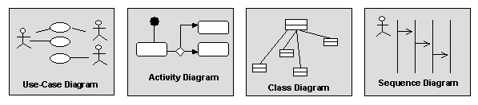
Diagrams
Diagrams graphically depict a view of a part of your model.
Different diagrams represent different views of the system that you are developing.
A model element will appear on one or more diagrams.
Notes:
Copyright 2005 IBM Corp.
Diagrams provide a means of visualizing and manipulating the model elements.

Slide 14
UML Diagrams in Software Architecture
Structural Diagrams
Use-Case
Diagrams
Class
Diagrams
Composite
Structure
Diagrams
Sequence
Diagrams
Communication
Diagrams
Component
Diagrams
Model
State Machine
Diagrams
Deployment
Diagrams
Activity
Diagrams
Behavioral Diagrams
Notes:
Copyright 2005 IBM Corp.
Visual models of a system require many different diagrams to represent different views of the system for different project stakeholders. The UML provides a rich notation for visualizing models, including the following key diagrams:
Use-Case diagrams to illustrate user interactions with the system
Class diagrams to illustrate logical structure
Composite Structure diagrams to show the internal structure of a class or component at runtime
Component diagrams to illustrate the organization and dependencies among modular parts of the system
Deployment diagrams to show the mapping of software to hardware configurations
Activity diagrams to illustrate flows of events
State Machine diagrams to illustrate the series of states an object can have
Communication diagrams to illustrate behavior in terms of how objects interact
Sequence diagrams to illustrate behavior in terms of the sequence of interactions between objects

Slide 15
Key Diagrams in UML
Requirements
System Structure
System Behaviour
Use Case Diagrams
Class Diagrams
Collaboration Diagrams
Interaction Diagrams
Activity Diagrams
State Charts
Notes:
Copyright 2005 IBM Corp.
This part of the course will give you an introduction to key elements of the UMLnotation - it is not a blow by blow account of all the standard notation - the latter would be neither particularly helpful nor interesting! Like many standards there is much more in it than you will ever really want to know - but it is important to know that it exists.
The lectures we will cover do not tell you all there is to know about UML - all we are trying to do here is give you a way into the notation and gain some insight in what it has to offer.
The above slide summarises the parts of the UML that we will explore through the two sessions. There is also something called CRC cards that we will mention. The CRC cards are *not* part of the UML - but they are a useful technique to know about for reasons that we will discuss later. As a post-sessions exercise, if you search for CRC cards on the Internet you will see that they are a fairly common topic when developing and testing OO designs using the UML.

Slide 16
Different diagrams of system for different people
Logical View
Implementation View
Analysts/Designers
Programmers
Structure
Software management
Use-Case View
End-user
Functionality
Process View
Deployment View
System engineering
System integrators
System topology, delivery,
installation, communication
Performance, scalability, throughput

Slide 17
What is a Use-Case Model?
A use-case model:
  Is a model of a system’s intended functions and its environment
  Serves as a contract between the customer and the developers
  Contains the following diagrams:
    Use case: Shows a set of use cases and actors and their relationships
    Activity: Shows the flow of events within a use case
    Sequence: Shows how a use case will be implemented in terms of collaborating objects
Notes:
Copyright 2005 IBM Corp.
In the RUP, a model is defined as a complete specification of a problem or solution domain from a particular perspective. Each model is complete in the sense that you do not need any additional information to understand the system from that perspective. A problem domain or a system may be specified by a number of models that represent different perspectives for different project stakeholders.

Slide 18
Use-Case Diagram (Example)
View Report Card
Course Catalog
Maintain Professor
Information
Register for Courses
Student
Login
Maintain Student
Information
Registrar
Select Courses to
Teach
Close Registration
Professor
Submit Grades
Billing System
Notes:
Copyright 2005 IBM Corp.
The use-case model contains the following elements, which are displayed in a use-case diagram:
Actors: Used to represent someone or something outside the system that interacts with the system.
Use Case: Used to represent a unit of system behavior that comprises several possible sequences of actions.
Mention the possible relationships that appear in a use-case diagram.

Slide 19
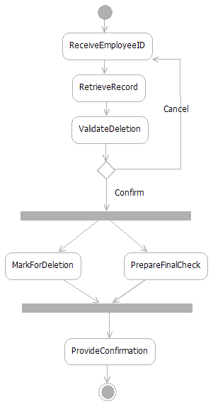
Activity Diagram
Action
A step in the flow of events
Decision
Flows split based on a guard
condition
Fork
Beginning of concurrent flows
Join
End of concurrent flow
Flow
Show the sequence of
activities
Notes:
Copyright 2005 IBM Corp.
Activities describe graphically the flow of events of a use case. The flow of events consists of a sequence of activities that together produce something of value for the actor. The flow of events consists of a basic flow and one or several alternative flows.
Actions: Represent the performance of an activity or step within the flow of events.
Flow/Edge: Show what activity state follows after another.
Decision/Merge Control which flow (of a set of alternative flows) follows once the activity has been completed, based on a guard condition. Decisions are used to show alternative threads in the flow of events of a use case.
Forks/Joins: Show the beginnings and ends of parallel subflows. Forks and joins are used to show concurrent threads in the flow of events of a use case.

Slide 20
Activity Diagram (Example)
Decision
Activity/Action
Concurrent Threads
Select Course
[ delete course ]
Delete Course
[ add course ]
Synchronization
Bar (Fork)
Guard
Condition
Check
Check
Schedule
Pre-requisites
Synchronization
Bar (Join)
[ checks completed ]
[ checks failed ]
Assign to
Resolve
Transition
Course
Conflicts
Update
Schedule
Notes:
Copyright 2005 IBM Corp.
The use-case model contains the following elements, which are displayed in a use-case diagram:
Actors: Used to represent someone or something outside the system that interacts with the system.
Use Case: Used to represent a unit of system behavior that comprises several possible sequences of actions.
Mention the possible relationships that appear in a use-case diagram.

Slide 21
What is a Design Model?
A design model:
  Describes the realization of use cases in terms of design elements
  Describes the design of the application
  Contains the following diagrams:
    Class: Shows UML classes and relationships
    Component: Shows the structure of elements in the implementation model
    Communication and Sequence: Show how objects and classes interact
    State Machine: Shows event-driven behavior
Notes:
Copyright 2005 IBM Corp.
The design model may include the following diagrams:
Class diagrams: Show the classes, their internal structure, and their relationships to other classes. May also show the package structure of the design model (package diagram).
Composite Structure diagrams: Show the runtime decomposition of a class.
Component diagrams: Used, in the design model, to show the high-level structure of the implementation model.
State Machine diagrams: Used to model the event-driven aspects of an object’s behavior.
Interaction diagrams: Used, in the design model, in use-case realizations to show how behavior is assigned to classes in the design model. The two interaction diagrams are semantically equivalent, so in Software Architect you can generate a sequence diagram under an interaction automatically from the interaction’s Collaboration diagrams or vice versa.
In Software Architect, one interaction diagram type can be generated automatically from another. So if you have a sequence diagram under an interaction and add a communication diagram, Software Architect will automatically populate the Collaboration diagrams with the correct interactions.

Slide 22
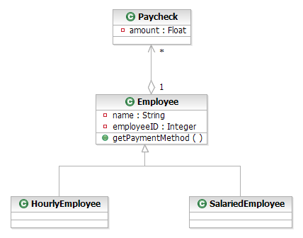
Class Diagram (Design Model)
Class diagrams show the static structure of the model, in particular, its classes, their internal structure, and their relationships to other classes. Class diagrams do not show temporal information.
Class
A description of a set
of objects
Aggregation
Represents a part-whole
relationship
Attribute
Named property of
a class
Operation
Class behavior
Generalization
Shows an inheritance
relationship
Notes:
Copyright 2005 IBM Corp.
Class diagrams show the static structure of the model, in particular, its classes, their internal structure, and their relationships to other classes. Class diagrams do not show temporal information.
A class diagram typically displays the following elements and the relationships among them:
Classes: Describe sets of objects that share the same responsibilities, relationships, operations, attributes, and semantics.
Attributes: Named properties of the class or its objects. An attribute also defines the type of its instances.
Operations: Services that can be requested (the behavior of the class).
Packages: Can be included for the sake of context although UML 2.0 has brought package diagrams into the mainstream.

Slide 23
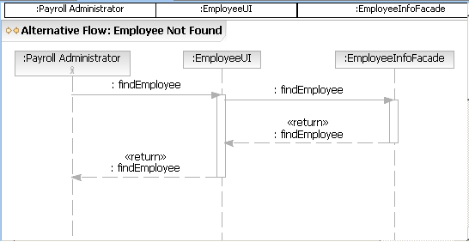
Sequence Diagram used to show how objects interact to perform the behavior of all or part of a use case as part of a use-case realization.
Object/Class
Shows the object/class involved in the interaction
Messages
Show data exchanged
between objects
Execution Occurrence
Shows object executing
Lifeline
Shows the life of the object
Notes:
Copyright 2005 IBM Corp.
In the design model, sequence diagrams are used to show how objects interact to perform the behavior of all or part of a use case as part of a use-case realization. The sequence diagram clarifies the roles of objects in a flow of events, and thus it provides basic input for determining class responsibilities and interfaces.
Sequence diagrams display the following model elements:
Lifelines: Represent the existence of the object at a particular time
Actors: Can be included in the diagram when you want to show that an actor initiates the interaction
Messages: Communicate between objects that conveys information with the expectation that activity will ensue

Slide 24
Sequence Diagram (Example)
:RegisterForCoursesForm
:RegistrationController
SWTSU Catalog :
Activity/Action
: Student
CourseCatalogSystem
: Course Catalog
1: create schedule( )
2: get course offerings( )
3: get course offerings(for Semester)
4: get course offerings( )
5: display course offerings( )
6: display blank schedule( )
ref
Select Offerings
Notes:
Copyright 2005 IBM Corp.
The use-case model contains the following elements, which are displayed in a use-case diagram:
Actors: Used to represent someone or something outside the system that interacts with the system.
Use Case: Used to represent a unit of system behavior that comprises several possible sequences of actions.
Mention the possible relationships that appear in a use-case diagram.

Slide 25
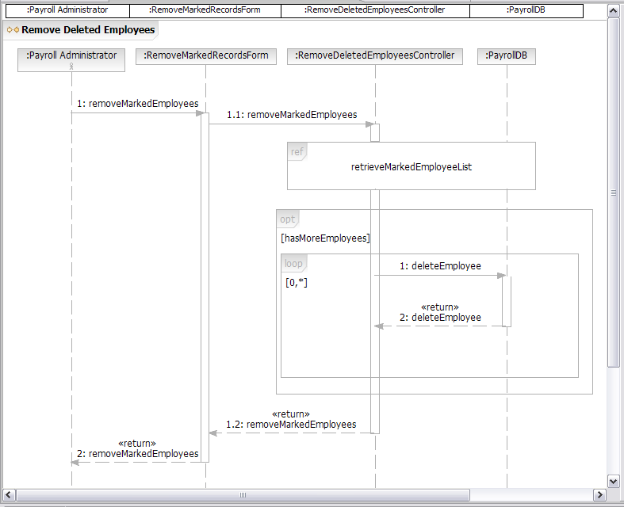
Sequence Diagram: Combined Fragments
Interaction Use (ref)
References another interaction
Optional Fragment (opt)
Executed if guard condition evaluates to true
Loop (loop)
Executed as long as the first guard condition
evaluates to true
Notes:
Copyright 2005 IBM Corp.
To help with the modeling of, for example, multiple flows of events, which in the past always meant creating many interaction diagrams with only slight differences among them, you can use combined fragment notation—new with UML 2.0 and supported in Software Architect—which allows you to embed multiple paths through an interaction inside the same interaction diagram.
A combined fragment in a sequence diagram has an operator and one or more subinteractions in a nested region of the diagram. Gates may be defined on the combined fragment so that messages can be sent from the combined fragment to other parts of the main interaction.
Combined fragments have a keyword associated with them, shown on the frame surrounding the combined fragment. The more common combined fragment types include:
loop: The loop fragment contains one subfragment that executes as long as a Boolean guard condition evaluates to true.
ref: The combined fragment references another sequence diagram. In Software Architect, adding the ref operator from the toolbox automatically generates a new interaction instance in the model.
opt: The opt fragment type contains one subfragment that executes only when the guard condition evaluates to true.
See Software Architect Help for discussion of other keywords.

Slide 26
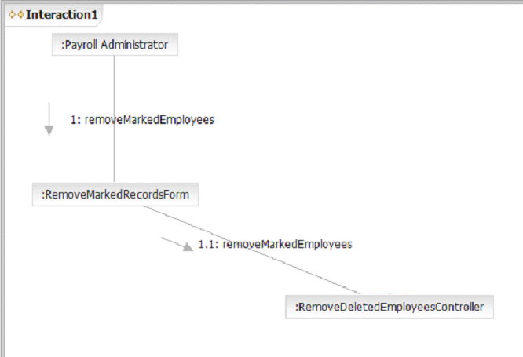
Communication (Collaboration) Diagram provide another way to show how objects interact to perform the behavior of a particular use case or a part of a use case. Where sequence diagrams emphasize the interactions of objects over time, communication diagrams are designed to emphasize the relationships between objects.
Object/Class
Shows the object/class involved in the interaction
Message
Shows data
exchanged
between objects
Notes:
Copyright 2005 IBM Corp.
Communication diagrams provide another way to show how objects interact to perform the behavior of a particular use case or a part of a use case. Where sequence diagrams emphasize the interactions of objects over time, communication diagrams are designed to emphasize the relationships between objects.
Objects: Objects show the name of the object and its class, separated by a colon:
objectname : classname
Links: Links are relationships among objects across which messages can be sent, shown as a solid line between two objects. A link can be an instance of an association, or it can be anonymous, meaning that its association is unspecified. Message flows are attached to links.
The diagram shown in the slide is based on the example sequence diagram from the previous slide. Two other elements that may appear in a Collaboration diagrams but do not appear in the example are:
Actors: Actor instances show the invoker of the interaction.
Messages: A message is a communication between objects that conveys information with the expectation that activity will ensue.
The Collaboration diagrams shown in the slide was generated from the sequence diagram on the previous slide.

Slide 27
Communication Diagram (Example)
Messages
5: display course offerings( )
6: display blank schedule( )
1: create schedule( )
Links
: Course Catalog
: RegisterForCoursesForm
: Student
2: get course offerings( )
4: get course offerings( )
3: get course offerings(forSemester)
: RegistrationController
: CourseCatalogSystem
Notes:
Copyright 2005 IBM Corp.
The use-case model contains the following elements, which are displayed in a use-case diagram:
Actors: Used to represent someone or something outside the system that interacts with the system.
Use Case: Used to represent a unit of system behavior that comprises several possible sequences of actions.
Mention the possible relationships that appear in a use-case diagram.

Slide 28
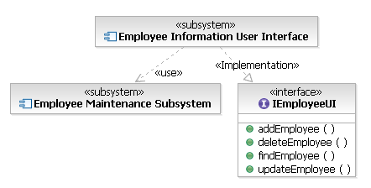
Component Diagram
It shows the runtime structure of the system at the level of software components. Components are the modular parts of the system and are made up of groups of related objects that are hidden behind an external interface.
Component
Modular parts of the system
Class
Included to show implementation
relationships.
Notes:
Copyright 2005 IBM Corp.
Component diagrams show the runtime structure of the system at the level of software components. Components are the modular parts of the system and are made up of groups of related objects that are hidden behind an external interface.
Component notation is based on class notation, so a component can have attributes and operations.
Relationships among components can include connectors or dependencies.
The definition of “component” has changed for UML 2.0. Components are no longer just code files, DLLs, and so on.
Notice that the notation for a component diagram has changed and that a class box with the «component» keyword can now also be used to represent a component.

Slide 29
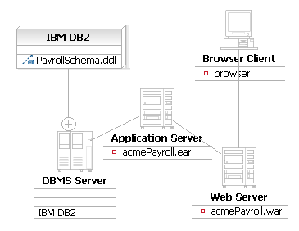
Deployment Diagram
Deployment diagrams show the deployment architecture of the system, that is, which of the system’s software artifacts reside on which pieces of hardware.
Artifact
Represents a physical file
Owned Element
Relationship
Shows another way of
showing nested elements
Node
Represents a
physical machine
Notes:
Copyright 2005 IBM Corp.
Deployment diagrams show the deployment architecture of the system, that is, which of the system’s software artifacts reside on which pieces of hardware.
Deployment diagrams display the following model elements:
Artifacts: Represent physical files (executable files, binaries, archives, and so on). In previous versions of UML, artifacts were called “components.”
Nodes: Represent any physical machine that can host software, such as a server or workstation. A node could also be used to model deployment to a virtual machine, for example, used as a test environment.

Slide 30
How Many Diagrams Need to be Created?
Depends:
  You use diagrams to visualize the system from different perspectives.
  No complex system can be understood in its entirety from one perspective.
  Diagrams are used for communication
Model elements will appear on one or more diagrams.
  For example, a class may appear on one or more class diagrams, be represented in a state machine diagram, and have instances appear on a sequence diagram.
  Each diagram will provide a different perspective.
Notes:
Copyright 2005 IBM Corp.
Good diagrams make the system you are developing understandable and approachable. Choosing the right set of diagrams to model your system forces you to ask the right questions about your system and helps to illuminate the implications of your design.
In Software Architect, one interaction diagram type can be generated automatically from another. If you have a sequence diagram under an interaction and add a communication diagram, Software Architect will automatically populate the communication diagram with the correct interactions.

Slide 31
References
Rational Unified Process® course
Essentials of Rational Unified Process®
  Essentials of Rational® RequisitePro®
    Web-based or Instructor-led training
  Mastering Business Modeling with the UML
Web sites
  Rational’s corporate site: www.rational.com
  Rational Developer NetworkSM: www.rational.net
Books and articles about requirements management
Notes:
Copyright 2005 IBM Corp.
There are many other sources of information about requirements management, including the sources listed here. Students who want more information about related topics should consider attending courses about the Rational Unified Process, Business Modeling, or RequisitePro.
Students who want to learn more about how to realize a use-case model and requirements in an object-oriented design should consider taking the Essentials of Visual Modeling with the UML or the Mastering Object-Oriented Analysis and Design courses.
Students who want to learn more about making reports that draw from the RequisitePro and Rational Rose repositories should consider taking a course in Rational SoDA® (Software Documentation Automation).
Students who want to learn more about quality testing from the beginning should consider taking Principles of Software Testing for Testers. Rational also offers courses on our automated testing tools that cover functional, performance, and embedded software testing.
Kurt Bittner and Ian Spence have written an excellent book that truly captures the essence of developing use cases. This book is a “must have” for anyone developing use cases. The book details are: Use Case Modeling, Kurt Bittner and Ian Spence, Addison Wesley, 2002, ISBN: 0-201-70913-9.
Dean Leffingwell and Don Widrig have written an excellent book on requirements management. The book details are: Managing Software Requirements a Unified Approach, D. Leffingwell and D. Widrig, Addison Wesley, 1999, ISBN: 0-201-61593-2.
Visit www.omg.org to learn more information about the UML.

Slide 32
THANK YOU

