Slide 1
Java 8
Parameswari Ettiappan

Slide 2
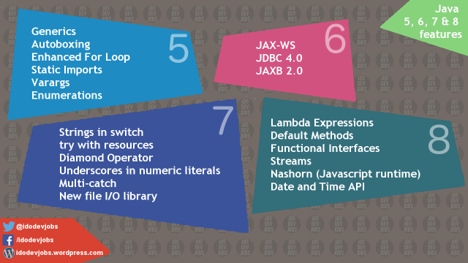

Slide 3
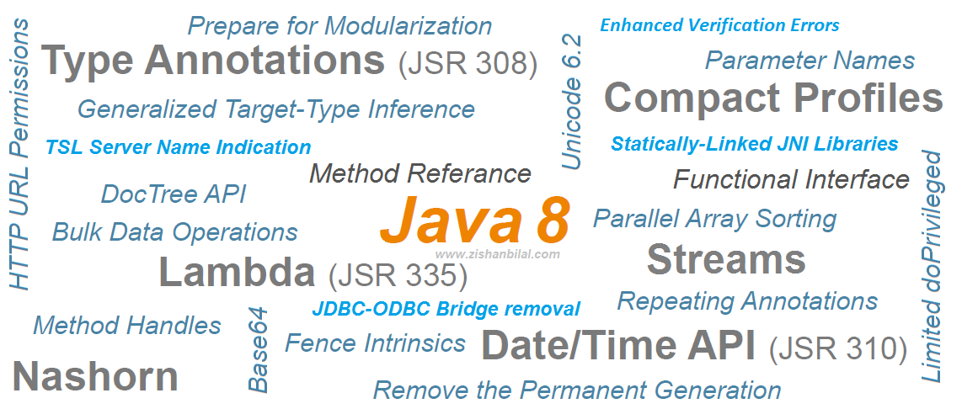

Slide 4
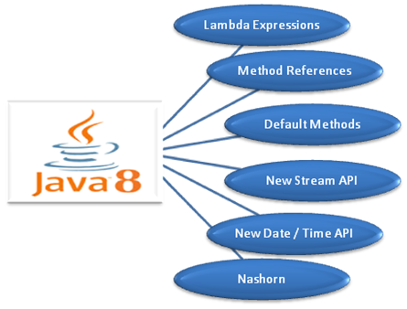

Slide 5
Java 8 Features
Java Programming Languages
Lambda Expressions, a new language feature
Method references provide easy-to-read lambda expressions for methods that already have a name.
Default methods enable new functionality to be added to the interfaces of libraries and ensure binary compatibility with code written for older versions of those interfaces.
Repeating Annotations provide the ability to apply the same annotation type more than once to the same declaration or type use.
Type Annotations provide the ability to apply an annotation anywhere a type is used, not just on a declaration. Used with a pluggable type system, this feature enables improved type checking of your code.
Improved type inference.
Method parameter reflection.

Slide 6
Java 8 Features
Collections
Classes in the new java.util.stream package provide a Stream API to support functional-style operations on streams of elements.
The Stream API is integrated into the Collections API, which enables bulk operations on collections, such as sequential or parallel map-reduce transformations.
Performance Improvement for HashMaps with Key Collisions

Slide 7
Java 8 Features
Concurrency
Classes and interfaces have been added to the java.util.concurrent package.
Methods have been added to the java.util.concurrent.ConcurrentHashMap class to support aggregate operations based on the newly added streams facility and lambda expressions.
Classes have been added to the java.util.concurrent.atomic package to support scalable updatable variables.

Slide 8
Java 8 Features
Concurrency
Methods have been added to the java.util.concurrent.ForkJoinPool class to support a common pool.
The java.util.concurrent.locks.StampedLock class has been added to provide a capability-based lock with three modes for controlling read/write access.

Slide 9
Java 8 Features
Networking
The class java.net.URLPermission has been added.
In the class java.net.HttpURLConnection, if a security manager is installed, calls that request to open a connection require permission.

Slide 10
Java 8 Features
JDBC
The JDBC-ODBC Bridge has been removed.
JDBC 4.2 introduces new features.
Java DB
JDK 8 includes Java DB 10.10.

Slide 11
Java 8 Features
HotSpot
Hardware intrinsics were added to use Advanced Encryption Standard (AES).
The UseAES and UseAESIntrinsics flags are available to enable the hardware-based AES intrinsics for Intel hardware.
The hardware must be 2010 or newer Westmere hardware. For example, to enable hardware AES, use the following flags:
-XX:+UseAES -XX:+UseAESIntrinsics

Slide 12
Java 8 Features
HotSpot
To disable hardware AES use the following flags:
-XX:-UseAES -XX:-UseAESIntrinsics
Removal of PermGen.
Default Methods in the Java Programming Language are supported by the byte code instructions for method invocation.

Slide 13
Java 8 Features
Compact Profiles contain predefined subsets of the Java SE platform and enable applications that do not require the entire Platform to be deployed and run on small devices.

Slide 14
Java 8 Features
Security
client-side TLS 1.2 enabled by default
New variant of AccessController.doPrivileged that enables code to assert a subset of its privileges, without preventing the full traversal of the stack to check for other permissions
Stronger algorithms for password-based encryption
SSL/TLS Server Name Indication (SNI) Extension support in JSSE Server

Slide 15
Java 8 Features
Security
Support for AEAD algorithms
KeyStore enhancements, including the new Domain KeyStore type java.security.DomainLoadStoreParameter, and the new command option -importpassword for the keytool utility
SHA-224 Message Digests
Enhanced Support for NSA Suite B Cryptography
Better Support for High Entropy Random Number Generation

Slide 16
Java 8 Features
Security
New java.security.cert.PKIXRevocationChecker class for configuring revocation checking of X.509 certificates
64-bit PKCS11 for Windows
New rcache Types in Kerberos 5 Replay Caching

Slide 17
Java 8 Features
Security
Support for Kerberos 5 Protocol Transition and Constrained Delegation
Kerberos 5 weak encryption types disabled by default
Unbound SASL for the GSS-API/Kerberos 5 mechanism
SASL service for multiple host names

Slide 18
Java 8 Features
Security
JNI bridge to native JGSS on Mac OS X
Support for stronger strength ephemeral DH keys in the SunJSSE provider
Support for server-side cipher suites preference customization in JSSE

Slide 19
Java 8 Features
JavaFX
The new SwingNode class enables developers to embed Swing content into JavaFX applications.
The new UI Controls include the DatePicker and the TreeTableView controls.
The javafx.print package provides the public classes for the JavaFX Printing API.

Slide 20
Java 8 Features
JavaFX
The 3D Graphics features now include 3D shapes, camera, lights, subscene, material, picking, and antialiasing.
The WebView class provides new features of HTML5 including Web Sockets, Web Workers, and Web Fonts.
Enhanced text support including bi-directional text and complex text scripts such as Thai and Hindi in controls, and multi-line, multi-style text in text nodes.
Support for Hi-DPI displays has been added in this release.

Slide 21
Java 8 Features
JavaFX
The CSS Styleable* classes became public API.
The new ScheduledService class allows to automatically restart the service.
JavaFX is now available for ARM platforms. JDK for ARM includes the base, graphics and controls components of JavaFX.

Slide 22
Java 8 Features
Tools
The jjs command is provided to invoke the Nashorn engine.
The java command launches JavaFX applications.
The java man page has been reworked.

Slide 23
Java 8 Features
Tools
The jdeps command-line tool is provided for analyzing class files.
Java Management Extensions (JMX) provide remote access to diagnostic commands.
The jarsigner tool has an option for requesting a signed time stamp from a Time Stamping Authority (TSA).

Slide 24
Java 8 Features
Javac tool
The javac tool now has support for checking the content of javadoc comments for issues that could lead to various problems, such as invalid HTML or accessibility issues, in the files that are generated when javadoc is run.
Javadoc tool
The javadoc tool supports the new DocTree API that enables you to traverse Javadoc comments as abstract syntax trees.
The javadoc tool supports the new Javadoc Access API that enables you to invoke the Javadoc tool directly from a Java application, without executing a new process.

Slide 25
Java 8 Features
Internationalization
Unicode Enhancements, including support for Unicode 6.2.0
Adoption of Unicode CLDR Data and the java.locale.providers System Property
New Calendar and Locale APIs
Ability to Install a Custom Resource Bundle as an Extension

Slide 26
Java 8 Features
Deployment
For sandbox applets and Java Web Start applications, URLPermission is now used to allow connections back to the server from which they were started. SocketPermission is no longer granted.
The Permissions attribute is required in the JAR file manifest of the main JAR file at all security levels.

Slide 27
Java 8 Features
Date-Time Package - a new set of packages that provide a comprehensive date-time model.
Scripting
Nashorn Javascript Engine
Pack200
Pack200 Support for Constant Pool Entries and New Bytecodes Introduced by JSR 292
JDK8 support for class files changes specified by JSR-292, JSR-308 and JSR-335

Slide 28
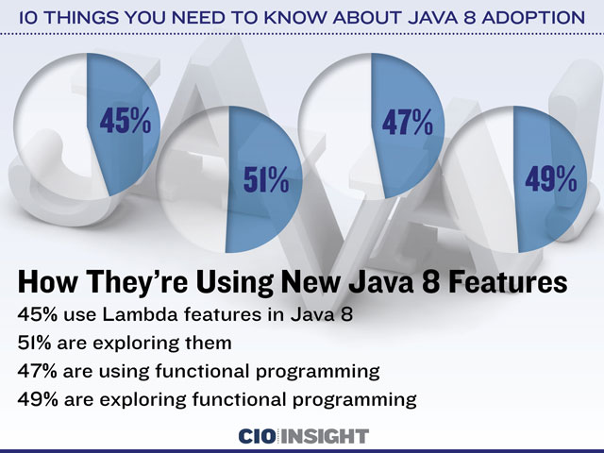

Slide 29
Lambda Expressions
A lambda expression is an unnamed block of code (or an unnamed function) with a list of formal parameters and a body.
Sometimes a lambda expression is simply called a lambda.
The body of a lambda expression can be a block statement or an expression.
An arrow (->) is used to separate the list of parameters and the body.
The term “lambda” in "lambda expression" has its origin in Lambda calculus that uses the Greek letter lambda (l) to denote a function abstraction.

Slide 30
Lambda Expressions

Slide 31
Lambda Expressions

Slide 32
Lambda Expressions
// Takes an int parameter and returns the parameter value incremented by 1
(int x) -> x + 1
// Takes two int parameters and returns their sum
(int x, int y) -> x + y
// Takes two int parameters and returns the maximum of the two
(int x, int y) -> { int max = x > y ? x : y;
return max;
}
// Takes no parameters and returns void
() -> { }

Slide 33
Lambda Expressions
// Takes no parameters and returns a string "OK"
() -> "OK"
// Takes a String parameter and prints it on the standard output
(String msg) -> { System.out.println(msg); }
// Takes a parameter and prints it on the standard output
msg -> System.out.println(msg)
// Takes a String parameter and returns its length
(String str) -> str.length()

Slide 34
Why Do We Need Lambda Expressions
A lambda expression is a block of code that can be passed around to execute.
It is a common feature for some programming languages, such as Lisp, Python, Scala, etc.
But before Java 8, we can not do the same in Java.
If we want a block of code to be executed, we need to create an object and pass the object around, such as using the strategy design pattern.
From Java 8, lambda expressions enable us to treat functionality as method argument and pass a block of code around.

Slide 35
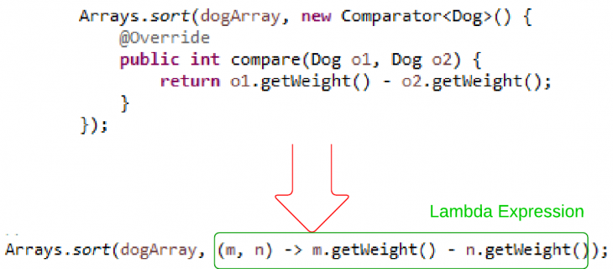
Why Do We Need Lambda Expressions

Slide 36
Syntax for Lambda Expressions
(<LambdaParametersList>) -> { <LambdaBody> }
A lambda expression consists of a list of parameters and a body that are separated by an arrow (->).
The list of parameters is declared the same way as the list of parameters for methods.
The list of parameters is enclosed in parentheses, as is done for methods.
The body of a lambda expression is a block of code enclosed in braces.
Like a method's body, the body of a lambda expression may declare local variables;
use statements including break, continue, and return; throw exceptions, etc.

Slide 37
Syntax for Lambda Expressions
Unlike a method, a lambda expression does not have four parts.
A lambda expression does not have a name.
• A lambda expression does not have a return type.
It is inferred by the compiler from the context of its use and from its body.
• A lambda expression does not have a throws clause. It is inferred from the context of its use and its body.
• A lambda expression cannot declare type parameters. That is, a lambda expression
cannot be generic.

Slide 38
Omitting Parameter Types
You can omit the declared type of the parameters.
The compiler will infer the types of parameters from the context in which the lambda expression is used.
// Types of parameters are declared
(int x, int y) -> { return x + y; }
// Types of parameters are omitted
(x, y) -> { return x + y; }

Slide 39
Omitting Parameter Types
// A compile-time error
(int x, y) -> { return x + y; }

Slide 40
Declaring a Single Parameter
// Declares the parameter type
(String msg) -> { System.out.println(msg); }
// Omits the parameter type
(msg) -> { System.out.println(msg); }
// Omits the parameter type and parentheses
msg -> { System.out.println(msg); }

Slide 41
Declaring a Single Parameter
The following lambda expression will not compile:
// Omits parentheses, but not the parameter type, which is not allowed.
String msg -> { System.out.println(msg); }

Slide 42
Declaring No Parameters
If a lambda expression does not take any parameters, you need to use empty parentheses.
// Takes no parameters
() -> { System.out.println("Hello"); }
It is not allowed to omit the parentheses when the lambda expression takes no parameter.
The following declaration will not compile:
-> { System.out.println("Hello"); }

Slide 43
Parameters with Modifiers
You can use modifiers, such as final, in the parameter declaration for explicit lambda expressions. The following two
lambda expressions are valid:
(final int x, final int y) -> { return x + y; }
(int x, final int y) -> { return x + y; }
The following lambda expression will not compile because it uses the final modifier in parameter declarations, but omits the parameter type:
(final x, final y) -> { return x + y; }

Slide 44
Declaring Body of Lambda Expressions
The body of a lambda expression can be a block statement or a single expression.
A block statement is enclosed in braces; a single expression is not enclosed in braces.
When a block statement is executed the same way as a method’s body.
A return statement or the end of the body returns the control to the caller of the lambda expression.
When an expression is used as the body, it is evaluated and returned to the caller.
If the expression evaluates to void, nothing is returned to the caller.
The following two lambda expressions are the same; one uses a block statement
and the other an expression:

Slide 45
Declaring Body of Lambda Expressions
// Uses a block statement. Takes two int parameters and returns their sum.
(int x, int y) -> { return x + y; }
// Uses an expression. Takes a two int parameters and returns their sum.
(int x, int y) -> x + y

Slide 46
Declaring Body of Lambda Expressions
The following two lambda expressions are the same; one uses a block statement as the body and the other an expression that evaluates to void:
// Uses a block statement
(String msg) -> { System.out.println(msg); }
// Uses an expression
(String msg) -> System.out.println(msg)

Slide 47
List of Functional Interfaces

Slide 48
Iterating with for each

Slide 49
iterating w/lambdas, type inference
List<Integer> numbers =
Arrays.asList(1, 2, 3, 4, 5, 6, 7, 8, 9, 10);
numbers.forEach(value -> System.out.println(value));

Slide 50
method references
List<Integer> numbers =
Arrays.asList(1, 2, 3, 4, 5, 6, 7, 8, 9, 10);
numbers.forEach(System.out::println);

Slide 51
transforms using map
List<Integer> numbers =
Arrays.asList(1, 2, 3, 4, 5, 6, 7, 8, 9, 10);
numbers.stream()
.map(value -> value * 2)
.forEach(System.out::println);

Slide 52
filtering
List<Integer> numbers =
Arrays.asList(1, 2, 3, 4, 5, 6, 7, 8, 9, 10);
numbers.stream()
.filter(value -> value % 2 == 0)
.forEach(System.out::println);

Slide 53
filtering v2
List<String> names = Arrays.asList(
"Bob", "Tom", "Jeff", "Scott", "Jennifer", "Steve");
final Function<String, Predicate<String>> startsWithLetter =
letter -> name -> name.startsWith(letter);
names.stream()
.filter(startsWithLetter.apply("J"))
.forEach(System.out::println);

Slide 54
Streams
Stream.iterate(1, number -> number + 1)
.map(number -> number * number)
.limit(25)
.forEach(number -> System.out.print(number + " "));
// 1 4 9 16 25 36 49 64 ... 529 576 625

Slide 55
finding with Optional
List<String> names = Arrays.asList(
"Bob", "Tom", "Jeff", "Scott", "Jennifer", "Steve");
Optional<String> firstS = names.stream()
.filter(name -> name.startsWith("S"))
.findFirst();
System.out.println(firstS.orElse("None found"));

Slide 56
reducers
List<String> names = Arrays.asList(
"Bob", "Tom", "Jeff", "Scott", "Jennifer", "Steve");
Optional<String> longestName = names.stream()
.reduce((name1, name2) ->
name1.length() >= name2.length() ? name1 : name2);
if (longestName.isPresent()) {
System.out.println(longestName.get());
}

Slide 57
sum reducer
List<Integer> numbers =
Arrays.asList(1, 2, 3, 4, 5, 6, 7, 8, 9, 10);
long sum =numbers.stream() .mapToInt(value->value*value).sum();
System.out.println(sum);

Slide 58
parallelization
numbers.parallelStream()
.filter(number -> isPerfect(number))
.forEach(System.out::println);

Slide 59
Iterating with foreach
List<Integer> numbers =
Arrays.asList(1, 2, 3, 4, 5, 6, 7, 8, 9, 10);
numbers.forEach(new Consumer<Integer>() {
@Override
public void accept(Integer integer) {
System.out.println(integer);
}
});

Slide 60
Threads

Slide 61
Threads

Slide 62
Threads
Process = address space + resources + threads

Slide 63
Object Monitor

Slide 64
New Thread Concurrency Packages
The package java.util.concurrent and its two subpackages,
java.util.concurrent.atomic and
java.util.concurrent.locks,

Slide 65
New Thread Concurrency Packages
We can broadly categorize these concurrency features into four categories:
• Atomic variables
• Locks
• Synchronizers
• Concurrent collections

Slide 66
Atomic Variables
To share an updateable variable among threads, synchronization is used.
Synchronization among multiple threads used to be achieved using the synchronized keyword and it was based on an object’s monitor.
If a thread is not able to acquire an object’s monitor, that thread is suspended and it has to be resumed later.
This way of synchronization (suspending and resuming) uses a great deal of system resources.
The problem is not in the locking and unlocking mechanism of the monitor lock; rather it is in suspending and resuming the threads.
If there is no contention for acquiring a lock, using the keyword synchronized to synchronize threads does not hurt much.

Slide 67
Atomic Variables
An atomic variable uses a lock-free synchronization of a single variable.
If program needs to synchronize on more than one shared variable, you still need to use the old synchronization methods.
By lock-free synchronization, multiple threads can access a shared variable safely using no object monitor lock.
JDK takes advantage of a hardware instruction called “compare-and-swap" (CAS) to implement the lock-free synchronization for one variable.

Slide 68
Atomic Variables
CAS is based on three operands: a memory location M, an expected old value O, and a new value N.
If the memory location M contains a value O, CAS updates it atomically to N; otherwise, it does not do anything.
CAS always returns the current value at the location M that existed before the CAS operation started.

Slide 69
Atomic Variables
CAS(M, O, N) {
currentValueAtM = get the value at Location M;
if (currentValueAtM == O) {
set value at M to N;
}
return currentValueAtM;
}

Slide 70
Atomic Variables
CAS takes an optimistic approach by assuming that there are no other threads updating the value at location M; if the location M contains value O, update it to N;
if the value at location M is not O, do not do anything.
Therefore, if multiple threads attempt to update the value at location M
to different values simultaneously, only one thread will succeed and others will fail.
The synchronization using locks takes a pessimistic approach by assuming that other threads may be working with location M and acquires a lock before it starts working at location M, so that other threads will not access location M while one is working with it.

Slide 71
Atomic Variables
Atomic variable classes are named like AtomicXxx, and can be used to execute multiple instructions on a single variable atomically without using any lock.
Here, Xxx is replaced with different words to indicate different classes that are used for different purposes; for example, the AtomicInteger class is used to represent an int variable, which is supposed to be manipulated atomically.
Twelve classes in the Java class library support read-modify-write operations on a single variable atomically.
They are in the java.util.concurrent.atomic package.

Slide 72
Atomic Variables
They can be classified into
1. Scalar
2. Array Classes
3. Field Updater
4.Compound Variable Classes

Slide 73
Atomic Variables
Scalar Variables
The AtomicInteger, AtomicLong, and AtomicBoolean classes support operations on primitive data types int, long, and boolean, respectively.
If you need to work with other primitive data types, use the AtomicInteger class.
You can use it directly to work with byte and short data types.
Atomic Arrays Classes
There are three classes called AtomicIntegerArray, AtomicLongArray, and AtomicReferenceArray that represent an array of int, long, and reference types whose elements can be updated atomically.

Slide 74
Atomic Variables
Atomic Field Updater Classes
There areThere are three classes called AtomicLongFieldUpdater, tomicIntegerFieldUpdater, and AtomicReferenceFieldUpdater that can be used to update a volatile field of a class atomically using reflection.
These classes have no constructors. To get a reference to an object of these classes, you need to use their factory method called newUpdater().
Atomic Compound Variable Classes
CAS works by asking “Is the value at location M still O?” If the answer is yes, it updates the value at location M from O to N. In a typical scenario, one thread may read the value from location M as O. By the time this thread tries to update the value from O to N, another thread has changed the value at location M from O to P, and back from P to O.

Slide 75
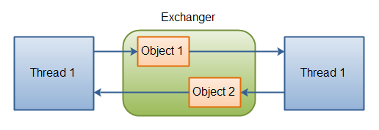
Exchanger

Slide 76
Concurrent hash map
Property | HashMap | Hashtable | ConcurrentHashMap
Null values/keys | allowed | not allowed | not allowed
Is thread-safe | no | yes | yes
Lock mechanism | Not applicable | Locks the whole map | Locks the portion
Iterator | fail-fast | fail-fast | fail-safe

Slide 77
Concurrent hash map
ConcurrentHashMap
You should use ConcurrentHashMap when you need very high concurrency in your project.
It is thread safe without synchronizing the whole map.
Reads can happen very fast while write is done with a lock.
There is no locking at the object level.
The locking is at a much finer granularity at a hashmap bucket level.
ConcurrentHashMap doesn’t throw a ConcurrentModificationException if one thread tries to modify it while another is iterating over it.
ConcurrentHashMap uses multitude of locks.

Slide 78
Synchronized hash map
SynchronizedHashMap
Synchronization at Object level.
Every read/write operation needs to acquire lock.
Locking the entire collection is a performance overhead.
This essentially gives access to only one thread to the entire map & blocks all the other threads.
It may cause contention.
SynchronizedHashMap returns Iterator, which fails-fast on concurrent modification.

Slide 79
Date API
Class | Description
LocalDate | a date, without time of day, offset or zone
LocalTime | the time of day, without date, offset or zone
LocalDateTime | the date and time, without offset or zone
OffsetDate | a date with an offset such as +02:00, without time of day or zone
OffsetTime | the time of day with an offset such as +02:00, without date or zone
OffsetDateTime | the date and time with an offset such as +02:00, without a zone

Slide 80
Date API
ZonedDateTime | the date and time with a time zone and offset
YearMonth | a year and month
MonthDay | month and day
Year/MonthOfDay/DayOfWeek/... | classes for the important fields
DateTimeFields | stores a map of field-value pairs which may be invalid
Calendrical | access to the low-level API
Period | a descriptive amount of time, such as "2 months and 3 days"

Slide 81
Nashorn and Shell Scripting
>jjs
Jjs>print (‘Hello Trainees’);

Slide 82
Java 8: From PermGen to Metaspace
Metaspace: A new memory space is born
The JDK 8 HotSpot JVM is now using native memory for the representation of class metadata and is called Metaspace; similar to the Oracle JRockit and IBM JVM's.
No more java.lang.OutOfMemoryError: PermGen space problems and no need for you to tune and monitor this memory space anymore…not so fast.

Slide 83
Java 8: From PermGen to Metaspace
PermGen space situation
This memory space is completely removed.
The PermSize and MaxPermSize JVM arguments are ignored and a warning is issued if present at start-up.
Metaspace memory allocation model
Most allocations for the class metadata are now allocated out of native memory.
The classes that were used to describe class metadata have been removed.

Slide 84
Java 8: From PermGen to Metaspace
Metaspace capacity
By default class metadata allocation is limited by the amount of available native memory (capacity will of course depend if you use a 32-bit JVM vs. 64-bit along with OS virtual memory availability).
A new flag is available (MaxMetaspaceSize), allowing you to limit the amount of native memory used for class metadata.
If you don’t specify this flag, the Metaspace will dynamically re-size depending of the application demand at runtime.

Slide 85
Java 8: From PermGen to Metaspace
Metaspace garbage collection
Garbage collection of the dead classes and classloaders is triggered once the class metadata usage reaches the “MaxMetaspaceSize”.
Proper monitoring & tuning of the Metaspace will obviously be required in order to limit the frequency or delay of such garbage collections.
Excessive Metaspace garbage collections may be a symptom of classes, classloaders memory leak or inadequate sizing for your application.

Slide 86
Java 8: From PermGen to Metaspace
Java heap space impact
Some miscellaneous data has been moved to the Java heap space. This means you may observe an increase of the Java heap space following a future JDK 8 upgrade.
Metaspace monitoring
Metaspace usage is available from the HotSpot 1.8 verbose GC log output.
Jstat & JVisualVM have not been updated at this point based on our testing with b75 and the old PermGen space references are still present.

Slide 87
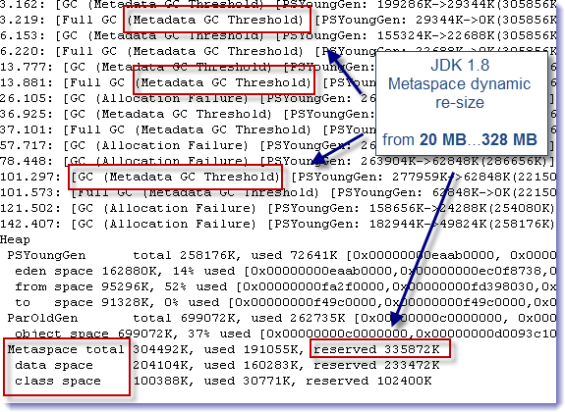

Slide 88
Annotations
Java 5 Annotations
public class Manager extends Employee {
@Override
public void setSalary(int salary) {
System.out.println("Manager.setSalary():" + salary);
}
}

Slide 89
Declaring an Annotation Type
<modifiers> @ interface <annotation-type-name> {
// Annotation type body goes here
}

Slide 90
Restriction #1
An annotation type cannot inherit from another annotation type
// Won't compile
public @interface WrongVersion extends BasicVersion {
int extended();
}

Slide 91
Every annotation type implicitly inherits the java.lang.annotation.Annotation interface
package java.lang.annotation;
public interface Annotation {
boolean equals(Object obj);
int hashCode();
String toString();
Class<? extends Annotation> annotationType();
}

Slide 92
Restriction #2
Method declarations in an annotation type cannot specify any parameters.
A method declares an element for the annotation type.
An element in an annotation type lets you associate a data value to an annotation’s instance.
A method declaration in an annotation is not called to perform any kind of processing.

Slide 93
Restriction #2
An element as an instance variable in a class having two methods, a setter and a getter, for that instance variable.
For an annotation, the Java runtime creates a proxy class that implements the annotation type (which is an interface).
Each annotation instance is an object of that proxy class.
The method you declare in your annotation type becomes the getter method for the value of that element you specify in the annotation.
The Java runtime will take care of setting the specified value for the annotation elements. Since the goal of declaring a method in an annotation type is to work with a data element, you do not need to (and are not allowed to) specify any parameters in a method declaration.

Slide 94
Restriction #2
// Won't compile
public @interface WrongVersion {
// Cannot have parameters
String concatenate(int major, int minor);
}

Slide 95
Restriction #3
Method declarations in an annotation type cannot have a throws clause.
A method in an annotation type is defined to represent a data element.
Throwing an exception to represent a data value does not make sense.
// Won't compile
public @interface WrongVersion {
int major() throws Exception; // Cannot have a throws clause
int minor(); // OK
}

Slide 96
Restriction #4
The return type of a method declared in an annotation type must be one of the following types:
• Any primitive type: byte, short, int, long, float, double, boolean, and char
• java.lang.String
• java.lang.Class
• An enum type
• An annotation type
• An array of any of the above mentioned type, for example, String[], int[], etc. The return
type cannot be a nested array. For example, you cannot have a return type of String[][] or
int[][].

Slide 97
Restriction #4
public @interface GoodOne {
Class element1(); // Any Class type
Class<Test> element2(); // Only Test class type
Class<? extends Test> element3(); // Test or its subclass type
}
The return type of Class needs a little explanation. Instead of the Class type, you can use a generic return type that will return a user-defined class type.
Suppose you have a Test class and you want to declare the return type of a method in an annotation type of type Test.

Slide 98
Restriction #5
An annotation type cannot declare a method, which would be equivalent to overriding a method in the Object class or the Annotation interface.

Slide 99
Restriction #6
An annotation type cannot be generic.

Slide 100
Default Value of an Annotation Element
<modifiers> @interface <annotation type name> {
<data-type> <element-name>() default <default-value>;
}
public @interface Version {
int major();
int minor() default 0; // Set zero as default value for minor
}

Slide 101
Default Value of an Annotation Element
@Version(major=1) // minor is zero, which is its default value
@Version(major=2) // minor is zero, which is its default value
@Version(major=2, minor=1) // minor is 1, which is the specified value
// Shows how to assign default values to elements of different types
public @interface DefaultTest {
double d() default 12.89;
int num() default 12;
int[] x() default {1, 2};
String s() default "Hello";
String[] s2() default {"abc", "xyz"};
Class c() default Exception.class;
Class[] c2() default {Exception.class, java.io.IOException.class};
}

Slide 102
Annotation Type and Its Instances
Version v = null; // Here, Version is an annotation type
A Class Implementing an Annotation Type
// DoNotUseIt.java
package com.jdojo.annotation;
import java.lang.annotation.Annotation;
public class DoNotUseIt implements Version {
// Implemented method from the Version annotation type
@Override
public int major() {
return 0;
}

Slide 103
Annotation Type and Its Instances
// Implemented method from the Version annotation type
@Override
public int minor() {
return 0;
}
// Implemented method from the Annotation annotation type,
// which is the supertype of the Version annotation type
@Override
public Class<? extends Annotation> annotationType() {
return null;
}

Slide 104
Using Annotations
public @interface PrimitiveAnnTest {
byte a();
short b();
int c();
long d();
float e();
double f();
boolean g();
char h();
}
@PrimitiveAnnTest(a=1, b=2, c=3, d=4, e=12.34F, f=1.89, g=true, h='Y')

Slide 105
String Types
public @interface Name {
String first();
String last();
}
@Name(first="John", last="Jacobs")
public class NameTest {
@Name(first="Wally", last="Inman")
public void aMethod() {
// More code goes here...
}
}

Slide 106
Class Types
public class DefaultException extends java.lang.Throwable {
public DefaultException() {
}
public DefaultException(String msg) {
super(msg);
}
}

Slide 107
Class Types
@Retention(RetentionPolicy.RUNTIME)
@Target(ElementType.METHOD)
public @interface TestCase {
Class<? extends Throwable> willThrow() default DefaultException.class;
}

Slide 108
Enum Type
public @interface Review {
ReviewStatus status() default ReviewStatus.PENDING;
String comments() default "";
// ReviewStatus enum is a member of the Review annotation type
public enum ReviewStatus {PENDING, FAILED, PASSED, PASSEDWITHCHANGES};
}

Slide 109
Enum Type
@Review()
// Leave status as Pending, but add some comments
@Review(comments="Have scheduled code review on June 3 2014")
// Fail the review with comments
@Review(status=ReviewStatus.FAILED, comments="Need to handle errors")

Slide 110
Annotation Type
public @interface Description {
Name name();
Version version();
String comments() default "";
}

Slide 111
Annotation Type
@Description(name=@Name(first="John", last="Jacobs"),
version=@Version(major=1, minor=2),
comments="Just a test class")
public class Test {
// Code goes here
}

Slide 112
Array Type Annotation Element
public @interface ToDo {
String[] items();
}
@ToDo(items={"Add readFile method", "Add error handling"})
public class Test {
// Code goes here
}

Slide 113
No Null Value in an Annotation
Using the following annotations will
result in compile-time errors:
@ToDo(items=null)
@Name(first=null, last="Jacobs")

Slide 114
Shorthand Annotation Syntax
public @interface Enabled {
boolean status() default true;
}
@Enabled
public class Test {
// Code goes here
}
@Enabled()
public class Test {
// Code goes here
}

Slide 115
Marker Annotation Types
public @interface Marker {
// No element declarations
}
A marker annotation type is an annotation type that does not declare any elements, not even one with a default value.
Typically, a marker annotation is used by the annotation processing tools, which generate boilerplate code based on the marker annotation type.

Slide 116
Marker Annotation Types
@Marker
public class Test {
// Code goes here
}

Slide 117
Meta-Annotation Types
Meta-annotations types are annotation types, which are used to annotate other annotation types.
The following annotation types are meta-annotation types:
• Target
• Retention
• Inherited
• Documented
• Repeatable
• Native
Meta-annotation types are part of the Java class library. They are declared in the package java.lang.annotation.

Slide 118
The Target Annotation Type

Slide 119
The Retention Annotation
An annotation can be retained at three levels.
• Source code only
• Class file only (the default)
• Class file and the runtime

Slide 120
The Retention Annotation
The Retention meta-annotation type is used to specify how an annotation instance of an annotation type should be retained by Java.
This is also known as the retention policy of an annotation type. If an annotation type has a “source code only” retention policy, instances of its type are removed when compiled into a class file.
If the retention policy is “class file only,” annotation instances are retained in the class file, but they cannot be read at runtime.
If the retention policy is “class file and runtime” (simply known as runtime), the annotation instances are retained in the class file and they are available for reading at runtime

Slide 121
The Inherited Annotation Type
The Inherited annotation type is a marker meta-annotation type.
If an annotation type is annotated with an Inherited meta-annotation, its instances are inherited by a subclass declaration.
It has no effect if an annotation type is used to annotate any program elements other than a class declaration.

Slide 122
The Inherited Annotation Type
public @interface Ann2 {
int id();
}
@Inherited
public @interface Ann3 {
int id();
}
Let’s declare two classes, A and B, as follows. Note that class B inherits class A.
@Ann2(id=505)
@Ann3(id=707)
public class A {
// Code for class A goes here
}

Slide 123
The Inherited Annotation Type
// Class B inherits Ann3(id=707) annotation from the class A
public class B extends A {
// Code for class B goes here
}

Slide 124
The Documented Annotation
The Documented annotation type is a marker meta-annotation type.
If an annotation type is annotated with a Documented annotation, the Javadoc tool will generate documentation for all of its instances.

Slide 125
The Repeatable Annotation
Prior to Java 8, it was not allowed to repeat an annotation in the same context. For example, the following repeated use
of the Version annotation would generate a compile-time error:
@Version(major=1, minor=1)
@Version(major=1, minor=2)
public class Test {
// Code goes here
}

Slide 126
Commonly Used Standard Annotations
Java API defines many standard annotation types.
They are defined in the java.lang package.
They are
• Deprecated
• Override
• SuppressWarnings
• FunctionalInterface

Slide 127
The FunctionalInterface Annotation Type
An interface with one abstract method declaration is known as a functional interface.
Previously, a functional interface was known as SAM (Single Abstract Method) type.
The compiler verifies all interfaces annotated with a @FunctionalInterface that the interfaces really contain one and only one abstract method.
A compile-time error is generated if the interfaces annotated with this annotation are not functional interfaces.
It is also a compile-time error to use this annotation on classes, annotation types, and enums.
The FunctionalInterface annotation type is a marker interface.

Slide 128
The FunctionalInterface
The following declaration of the Test class uses a @FunctionalInterface annotation, which will generate a compile-time error because a @FunctionalInterface annotation can only be used on interfaces.
@FunctionalInterface
public class Test {
public void test() {
// Code goes here
}
}

Slide 129
Annotating a Java Package
A package declaration appears as part of a top-level type declaration.
Further, the same package declaration occurs multiple times at different places.
Create a file, which should be named package-info.java, and place the annotated package declaration in it.
// package-info.java
@Version(major=1, minor=0)
package com.jdojo.annotation;

Slide 130
Annotating a Java Package
// package-info.java
@com.jdojo.myannotations.Author("John Jacobs")
@Reviewer("Wally Inman")
package com.jdojo.annotation;
import com.jdojo.myannotations.Reviewer;

