Slide 1
PCF and APIGEE
1. cf –h
2. cf login -a https://donotuseapi.run.pivotal.io
3. cf marketplace
3a. git clone https://github.com/apigee/cloud-foundry-apigee.git
3b. cd cloud-foundry-apigee/apigee-cf-service-broker
3c.cf push

Slide 2
PCF and APIGEE
cf set-env apigee-cf-service-broker SECURITY_USER_NAME <pick a username>
cf set-env apigee-cf-service-broker SECURITY_USER_PASSWORD <pick a password>
cf restage apigee-cf-service-broker
cf create-service-broker apigee-edge eswaribala vigneshbala https://apigee-cf-service-broker.cfapps.io/ --space-scoped
cf enable-service-access apigee-edge --→ skip this command
cf marketplace
cf marketplace -s apigee-edge

Slide 3
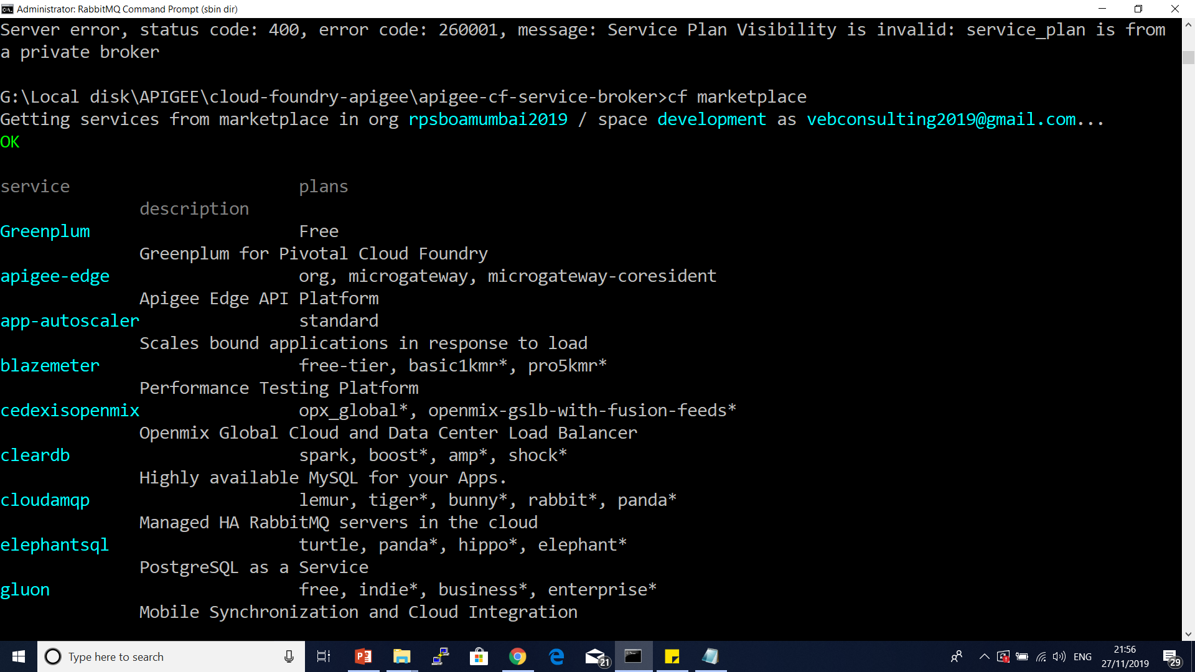

Slide 4
PCF and APIGEE
4. cf create-service apigee-edge org org -c "{\"org\":\“test-org\", \"env\":\"test\"}"
Refer apigee cloud founder service broker manifest.yml file
5. cf service org

Slide 5
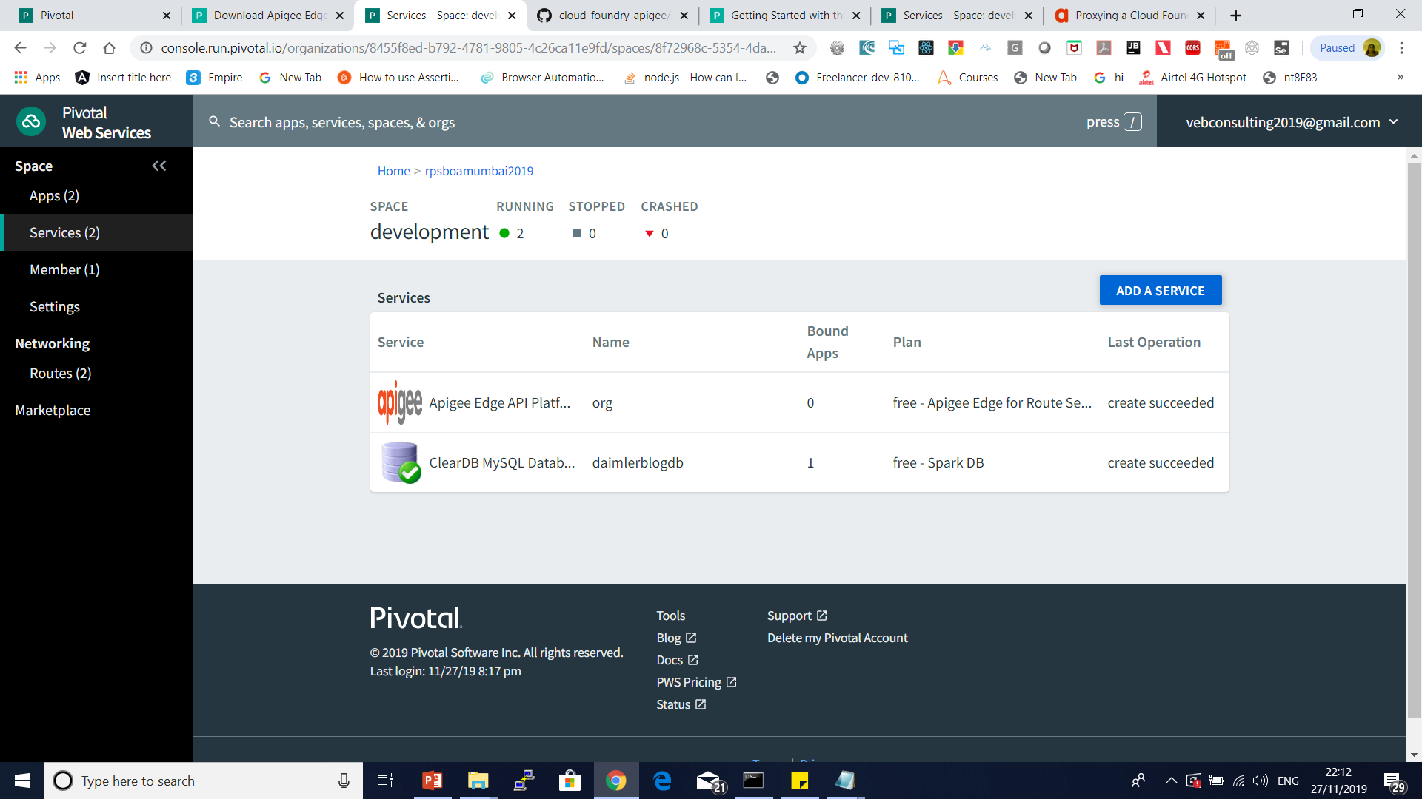

Slide 6
PCF and APIGEE
curl https://login.apigee.com/resources/scripts/sso-cli/ssocli-bundle.zip -o "ssocli-bundle.zip“
tar xvf ssocli-bundle.zip
Create a .sso-cli directory in your user directory
$ mkdir ~/.sso-cli
Run ./get_token from linux shell (use gitbash)
You may be prompted for your Apigee Edge username and password, and an MFA token.

Slide 7
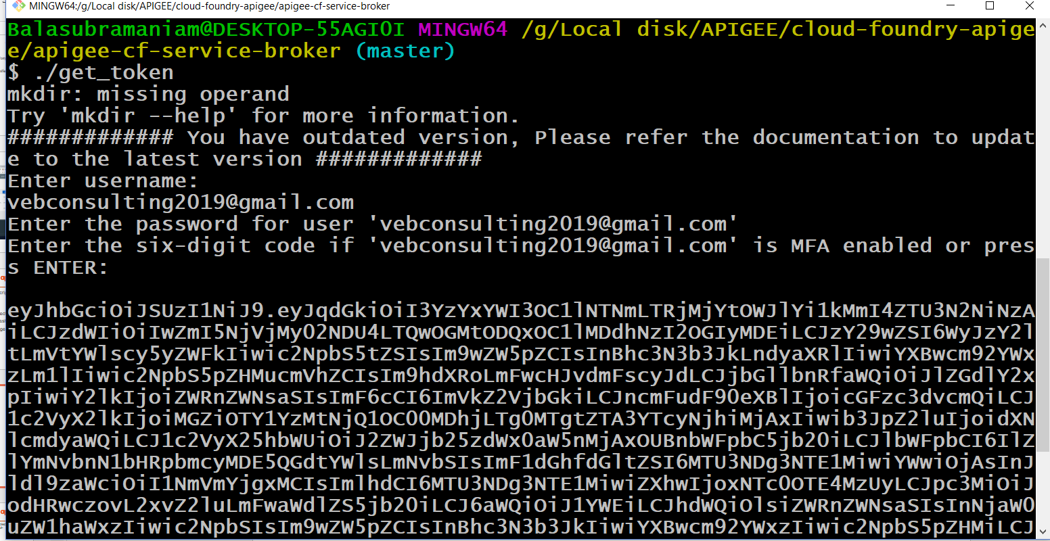

Slide 8
PCF and APIGEE
cf bind-route-service cfapps.io org --hostname daimlerblogapp2019-cf -c '{"org":“vebconsulting2019-eval","env":"test",
"bearer":"'$(cat ~./valid_token.dat)'",
"action":"proxy bind",
"protocol":"https"}'

