Slide 1
PCF and APIGEE
1. cf –h
2. cf login -a https://donotuseapi.run.pivotal.io
3. cf marketplace
3a. git clone https://github.com/apigee/cloud-foundry-apigee.git
3b. cd cloud-foundry-apigee/apigee-cf-service-broker
3c.cf push

Slide 2
PCF and APIGEE
cf set-env apigee-cf-service-broker SECURITY_USER_NAME <pick a username>
cf set-env apigee-cf-service-broker SECURITY_USER_PASSWORD <pick a password>
cf restage apigee-cf-service-broker
cf create-service-broker apigee-edge eswaribala vigneshbala https://apigee-cf-service-broker.cfapps.io/ --space-scoped
cf enable-service-access apigee-edge --→ skip this command
cf marketplace
cf marketplace -s apigee-edge

Slide 3
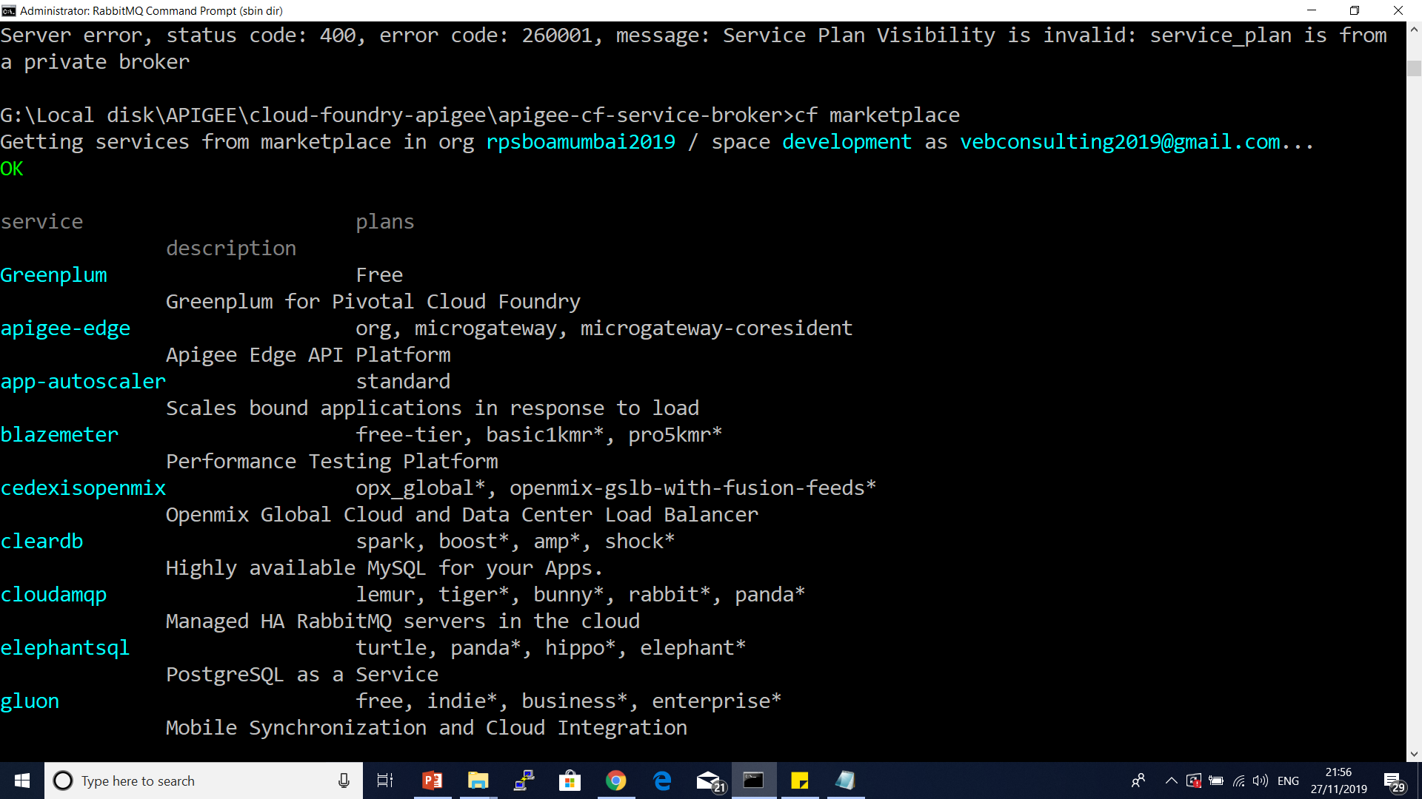

Slide 4
PCF and APIGEE
4. cf create-service apigee-edge org org -c "{\"org\":\“test-org\", \"env\":\"test\"}"
Refer apigee cloud founder service broker manifest.yml file
5. cf service org

Slide 5
