Slide 1
JCAPS 6.3
Parameswari Ettiappan

Slide 2
What's the Problem?
Accidental Architecture

Slide 3
Services-Oriented Architecture

Slide 4
IT is Limiting the Business

Slide 5
What is SOA?
Evolution of distributed computing and modular programming
Build applications out of software services that are:
Relatively large-grained (like: Fraud Detection, Payment Management, Trade Execution)
Intrinsically unassociated units of functionality (no embedded calls to other services)
Protocols are defined which describe how services can “talk” to each other
Relies on a business process expert to sequence services (orchestrate) to meet business needs

Slide 6
What is SOA?
Track-tested architectural style for building applications using services available in a network (“The Network is the Computer”)
Promotes loose-coupling between software components
Service implements a well-defined business functionality
Implementation is shielded by a public interface definition (signature / contract)
Services form building blocks of SOA applications
Composite applications can be built by aggregating services
Open standards have emerged to support web services implementation

Slide 7
How is SOA Being Implemented? Enterprise Service Bus (ESB)

Slide 8
How is SOA Being Implemented? ESB Value-Added Services

Slide 9
How is SOA Being Implemented? Slowly and Cautiously

Slide 10
SOA Technologies

Slide 11
REST Definition

Slide 12
SOA Technologies BPEL: Definition
XML-based language for formally describing business processes and business integration
Extends web service interactions to support orchestration and long running business transactions
History:
> Inspired by IBM’s Web Services Flow Language (WSFL) and Microsoft’s XLANG
> BPEL4WS (Business Process Execution Language for Web Services) was first conceived in July 2002 with the release of the BPEL4WS 1.0 specification, a joint effort by IBM, Microsoft and BEA
> Evolved into WS-BPEL 2.0 in April 2007, as a standard now managed by OASIS (Organization for the Advancement of Structured Information Standards)
Prerequisites for personal success:
> XML
> WSDL
> Programming experience

Slide 13
SOA Technologies BPEL: Definition

Slide 14
SOA Technologies BPEL: Definition

Slide 15
Java Business Integration (JBI)

Slide 16
Java Business Integration (JBI)

Slide 17
Java Business Integration (JBI)

Slide 23
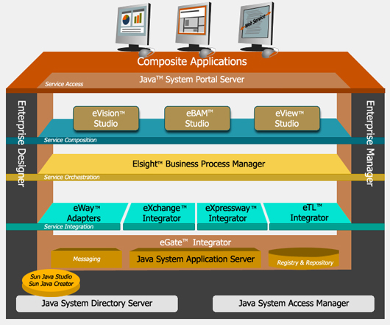

Slide 24
Java CAPS helps you to:
Connect securely to exchange business critical information with your partners, suppliers and customer organizations.
Integrate on to a common platform, all critical business data and fundamentally distinct or dissimilar applications among multiple independent business units to deliver real time information to partners, suppliers and customer.
Create an agile organization that reacts quickly to changing business conditions in real-time, by optimizing core internal and external business processes.

Slide 25
Oracle Fusion Middleware components
Infrastructure / Application server
Oracle Weblogic Server (WLS)
Oracle Application Server (IAS)
JRockit - a JVM whose functionality has now been merged to OpenJDK
Tuxedo (software)
Oracle Coherence
Oracle Service Registry - metadata registry
application-server security
Oracle Web Cache

Slide 26
Oracle Fusion Middleware components
Integration and process-management
BPEL Process Manager
Oracle Business Activity Monitoring (Oracle BAM) - Business activity monitoring (BAM)
business rules
Business Process Analysis Suite
Oracle BPM - Business process management
Oracle Data Integrator (ODI) - an application using the database for set-based data integration
Enterprise connectivity (adapters)
Oracle Enterprise Messaging Service
Oracle Enterprise Service Bus
Oracle Application server B2B
Oracle Web Services Manager (OWSM) - a security and monitoring product for web services

Slide 27
Oracle Fusion Middleware components
Application development tools
Oracle Application Development Framework (ADF)
JDeveloper
Oracle SOA Suite
TopLink - a Java object-relational mapping package
Oracle Forms services
Oracle Developer Suite

Slide 28
Oracle Fusion Middleware components
Business intelligence
Oracle Business Intelligence (OBIEE)
Oracle Crystal Ball - enables stochastic forecasting and simulation using spreadsheet models
Oracle Discoverer
Data hubs
Oracle BI Publisher
Oracle Reports services

Slide 29
Oracle Fusion Middleware components
Systems management
Oracle Enterprise Manager
Web services manager

Slide 30
Oracle Fusion Middleware components
User interaction / content management
Oracle Beehive - collaboration platform
Unified messaging
Workspaces
Oracle WebCenter
Oracle Imaging and Process Management
Web content management
Records management
Enterprise search
Digital asset management
Email archiving

Slide 31
Oracle Fusion Middleware components
Identity management
Oracle Identity Management
Enterprise Single sign-on
Oracle Entitlements Server
Oracle Identity Manager
Oracle Access Manager
Oracle Adaptive Access Manager
Oracle Virtual Directory

Slide 32
Oracle SOA Suite
Oracle BPEL Process Manager
Oracle Service Bus (OSB)
Oracle Event Processing
Oracle Web Services Manager, a security and monitoring product for web services
Oracle Business Rules, contains a JSR 94 Business rules engine
Oracle Business Activity Monitoring
Oracle Enterprise Service Bus (now known as the Mediator component)
Oracle JDeveloper

Slide 33
JAVA CAPS
Java Composite Application Platform Suite (CAPS or Java CAPS), is a standards-based Enterprise Service Bus software suite from Oracle Corporation.
Java CAPS was originally a product of SeeBeyond Technology Corporation named Integrated Composite Application Network Suite (ICAN).
It was renamed to Sun Java Composite Application Platform Suite (Java CAPS), after the acquisition of SeeBeyond by Sun Microsystems in 2005.

Slide 34
JAVA CAPS
ICAN suite was a
Java EE compliant platform and provided application-to-application integration,
business-to-business integration,
business process management along with integrated human workflow,
an Enterprise Information Portal,
extract transform and load (ETL),
business activity monitoring and composite application development.

Slide 35
Version history
Initially the project was named DataGate, renamed to eGate in the late 1990s with a new distributed architecture. Monk, a LISP variant was used for translation of the messages.
eGate 4.5 was released in 2001 with enhanced support of Java including introduction of Java Message Service.
A new architecture based on J2EE (now Java EE) was launched in 2003 with version 5.0, using an Integrated Development Environment based on Netbeans.
The suite was again renamed as ICAN. The Table Runtime Environment(TRE) upgraded Data Gate 3.6 to take advantage of eGate 5.0 tools, such as Enterprise Manager.

Slide 36
Version history
In 2005, Sun took over SeeBeyond and the first updated release from Sun was Java CAPS 5.1 with a few enhancements in the architecture.
In 2008, Java CAPS 6 was launched including Netbeans 6.1, GlassFish v2 and OpenESB v2.
In 2009, Java CAPS 6.2 version was launched with NetBeans IDE 6.5.1 and GlassFish Enterprise Server 2.1 patch 2. This version also introduced an adapter for HL7 messaging.
In 2010, Sun was acquired by Oracle and in 2011, Oracle released Java CAPS 6.3 version which includes NetBeans IDE 6.9 and GlassFish Enterprise Server 2.1.1.

Slide 37
Java CAPS 6 vs Java CAPS 5
NetBeans 6.1 is used for Java CAPS IDE.
Netbeans 6.1 has plugins to support the standard Java CAPS 5.1.3 editors and it has a unified project view, editors for Java Collaboration Definition, BPEL etc. and a runtime environment of IDE.
Sun Java application server 9.1(GlassFish V2) is used as Java CAPS runtime environment and its admin console can be used for management and administration of Java CAPS runtime components.

Slide 38
Java CAPS 6 vs Java CAPS 5
Java CAPS 6 provides support for Java Business Integration (JBI).
JBI has two types of component:
Binding component(communication protocols) and SE service Engine(business logic).
Both JBI container and EE container are in sun app server.
Java CAPS 6 provides interoperability between Java EE and JBI components via JBI bridge.

Slide 39
Java CAPS 6 vs Java CAPS 5
Java CAPS 6 support three types of messaging servers:
* JMS IQ manager(stcms),
* Java message service grid
* Java MQ4.1
Java CAPS 6 also provides supports for sub Java collaboration.

Slide 40
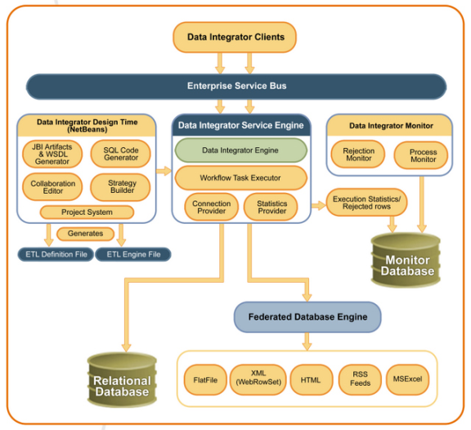
Data Integrator Architecture

Slide 41
Database Binding Steps
To Start the GlassFish V2 Application Server From NetBeans IDE.
To Create a BPEL Module Project.
To Connect to a MySQL Database.
To Start the Admin Console.
To Integrate a JDBC Driver.
To Create a JDBC Connection Pool.
To Create a JDBC Resource.
To Create a WSDL Document : dbWSDL.
To Select the Database Connection.
To Edit the SQL Code.

Slide 42
Database Binding Steps
To Create a WSDL Document : SOAPWSDL.
To Create a BPEL Process.
To Add a Partner Link.
To Add a Web Service and Basic Activities.
To Edit Web Service : Receive1.
To Edit the Web Service : Invoke1.
To Edit the Web Service : Reply1.
To Edit the Basic Activities : Assign1.
To Edit the Basic Activities : Assign2.
To Invoke Explicit Validation.
To Create the Composite Application Project.
To Deploy the Composite Application.
To Test the Composite Application.
To Debug the Test Case.

Slide 43
XSLT Designer: Simple Transformation
Creating the XSLT Module Project
Creating XML Schemas
Creating a WSDL File
Creating and Deploying the Composite Application
Performing a Test Run of the XSL Transformation Service

Slide 44
Oracle Java CAPS File Binding Component
Starting the GlassFish Server
Creating a BPEL Module Project
Creating a Composite Application Project
Building and Deploying the Composite Application Project
Testing the Composite Application

Slide 45
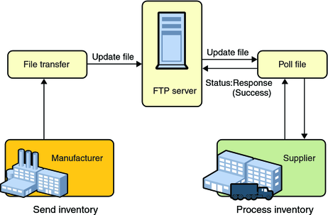
Understanding the FTP Binding

Slide 46
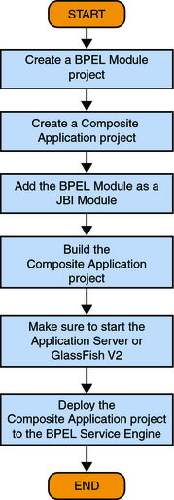
Understanding the FTP Binding

