Slide 1
Module 1: Introduction to OOAD
(Object-Oriented Analysis and Design)

Slide 2
Objectives
Why OO?
What is OOAD?
How to do OOAD?

Slide 3
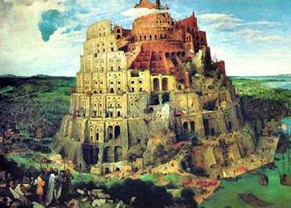
Why Object-Oriented?
Genesis 11:1-9 Acts 2:1-4
The Tower Of Babel
Let's become famous by building a city with a tower that reaches up to heaven (verse four).
Let's go down and confuse their speech right away, and make it so that they will not understand each other's speech. (verses five through seven).

Slide 4
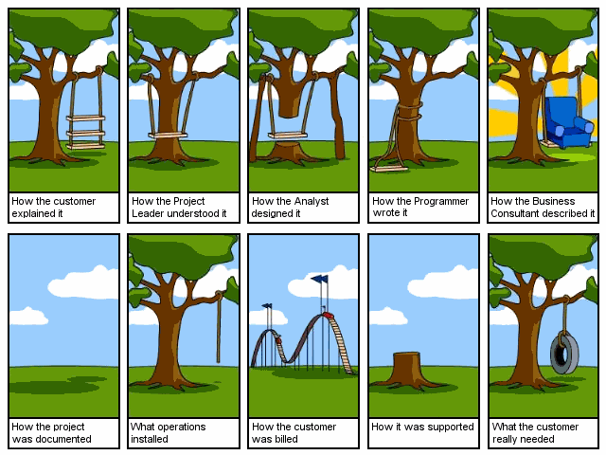
Why Object-Oriented?

Slide 5


Why Object-Oriented?
“The "software crises" came about when people realized the major problems in software development were … caused by communication difficulties and the management of complexity” [Budd]
The Whorfian Hypothesis:
Human beings … are very much at the mercy of the particular language which has become the medium of expression for their society … the 'real world' is … built upon the language habits … We cut nature up, organize it into concepts, and ascribe significances as we do, largely because we are parties to an agreement to organize it in this way … and is codified in the patterns of our language.


What kind of language can alleviate difficulties with
communication & complexity hopefully well?

Slide 6
Why Object-Oriented?
– Consider Human Growth & Concept Formation
Communication & complexity about the problem and the solution, all expressed in terms of concepts in a language!
But then, What is CONCEPT? [Martin & Odell]
Consider Human Growth & Concept Formation
stage | concepts
infant | the world is a buzzing confusion
very young age | "blue" "sky“ (individual concepts) "blue sky“ (more complex concept) hypothesis: humans possess an innate capacity for perception
getting older | -> increased meaning, precision, subtlety, ... the sky is blue only on cloudless days the sky is not really blue it only looks blue from our planet Earth because of atmospheric effects elaborate conceptual constructs
Concept formation: from chaos to order!

Slide 7
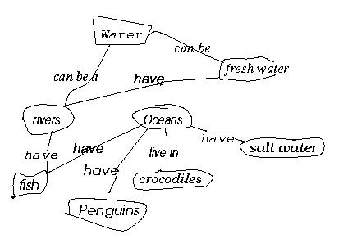
Why Object-Oriented?
- concepts and objects
So, concepts are needed to bring order … into
But, What is CONCEPT? [Martin & Odell] [Novak, 1984, Cambridge University Press]
Study of a first grade class
When given a list of concepts (water, salt water, Oceans, Penguins,...),
Harry constructed a concept diagram through which he understands his world and communicates meaning
Does Harry understand the concepts? Do you understand what Harry understands? Agree or Diagree?

Slide 8
Why Object-Oriented?
… for Conceptual … Modeling Reasons
What kind of language can be used to create this concept diagram, or Harry’s mental image?
Water
Fresh water
have
Rivers
Oceans
have
have
live in
Salt water
have
Crocodiles
Fish
have
Penguins

Slide 9
Why Object-Oriented ->
What is a model and why?
A model is a simplification of reality.
E.g., a miniature bridge for a real bridge to be built
  Well...sort of….but not quite
  A model is our simplification of our perception of reality
  (that is, if it exists, otherwise it could be a mere illusion).
  communication is not about reality but about your/my/his/her perception of reality => validation and verification hard but needed
A model is an abstraction of something for the purpose of understanding, be it the problem or a solution.
To understand why a software system is needed, what it should do, and how it should do it.
To communicate our understanding of why, what and how.
To detect commonalities and differences in your perception, my perception, his perception and her perception of reality.
To detect misunderstandings and miscommunications.

Slide 10



What is Object-Orientation?
- What is Object?
An "object" is anything to which a concept applies, in our awareness
Things drawn from the problem domain or solution space.
  E.g., a living person in the problem domain, a software component in the solution space.
A structure that has identity and properties and behavior
It is an instance of a collective concept, i.e., a class.

Slide 11

What is Object-Orientation
- Abstraction and Encapsulation
Abstraction
  Focus on the essential
  Omits tremendous amount of details
  …Focus on what an object “is and does”
Encapsulation
  a.k.a. information hiding
Objects encapsulate:
  property
  behavior as a collection of methods invoked by messages
  …state as a collection of instance variables

Slide 12


What is Object-Orientation
- Another Example of Abstraction and Encapsulation
Class Car
Attributes
  Model
  Location
  #Wheels = 4
Operations
  Start
  Accelerate
<<instanceOf>>
<<instanceOf>>
<<instanceOf>>
What is generalization?
What is over-generalization??
Forall x [Car(x) -> …]

Slide 13
What is Object-Orientation?
- Class
<<instanceOf>>
Class Car
Attributes
  Model
  Location
  #Wheels = 4
Operations
  Start
  Accelerate
<<instanceOf>>
<<instanceOf>>
What is CLASS?
  a collection of objects that share common properties, attributes, behavior and semantics, in general. What are all these???
  A collection of objects with the same data structure (attributes, state variables) and behavior (function/code/operations) in the solution space.
Classification
  Grouping of common objects into a class
Instantiation.
  The act of creating an instance.

Slide 14
What is Object-Orientation
- Subclass vs. Superclass
Specialization: The act of defining one class as a refinement of another.
Subclass: A class defined in terms of a specialization of a superclass using inheritance.
Superclass: A class serving as a base for inheritance in a class hierarchy
Inheritance: Automatic duplication of superclass attribute and behavior definitions in subclass.
Person
name
SSN
Student
Employee
std-id
emp-id
multiple inheritance?
level
age

Slide 15
What is Object-Orientation
- Subclass vs. Superclass
A
A
A
B
B
B
C
C
A
A
A
A
<<instanceOf>>
<<instanceOf>>
B
B
B
B
<<instanceOf>>
<<instanceOf>>
c: C
c: C

Slide 16
What is Object-Orientation
- Subclass vs. Superclass and …
3
A
A
A
A
A
2
<<instanceOf>>
<<instanceOf>>
<<instanceOf>>
<<instanceOf>>
B
B
B
B
B
<<instanceOf>>
<<instanceOf>>
c: C
C
C
C
C
<<instanceOf>>
1
d: D
D

Slide 17
What is Object-Orientation
- Polymorphism
  Objects of different classes respond to the same message differently.
Person
name
SSN
Student
Employee
payTuition
std-id
level
emp-id
payTuition
In-State
Student
Out-of-State
Student
state
payTuition
payTuition

Slide 18
What is Object-Orientation
- Interfaces
Information hiding - all data should be hidden within a class, at least in principle.
make all data attributes private
provide public methods to get and set the data values (cf. Java design patterns)
e.g. Grade information is usually confidential, hence it should be kept
private to the student. Access to the grade information should be
done through interfaces, such as setGrade and getGrade
Student
setGrade
std-id
level
grade
payTuition
setGrade()
getGrade()
getGrade

Slide 19
What is Object-Orientation
- Abstract Class vs. Concrete Class
Abstract Class.
  An incomplete superclass that defines common parts.
  Not instantiated.
Concrete class.
  Is a complete class.
  Describes a concept completely.
  Is intended to be instantiated.
Work out an example!

Slide 20
What is Object-Orientation?
-State
What is STATE?
"State" is a collection of association an object has with other objects and object types.
What is STATE CHANGE?
A "state change" is the transition of an object from one state to another.
What is EVENT?
An "event" is a noteworthy change in state [Rumbaugh]
Work out an example!

Slide 21
What is Object-Orientation?
-State transition impossible?
tom: Actor
tom: Actor
name = “Tom Cruise”
name = “Tom Holmes”
married/changeLastName
katie: Actor
katie: Actor
name = “Katie Holmes”
name = “Katie Holmes”
tom: Actor
name = “Tom Holmes”
newArrival/getName
katie: Actor
name = “Katie Holmes”
suri: BabyActor
name = “Suri Holmes”

Slide 22
What is Object-Oriented Application?
Collection of discrete objects, interacting w. each other
Objects have property and behavior (causing state transition)
Interactions through message passing
(A sender object sends a request (message) to another object (receiver)
to invoke a method of the receiver object’s)
O1
O2
Data
m1
Data
Fn
Fn
m3
m2
O3
{m in Fn}
Data
Fn

Slide 23
What is OOAD?
Analysis — understanding, finding and describing concepts in the problem domain.
Design — understanding and defining software solution/objects that represent the analysis concepts and will eventually be implemented in code.
OOAD — Analysis is object-oriented and design is object-oriented. A software development approach that emphasizes a logical solution based on objects.
Traceability!
Involves both a notation and a process

Slide 24
Harry again …
What do we see here?
Water
Fresh water
have
Rivers
Oceans
have
have
live in
Salt water
have
Crocodiles
Fish
have
Penguins
Things, Relationships, Diagram

Slide 25
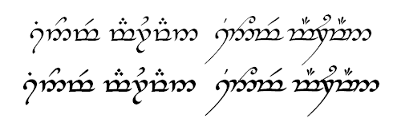
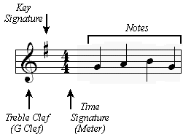
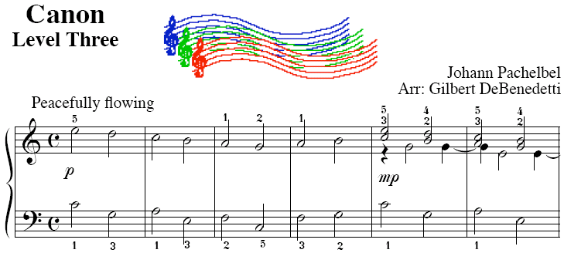

How to do OOAD
- notation vs. process
UML is a notation.
So are English, Elvish, Ku, …
But as yet I can’t

Slide 26
How to Do OOAD
– Where to Use OO?
Traceability!
Software Lifecycle
Systems Engineering
Requirements Analysis
Quality Assurance
Project Planning
Maintenance
Architectural Design
Detailed Design
Implementation
Something missing?
Release
What’s yours like?

Slide 27
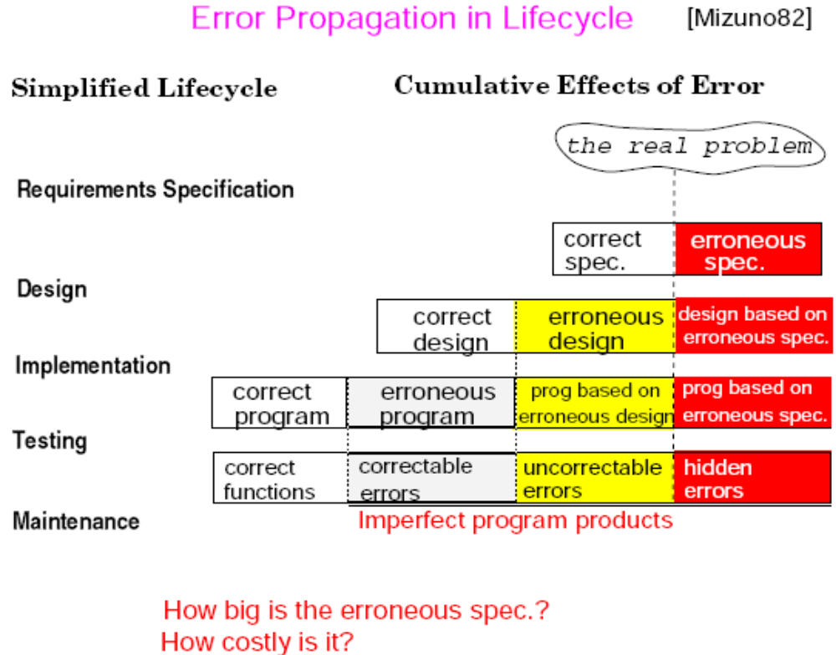
Artificial problem
Accidental design
Traceability!

Slide 28
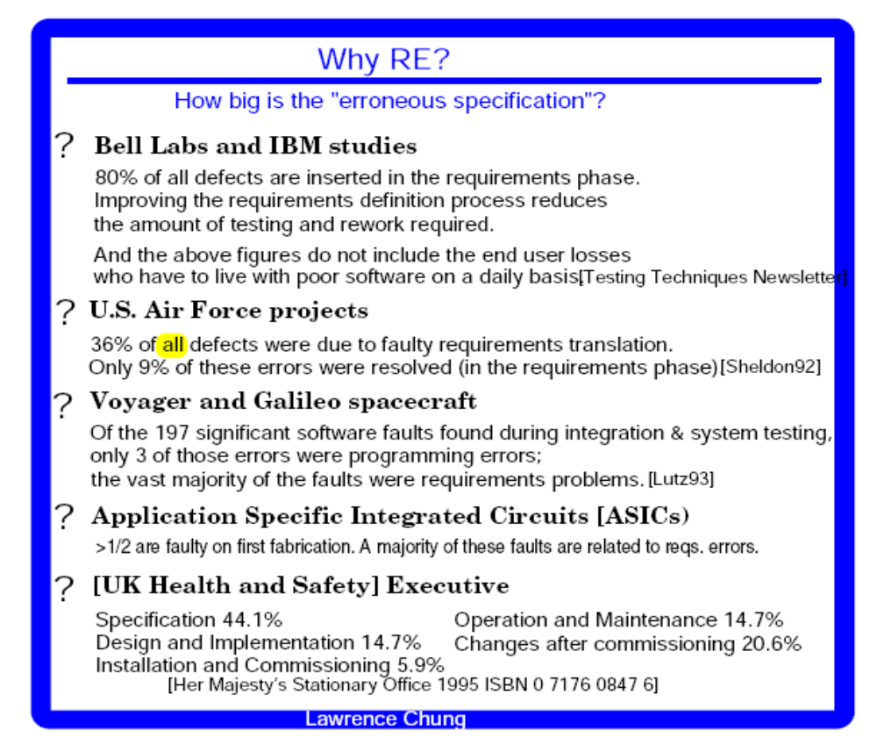
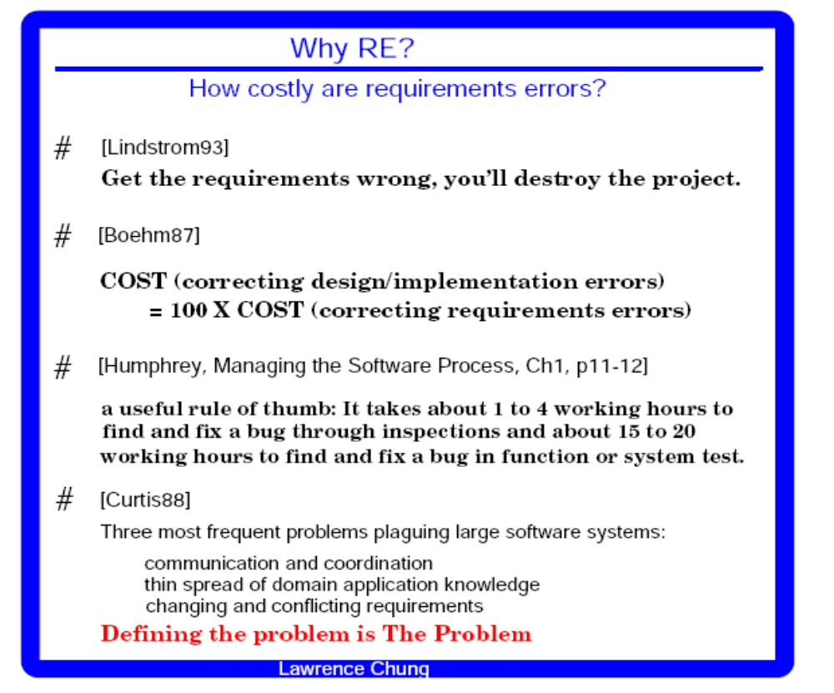
Specifications are important too

Slide 29
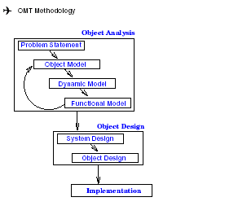
How to Do OOAD
– OMT as Object-Oriented Methodology
OMT (Object Modeling Technique) by James Rumbaugh
Object Model: describes the static structure of the objects in the system and their relationships -> Object Diagrams.
Dynamic Model: describes the interactions among objects in the system -> State Diagrams.
Functional Model: describes the data transformation of the system
-> DataFlow Diagrams.
Traceability!

Slide 30
How to Do OOAD
– OMT as Object-Oriented Methodology
OMT (Object Modeling Technique) by James Rumbaugh
Analysis:
i) Model the real world showing its important properties;
ii) Concise model of what the system will do
System Design:
Organize into subsystems based on analysis structure and propose architecture
Object Design: Based on analysis model but with implementation details; Focus on data structures and algorithms to implement each class; Computer and domain objects
Implementation: Translate the object classes and relationships into a programming language
Traceability!

Slide 31

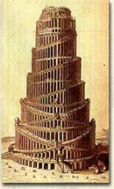
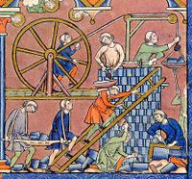
A Unified Language + A Good Process + A Good Goal, perhaps

Slide 32
Introduction to OOAD - Summary
Why
Once Software Crisis due to Communication and Complexity
Languages, Concepts, Models
OO for Conceptual Modeling
What
Fundamental OO Concepts
A little taste of UML
How
OO development processes & (Design) Patterns

Slide 33
How to Do OOAD
- Historical Perspective
OO Technology
Process Perspective
OO Prog. Languages
(Smalltalk, C++)
just program!
OO Design
(Booch)
design then program
OO Analysis
(Rumbaugh, Jacobson)
Analyze (use case) first,
then design,
T then program
Where are we heading?

Slide 34
How to Do OOAD
- OO Development Processes
Some Popular OOAD Processes (for reference only)
Fusion
  Hewlett Packard
Recommended Process and Models
  ObjectSpace best practices
  Larman’s experiences
  …
The Rational Unified Process (RUP)
  Rational; Booch, Jacobson, and Rumbaugh

Slide 35
How to Do OOAD
– One Good Way: Use (OO) Design Patterns
Reusable solutions to typical problems.
“Each design pattern systematically names, explains, and evaluates an important and recurring design in object-oriented systems.” [Gamma]
Name — identifies a particular pattern, creating a vocabulary.
Problem — identifies context when pattern should be applied.
Solution — an abstract description of a design problem along with a template object design that solves the problem.
Consequences — results and trade-offs of applying the pattern.

Slide 36
Why Object-Oriented
- Who’s Behind Object-Orientation w. Diff. Concerns
Knowledge Representation (in A.I.)
Psychological Validity
Philosophical Validity
Computational Validity
Databases
Emphasis in Persistent Data (and now ACID properties)
RelationalDB
Network DB
Hierarchical DB
OODB
ERD
CM
SDM
ADT
Programming Languages
Emphasis in Efficiency
Simula, SmallTalk, C++, Protel, Java
ERD: Entity Relationship Diagram
SDM: Semantic Data Model
ADT: Abstract Data Type
CM: Conceptual Model
System/Software
Engineering
Where does Unified Modeling Language come into this?

Slide 37
Why Object-Oriented
– A New Paradigm with Evolving Object Orientation
OOP: Object-Oriented Programming
  Simula (1967), Smalltalk (70’s), C++ (mid 80’s), Eiffel, Ada95, Turing, …
OOD: Object-Oriented Design
  Taxis (1976), Adaplex, …, Grady Booch (1980)
OOA: Object-Oriented Requirements
  RML (1981), James Rumbaugh (late 80’s)
OO-Databases (OODBs): 1980-90’s
OLE/DCOM, VisualBasic, CORBA, Java: mid 90’s
.Net, C#, (eb/voice…/-)XML, J2EE: into 2000+
UML: mid 90’s and still evolving

Slide 38
Introduction to OOAD - Points to Ponder
How do you think your mental image is represented?
What kinds of languages are used for what purpose in our daily life?
What are the differences among a concept, a model and a language?
What are the differences between a language and a methodology?
Can we use C# for analysis?
If C++ is a language, does it model anything? If so, what?
What does a concept in C++ refer to (i.e., semantics)?
What does a concept in a (OO) design refer to?
What does a concept in an (OO requirements) analysis refer to?
Is the current OOAD for Functional Analysis and Design, or Non-Functional Analysis and Design?
What is the relationship between OO (Object-Orientation) and GO (Goal-Orientation), between OO and AO (Agent-Orientation), and between GO and AO?
Can you prove you and I communicate with each other perfectly?

