Slide 1
Design Patterns

Slide 2
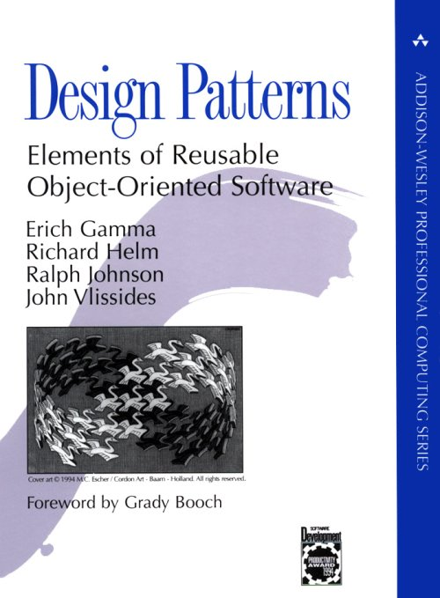
Design patterns
The reference for design patterns
“Gang of four”
Based on Erich Gamma’s Ph.D. thesis
This lecture (and slide set) is based solely on this book

Slide 3
What is a design pattern?
A solution for a recurring problem in a large OOP system
“Each pattern describes a problem which occurs over and over again in our environment, and then describes the core of the solution to that problem, in such a way that you can use this solution a million times over, without ever doing it the same way twice”
  Charles Alexander

Slide 4
Types of design patterns
Design patterns can be (roughly) grouped into three categories:
Creational patterns
  Constructing objects
Structural patterns
  Controlling the structure of a class, e.g. affecting the API or the data structure layout
Behavioral patterns
  Deal with how the object behaves (duh!)

Slide 5
Iterator Design Pattern

Slide 6
Iterator design pattern
Often you may have to move through a collection
  Tree (splay, AVL, binary, red-black, etc.), linked list, array, hash table, dictionary, etc.
If it’s an array or vector, then this is easy
But hard if it’s a more complicated data structure
  Hash table, dictionary, etc.
The code doing the iteration should not have to know the details of the data structure being used
  What if that type is not known at compile time?
This pattern answers the question: How do you provide a standard interface for moving through a collection of objects whose data structure is unknown?

Slide 7
Iterator pattern
The key participants in this pattern are:
  The Iterator, which provides an (virtual) interface for moving through a collection of things
  The Aggregate, which defines the (virtual) interface for a collection that provides iterators
  The ConcreteIterator, which is the class that inherits/extends/implements the Iterator
  The ConcreteAggregate, which is the class that inherits/extends/ implements the Aggregate
This pattern is also known as cursor
Iterator is a pattern that shows why we would use multiple inheritance
  Or interfaces in Java

Slide 8
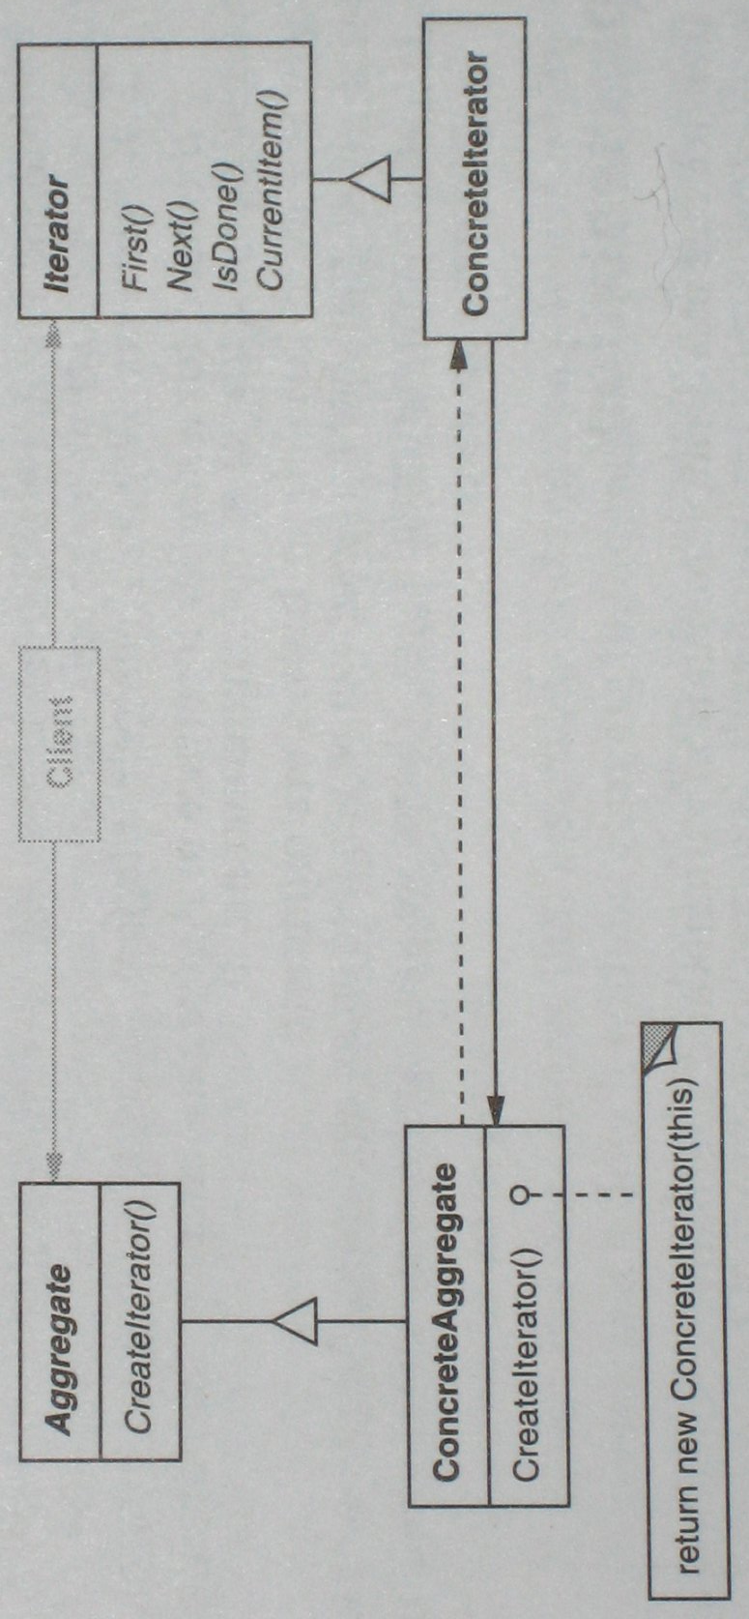
Iterator pattern: Structure

Slide 9
Iterator pattern: class Iterator
We use an abstract C++ class to define the Iterator:
template <class Item>
class Iterator {
public:
virtual void First() = 0;
virtual void Next() = 0;
virtual bool IsDone() const = 0;
virtual Item CurrentItem() const = 0;
protected:
Iterator();
}
Any collection class that wants to define an iterator will define another (concrete iterator) class that inherits from this class

Slide 10
Iterator pattern: class AbstractAggregate
We use an abstract C++ class to define the AbstractAggregate:
template <class Item>
class AbstractAggregate {
public:
virtual Iterator<Item>* CreateIterator() const = 0;
//...
}
Any collection class that wants to provide iterators will inherit from this class

Slide 11
Iterator pattern: class List
We use a sample C++ class to define a collection class (List):
template <class Item>
class List : public AbstractAggregate {
public:
List (long size = DEFAULT_LIST_CAPACITY);
long Count() const;
Item& Get (long index) const;
// ...
// and the method to provide the iterator...
}
Obviously, this class could be a hash table, dictionary, tree, etc.

Slide 12
Iterator pattern: class ListIterator
We use an abstract C++ class to define the Iterator:
template <class Item>
class ListIterator : public Iterator<Item> {
public:
ListIterator (const List<Item>* aList);
void First();
void Next();
bool IsDone() const;
Item CurrentItem() const;
private:
const List<Item>* _list;
long _current;
}
Any collection class that wants to define an iterator will define another (concrete iterator) class that inherits from this class

Slide 13
Iterator pattern: class ListIterator cont’d
template <class Item>
ListIterator<Item>::ListIterator (
const List<Item>* aList
) : _list(aList), _current(0) {
}
template <class Item>
void ListIterator<Item>::First() {
_current = 0;
}
template <class Item>
void ListIterator<Item>::Next() {
_current++;
}

Slide 14
Iterator pattern: class ListIterator cont’d
template <class Item>
void ListIterator<Item>::IsDone() const {
return _current >= _list->Count();
}
template <class Item>
void ListIterator<Item>::CurrentItem() const {
if (IsDone())
throw IteratorOutOfBounds;
return _list->Get(_current);
}

Slide 15
Iterator pattern: class List cont’d
The List class now provides the concrete method for the CreateIterator() abstract method
template <class Item>
Iterator<Item>* List<Item>::CreateIterator() const {
return new ListIterator<Item>(this);
}
And, of course, in the List class header:
Iterator<Item>* CreateIterator() const;

Slide 16
Iterator pattern: Structure again

Slide 17
Iterator pattern: Consequences
An iterator supports variations in transversal of an aggregate
  The List class can provide one that iterates forward or backward
  Moving through a tree can be done in pre-order, in-order, or post-order
    Separate methods can provide iterators for each transversal manner
Iterators support the aggregate interface
  As it doesn’t have to define similar methods
More than one transversal can be moving through an aggregate
  Multiple iterators can be working at any given time

Slide 18
Iterator pattern: Beyond Iterators
Java defines an Iterator interface
  Provides the hasNext(), next(), and remove() methods
A sub-interface of that is the ListIterator
  Sub-interface is “inheritance” for interfaces
  Provides additional methods: hasPrevious(), nextIndex(), previous(), previousIndex(), set()
Some methods can provide a ListIterator
  Arrays, lists, vectors, etc.
And some cannot
  Hash tables, dictionaries, etc.

Slide 19
Observer Design Pattern

Slide 20
Observer design pattern
In many programs, when a object changes state, other objects may have to be notified
  Example: when an car in a game is moved
    The graphics engine needs to know so it can re-render the item
    The traffic computation routines need to re-compute the traffic pattern
    The objects the car contains need to know they are moving as well
  Another example: data in a spreadsheet
    The display must be updated
    Possibly multiple graphs that use that data need to re-draw themselves
This pattern answers the question: How best to notify those objects when the subject changes?
  And what if the list of those objects changes during run-time?

Slide 21
Observer pattern
The key participants in this pattern are:
  The Subject, which provides an (virtual) interface for attaching and detaching observers
  The Observer, which defines the (virtual) updating interface
  The ConcreteSubject, which is the class that inherits/extends/implements the Subject
  The ConcreteObserver, which is the class that inherits/extends/implements the Observer
This pattern is also known as dependents or publish-subscribe
Observer is a pattern that shows why we would use multiple inheritance
  Or interfaces in Java

Slide 22
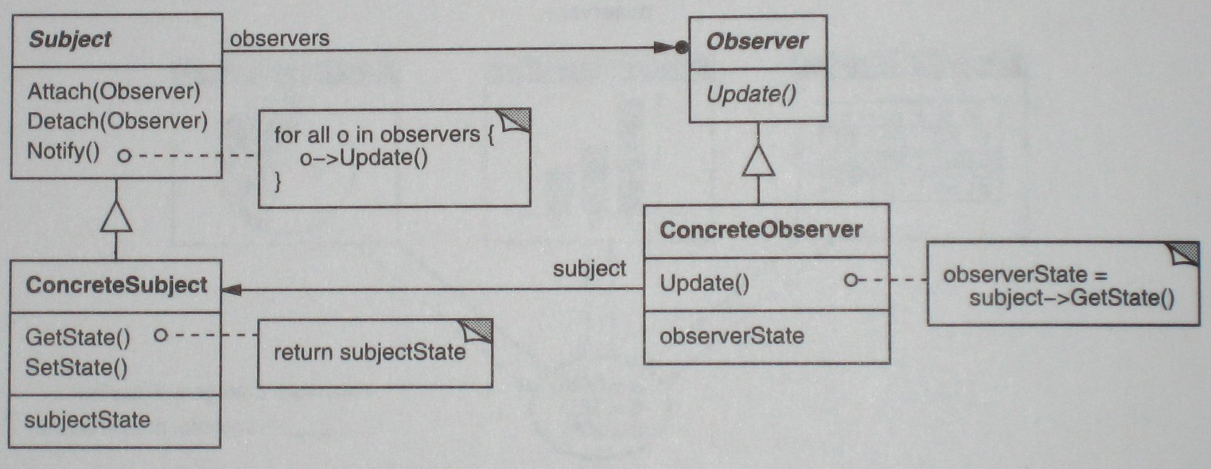
Observer pattern: Structure

Slide 23
Observer pattern: class Observer
We use an abstract C++ class to define the Observer:
class Observer {
public:
virtual ~Observer();
virtual void Update (Subject* theChagnedSubject) = 0;
protected:
Observer();
}
Any class that wants to (potentially) observe another object will inherit from this class

Slide 24
Observer pattern: class Subject
We also use an abstract C++ class to define the Subject:
class Subject {
public:
virtual ~Subject();
virtual void Attach (Observer*);
virtual void Detach (Observer*);
virtual void Notify();
protected:
Subject();
private:
List<Observer*> *_observers;
};
Any class that can be observed will inherit from this class

Slide 25
Observer pattern: class Subject cont’d
We also use an abstract C++ class to define the Subject:
void Subject::Attach (Observer* o) {
_observers->Append(o);
}
void Subject::Detach (Observer* o) {
_observers->Remove(o);
}
void Subject::Notify() {
ListIterator<Observer*> i(_observers);
for ( i.First(); !i.IsDone(); i.Next() )
i.CurrentItem()->Update(this);
}

Slide 26
Observer pattern structure again

Slide 27
Observer pattern: Consequences
Abstract coupling between subject and observer
  Subject has no idea who the observers are (or what type they are)
Support for broadcast communication
  Subject can notify any number of observers
  Observer can choose to ignore notification
Unexpected updates
  Subjects have no idea the cost of an update
  If there are many observers (with many dependent objects), this can be an expensive operation
  Observers do not know what changed in the subject, and must then spend time figuring that out

Slide 28
Singleton Design Pattern

Slide 29
Singleton design pattern
In many systems, there should often only be one object instance for a given class
  Print spooler
  File system
  Window manager
This pattern answers the question: How to design the class such that any client cannot create more than one instance of the class?
The key participants in this pattern are:
  The Singleton, the class which only allows one instance to be created

Slide 30
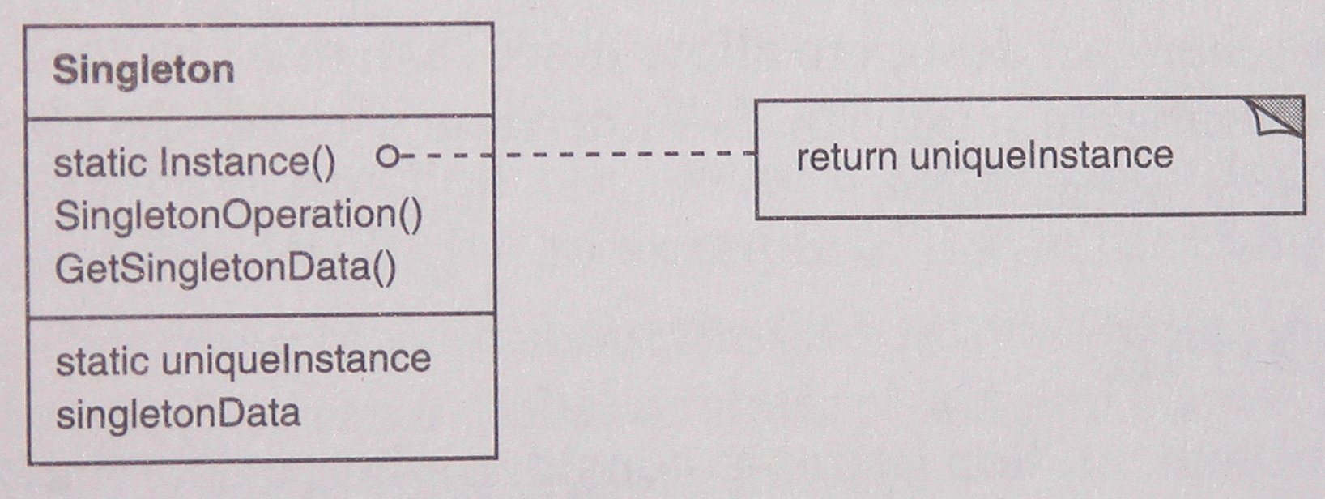
Singleton pattern: Structure

Slide 31
Singleton pattern: class Singleton
We also use a C++ class to define the Singleton class:
class Singleton {
public:
static Singleton* Instance();
protected:
Singleton();
private:
static Singleton* _instance;
};
Singleton* Singleton::_instance = 0;
Singleton* Singleton::Instance() {
if ( _instance == 0 )
_instance = new Singleton();
return _instance;
}

Slide 32
Singleton pattern: Structure again

Slide 33
Singleton pattern: Consequences
Controlled access to sole instance
  As the constructor is protected, the class controls when an instance is created
Reduced name space
  Eliminates the need for global variables that store single instances
Permits refinement of operations and representations
  You can easily sub-class the Singleton
Permits a variable number of instances
  The class is easily modified to allow n instances when n is not 1
More flexible than class operations
  This pattern eliminates the need for class (i.e. static) methods
  Note that (in C++) static methods are never virtual

Slide 34
Mediator Design Pattern

Slide 35
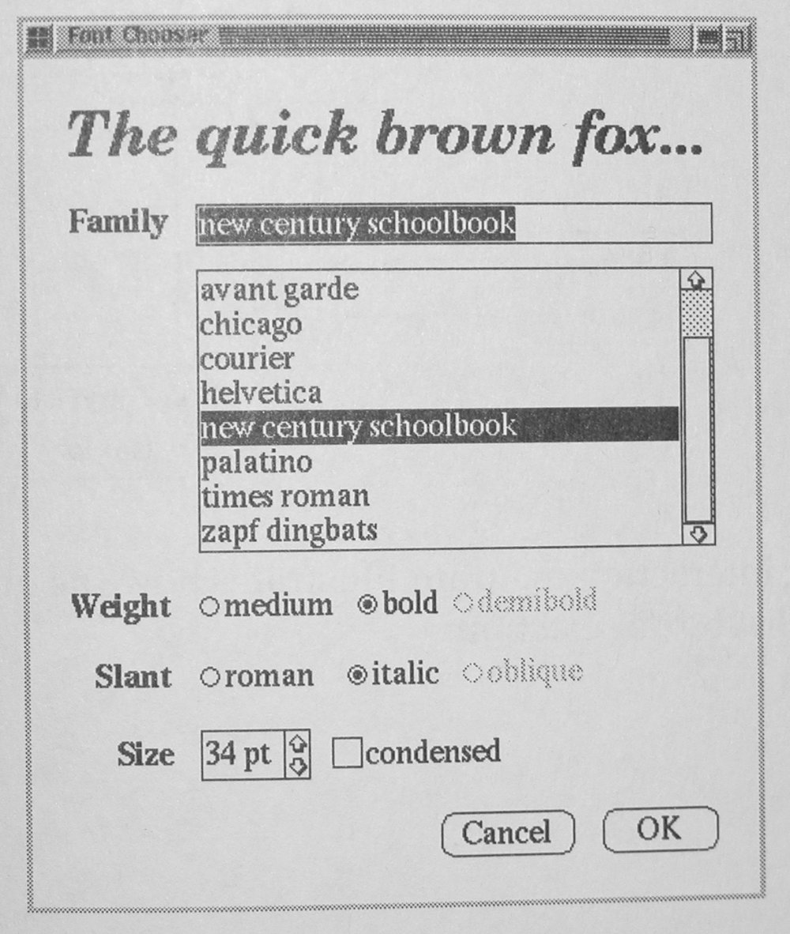
Mediator design pattern
What happens if multiple objects have to communicate with each other
  If you have many classes in a system, then each new class has to consider how to communicate with each existing class
  Thus, you could have n² communication protocols
Example
  Elements (widgets) in a GUI
  Each control has to modify the font
  But we shouldn’t have each widget have a
  separate communication means with every
  other widget
This pattern answers the question: How
to define an object to encapsulate and
control the communication between the
various objects?

Slide 36
Mediator pattern
The key participants in this pattern are:
  The Mediator, which defines an abstract interface for how the Colleague classes communicate with each other
  The ConcreteMediator, which implements the Mediator behavior
  Multiple Colleage classes, each which know the ConcreteMediator, but do not necessarily know each other
In the GUI example, the classes are implemented as follows:
  Mediator: DialogDirector
  ConcreteMediator: FontDialogDirector
  Colleague classes: ListBox, EntryField, RadioButton, etc.
    All these classes inherit from the Widget class

Slide 37
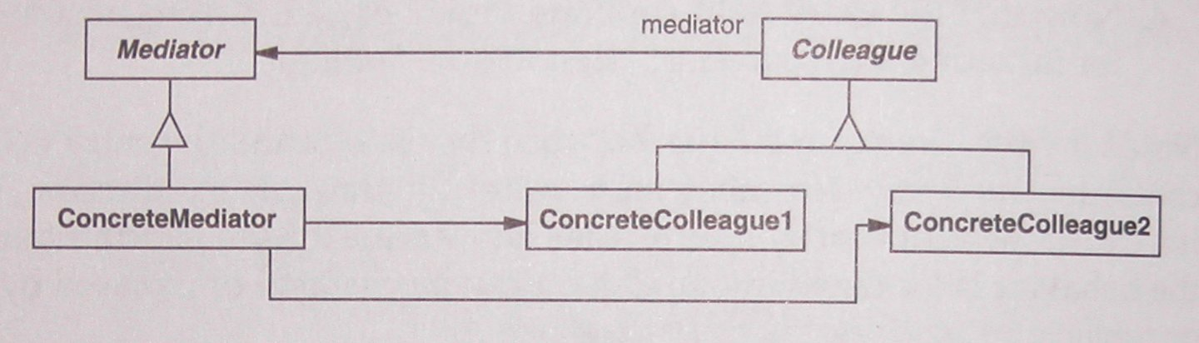
Mediator pattern: Structure

Slide 38
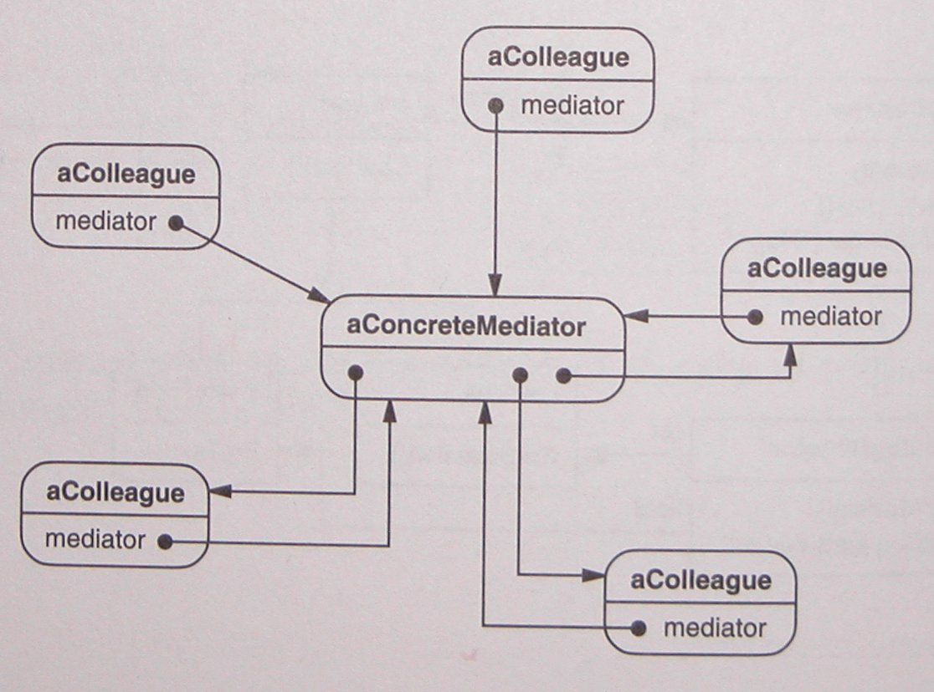
Mediator pattern: Structure

Slide 39
Mediator pattern: class DialogDirector
We use an abstract C++ class to define the DialogDirector:
class DialogDirector {
public:
virtual ~DialogDirector();
virtual void ShowDialog();
virtual void WidgetChanged(Widget*) = 0;
protected:
DialogDirector();
virtual void CreateWidgets() = 0;
}
Whenever a widget is modified, it will call the WidgetChanged() method

Slide 40
Mediator pattern: class FontDialogDirector
class FontDialogDirector : public DialogDirector {
public:
FontDialogDirector();
~FontDialogDirector();
void WidgetChanged(Widget*);
protected:
void CreateWidgets();
private:
Button* _ok;
Button* _cancel;
ListBox* _fontList;
EntryField* _fontName;
}
Note that we probably would want to make this class a Singleton as well (via multiple inheritance)

Slide 41
Mediator pattern: method CreateWidgets()
The implementation of the CreateWidgets() method
void FontDialogDirector::CreateWidgets () {
_ok = new Button(this);
_cancel = new Button(this);
_fontList = new ListBox(this);
_fontName = new EntryField(this);
// fill the listBox with the available font names
// assemble the widgets in the dialog
}
In the actual dialog, it would probably need more controls than the above four…

Slide 42
Mediator pattern: method WidgetChanged()
The implementation of the WidgetChanged() method
void FontDialogDirector::WidgetChanged (
Widget* theChangedWidget
) {
if (theChangedWidget == _fontList) {
_fontName->setText (_fontList->GetSelection());
} else if ( theChangedWidget == _ok ) {
// apply font change and dismiss dialog
// ...
} else if ( theChangedWidget == _cancel ) {
// dismiss dialog
}
}
Here the actual communication between the widgets is implemented

Slide 43
Mediator pattern: Consequences
It limits subclassing
  The communication behavior would otherwise have to be distributed among many sub-classes of the widgets
  Instead, it’s all in the Mediator
It decouples colleagues
  They don’t have to know how to interact with each other
It simplifies object protocols
  A Mediator replaces many-to-many communication with a one-to-many paradigm
It abstracts how objects cooperate
  How objects communicate is abstracted into the Mediator class
It centralizes control
  As it’s all in the Mediator
  This can make the Mediator quite large and monolithic in a large system

Slide 44
More Design Patterns

Slide 45
That’s all the design patterns for today…
The rest are described in great detail in the book
  “Design Patterns: Elements of Reusable Object-Oriented Software”
  ISBN 0201633612
We will mention the others briefly here…

Slide 46
Creational Design Patterns
Abstract Factory
Builder
Factory Method
Prototype
Singleton

Slide 47
Structural Patterns
Adapter
Bridge
Composite
Decorator
Façade
Flyweight
Proxy

Slide 48
Behavioral Patterns
Chain of Responsibility
Command
Interpreter
Iterator
Mediator
Memento
Observer
State
Strategy
Template Method
Visitor

Slide 49
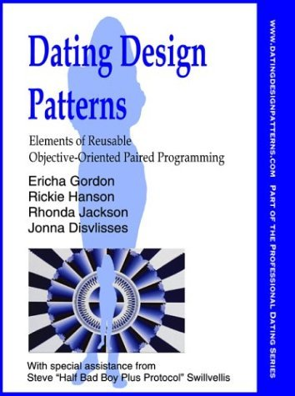
A bit of humor
It’s a spoof on the book, obviously
But also a spoof on how the book is written

