Slide 1
Angular4
Parameswari Ettiappan

Slide 2
Why is it so hard to build large single page apps
One of the biggest design changes in single page apps that the state of the app is now completely on the client instead of the server.
The application state resides in the browser and is easily accessible for modification by any part of the app.
The problem is that once the code gets larger and the team increases, this easy access to the application state starts to cause issues.

Slide 3
The danger of unconstrained mutable state
Allowing the state to be mutated from anywhere in the app at any time quickly gets out of hand.
Bugs and subtle race conditions start creeping in, and its hard to refactor without unexpected side effects.
Keeping the frontend code maintainable is is all about:
keeping the application state under control, so that the application remains simple to reason about
ensuring the type-safety of the code, which allows the application to be refactored and maintained over time

Slide 4
The advantages of immutable state
If mutable state is dangerous, the safest alternative is to make our data read-only by default, or immutable.
If the state needs to be changed we replace it by a new state in a controlled manner, but don't mutate the existing state.
This has two major advantages:
it makes it easier to reason about the application, because we know that the state can only be changed in certain places
Frameworks like React or Angular can take advantage of knowing that the state is immutable to optimize their change detection mechanisms and improve performance

Slide 5
Applications have three types of state
When we mention the application state, we need to make a distinction between several types of state:
Internal Component State: each component of the component tree (like for example a dropdown) is bound to have some internal state, for example a open flag to indicate that the dropdown is opened
Global UI State: This state defines the way the user configured the UI: which language is active, which charts are visible, etc.
Application Data State: This state is the data of the application, for example a list of countries passed to a dropdown

Slide 6

The Flux Architecture
Flux is an architecture for building frontends that originally came from the React community.
The main idea of Flux is that the state of the application can be controlled by keeping it inside a data store.

Slide 7
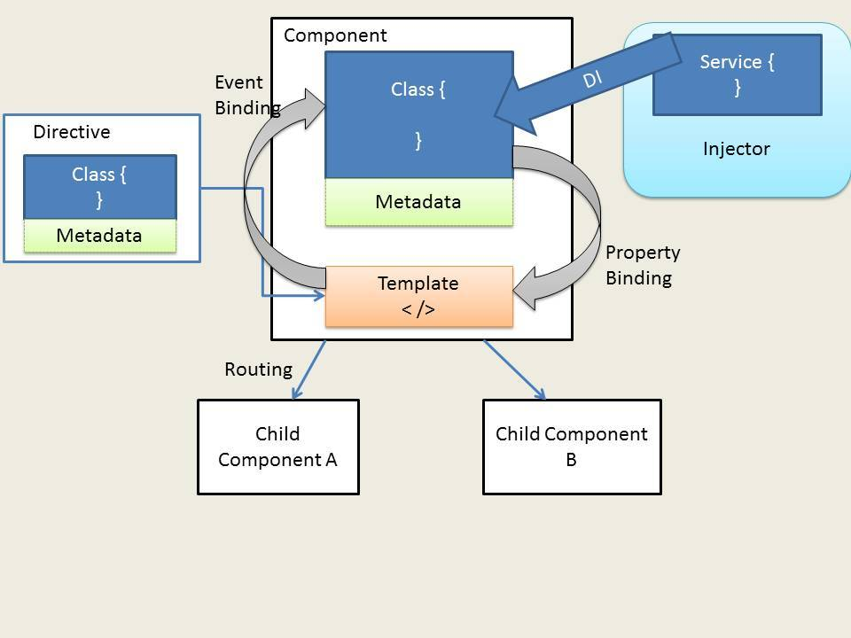
Angular 4 Architecture

Slide 8
Modules
Angular Application is modular in nature.
Therefore, an Application is just a collection of the individual modules.
Modules are just blocks of code, which are created for a specific purpose.
Because of this, each module exports something like a value or a function or a class, which the other module can import and make use of.
In fact, an Angular framework itself is a collection of library modules.
Angular 4 itself ships in large modules, some of them are ‘angular/core‘, ‘angular/router‘ and there are more.

Slide 9
Components
A Component is usually a JavaScript class with some metadata attached to it.
This metadata tells us how to process this particular class.
For e.g. In metadata, we might have an HTML, which is going to be a view for our Component and our class contains a logic, which influences particular view.
Let's say that we have a Web page, where we have a navigation bar and main content.
Now, we are going to create a component for each of these individual functionalities.

Slide 10
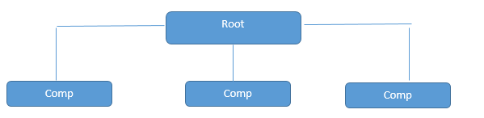
Root
In our Angular Application, we will have at least one component called Root Component and all the other components are going to fall under this Root Component.

Slide 11

Directives
Directives are everywhere in Angular 2.
A directive is a TypeScript Class with a metadata.
Directives may or may not have a template attached.
Component is an example of a directive with a template.
There are two kinds of directives in Angular 2, structural and attribute directives. Structural directives modify the structure or layout of the DOM.
Attribute directives alter the behavior of the elements. Some of the examples of pre-built directives are ngFor, ngIf, ngSwitch, ngModel etc.

Slide 12
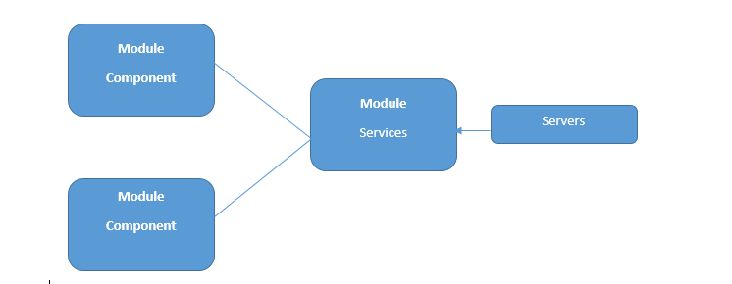
Services
A good Angular 2 application is one in which specific tasks are assigned to different services.
A component may consume these services to perform these tasks.
Typically a component should only deal with the user experience and the display of properties and use services to perform heavy behind the scenes operations.
A service must be injected in to the controller before it can be used. This is done via dependency injection.

Slide 13
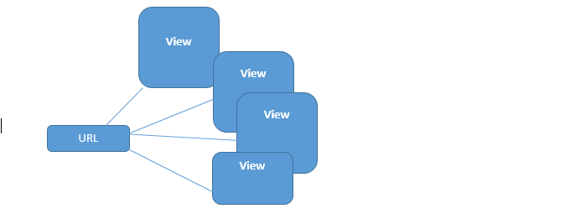
Routers
Routers are responsible for the navigation.
Thus, based on the URL, it will decide which view component will be presented to the user.

Slide 14
TypeScript
Angular 2 application can be written in JavaScript, Dart or TypeScript.
TypeScript is Microsoft’s extension of JavaScript.
TypeScript is a super-set of ES6 which in turn is a super set of the standard JavaScript (ES5).
This means whatever that can be done with ES5 or ES6 can be written in TypeScript.
In-fact you can most of the times write in plain old JavaScript in a TypeScript program.
TypeScripts adds important features like annotations, interfaces and types in addition to classes and modules offered by ES6 on top of ES5.
Browsers do not understand TypeScript and hence it has to be transpired into ES5 and this can be done using the TypeScript compiler.

Slide 15
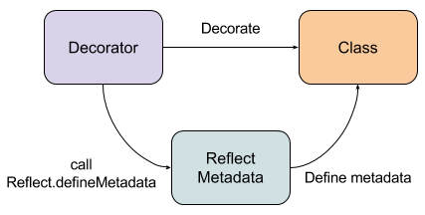
Decorators
Basically, decorators in Angular 4 apply metadata on classes leveraging the Reflect Metadata library.
When Angular 4 will use the class, it will get this metadata to configure the expected behavior, for example in the case of a component.

Slide 16
Decorators
Angular 4 uses several entries for this metadata:
Annotations
This corresponds to metadata set by decorators at the class level. It’s an array since you can apply several decorators at this level. For example, @Component and @Routes.
design:paramtypes. This corresponds to the types of constructor parameters.(only from typescript or es6)
propMetadata. This corresponds to metadata set by decorators at the class property level. It’s an object and each entry name is the property name. Each entry contains an array since it’s also possible to define several decorators on a property.
parameters. This corresponds to metadata set by decorators at the constructor parameter level. It’s an array of arrays since it’s always possible to define several decorators on a parameter.

Slide 17
Shadow DOM
Shadow DOM is mostly about encapsulation of the implementation.
A single custom element can implement more-or-less complex logic combined with more-or-less complex DOM.
An entire web application of arbitrary complexity can be added to a page by an import and <body><my-app></my-app>.
but also simpler reusable and composable components can be implemented as custom elements where the internal representation is hidden in the shadow DOM like <date-picker></date-picker>.

Slide 18
Reactjs and Shadow DOM
<header>
<div class="name">
Not Logged In
</div>
</header>
$.post('/login', credentials, function( user ) {
// Modify the DOM here
$('header .name').text( user.name );
});

Slide 19
Reactjs and Virtual DOM
React is a library for building composable user interfaces.
It encourages the creation of reusable UI components which present data that changes over time.
React uses virtual DOM which is JavaScript object.
React only covers view layer of the app so you still need to choose other technologies to get a complete tooling set for development.

Slide 20
Reactjs and Virtual DOM
The virtual DOM is an in-memory representation of the real DOM elements generated by React components before any changes are made to the page.
Now with this virtual DOM, it will be checking the difference between this and your current DOM.
And only the part which is different (in this case the new <div>) will be added instead of re-rendering the whole DOM.

Slide 21
Angular4
Angular is designed to be modular, an Angular 2 app comprises of several components, which are connected via routing or selectors.
These components may have templates attached to it which may display component properties and attach events to interact with the properties.
A component may use a service, to access a particular feature or perform a very specific task.
Services must be injected into components before they can be used from within the component, this is referred to as Dependency Injection, which has also been a key feature of Angular 1.x.

Slide 22
Module Loaders
Requirejs
Browserifyjs
Webpack
systemjs

Slide 23
Why Module loaders
Complex dependencies are difficult to manage
Browser code does not inherently mix with node
Lot of script tags in html is problem

Slide 24
What Are These Libraries For?
system.js
typescript.js
angular2-polyfills.js
Rx.js
angular2.dev.js

Slide 25
Require js
Need single build file to load all the required libraries.
It is addressed by Asynchronous Module Definitions.
Require js uses AMD

Slide 26
Requirejs
Good
Lazy loading allows optimization
Only one script tag
Bad
Many separate Requests
Lazy loading will slow down
Must maintain config file
Enormous unreadable syntax
Prrfers AMDModules

Slide 27
Browserifyjs
Browserifyjs =Common js
Require(‘http’) ---------------------→ nodejs
For bundling
Bowserify app.js –o bundle.js

Slide 28
Browserifyjs
Good
Build is good
Only one script tag
Syntax is consistent and works with any module
Bad
Must maintain config file only for 3rd party lib
Debug troubles

Slide 29
System js
Systemjs needs ES6 runtime.
it calls itself the ‘universal loader’, in that it loads ES6 modules, AMD, CommonJS and global scripts in the browser and NodeJS.
Meaning, it has a lot more built-in support for including different types of files than Webpack or Browserify.
However you have to directly tell SystemJs where to look for its dependencies and you end up with a config file:
Above is an Angular 2 SystemJs example. Including all your dependencies one by one is not ideal for large application.
Thus I recommend that you’d only want to use SystemJs for smaller to medium and more diverse projects and save yourself sometime not having to write out this configuration.

Slide 30
Webpack
Webpack is a flexible module bundler.
This means that it goes further and doesn't only handle modules but also provides a way to package your application (concat files, uglify files, ...).
It also provides a dev server with load reload for development
Webpack treats everything as a module. Your css, html, javascript, fonts, images.
Anything and everything can be inlined into your code if you desire.
In addition to making everything a module, it also allows to you specify how you load these modules with ‘loaders’ and bundle them together into your bundle or index.html.
Because webpack can bundle your entire app together , it makes tree shaking and optimising your code easy.

Slide 31
Webpack
Webpack is also my first choice for single page web applications.
Webpack reduces our bundle size by 10–20%, watch times by seconds, and builds by minutes.
Also reduces the number of gulp tasks in our builds and decreases the complexity.
Overall, webpack is the clear winner when it comes to speed and flexibility.

Slide 32
SystemJS
Angular 2 doesn’t have its own module system like Angular 1 did – it uses SystemJS.
it is a “Universal dynamic module loader”.
SystemJS is a library written by Guy Bedford (and others) built upon es6-module-loader to provide a way to load not only ES6 modules, but also CommonJS, AMD and global scripts.

Slide 33
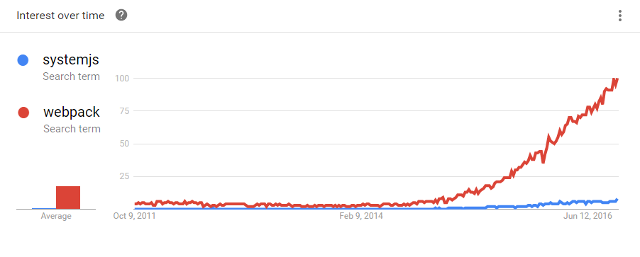
System js vs webapack

Slide 34
typescript.js
typescript.js is the transpiler used by SystemJS, which it uses to transpile TypeScript into JavaScript, live in the browser.
It’s setup by System.config:
System.config({ transpiler: 'typescript', // here typescriptOptions: { emitDecoratorMetadata: true }, packages: {'src': {defaultExtension: 'ts'}} });

Slide 35
angular2-polyfills
This file is essentially a mashup of zone.js and reflect-metadata.
Zones are an idea borrowed from Dart that Angular 2 uses to efficiently know when to update the view.
reflect-metadata is used to enable dependency injection through decorators.

Slide 36
RxJS
RxJS (Reactive Extensions for JavaScript) is a library for Observables.
Observables are a new addition that resemble the Promises you already know from Angular 1, except they can be called multiple times.

Slide 37
Development Setup
Install Node
npm install
Npm start

Slide 38
Dynamic Component
The solution has 4 essential steps to it :
1 ) Create a dynamic component outlet / wrapper(call it dynamic-outlet
2 ) Get the necessary parts of what makes a component (style, template, inputs etc..)
3 ) Dynamically generate the Component Factory with the Angular runtime compiler
4 ) Inject the component factory into the dynamic outlet component template using viewContainerRef
https://eyalvardi.wordpress.com/2016/09/04/injecting-components-in-runtime/

Slide 39
Promise vs Observable
! Promises vs Observables
promise:
returns a single value
not cancellable
observable
works with multiple values over time
cancellable
supports map, filter, reduce and similar operators
proposed feature for ES 2016
use Reactive Extensions (RxJS)
an array whose items arrive asynchronously over time

Slide 40
Excel File
Npm install
Npm run lite

Slide 41
Death of Angular 1 concepts
Controllers,
Directive Definition Objects,
$scope,
angular.module(...)

Slide 43
Angular 4 Features
1. Smaller & Faster Apps
2. View Engine Size Reduce
3. Animation Package
4. NgIf and ngFor Improvement
5. Template
6. NgIf with Else
7. Use of AS keyword

Slide 44
Angular 4 Features
8. Pipes
9. HTTP Request Simplified
10. Apps Testing Simplified
11. Introduce Meta Tags
12. Added some Forms Validators Attributes
13. Added Compare Select Options
14. Enhancement in Router
15. Added Optional Parameter
16. Improvement Internationalization

Slide 45
Angular 4 Features
Revamped *ngIf and *ngFor
<div *ngIf="productList | async as products; else loading">
<product-info *ngFor="let product of products; count as count; index as i" [product]="product"> Product {{i}} of {{count}}
</ product-info >
</div>
<ng-template #loading>Loading...</ng-template>

Slide 46
Angular 4 Features
Router ParamMap
Router parameters were saved in a key value object structure until now, but with Angular 4 it is permissible to query a ParamMap in the router itself.
It leads beneficial for security aspects with all types, as earlier key-value structure had an unsafe type (type Params = {[key : string]: any}).
ParamMap values are either string or an array of strings, depending upon method used.

Slide 47
Angular 4 Features
class TestComponent {
sessionId: Observable&lt;string&gt;;
constructor(private route: ActivatedRoute) {}
ngOnInit() {
this.sessionId = this.route
.queryParamMap
.map(paramMap =&gt; paramMap.get('session_id') || 'None');
}
}

Slide 48
Angular 4 Features
TypeScript Compatibility
Support to recent versions of TypeScript – 2.1 and 2.2 improved Type Security throughout application and speed rate of ngc-Compiler.

Slide 49
Angular 4 Features
Animations Package
In older version with @angular/core module, issue was functions were included in the part of code irrespective of animations is used or not.
So, in Angular version 4, the function is added into its own package to avoid load on app.
Animations can be added to main NgModule by importing BrowserAnimationsModule from @angular/platform-browser/animations

Slide 50
Angular 4 Features
Dynamic Components
Dynamic components are built in a declarative way with new * ngComponentOutlet-Directive.
Earlier with ComponentFactory it took lots of programming work to execute components dynamically at runtime.

Slide 51
Angular 4 Features
Angular Universal
Render Angular applications directly with web server with Angular Universal.
For Angular Universal, developers no longer need JavaScript to render content, so the websites are optimized faster on search engines.
Also, with Web Worker Threads content can be rendered outside the GUI thread even and can be simply added to the DOM Tree to display content later.
Majority of the Angular 4 Universal code is now stored in @ angular/platform-server.

Slide 52
Angular 4 Features
Smaller and Quick
As Angular 4 web development code consume less space, it runs rapidly compared to AngularJS and Angular 2. The developer is continuously pursuing additional improvements to make it faster and smoother.

Slide 53
Angular 4 Features
View Engine – AOT Compilation
AOT – Ahead Of Time complication reduces about 60% size of generated code.
So, with an increase in complexity of templates, more time is saved.
It is heard that in Angular 4 adjustments are made under the hood such that it cuts down production bundles by hundreds of kilobytes.
It reduces the loading time of the page and at same time it boosts overall page speed with reduced size of code.
It results in the noticeable improvement in performance.

Slide 54
Angular 4 Features
Flat ES Modules (Flat ESM / FESM)
No multiple small files per module, just one file is shipped per module inclusive of all necessary files for that module.
As the files are of ‘flat’ versions, they provide better performance on execution and improve Tree Shaking and build.
Flattened version ships rolled up version of code in ECMAScript Module format.

