Slide 1
RESPONSIVE DESIGN
Sources:
Kadlec, T. (2012). Implementing responsive design. Berkeley, California: New Riders Publishing.
Marcotte, E. (2010). Responsive Web Design
http://alistapart.com/article/responsive-web-design

Slide 2
Positioning - review
CSS position property lets you control how and where a web browser displays particular elements.
CSS offers four types of positioning:
  Absolute
  Relative
  Fixed
  Static

Slide 3
Absolute Positioning- review
Element moves out of the normal flow of the page as determined by the HTML.
Detached from document flow.
Other elements fill-in the space vacated by an absolutely positioned element.

Slide 4
Browser
<div id=“wrap”> no positioning
- 150px -
<div id=“nav”> position: absolute;
left:150px;
Content below fills vacated space.

Slide 5
Browser
<div id=“wrap”> absolute or relative
- 150px -
<div id=“nav”> position: absolute;
left:150px;

Slide 6
Relative positioning
Relative. Element placed relative to its current position in the normal document flow.
Other elements do NOT fill in the space vacated in the document flow.
Left:250px
This space does not get filled in.

Slide 7
RESPONSIVE DESIGN

Slide 8
Responsive Web Design
RWD is about adopting a more flexible, device agnostic approach to design for the web.
Device-agnostic because can’t know what devices people will use.
  Device-agnostic – anything designed to be compatible across different device types and operating systems.

Slide 9
Responsive Web Design
Start by building baseline experience.
Then use fluid grids, media queries to enhance the experience for devices with varying capabilities and larger screens.

Slide 10
Responsive Web Design
A responsive site is not a mobile site.
A responsive site is no more a mobile site than it is a desktop site or a tablet site.
Remember - device-agnostic

Slide 11
Responsive Web Design
In 2010 Ethan Marcotte wrote, “Responsive Web Design”.
Used three exiting tools:
  Media queries
  Fluid grids
  Scalable images
…to display sites on various devices of multiple resolutions

Slide 12
Media queries
W3C created media queries as part of the CSS3 specification.
  Enhanced media types.
  Allows targeting of specific physical characteristics of the device.

Slide 13
Media queries
<link rel="stylesheet" type="text/css" media="screen and (max-device-width: 480px)" href=“min.css" />
a media type (screen), and
the actual query enclosed within parentheses, containing a particular media feature (max-device-width) to inspect, followed by the target value (480px).

Slide 14
Media queries
<link rel="stylesheet" type="text/css" media="screen and (max-device-width: 480px)" href="shetland.css" />
Asking device if its horizontal resolution (max-device-width) is equal to or less than 480px.

Slide 15
Media queries
Multiple property values in a single query by chaining them together with the and keyword
<link rel="stylesheet" media="only screen and (min-width:200px) and (max-width: 500px)" href=“small.css">
<link rel="stylesheet" media="only screen and (min-width:501px) and (max-width: 1100px)" href=“large.css">

Slide 16
Media queries
Can include MQ in CSS as part of a @media rule:
@media screen and (max-device-width: 480px) { .column { float: none; }
}

Slide 17
Fluid Grids
target ÷ context = result
Title – target width= 700px
700px ÷ 988px = 0.7085 *100 =70.85%
Context Width= 988px
Target column width = 329px 329px ÷ 988px = 33.29%

Slide 18


Scalable images
Scale to size of containing element
ul#image-icons li img {
max-width:100%}

Slide 19
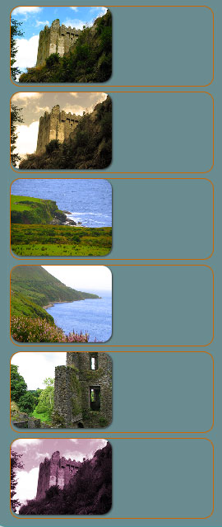
Scalable images
ul#image-icons li img {
max-width:50%}
Scale to size of containing element
ul#image-icons li img {max-width:100%}

Slide 20
Mobile first
Mobile experience should be the first one created.
Spearheaded by Luke Wroblewski.
Three reasons why:
  Mobile is exploding
  Mobile forces you to focus
  Mobile can extend your capabilities

Slide 21
Mobile is exploding
A proliferation of mobile devices worldwide.
More and more people access Internet only through mobile devices.
Estimated by the year 2020, 12 billion mobile subscriptions.
MF ensures you have an experience available to extremely fast-growing user base - the next big computing platform.

Slide 22
Mobile forces you to focus
Requires design team to focus on most important content, data, and functions.
No space in a 320 by 480 pixel screen for extraneous, unnecessary elements.
Forced to focus on content that's most important to users.
  What features and functionality are essential?
  If it is nice to have, then does it belong on your page?
Designers must prioritize.

Slide 23
Mobile extends your capabilities
Mobile first allows designers to use full capabilities of device.
"Saying mobile design should have less is like saying paperbacks have smaller pages, so we should remove chapters.” (Clark)
Use of geo-location to optimize the experience.
Switch layouts depending on the way they're held.
Rich, multi-touch interface.
Provide a rich user experience.

