Slide 1
From 0 to Spring Security 4.0

Slide 2
Agenda
Introductions
Spring Security (Java Config)
Custom Authentication
Spring Data Integration
Testing Support
WebSocket Support
White Hat Hacker

Slide 3
Security Scope
Application Layer Security
The application security layer refers to all the constraints we establish in our applications to make sure that only the right people can do only the right things when working through the application.
Applications, by default, are open to countless avenues of attack.
An improperly secured application can allow an attacker to steal information from the application, impersonate other users, execute restricted operations, corrupt data, gain access to operating system level, and perform many other malicious acts.

Slide 4
Security
Application-level security is achieved by implementing
Authentication
Authorization
ACLs(Access control lists)

Slide 5
Authentication
database or LDAP1 (Lightweight Directory Access Protocol) server

Slide 6
Authorization

Slide 7
ACLs
Access control lists (ACLs) are part of the authorization process explained in the previous section.
The key difference is that ACLs normally work at a finer grained level in the application.
ACLs are simply a collection of mappings between resources, users, and permissions.
With ACLs, you can establish rules like “User John has administrative permission on the blog post X” or “User Luis has read permission on blog post X.”
You can see the three elements:
user, permission, and resource.

Slide 8
Authentication and Authorization
User
Credentials
Role
Resource
(Any part of application to be securelyaccessed, ex., a URL, a business method, or a particular
business object.)
Permissions
Encryption
One-way encryption
Symmetric encryption
Public key cryptography

Slide 9
One Way Encryption
These algorithms, referred as hashing algorithms,
take an input string and generate an output number known as the message digest.
This output number cannot be converted back into the original string.
This is why the technique is referred to as one-way encryption.
Here is the way to use it: A requesting client encrypts a string and sends the encrypted string to the server.
The server may have access to the original information from a previous registration process, for example, and if it does, it could apply the same hash function to it.
Then it compares the output from this hashing to the value sent by the client.
If they match, the server validates the information.

Slide 10
One Way Encryption

Slide 11
Symmetric Encryption
These algorithms provide two functions: encrypt and decrypt.
A string of text is converted into an encrypted form and then can be converted back to the original string.
In this scheme, a sender and a receiver share the same keys so that they can encrypt and decrypt messages on both ends of the communication.
One problem with this scheme is how to share the key between the endpoints of the communication.

Slide 12
Symmetric Encryption

Slide 13
Public key cryptography
These techniques are based on asymmetric cryptography.
In this scheme, a different key is used for encryption than for decryption.
These two keys are referred as the public key, which is used to encrypt messages, and the private key, which is used to decrypt messages.
The advantage of this approach over symmetric encryption is that there is no need to share the decryption key, so no one but the intended receiver of the information is able to decrypt the message.

Slide 14
Public key cryptography
The intended recipient of messages shares its public key with everyone interested in sending information to it.
The senders encrypt the information with the receiver’s public key, and send the message.
The receiver uses its private key to decrypt the message.
No one else is able to decrypt the message as they don’t have the receiver’s private key.

Slide 15
Public key cryptography

Slide 16
What to Secure
Identity management
Secured connections
Sensitive data protection
SQL (and other code) injection
Validating user input is a very important part of application security. If data is not validated, an attacker could potentially write any kind of string as input (including SQL or server-side code) and send that information to the server. If the server code is not properly written, the attacker could wreak significant havoc, as she could execute any arbitrary code on the server.
Denial of service attacks
These attacks consist of making the target system unresponsive to its intended users.
Cross-site scripting and output sanitation
A kind of injection can be done where the target is the client part of the application. The idea is that the attacker can make an application return malicious code inside the web pages returned, and thus execute it in the user’s browser.

Slide 17
Java and J2EE Options for Security
Java Cryptography Architecture (JCA)
This API offers support for cryptographic algorithms, including hash-digest and digital-signature support.
Java Cryptographic Extensions (JCE)
This API mainly provides facilities for the encryption and decryption of strings and also secret key generation for symmetric algorithms.
Java Certification Path API (CertPath)
This API provides comprehensive functionality for integrating the validation and verification of digital certificates into an application.

Slide 18
Java and J2EE Options for Security
Java Secure Socket Extension (JSSE)
This API Provides a standardized set of features to offer support for SSL and TLS protocols, both client and server, in Java.
Java Authentication and Authorization Service (JAAS)
This API provides service for authentication and authorization in Java applications.
It provides a pluggable system where authentication mechanisms can be plugged in independently to applications.

Slide 19
Spring Security
It’s built on top of the successful Spring Framework
Dependency Injection (DI) and Aspect-Oriented Programming (AOP)
It provides out-of-the-box support for many authentication models
Spring Security supports out-of-the-box integration with Lightweight Directory Access Protocol (LDAP), OpenID, Form authentication, Certificate X.509 authentication, database authentication, Jasypt cryptography, and lots more.
All this support means that Spring Security adapts to your security needs—and not only that, it can change if your needs change, without much effort involved for the developer.

Slide 20
Spring Security
It offers layered security services
Spring Security allows you to secure your application at different levels, and to secure your web URLs, views, service methods, and domain model.
You can pick and combine these features to achieve your security goals.

Slide 21
Where Does Spring Security Fit In?
Your application is in Java
You need role-based authentication/authorization
You want to secure a web application from malicious users
You need to integrate with OpenID, LDAP, Active Directory, and databases as security providers
If you need to integrate with a particular Users and Roles or Groups provider, you should take a look at the vast array of options Spring Security offers because integration might be already implemented for you, saving you from writing lots of unnecessary code.
You need to secure your domain model and allow only certain users to access certain objects in your application

Slide 22
Where Does Spring Security Fit In?
You want a nonintrusive, declarative way for adding security around your application
Security is a cross-cutting concern, not really a core business functionality of your application (unless you work in a security provider firm).
As such, it is better if it can be treated as a separate and modular add-on that you can declare, configure, and manage independently of your main business concerns.
Spring Security is built with this in mind. By using Servlet Filters, XML configuration, and AOP concepts, the framework tries not to pollute your
application with security rules.
Even when using annotations, they are still metadata on top of your code.

Slide 23
Where Does Spring Security Fit In?
You want to secure your service layer the same way you secure your URLs, and you need to add rules at the method level for allowing or disallowing user access
You need your application to remember its users on their next visit and allow them access
Spring supports out-of-the-box, remember-me functionality so that a user can be automatically logged in on subsequent visits to your site, allowing them full or partial access to their profile’s functionality.
You want to use public/private key certificates to authenticate against your application

Slide 24
Where Does Spring Security Fit In?
You need to hide elements in your web pages from certain users and show them to some others
You need more flexibility than simple role-based authentication for your application
For example, suppose that you want to allow access only to users over 18 years of age using simple script expressions.
You want your application to automatically handle HTTP status codes related to authorization errors (401, 403, and others)

Slide 25
Where Does Spring Security Fit In?
You want to configure your application to be used from other applications (not browsers) and allow these other applications to authenticate themselves against yours
You are running an application outside a Java EE Server
If you are running your application in a simple web container like Apache Tomcat, you probably don’t have support for the full Java EE security stack.
You are running an application inside a Java EE Server

Slide 26
Spring Security

Slide 27
Spring Security

Slide 28
Spring Security

Slide 29
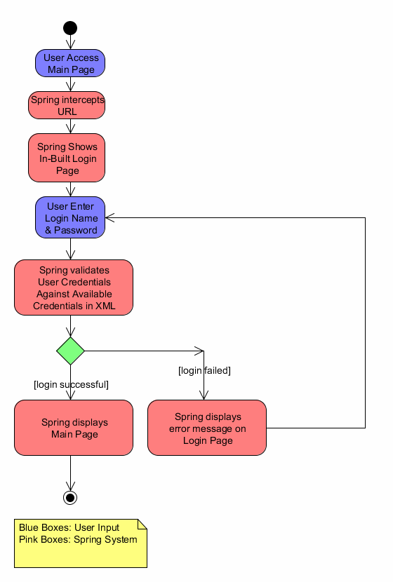

Slide 30
Spring Security Remember Me
In Remember-me or persistent-login authentication, Applications remember the identity of user between sessions.
Basically, during login, when you ask for Remember-Me support, application will send a cookie to the browser during login.
This cookie will be stored at browser side and will remain there for certain period(defined by cookie lifetime).
Next time when you try to access the application, browser will detect the cookie (if still valid) and user will be automatically logged in, without providing userid/password

Slide 31
Spring Security Remember Me
Spring Security provides two implementations for Remember-Me :
Simple Hash-Based Token Approach : It uses hashing to preserve the security of cookie-based tokens
Persistent Token Approach : It uses a database or other persistent storage mechanism to store the generated tokens

Slide 32
Spring Security Remember Me
<security:http> ... <security:remember-me services-ref="rememberMeServices" /> </security:http> <bean id="rememberMeServices" class="org.springframework.security.web.authentication.rememberme.TokenBasedRememberMeServices"> <property name="userDetailsService" ref="customUserDetailService"/> <property name="tokenValiditySeconds" value="864000"/> <property name="cookieName" value="SPRING_RM"/> <property name="key" value="myAppKey"/> </bean>

Slide 33
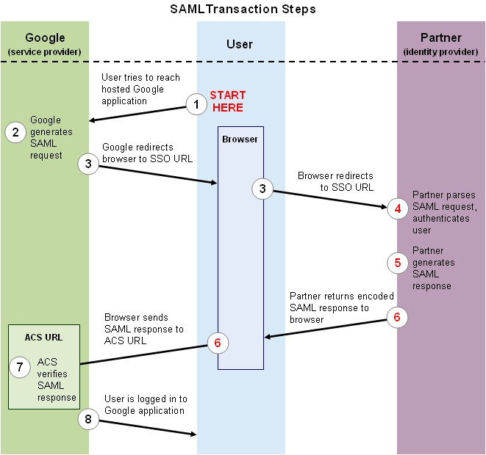

Slide 34
SAML 2.0
Security Assertion Markup Language
is an XML-based, open-standard data format for exchanging authentication and authorization data between parties, in particular, between an identity provider and a service provider.

Slide 35
SAML 2.0
The single most important requirement that SAML addresses is web browser single sign-on (SSO).
Single sign-on is common at the intranet level (using cookies, for example) but extending it beyond the intranet has been problematic and has led to the proliferation of non-interoperable proprietary technologies.

Slide 36
SAML 2.0
The SAML specification defines three roles:
the principal (typically a user)
the Identity provider (IdP)
the service provider (SP)

Slide 37
SAML 2.0
In the use case addressed by SAML, the principal requests a service from the service provider.
The service provider requests and obtains an identity assertion from the identity provider.
On the basis of this assertion, the service provider can make an access control decision – in other words it can decide whether to perform some service for the connected principal.
Before delivering the identity assertion to the SP, the IdP may request some information from the principal – such as a user name and password – in order to authenticate the principal.

Slide 38
SAML 2.0
SAML does not specify the method of authentication at the identity provider;
it may use a username and password, or other form of authentication, including multi-factor authentication.
A directory service such as LDAP, RADIUS(Remote Authentication Dial-In User Service ), or Active Directory that allows users to log in with a user name and password is a typical source of authentication tokens at an identity provider.

Slide 39
SAML 2.0
SAML has undergone one minor and one major revision since V1.0.
SAML 1.0 was adopted as an OASIS Standard in November 2002
SAML 1.1 was ratified as an OASIS Standard in September 2003
SAML 2.0 became an OASIS Standard in March 2005

Slide 40
SAML 2.0
SAML is built upon a number of existing standards:
XML,XSD,XML Signature, XML Encryption, HTTP and SOAP

Slide 41
SAML 2.0
Assertions
A SAML assertion contains a packet of security information
Assertion A was issued at time t by issuer R regarding subject S provided conditions C are valid.
<saml:Assertion ...> .. </saml:Assertion>

Slide 42
SAML 2.0
SAML assertions are usually transferred from identity providers to service providers.
Assertions contain statements that service providers use to make access-control decisions.

Slide 43
SAML 2.0
Three types of statements are provided by SAML:
Authentication statements
Attribute statements
Authorization decision statements

Slide 44
SAML 2.0
Authentication statements assert to the service provider that the principal did indeed authenticate with the identity provider at a particular time using a particular method of authentication.
An attribute statement asserts that a subject is associated with certain attributes. An attribute is simply a name-value pair.
An authorization decision statement asserts that a subject is permitted to perform action A on resource R given evidence E.

Slide 45
SAML 2.0
Authentication Schema
<element name=”AuthenticationStatement” type=”saml:AuthenticationStatementType”/>
<complexType name=”AuthenticationStatementType”>
<complexContent>
<extension base=”saml:SubjectStatementAbstractType”>
<sequence>
<element ref=”saml:SubjectLocality” minOccurs=”0”/>
<element ref=”saml:AuthorityBinding” minOccurs=”0”
maxOccurs=”unbounded”/>
</sequence>
<attribute name=”AuthenticationMethod” type=”anyURI”
use=”required”/>
<attribute name=”AuthenticationInstant” type=”dateTime”
use=”required”/>
</extension>
</complexContent>
</complexType>

Slide 46
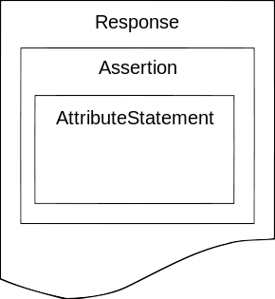
SAML 2.0
Protocols
A SAML protocol describes how certain SAML elements (including assertions) are packaged within SAML request and response elements, and gives the processing rules that SAML entities must follow when producing or consuming these elements.

Slide 47
SAML 2.0
SAML 2.0 expands the notion of protocol
Assertion Query and Request Protocol
Authentication Request Protocol
Artifact Resolution Protocol
Name Identifier Management Protocol
Single Logout Protocol
Name Identifier Mapping Protocol

Slide 48
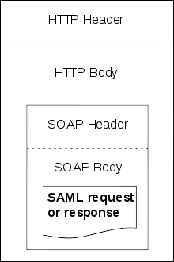
SAML 2.0
Bindings
A SAML binding is a mapping of a SAML protocol message onto standard messaging formats and/or communications protocols.
For example, the SAML SOAP binding specifies how a SAML message is encapsulated in a SOAP envelope, which itself is bound to an HTTP message.

Slide 49
SAML 2.0
Bindings
SAML SOAP Binding (based on SOAP 1.1)
Reverse SOAP (PAOS) Binding
HTTP Redirect (GET) Binding
HTTP POST Binding
HTTP Artifact Binding
SAML URI Binding

Slide 50
SAML 2.0
Profiles
A SAML profile describes in detail how SAML assertions, protocols, and bindings combine to support a defined use case.
The most important SAML profile is the Web Browser SSO Profile.
SSO Profiles
Web Browser SSO Profile
Enhanced Client or Proxy (ECP) Profile
Identity Provider Discovery Profile
Single Logout Profile
Name Identifier Management Profile
Artifact Resolution Profile
Assertion Query/Request Profile
Name Identifier Mapping Profile
SAML Attribute Profiles

Slide 51
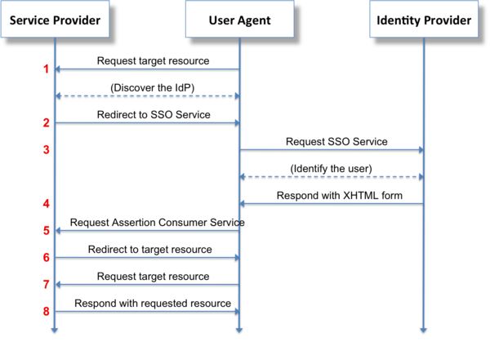
SAML 2.0

Slide 52
What is Spring Security?
Comprehensive support for Authentication And Authorization
Protection against common attacks
Servlet API Integration
Optional integration with Spring MVC
Optional Spring Data Integration
WebSocket Support

Slide 53

Message Application
SPRING SECURITY
Notes:
7 minutes

Slide 54

Spring Security

Slide 55
web.xml
<filter>
<filter-name>springSecurityFilterChain</filter-name>
<filter-class> org.springframework.web.filter.DelegatingFilterProxy </filter-class>
</filter>
<filter-mapping>
<filter-name>springSecurityFilterChain</filter-name>
<url-pattern>/*</url-pattern>
</filter-mapping>

Slide 56
Hello Java Configuration – Replaces web.xml
public class SecurityWebInitializer
extends AbstractSecurityWebApplicationInitializer {
// optionally override methods
}

Slide 57
Hello Java Configuration – WebSecurityConfig
@Configuration
@EnableWebMvcSecurity
public class WebSecurityConfig
extends WebSecurityConfigurerAdapter {
...
}

Slide 58
Hello Java Configuration – WebSecurityConfig
@Autowired public void configureGlobal( AuthenticationManagerBuilder auth) throws Exception {
auth
.inMemoryAuthentication() .withUser("admin”) .password("password”) .roles("ADMIN","USER") .and() .withUser("user") .password("password") .roles("USER");
}

Slide 59
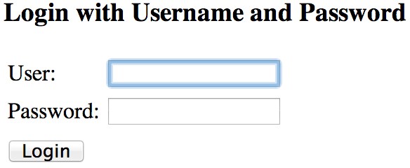
Hello Java Configuration

Slide 60


Hello Java Configuration

Slide 61
Hello Java Configuration
<div th:with="currentUser=${#httpServletRequest.userPrincipal?.name}">
<div th:if="${currentUser != null}">
<form th:action="@{/logout}" method="post”> <input type="submit" value="Log out" /> </form>
<p th:text="${currentUser}”> sample_user </p>
</div>

Slide 62
Hello Java Configuration
<div th:with="currentUser=${#httpServletRequest.userPrincipal?.name}">
<div th:if="${currentUser != null}">
<form th:action="@{/logout}" method="post”> <input type="submit" value="Log out" /> </form>
<p th:text="${currentUser}”> sample_user </p>
</div>
public interface HttpServletRequest … { Principal getUserPrincipal(); ...
}

Slide 63
Hello Java Configuration
<div th:with="currentUser=${#httpServletRequest.userPrincipal?.name}">
<div th:if="${currentUser != null}">
<form th:action="@{/logout}" method="post”> <input type="submit" value="Log out" /> </form>
<p th:text="${currentUser}”> sample_user </p>
</div>
public interface Principal … { String getName(); ...
}

Slide 64
Hello Java Configuration
<div th:with="currentUser=${#httpServletRequest.userPrincipal?.name}">
<div th:if="${currentUser != null}">
<form th:action="@{/logout}" method="post”> <input type="submit" value="Log out" /> </form>
<p th:text="${currentUser}”> sample_user </p>
</div>
</div>

Slide 65
Custom Log in Form
Notes:
13 min

Slide 66
Java Configuration
@Override protected void configure(HttpSecurity http) throws Exception {
http .authorizeRequests() .anyRequest().authenticated() .and() .formLogin().and() .httpBasic();
}

Slide 67
Java Configuration
http .authorizeRequests() .anyRequest().authenticated() .and() .formLogin().and() .httpBasic();
<http use-expressions="true">
<intercept-url pattern="/**" access="authenticated"/>
<form-login />
<http-basic />
</http>

Slide 68
Java Configuration
http
.authorizeRequests() .anyRequest().authenticated() .and() .formLogin() .loginPage("/login”) .permitAll() .and() .logout() .permitAll();

Slide 69
Java Configuration
http
.authorizeRequests() .antMatchers("/resources/**”).permitAll() .anyRequest().authenticated() .and() .formLogin() .loginPage("/login”) .permitAll() .and() .logout() .permitAll();

Slide 70
Java Configuration
<form th:action="@{/login}" method="post">
<label for="username">Username</label>
<input type="text" id="username" name="username"/>
<label for="password">Password</label>
<input type="password" id="password" name="password"/>
<button type="submit">Log in</button>
</form>

Slide 71
Java Configuration
<form th:action="@{/login}" method="post">
<label for="username">Username</label>
<input type="text" id="username" name="username"/>
<label for="password">Password</label>
<input type="password" id="password" name="password"/>
<button type="submit">Log in</button>
</form>

Slide 72
Java Configuration
<form th:action="@{/login}" method="post">
<label for="username">Username</label>
<input type="text" id="username" name="username"/>
<label for="password">Password</label>
<input type="password" id="password" name="password"/>
<button type="submit">Log in</button>
</form>
http
…. .formLogin() .loginPage("/login”)

Slide 73
Custom Authentication
Notes:
20 min / 25 min

Slide 74
Java Configuration – Custom Authentication
public interface UserDetailsService {
UserDetails loadUserByUsername(String username) throws UsernameNotFoundException;
}

Slide 75
Java Configuration – Custom Authentication
public interface UserDetails extends Serializable {
Collection<? extends GrantedAuthority> getAuthorities();
String getPassword();
String getUsername();
boolean isAccountNonExpired();
boolean isAccountNonLocked();
boolean isCredentialsNonExpired();
boolean isEnabled();
}

Slide 76
Java Configuration – Custom Authentication
@Entity
public class User implements Serializable {
@Id @GeneratedValue(strategy = GenerationType.AUTO) private Long id;
private String firstName;
private String lastName;
private String email;
private String password;
...
}

Slide 77
Java Configuration – Custom Authentication
pubic class CustomUserDetails extends User implements UserDetails {
public CustomUserDetails(User u) { super(user); }
public Collection getAuthorities() { return AuthorityUtils.createAuthorityList("ROLE_USER"); }
public String getUsername() { return getEmail(); }
public boolean isEnabled() { return true; }
...

Slide 78
Java Configuration – Custom Authentication
public UserDetails loadUserByUsername(String username) throws UsernameNotFoundException {
User user = userRepository.findByEmail(username); if(user == null) { throw new UsernameNotFoundException(…); }
return new CustomUserDetails(user);
}

Slide 79
Java Configuration – Custom Authentication
@Autowired public void configureGlobal( AuthenticationManagerBuilder auth, UserDetailsService userDetailsService) throws Exception {
auth .userDetailsService(userDetailsService);
}

Slide 80
Java Configuration – Custom Authentication
<div th:with="currentUser=${#httpServletRequest.userPrincipal?.name}">
<div th:if="${currentUser != null}">
<form th:action="@{/logout}" method="post”> <input type="submit" value="Log out" /> </form>
<p th:text="${currentUser}”> sample_user </p>
</div>

Slide 81
Java Configuration – Custom Authentication
<div th:with="currentUser=${#httpServletRequest.userPrincipal?.name}">
<div th:if="${currentUser != null}">
<form th:action="@{/logout}" method="post”> <input type="submit" value="Log out" /> </form>
<p th:text="${currentUser}”> sample_user </p>
</div>
public interface HttpServletRequest … { Principal getUserPrincipal(); ...
}

Slide 82
Java Configuration – Custom Authentication
<div th:with="currentUser=${#httpServletRequest.userPrincipal?.name}">
<div th:if="${currentUser != null}">
<form th:action="@{/logout}" method="post”> <input type="submit" value="Log out" /> </form>
<p th:text="${currentUser}”> sample_user </p>
</div>
public interface HttpServletRequest … { (Authentication) Principal getUserPrincipal(); ...
}

Slide 83
Java Configuration – Custom Authentication
<div th:with="currentUser=${#httpServletRequest.userPrincipal?.principal}">
<div th:if="${currentUser != null}">
<form th:action="@{/logout}" method="post”> <input type="submit" value="Log out" /> </form>
<p th:text="${currentUser}”> sample_user </p>
</div>
public interface Authentication … { Object getPrincipal(); ...
}

Slide 84
Java Configuration – Custom Authentication
<div th:with="currentUser=${#httpServletRequest.userPrincipal?.principal}">
<div th:if="${currentUser != null}">
<form th:action="@{/logout}" method="post”> <input type="submit" value="Log out" /> </form>
<p th:text="${currentUser}”> sample_user </p>
</div>
public interface Authentication … { (UserDetails) Object getPrincipal(); ...
}

Slide 85
Java Configuration – Custom Authentication
<div th:with="currentUser=${#httpServletRequest.userPrincipal?.principal}">
<div th:if="${currentUser != null}">
<form th:action="@{/logout}" method="post”> <input type="submit" value="Log out" /> </form>
<p th:text="${currentUser}”> sample_user </p>
</div>
public interface Authentication … { (CustomUserDetails) Object getPrincipal(); ...
}

Slide 86
Java Configuration – Custom Authentication
public class CustomUserDetails … { String getFirstName(); ...
}
<div th:with="currentUser=${#httpServletRequest.userPrincipal?.principal}">
<div th:if="${currentUser != null}">
<form th:action="@{/logout}" method="post”> <input type="submit" value="Log out" /> </form>
<p th:text="${currentUser.firstName}”> sample_user </p>
</div>

Slide 87
Java Configuration – Custom Authentication
@RequestMapping(method=RequestMethod.GET) public ModelAndView list() { SecurityContext ctx = SecurityContextHolder.getContext();
Authentication authentication = ctx.getAuthentication();
User custom = authentication == null ? null : (User) authentication.getPrincipal();
...
}

Slide 88
Java Configuration – Custom Authentication
@RequestMapping(method=RequestMethod.GET) public ModelAndView list(Authentication authentication) { User custom = authentication == null ? null : (User) authentication.getPrincipal();
...
}

Slide 89
Java Configuration – Custom Authentication
@RequestMapping(method=RequestMethod.GET) public ModelAndView list( @AuthenticationPrincipal User currentUser) {
...
}

Slide 90
Java Configuration – Custom Authentication
@Target(ElementType.PARAMETER) @Retention(RetentionPolicy.RUNTIME) @Documented @AuthenticationPrincipal public @interface CurrentUser { }

Slide 91
Java Configuration – Custom Authentication
@RequestMapping(method=RequestMethod.GET) public ModelAndView list( @CurrentUser User currentUser) {
Iterable<Message> messages = messageRepository.findByToId(currentUser.getId());
...
}

Slide 92
Spring Security / Spring Data
SpEL Support
Notes:
33 min / 38 min

Slide 93
Spring Security / Spring Data
@Bean public SecurityEvaluationContextExtension securityEvaluationContextExtension() {
return new SecurityEvaluationContextExtension();
}

Slide 94
Spring Security / Spring Data
public interface MessageRepository extends CrudRepository<Message, Long> {
@Query("select m from Message m where m.to.id = " + "?#{principal.id}”) Iterable<Message> findAllToCurrentUser();
}

Slide 95
Spring Security / Spring Data
public interface MessageRepository extends CrudRepository<Message, Long> {
@Query("select m from Message m where m.to.id = " + "?#{hasRole('ROLE_ADMIN') ? '%' : principal.id}”) Iterable<Message> findAll();
}

Slide 96

Spring Security / Spring Data

Slide 97
In the year 2000….
@EnableAclSecurity public interface SecuredMessageRepository extends MessageRepository {}

Slide 98
Password Storage
Notes:
53

Slide 99
Password Storage
auth .userDetailsService(userDetailsService)
.passwordEncoder(new BCryptPasswordEncoder());

Slide 100
CSRF Protection
Notes:
39 min

Slide 101
CSRF Protection
SPRING SECURITY

Slide 102
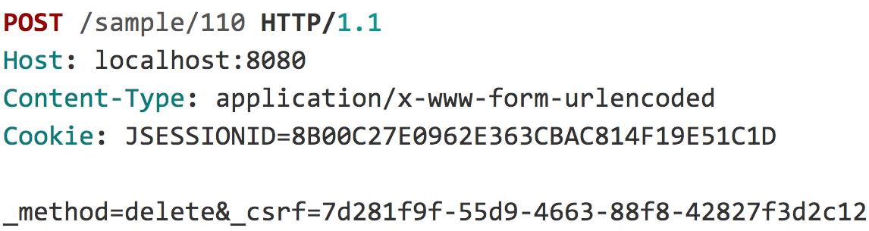
CSRF Protection

Slide 103
CSRF Protection

Slide 104
CSRF Protection
“
When do I use CSRF protection?
Notes:
When the application is intended to be ran in a browser

Slide 105
CSRF Protection
“
... but my application uses JSON

Slide 106
CSRF Protection
<form ... method="post" enctype="text/plain">
<input type='hidden'
name=’{"summary":"Hi", … "ignore_me":"' value='test"}' />
</form>

Slide 107
CSRF Protection
{ "summary": "Hi",
"message": "New Message",
"to": "luke@example.com",
"ignore_me": "=test"
}

Slide 108
CSRF Protection
“
… but my application is stateless

Slide 109
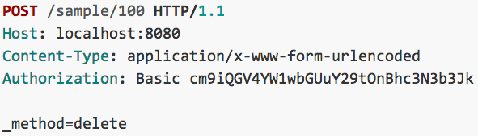
CSRF Protection

Slide 110
CSRF Protection
“
…and I use a custom header for authentication and ignore cookies

Slide 111
CSRF Protection
Use proper HTTP Verbs
Configure CSRF Protection
Include the CSRF Token

Slide 112
CSRF Protection – Providing the Token
<form ... method="post">
...
<input type="hidden"
name="${_csrf.parameterName}"
value="${_csrf.token}"/>
</form>

Slide 113
CSRF Protection – Providing the Token
<form ... method="post">
...
<sec:csrfInput />
</form>

Slide 114
CSRF Protection – Providing the Token
<form:form … method="post”>
...
</form:form>

Slide 115
CSRF Protection – Providing the Token
<form ... method="post">
...
<input type="hidden" name="_csrf" value="f81d4fae-…"/>
</form>

Slide 116
Security HTTP Response Headers
Notes:
52 min

Slide 117
Click Jacking
SPRING SECURITY

Slide 118
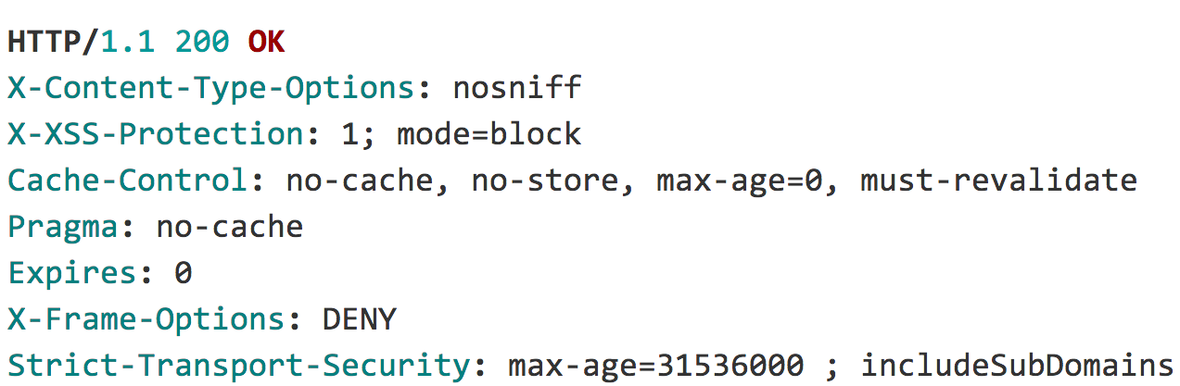
Security HTTP Response Headers
Notes:
112 min

Slide 119
Security HTTP Response Headers

Slide 120
Test Support
Notes:
101 min

Slide 121
Testing Support
@Before public void setup() { Authentication auth = new TestingAuthenticationToken("user",”pass","ROLE_USER");
SecurityContext ctx = SecurityContextHolder.getContext(); ctx.setAuthentication(auth); SecurityContextHolder.setContext(ctx); }
@After public void cleanup() { SecurityContextHolder.clearContext(); }

Slide 122
Testing Support
UserDetails user = ...
List<GrantedAuthority> roles = AuthorityUtils.createAuthorityList("ROLE_USER");
Authentication auth = new UsernamePasswordAuthenticationToken(user,”pass", roles);
SecurityContext ctx = SecurityContextHolder.getContext();
ctx.setAuthentication(auth);

Slide 123
Testing Support
User user = ...
List<GrantedAuthority> roles = AuthorityUtils.createAuthorityList("ROLE_USER");
Authentication auth = new UsernamePasswordAuthenticationToken(user,”pass", roles);
SecurityContext ctx = SecurityContextHolder.getContext();
ctx.setAuthentication(auth);

Slide 124
Testing Support
...
@WithMockUser public class SecurityMethodTests {
...
}

Slide 125
Testing Support
...
public class SecurityMethodTests {
@Test @WithMockUser public void findAllMessages() {
...
}
}

Slide 126
Testing Support
...
public class SecurityMethodTests {
@Test @WithMockUser(username="admin",roles="ADMIN”) public void findAllMessages() {
repository.findAll();
} }

Slide 127
Testing Support
...
public class SecurityMethodTests {
@Test @WithUserDetails(”rob@example.com") public void findAllMessages() {
repository.findAll();
} }

Slide 128
Testing Support
@Target({ ElementType.METHOD, ElementType.TYPE }) @Retention(RetentionPolicy.RUNTIME) @Inherited @Documented @WithSecurityContext(factory = WithCustomUserSecurityContextFactory.class) public @interface WithCustomUser {
String email() default "rob@example.com";
String firstName() default "Rob";
String lastName() default "Winch";
long id() default 0L;
}

Slide 129
Testing Support
public class WithCustomUserSecurityContextFactory implements WithSecurityContextFactory<WithCustomUser> {
public SecurityContext createSecurityContext(WithCustomUser customUser) {
User principal = new User(); principal.setEmail(customUser.email());
...
return ctx;
}
}

Slide 130
Testing Support
...
public class SecurityMethodTests {
@Test @WithCustomUser public void findAllMessages() {
repository.findAll();
} }

Slide 131
Testing Support
...
public class SecurityMethodTests {
@Test @WithCustomUser(id=1,email=”luke@example.com") public void findAllMessages() {
repository.findAll();
} }

Slide 132
Testing Support
“
…what about Spring Test MVC?

Slide 133
Testing Support
... public class SecurityMockMvcTests {
@Before public void setup() { mvc = MockMvcBuilders .webAppContextSetup(context) .apply(springSecurity()) .build();
}

Slide 134
Testing Support
@Test @WithCustomUser public void inboxShowsOnlyTo() throws Exception {
...
}

Slide 135
Testing Support
@Test @WithCustomUser(id=1,email=”luke@example.com") public void inboxShowsOnlyTo() throws Exception {
...
}

Slide 136
Testing Support
@Test @WithCustomUser public void compose() throws Exception {
MockHttpServletRequestBuilder compose = post("/”) .param("summary", "Hello Luke”) .param("message", "This is my message”) .with(csrf());
mvc .perform(compose) .andExpect(status().is2xxSuccessful());
}

Slide 137
WebSocket Security
Notes:
108 min
Already have authentication, how it works, need authorization

Slide 138
Web Socket Authorization
SPRING SECURITY

Slide 139
WebSocket Authorization
Browser
/app/im
@MessageMapping("/im")
/queue/messages-user<id>
Client (Web Browser)

Slide 140
WebSocket Authorization
@Configuration
public class WebSocketSecurityConfig extends AbstractSecurityWebSocketMessageBrokerConfigurer {

Slide 141
WebSocket Authorization
protected void configure( MessageSecurityMetadataSourceRegistry messages) {
messages
.matchers(message("/topic/**","/queue/**")).denyAll()
.anyMessage().hasRole("USER");
}

Slide 142
WebSocket Authorization
// avoid processing outbound channel
public void configureClientOutboundChannel(
ChannelRegistration registration) {}

Slide 143
WebSocket Security
Spring Session
Notes:
Keep Alive, Clustering, determine session id in header, allow users to invalidate suspicious sessions, sessions on other systems (i.e. Messaging)

