Slide 1
Application Delivery Fundamentals 2.0 B: Java
Spring Form Validation

Slide 2
Module Objectives
In this module you will be able to
Understand how to use the Spring validation framework to perform form validation

Slide 3

Form Validation
Spring supports form validation through its Validation framework
Validation
shouldn’t be tied to the web tier
Should be easy to localize
Should be easy to plug in
Spring MVC’s validation support provides all of these attributes

Slide 4
Validator Interface
org.springframework.validation.Validator
supports – Returns a boolean indicating whether or not the target class can be validated by this validator
validate – In charge of actually performing validation. Validation errors should be reported by adding them to the errors object.
public interface Validator {
boolean supports(Class<?> class);
void validate(Object target, Errors errors);
}

Slide 5
Validator Example
public class VisitorValidator implements Validator {
/**
* This Validator validates the Visitor instances
*/
public boolean supports(Class obj) {
return Visitor.class.equals(obj);
}
public void validate(Object obj, Errors e) {
ValidationUtils.rejectIfEmpty(e, "name", "name.empty");
Visitor v = (Visitor) obj;
if (v.getAge() < 0) {
e.rejectValue("age”, ”age value cannot be negative");
} else if (v.getAge() > 130) {
e.rejectValue("age", "too old");
}
}
}

Slide 6
Invoking Validator
Invoking validator from controller
@RequestMapping(value = "/visitor/add", method = RequestMethod.POST)
public String createVisitor(Visitor visitor, Errors errors) {
VisitorValidator vv = new VisitorValidator();
ValidationUtils.invokeValidator(vv, visitor, errors);
if(errors.hasErrors()) {
return "addVisitor";
}
return "viewVisitor";
}

Slide 7
Spring Form Validation
In order to validate a form:
Provide an implementation of the Validator interface
Override the validate() method to define all the validations.
Link the controller and validator classes
In the view page add form:errors tag to display errors
Can be done with Annotations too…
Notes:
Sumaiya – Talk about message resources. How it is configured in application context and how the error messages are declared.

Slide 8
Annotation based Validation
Uses annotations for Validations like
@NotNull
@Size
@Length
@Min
@Max

Slide 9
Annotation based Validation
public final class UserMessage
{
@NotBlank
@Length(max = 80)
private String name;
@NotBlank
@Length(max = 80) private String email;
….. //getters and setters for the variables
}

Slide 10
Annotation based Validation (1 of 2)
In order to implement Annotation based Validation in Spring MVC :
Create a Spring bean annotated with the validations specified imported from the package
org.springmodules.validation.bean.conf.loader.annotation.handler
Inject the Validator in the Controller

Slide 11
Annotation based Validation (2 of 2)
Enable scanning and autowiring of the validator in dispatcher servlet by using the following xml
<bean id="configurationLoader"
class="org.springmodules.validation.bean.conf.loader.annotation.AnnotationBeanValidationConfigurationLoader" />
<bean id="validator" class="org.springmodules.validation.bean.BeanValidator"
p:configurationLoader-ref="configurationLoader" />
<bean id="messageSource"
class="org.springframework.context.support.ResourceBundleMessageSource"
p:basenames="messages" />
Display error messages in jsp using Spring Form TLDs.

Slide 12
Spring MVC – Form Validation: See It
Demonstration:
Faculty will demonstrate how to handle Form Validation & Form tags in Spring MVC.
Time Allocated: 20 minutes
Environment or File: SampleController.java / User.java / sample.jsp
Steps:
Open the project ADFExtensionCodebaseM5Form Validations_participant in Eclipse
Run it on Tomcat server.
You should be able to see a click link for Sample. Click on it.

Slide 13

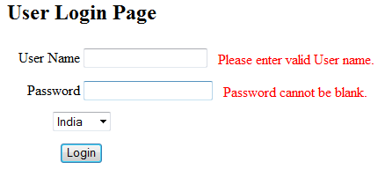
Spring MVC – Form Validation: See It
You should see a screen like the one below (see 2a. below).
Click the link to view sample code
Click on Login button without any value in user name & password (see 2b. below).
Try various combinations and see how it behaves.
2a.
2b.

Slide 14
Spring MVC – Form Validation: Try It
Now You Try It:
Spring MVC – Form Validation.
Time Allocated: 30 minutes
Environment or File: ActivityController.java (incomplete) / Customer.java (complete) / customer.jsp (complete)
Steps:
Open the project ADFExtensionCodebaseM5Form Validations_participant in Eclipse
Refer com.accenture.adfX.module5.entity.Customer.java for validation annotations.
Open com.accenture.adfX.module5.activity.ActivityController.java

Slide 15
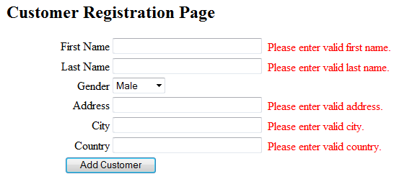
Spring MVC – Form Validation: Try It
Complete the Try It TODO 1 - TODO 14 mentioned in ActivityController.java to
a) Validate the Customer attributes & Insert a customer record in the database.
Save and run the program & Click the link to run Activity code
Click Add Customer (see 2b. below) with out any values.
Enter Customer details and click Add Customer
2a.
2b.

Slide 16
Questions

Slide 17
Module Summary
In this module we
Understood the Spring Validation framework
Created added validation functionality to our spring mvc application

Slide 18
References
http://static.springsource.org/spring/docs/3.0.x/reference/view.html#view-jsp-formtaglib

