Slide 1
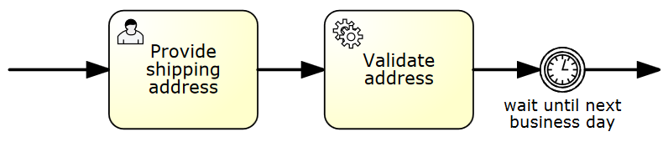
Application/Client Thread:
taskService.complete(id)
3
1
2
1st Transaction
2ndTransaction

Slide 2
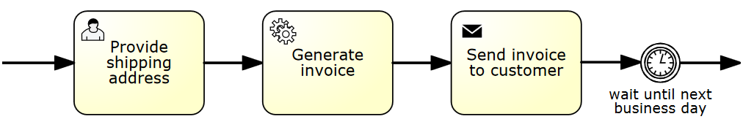
Application/Client Thread:
taskService.complete(id)
Job Execution Thread
1
2
3
camundabpm:async=“true“
1st TX
2nd TX
3rd TX

Slide 3
taskService.complete(id)
1
2
3
throws
Exception
process instance
will not move as the TX
gets rolled back

Slide 4
Acquired Jobs Queue (main memory)
Job Acquisition
Job Execution
(Thread Pool)
poll, lock
Job Table
(Database)

Slide 5
Acquired
Jobs Queue
Job Table
(Database)
Job Acquisition
Thread
Job Execution
(Thread Pool)
Process Engine

Slide 6
Job Table
(Database)
Process Engine
Job Acquisition
Thread
Job Table
(Database)
Acquired
Jobs Queue
Process Engine
Job Execution
(Thread Pool)
Job Table
(Database)
Process Engine
Job Acquisition
Thread
Job Table
(Database)
Process Engine
Job Table
(Database)
Process Engine

Slide 7
Node 1
Node 2
camunda
BPM platform
camunda
BPM platform
Engine
Engine
Process
Application A
Engine
Process
Application A
Engine
Engine
Engine
Process
Application B
Job
Acquisition
Job
Execution
Process
Application B
Job
Acquisition
Job
Execution
Shared Database

Slide 8
Node 1
Node 2
camunda
BPM platform
camunda
BPM platform
Engine
Engine
Process
Application A
Engine
Process
Application B
Engine
Engine
Engine
Job
Acquisition
Job
Execution
Job
Acquisition
Job
Execution
Shared Database

