Slide 1
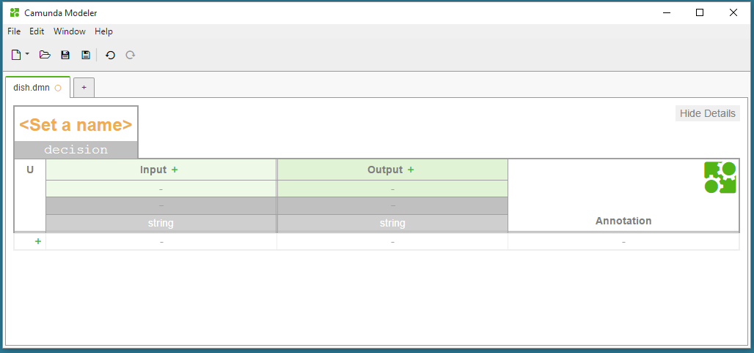
Set a name
Change the decision id

Slide 2
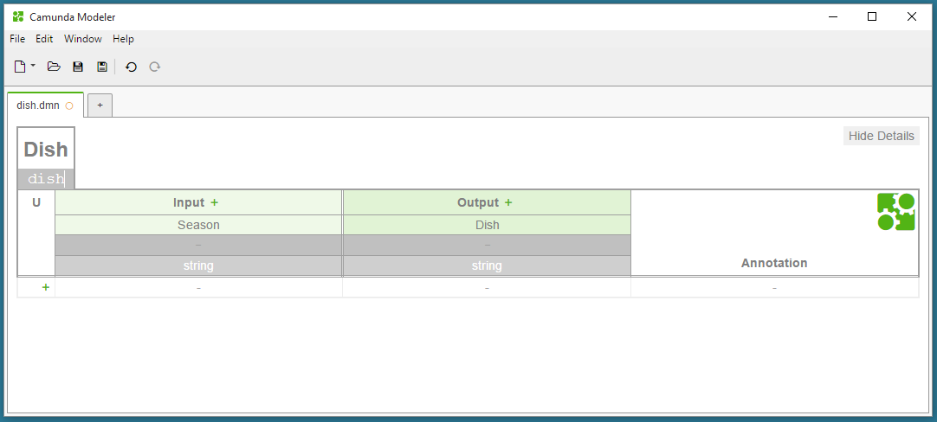
Set an input label
Set an output label

Slide 3
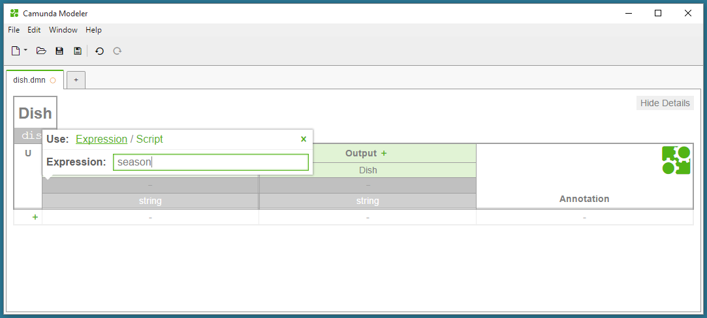
Click on the field
Set an input expression
Close the pop-up
Set an output name

Slide 4
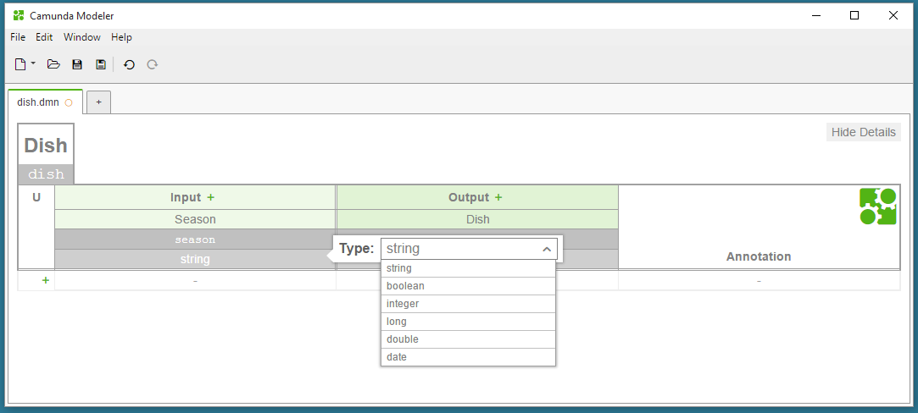
Click on the field
2. Choose a type

Slide 5
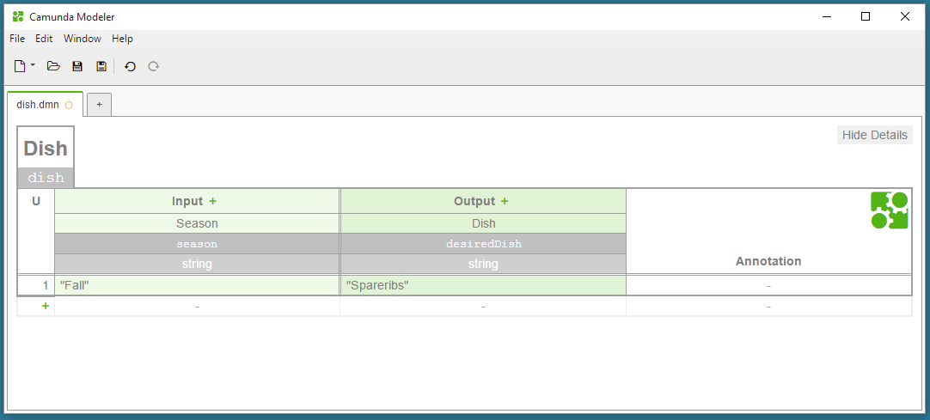
Click on the „+“ button
2. Set a condition
3. Set a conclusion

Slide 6
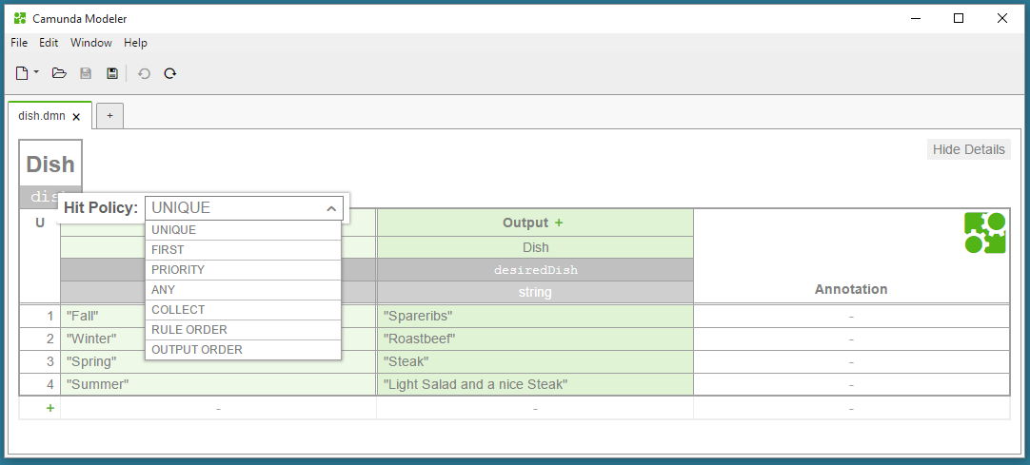
Click on the field
2. Choose a hit policy

