Slide 1
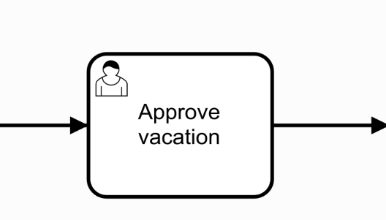
create
complete
Task
Group
Task List
Candidate Groups
Assignee
Personal
Task List
claim

