Slide 1
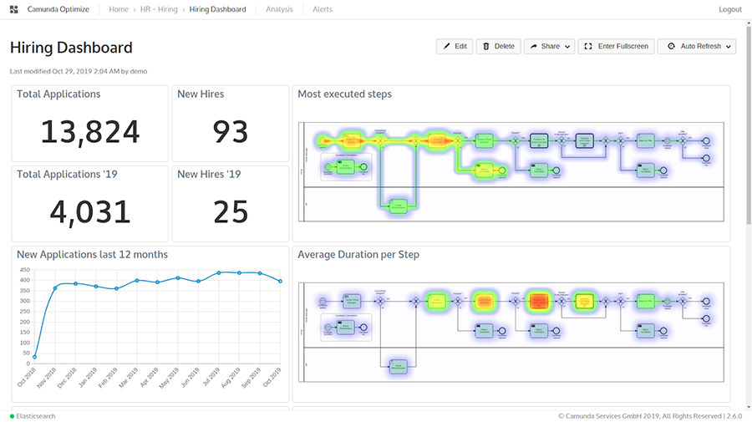
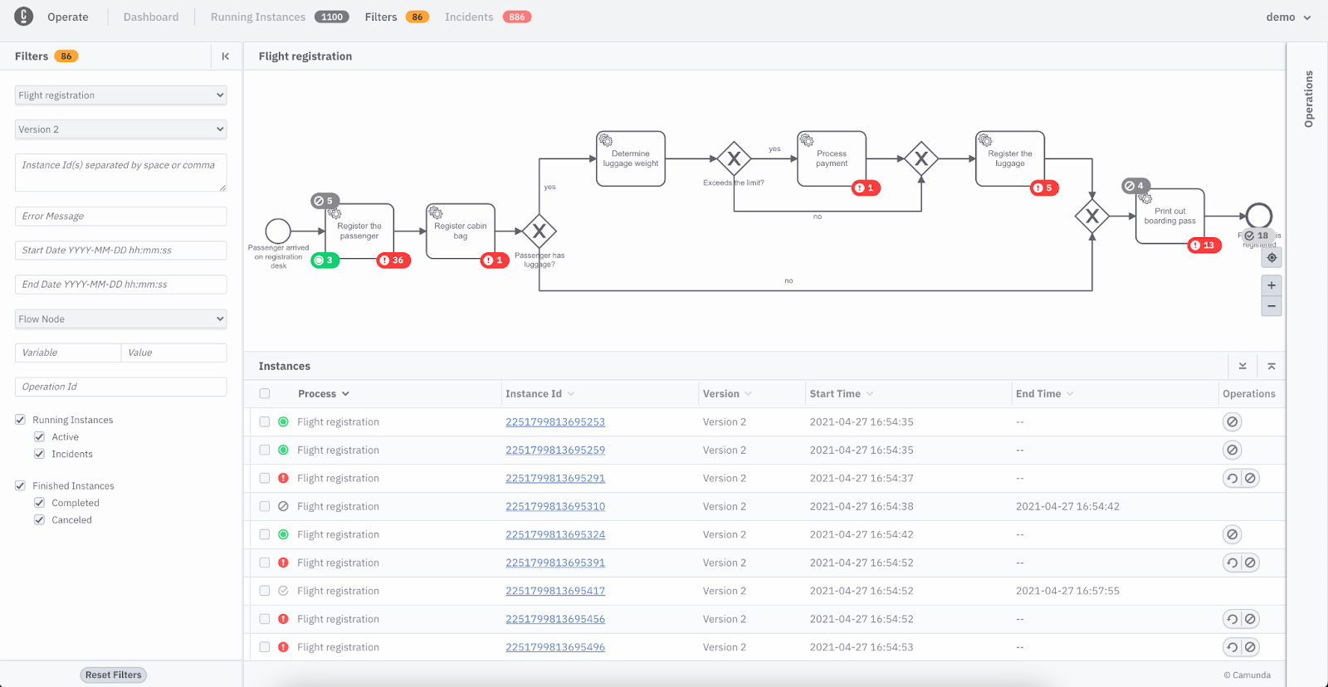
Workflow Engine
Runtime
Export all events
into “load area” of Elastic
Elastic
Pull data and optimize format for use case
History API
History optimized for Operations
History optimized for BI
Elastic
Elastic
Optimize
Operate

