Slide 1
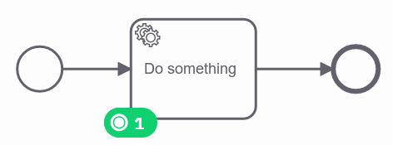
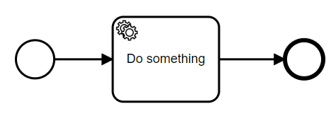
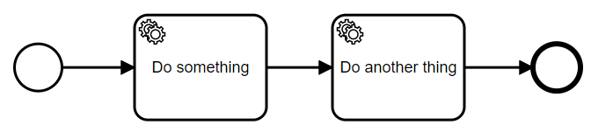
references
V1
V2

Slide 2
my-application.jar
my-process.bpmn
MyClass.java
task-form.html
some-library.jar

Slide 3
my-application.jar
my-process.bpmn
V2 gets created in the workflow engine
MyClass.java
task-form.html
MyClassV2.java
task-form-v2.html
some-library.jar

Slide 4
my-application.jar
my-application-v2.jar
my-process.bpmn
my-process.bpmn
MyClass.java
MyClass.java
task-form.html
task-form.html
some-library.jar
some-library-v2.jar

