Slide 1
Application,
Service, or
Microservice
A
Zeebe
Workflow Engine
Cluster
Zeebe Client
gRPC
Gateway
Application,
Service, or
Microservice
B
Zeebe Client

Slide 2
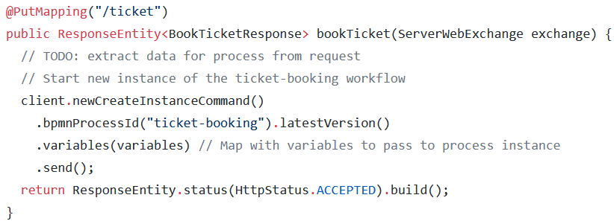
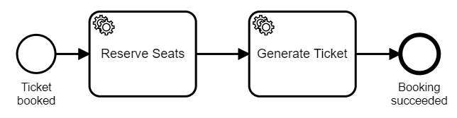
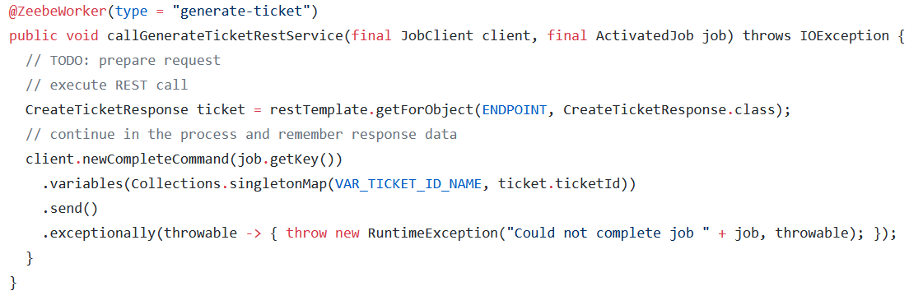
Your code to provide a REST endpoint
Your glue code to implement the REST call
Notes:
https://gist.github.com/berndruecker/d333998ea05302baa95cabb23668dd37
https://gist.github.com/berndruecker/0b900b39eb6aefdc6180d2a2ccf896db

Slide 3
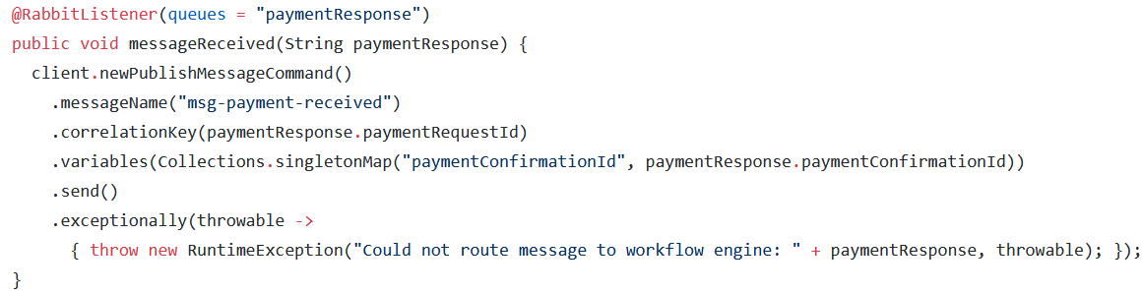
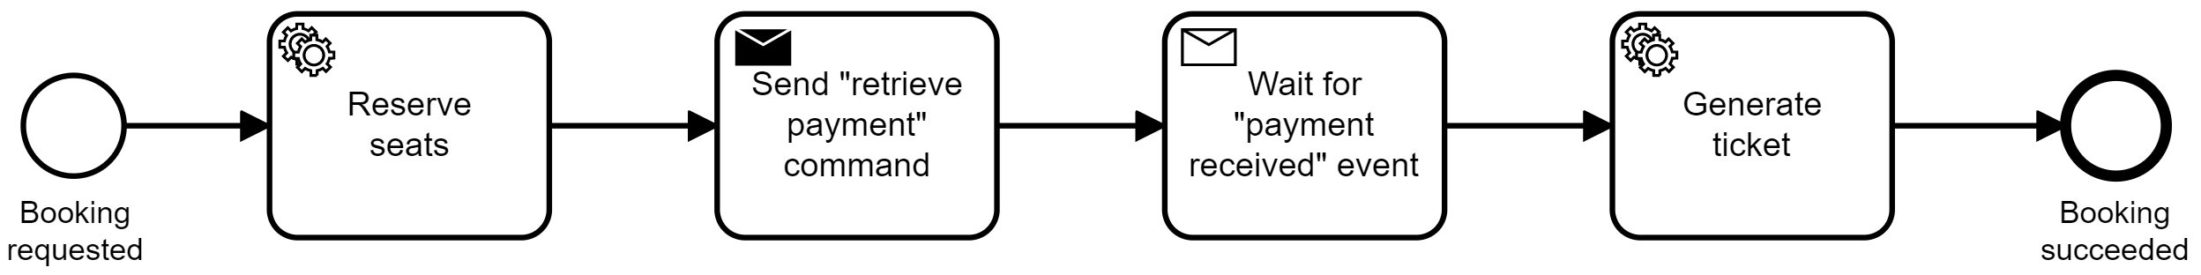
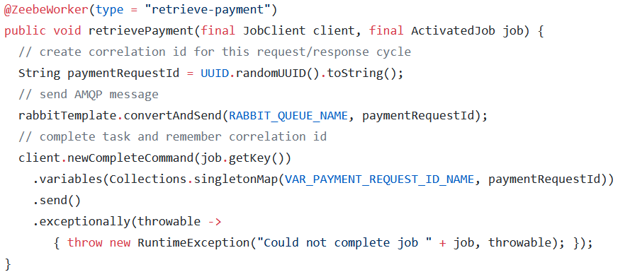
Your code to receive AMQP messages and route them to process instances
Message Broker
Some Payment Service
Your glue code to send AMQP message
Message Broker
Notes:
https://gist.github.com/berndruecker/2e4b09836012d3e8f76c46770336ea97
https://gist.github.com/berndruecker/8c3f3accaa40353ad37eacb7d1a390d7

Slide 4
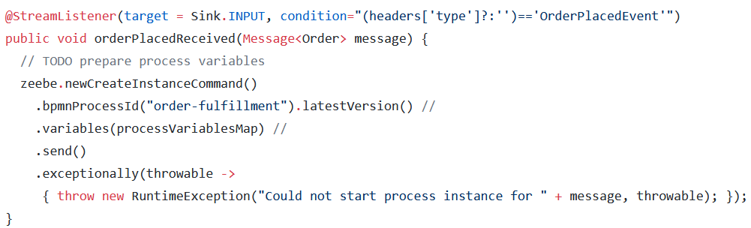
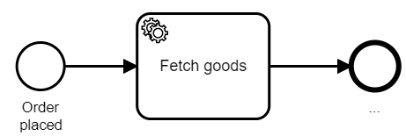
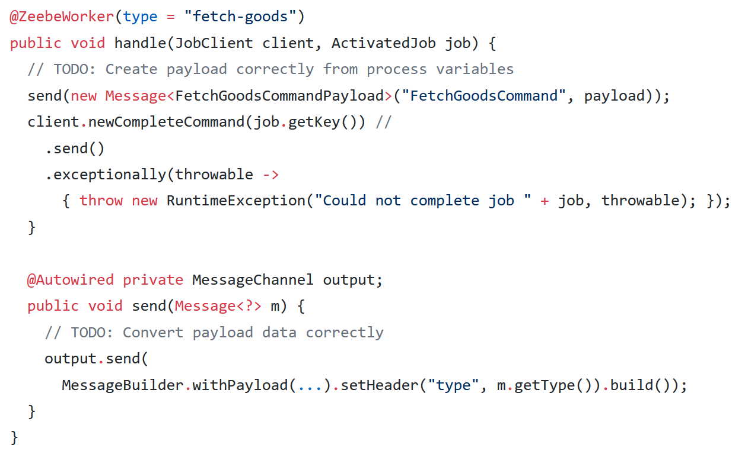
Your code to receive Kafka records and start process instances
Apache Kafka
Your glue code to create Kafka records
Apache Kafka
Notes:
https://gist.github.com/berndruecker/c53196953768baa6ef7ccb420cbd112b
https://gist.github.com/berndruecker/ec35f4d260cbca915588881a11bb90e9

Slide 5
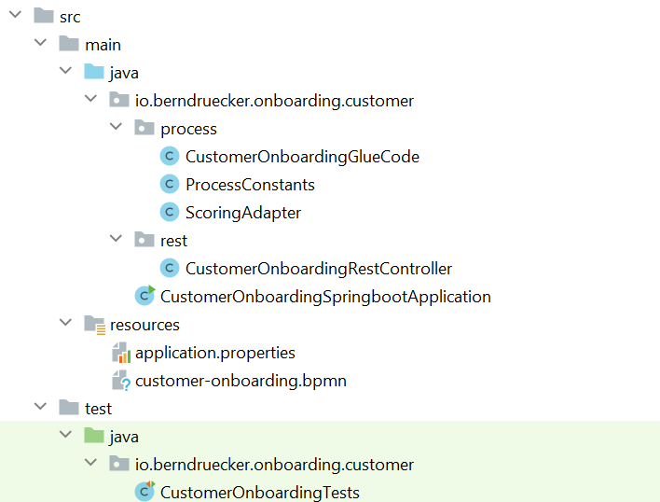
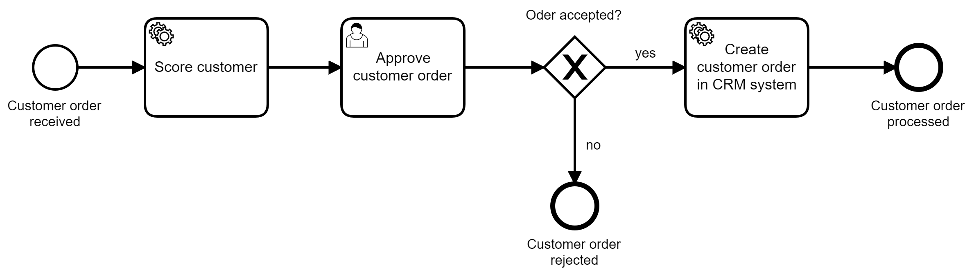
REST API
Onboarding Microservice
Java Maven Project
(using Spring Boot)
1
4
Process Definition
3
1
2
2
3
Java glue code to invoke REST API
4
Java glue code to invoke REST API
Zeebe
client
REST
REST
Scoring service
CRM system

Slide 6
Application,
Service, or
Microservice
A
Zeebe
Workflow Engine
Cluster
e.g. HTTP
Connector
Application,
Service, or
Microservice
B
Zeebe Client
gRPC
Gateway
Application,
Service, or
Microservice
C

Slide 7
Zeebe
Workflow Engine
Cluster
Connector
Ticket Service
HTTP PUT
Zeebe Client
gRPC
Gateway

Slide 8
Application,
Service, or
Microservice
Application,
Service, or
Microservice
A
B
Zeebe
Workflow Engine
Cluster
Connector
Pub/Sub (e.g. Kafka)
Zeebe Client
gRPC
Gateway
Application,
Service, or
Microservice
C

Slide 9
Your environment (e.g. public cloud)
Camunda Cloud
Application,
Service, or
Microservice
A
Zeebe
Workflow Engine
Cluster
e.g. HTTP
Connector
Application,
Service, or
Microservice
B
Zeebe Client
gRPC
Gateway
Application,
Service, or
Microservice
C

Slide 10
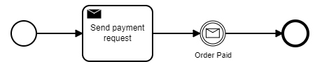
Apache Kafka
Kafka Connector
Zeebe
Workflow Engine
Cluster
Topic
Source
Topic
Sink

