Slide 1
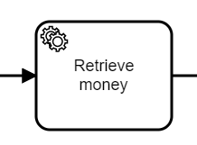

Workflow engine
Client application
Thread
long polling
Job Handler
complete job

Slide 2
Workflow
Engine
Worker /
Job Handler
Business
Service
gRPC
REST
RDMS
Engine-internal transaction mechanism
(based on event-sourcing paradigms)
No specific transaction management needed
ACID transactions at play

