Slide 1

EQ2341- Project Wu Camus
Song recognition

Slide 2
Presentation
Goal of the project
Description of the features and the HMM design
Test and results
Demonstration

Slide 3


Goal of the project
Song recognition
Classification between hummed (1st ) and voiced sound (2nd)

Slide 4
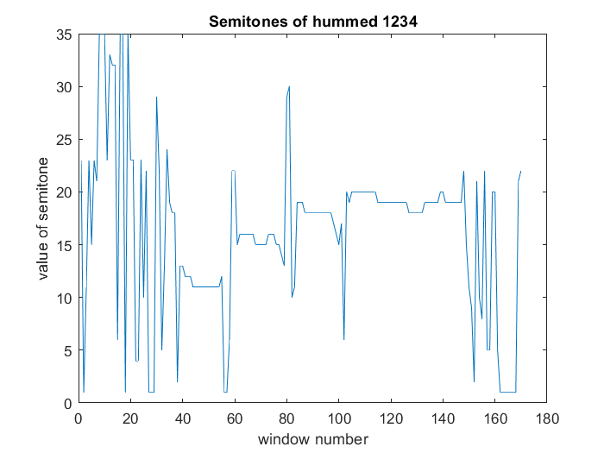
Description of the features
From pitch frequency and intensity to values of the semitones (discrete)

Slide 5
HMMs design
1HMM for each class (hummed & voiced)
10 states for each HMM
Output Distributions are discrete .
Represent number of counts for each semitone.

Slide 6
Tests and results

Slide 7
Demonstration

