Slide 1

EQ2341- Project Wu Camus
Song recognition

Slide 2
Presentation
Goal of the project
Description of the features and the HMM design
Test and results
Demonstration

Slide 3


Goal of the project
Song recognition
Classification between hummed (1st ) and voiced sound (2nd)

Slide 4
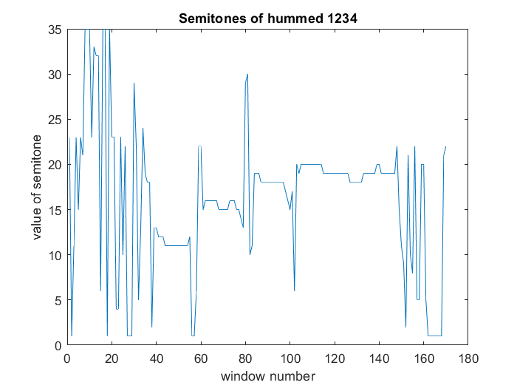
Description of the features
From pitch frequency and intensity to values of the semitones (discrete)

Slide 5
HMM design
Building dataset
Feature extraction
HMM modelling and training
Classifier evaluating

Slide 6
Test & Demonstration
10 states
2 HMM model
hummed (1st ), voiced sound (2nd)
Error rate
7 test data each class
error rate=0.357
Demo
Problem analysis

Slide 7
Thank you

