Slide 1
Developing Null and Alternative Hypotheses
Hypothesis testing can be used to determine whether
a statement about the value of a population parameter
should or should not be rejected.
The null hypothesis, denoted by H₀ , is a tentative
assumption about a population parameter.
The alternative hypothesis, denoted by H_{a}, is the
opposite of what is stated in the null hypothesis.
The alternative hypothesis is what the test is
attempting to establish.

Slide 2
Developing Null and Alternative Hypotheses
Testing Research Hypotheses
The research hypothesis should be expressed as
the alternative hypothesis.
The conclusion that the research hypothesis is true
comes from sample data that contradict the null
hypothesis.

Slide 3
Developing Null and Alternative Hypotheses
Testing the Validity of a Claim
Manufacturers’ claims are usually given the benefit
of the doubt and stated as the null hypothesis.
The conclusion that the claim is false comes from
sample data that contradict the null hypothesis.

Slide 4
Developing Null and Alternative Hypotheses
Testing in Decision-Making Situations
A decision maker might have to choose between
two courses of action, one associated with the null
hypothesis and another associated with the
alternative hypothesis.
Example: Accepting a shipment of goods from a
supplier or returning the shipment of goods to the
supplier

Slide 5






Summary of Forms for Null and Alternative Hypotheses about a Population Mean
The equality part of the hypotheses always appears
in the null hypothesis.
In general, a hypothesis test about the value of a
population mean μ must take one of the following
three forms (where μ₀ is the hypothesized value of
the population mean).
One-tailed
(lower-tail)
One-tailed
(upper-tail)
Two-tailed

Slide 6
Null and Alternative Hypotheses
Example: Metro EMS
The director of medical services
wants to formulate a hypothesis
test that could use a sample of
emergency response times to
determine whether or not the
service goal of 12 minutes or less
is being achieved.

Slide 7
Null and Alternative Hypotheses
H₀: μ < 12
The emergency service is meeting
the response goal; no follow-up
action is necessary.
H_{a}: μ > 12
The emergency service is not
meeting the response goal;
appropriate follow-up action is
necessary.
where: μ = mean response time for the population
of medical emergency requests

Slide 8
Type I Error
Because hypothesis tests are based on sample data,
we must allow for the possibility of errors.
A Type I error is rejecting H₀ when it is true.
The probability of making a Type I error when the
null hypothesis is true as an equality is called the
level of significance.
Applications of hypothesis testing that only control
the Type I error are often called significance tests.

Slide 9
Null and Alternative Hypotheses
Example: Metro EMS
A major west coast city provides
one of the most comprehensive
emergency medical services in
the world.
Operating in a multiple
hospital system with
approximately 20 mobile medical
units, the service goal is to respond to medical
emergencies with a mean time of 12 minutes or less.

Slide 10
Type II Error
A Type II error is accepting H₀ when it is false.
It is difficult to control for the probability of making
a Type II error.
Statisticians avoid the risk of making a Type II
error by using “do not reject H₀” and not “accept H₀”.

Slide 11
Type I and Type II Errors
Population Condition
H₀ True
(μ < 12)
H₀ False
(μ > 12)
Conclusion
Accept H₀
(Conclude μ < 12)
Correct
Decision
Type II Error
Reject H₀
(Conclude μ > 12)
Type I Error
Correct
Decision

Slide 12
p-Value Approach to
One-Tailed Hypothesis Testing
The p-value is the probability, computed using the
test statistic, that measures the support (or lack of
support) provided by the sample for the null
hypothesis.
If the p-value is less than or equal to the level of
significance α, the value of the test statistic is in the
rejection region.
Reject H₀ if the p-value < α .

Slide 13
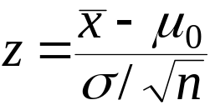
Lower-Tailed Test About a Population Mean:
σ Known
p-Value < α ,
so reject H₀.
p-Value Approach
α = .10
Sampling
distribution
of
p-value
= .072
z
z =
-1.46
-z_{α} =
-1.28
0
Signal: Noise

Slide 14
Upper-Tailed Test About a Population Mean:
σ Known
p-Value < α ,
so reject H₀.
p-Value Approach
Sampling
distribution
of
α = .04
p-Value
= .011
z
0
z_{α} =
1.75
z =
2.29

Slide 15
Critical Value Approach to
One-Tailed Hypothesis Testing
The test statistic z has a standard normal probability
distribution.
We can use the standard normal probability
distribution table to find the z-value with an area
of α in the lower (or upper) tail of the distribution.
The value of the test statistic that established the
boundary of the rejection region is called the
critical value for the test.
The rejection rule is:
  Lower tail: Reject H₀ if z < -z_{α}
  Upper tail: Reject H₀ if z > z_{α}

Slide 16
Lower-Tailed Test About a Population Mean:
σ Known
Critical Value Approach
Sampling
distribution
of
Reject H₀
α = .10
Do Not Reject H₀
z
−z_{α} = −1.28
0

Slide 17
Upper-Tailed Test About a Population Mean:
σ Known
Critical Value Approach
Sampling
distribution
of
Reject H₀
α = .05
Do Not Reject H₀
z
0
z_{α} = 1.645

Slide 18
Steps of Hypothesis Testing
Step 1. Develop the null and alternative hypotheses.
Step 2. Specify the level of significance α.
Step 3. Collect the sample data and compute the test statistic.
p-Value Approach
Step 4. Use the value of the test statistic to compute the
p-value.
Step 5. Reject H₀ if p-value < α.

Slide 19
Steps of Hypothesis Testing
Critical Value Approach
Step 4. Use the level of significance to determine the critical value and the rejection rule.
Step 5. Use the value of the test statistic and the rejection
rule to determine whether to reject H₀.

Slide 20
One-Tailed Tests About a Population Mean:
σ Known
Example: Metro EMS
The response times for a random
sample of 40 medical emergencies
were tabulated. The sample mean
is 13.25 minutes. The population
standard deviation is believed to
be 3.2 minutes.
The EMS director wants to
perform a hypothesis test, with a
.05 level of significance, to determine
whether the service goal of 12 minutes or less is being
achieved.

Slide 21
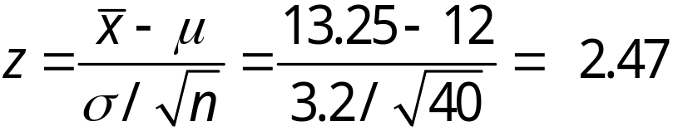
One-Tailed Tests About a Population Mean:
σ Known
p -Value and Critical Value Approaches
1. Develop the hypotheses.
H₀: μ < 12
H_{a}: μ > 12
2. Specify the level of significance.
α = .05
3. Compute the value of the test statistic.
Signal: Noise

Slide 22
One-Tailed Tests About a Population Mean:
σ Known
p –Value Approach
4. Compute the p –value.
For z = 2.47, cumulative probability = .9932.
p–value = 1 − .9932 = .0068
5. Determine whether to reject H₀.
Because p–value = .0068 < α = .05, we reject H₀.
We are at least 95% confident that Metro EMS is not meeting the response goal of 12 minutes.

Slide 23
One-Tailed Tests About a Population Mean:
σ Known
p –Value Approach
Sampling
distribution
of
α = .05
p-value
= .0068
z
0
z_{α} =
1.645
z =
2.47

Slide 24
One-Tailed Tests About a Population Mean:
σ Known
Critical Value Approach
4. Determine the critical value and rejection rule.
For α = .05, z_{.05} = 1.645
Reject H₀ if z > 1.645
5. Determine whether to reject H₀.
Because 2.47 > 1.645, we reject H₀.
We are at least 95% confident that Metro EMS is not meeting the response goal of 12 minutes.

Slide 25
p-Value Approach to
Two-Tailed Hypothesis Testing
Compute the p-value using the following three steps:
1. Compute the value of the test statistic z.
2. If z is in the upper tail (z > 0), find the area under
the standard normal curve to the right of z.
If z is in the lower tail (z < 0), find the area under
the standard normal curve to the left of z.
3. Double the tail area obtained in step 2 to obtain
the p –value.
The rejection rule:
Reject H₀ if the p-value < α .

Slide 26
Critical Value Approach to
Two-Tailed Hypothesis Testing
The critical values will occur in both the lower and
upper tails of the standard normal curve.
Use the standard normal probability distribution
table to find z_{α/2} (the z-value with an area of α/2 in
the upper tail of the distribution).
The rejection rule is:
  Reject H₀ if z < -z_{α/2} or z > z_{α/2}.

Slide 27
Example: Glow Toothpaste
Two-Tailed Test About a Population Mean: σ Known
The production line for Glow toothpaste
is designed to fill tubes with a mean weight
of 6 oz. Periodically, a sample of 30 tubes
will be selected in order to check the
filling process.
oz.
Glow
Quality assurance procedures call for
the continuation of the filling process if the
sample results are consistent with the assumption that
the mean filling weight for the population of toothpaste
tubes is 6 oz.; otherwise the process will be adjusted.

Slide 28
Example: Glow Toothpaste
Two-Tailed Test About a Population Mean: σ Known
Assume that a sample of 30 toothpaste
tubes provides a sample mean of 6.1 oz.
The population standard deviation is
believed to be 0.2 oz.
oz.
Glow
Perform a hypothesis test, at the .03
level of significance, to help determine
whether the filling process should continue
operating or be stopped and corrected.

Slide 29

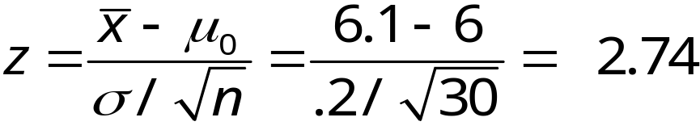
Two-Tailed Tests About a Population Mean:
σ Known
Glow
p –Value and Critical Value Approaches
1. Determine the hypotheses.
H₀: μ = 6
H_{a}:
2. Specify the level of significance.
α = .03
3. Compute the value of the test statistic.

Slide 30
Two-Tailed Tests About a Population Mean:
σ Known
Glow
p –Value Approach
4. Compute the p –value.
For z = 2.74, cumulative probability = .9969
p–value = 2(1 − .9969) = .0062
5. Determine whether to reject H₀.
Because p–value = .0062 < α = .03, we reject H₀.
We are at least 97% confident that the mean filling weight of the toothpaste tubes is not 6 oz.

Slide 31
Two-Tailed Tests About a Population Mean:
σ Known
Glow
p-Value Approach
1/2
p -value
= .0031
1/2
p -value
= .0031
α/2 =
.015
α/2 =
.015
z
z = -2.74
0
z = 2.74
-z_{α/2} = -2.17
z_{α/2} = 2.17

Slide 32
Two-Tailed Tests About a Population Mean:
σ Known
Glow
Critical Value Approach
4. Determine the critical value and rejection rule.
For α/2 = .03/2 = .015, z_{.015} = 2.17
Reject H₀ if z < -2.17 or z > 2.17
5. Determine whether to reject H₀.
Because 2.47 > 2.17, we reject H₀.
We are at least 97% confident that the mean filling weight of the toothpaste tubes is not 6 oz.

Slide 33
Two-Tailed Tests About a Population Mean:
σ Known
Glow
Critical Value Approach
Sampling
distribution
of
Reject H₀
Do Not Reject H₀
Reject H₀
α/2 = .015
α/2 = .015
z
-2.17
0
2.17

Slide 34

Confidence Interval Approach to
Two-Tailed Tests About a Population Mean
Select a simple random sample from the population
and use the value of the sample mean to develop
the confidence interval for the population mean μ.
(Confidence intervals are covered in Chapter 8.)
If the confidence interval contains the hypothesized
value μ₀, do not reject H₀. Otherwise, reject H₀.

Slide 35
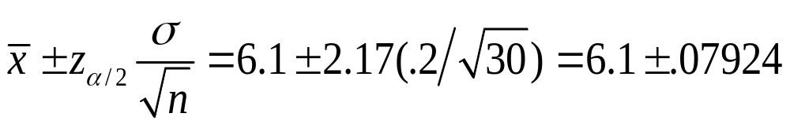
Confidence Interval Approach to
Two-Tailed Tests About a Population Mean
Glow
The 97% confidence interval for μ is
or 6.02076 to 6.17924
Because the hypothesized value for the
population mean, μ₀ = 6, is not in this interval,
the hypothesis-testing conclusion is that the
null hypothesis, H₀: μ = 6, can be rejected.

Slide 36
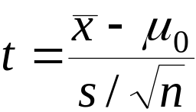
Tests About a Population Mean: σ Unknown
Test Statistic
This test statistic has a t distribution
with n - 1 degrees of freedom.

Slide 37
Tests About a Population Mean:
σ Unknown
Rejection Rule: p -Value Approach
Reject H₀ if p –value < α
Rejection Rule: Critical Value Approach
H₀: μ > μ₀
Reject H₀ if t < -t_{α}
H₀: μ < μ₀
Reject H₀ if t > t_{α}
H₀: μ = μ₀
Reject H₀ if t < - t_{α/2} or t > t_{α/2}

Slide 38
p -Values and the t Distribution
The format of the t distribution table provided in most
statistics textbooks does not have sufficient detail
to determine the exact p-value for a hypothesis test.
However, we can still use the t distribution table to
identify a range for the p-value.
An advantage of computer software packages is that
the computer output will provide the p-value for the
t distribution.

Slide 39

Example: Highway Patrol
One-Tailed Test About a Population Mean: σ Unknown
A State Highway Patrol periodically samples
vehicle speeds at various locations
on a particular roadway.
The sample of vehicle speeds
is used to test the hypothesis
H₀: μ < 65
The locations where H₀ is rejected are deemed
the best locations for radar traps.

Slide 40
Example: Highway Patrol
One-Tailed Test About a Population Mean: σ Unknown
At Location F, a sample of 64 vehicles shows a
mean speed of 66.2 mph with a
standard deviation of
4.2 mph. Use α = .05 to
test the hypothesis.

Slide 41
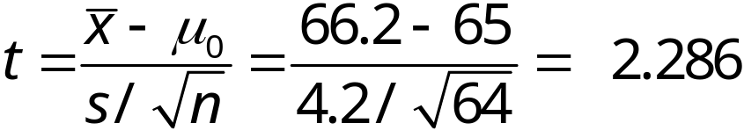
One-Tailed Test About a Population Mean:
σ Unknown
p –Value and Critical Value Approaches
1. Determine the hypotheses.
H₀: μ < 65
H_{a}: μ > 65
2. Specify the level of significance.
α = .05
3. Compute the value of the test statistic.

Slide 42
One-Tailed Test About a Population Mean:
σ Unknown
p –Value Approach
4. Compute the p –value.
For t = 2.286, the p–value must be less than .025
(for t = 1.998) and greater than .01 (for t = 2.387).
.01 < p–value < .025
5. Determine whether to reject H₀.
Because p–value < α = .05, we reject H₀.
We are at least 95% confident that the mean speed
of vehicles at Location F is greater than 65 mph.

Slide 43
One-Tailed Test About a Population Mean:
σ Unknown
Critical Value Approach
4. Determine the critical value and rejection rule.
For α = .05 and d.f. = 64 – 1 = 63, t_{.05} = 1.669
Reject H₀ if t > 1.669
5. Determine whether to reject H₀.
Because 2.286 > 1.669, we reject H₀.
We are at least 95% confident that the mean speed of vehicles at Location F is greater than 65 mph. Location F is a good candidate for a radar trap.

Slide 44
One-Tailed Test About a Population Mean:
σ Unknown
Reject H₀
Do Not Reject H₀
α = .05
t
0
t_{α} =
1.669

