Slide 1

Summarizing Quantitative Data
Frequency Distribution
Relative Frequency and Percent Frequency Distributions
Histogram
Cumulative Distributions
Ogive

Slide 2
Example
The ages of the people involved in accidents over a four month period were recorded as follows:

Slide 3
Example
31 | 16 | 22 | 50 | 30 | 42 | 63 | 33 | 56 | 64 | 41 | 37
41 | 63 | 31 | 17 | 61 | 53 | 30 | 52 | 32 | 28 | 54 | 36
65 | 24 | 41 | 26 | 54 | 49 | 19 | 31 | 56 | 32 | 20 | 54
64 | 54 | 52 | 58 | 17 | 19 | 64 | 42 | 23 | 43 | 34 | 33
42 | 21 | 41 | 24 | 41 | 64 | 61 | 46 | 34 | 40 | 30 | 43
54 | 43 | 45 | 53 | 30 | 43 | 40 | 30 | 25 | 52 | 58 | 28
60 | 32 | 24 | 34 | 43 | 23 | 42 | 59 | 54 | 45 | 51 | 41
50 | 58 | 44 | 40 | 64 | 24 | 42 | 62 | 46 | 52 | 21 | 25
51 | 56 | 50 | 60 | 65 | 40 | 41 | 61 | 16 | 40 | 25 | 55
52 | 19 | 41 | 26 | 52 | 56 | 62 | 57 | 16 | 21 | 26 | 29
48 | 26 | 62 | 43 | 58 | 25 | 21 | 52 | 42 | 33 | 39 | 26

Slide 4
Frequency Distribution
Guidelines for Selecting Number of Classes
Use between 5 and 20 classes.
Data sets with a larger number of elements
usually require a larger number of classes.
Smaller data sets usually require fewer classes

Slide 5
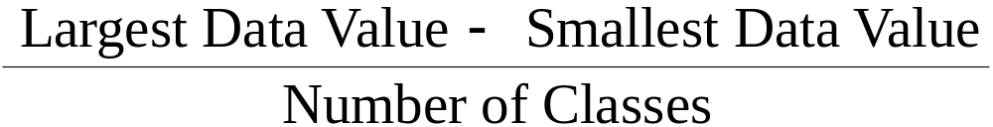
Frequency Distribution
Guidelines for Selecting Width of Classes
Use classes of equal width.
Approximate Class Width =

Slide 6
Frequency Distribution
For Example 2, if we choose six classes:
Approximate Class Width = (65 - 16)/6 = 8.2 =   9
Round up
We first prepare a Tally Sheet

Slide 7
Tally Sheet
Age | Tally
15 - 23 | IIII IIII IIII I
24 - 32 | IIII IIII IIII IIII IIII II
33 - 41 | IIII IIII IIII III
42 - 50 | IIII IIII IIII III
51 - 59 | IIII IIII IIII IIII IIII III
60 - 68 | IIII IIII IIII II

Slide 8
Frequency Distribution
15-23
24-32
33-41
42-50
51-59
60-68
16
27
22
22
28
17
Total 132
Age
Frequency

Slide 9
Relative Frequency and
Percent Frequency Distribution
Age
Relative
Frequency
Percent
Frequency
15-23
24-32
33-41
42-50
51-59
60-68
.121
.205
.167
.167
.212
.128
Total 1.00
12.1
20.5
16.7
16.7
21.2
12.8
100.0
16/132
.121(100)

Slide 10
Histogram
Another common graphical presentation of
quantitative data is a histogram.
The variable of interest is placed on the horizontal
axis.
A rectangle is drawn above each class interval with
its height corresponding to the interval’s frequency,
relative frequency, or percent frequency.
Unlike a bar graph, a histogram has no natural
separation between rectangles of adjacent classes.

Slide 11
Histogram
Example
36
32
28
24
Frequency
20
16
12
8
4
15−23 24−32 33−41 42−50 51−59 60-68
Age

Slide 12
Histogram
Symmetric
  Left tail is the mirror image of the right tail
.35
.30
.25
.20
Relative Frequency
.15
.10
.05
0

Slide 13
Histogram
Moderately Skewed Left
  A longer tail to the left
.35
.30
.25
.20
Relative Frequency
.15
.10
.05
0

Slide 14
Histogram
Moderately Right Skewed
  A Longer tail to the right
.35
.30
.25
.20
Relative Frequency
.15
.10
.05
0

Slide 15
Histogram
Highly Skewed Right
  A very long tail to the right
.35
.30
.25
.20
Relative Frequency
.15
.10
.05
0

Slide 16
Cumulative Distributions
Cumulative frequency distribution − shows the
number of items with values less than or equal to
the upper limit of each class..
Cumulative relative frequency distribution – shows
the proportion of items with values less than or
equal to the upper limit of each class.
Cumulative percent frequency distribution – shows
the percentage of items with values less than or
equal to the upper limit of each class.

Slide 17
Cumulative Distributions
Example
Cumulative
Relative
Frequency
Cumulative
Percent
Frequency
Cumulative
Frequency
< 23
< 32
< 41
< 50
< 59
< 68
Age
16
43
65
87
115
132
.121
.326
.492
.660
.871
1.00
12.1
32.6
49.2
66.0
87.1
100.0
16 + 27
43/132
.326(100)

Slide 18
Ogive
An ogive is a graph of a cumulative distribution.
The data values are shown on the horizontal axis.
Shown on the vertical axis are the:
  cumulative frequencies, or
  cumulative relative frequencies, or
  cumulative percent frequencies
The frequency (one of the above) of each class is plotted as a point.
The plotted points are connected by straight lines.

Slide 19
Ogive
  Because the class limits for the age data are 15-23, 24-32, and so on, there appear to be one-unit gaps from 23 to 24, 32 to 33, and so on.
Example
  These gaps are eliminated by plotting points halfway between the class limits.
  Thus, 23.5 is used for the 15-23 class, 32.5 is used for the 24-32 class, and so on.

Slide 20
Ogive with
Cumulative Percent Frequencies
Example
100
80
60
Cumulative Percent Frequency
(50.5, 66)
40
20
15 24 33 42 51 61 68
Age

Slide 21
Stem-and-Leaf Display
A stem-and-leaf display shows both the rank order
and shape of the distribution of the data.
It is similar to a histogram on its side, but it has the
advantage of showing the actual data values.
The first digits of each data item are arranged to the
left of a vertical line.
To the right of the vertical line we record the last
digit for each item in rank order.
Each line in the display is referred to as a stem.
Each digit on a stem is a leaf.

Slide 22

Example: Hudson Auto Repair
The manager of Hudson Auto
would like to have a better
understanding of the cost
of parts used in the engine
tune-ups performed in the
shop. She examines 50
customer invoices for tune-ups. The costs of parts,
rounded to the nearest Euro, are listed on the next
slide.

Slide 23
Example: Hudson Auto Repair
Sample of Parts Cost for 50 Tune-ups

Slide 24
Stem-and-Leaf Display
5
6
7
8
9
10
2 7
2 2 2 2 5 6 7 8 8 8 9 9 9
1 1 2 2 3 4 4 5 5 5 6 7 8 9 9 9
0 0 2 3 5 8 9
1 3 7 7 7 8 9
1 4 5 5 9
a stem
a leaf

Slide 25
Stretched Stem-and-Leaf Display
If we believe the original stem-and-leaf display has
condensed the data too much, we can stretch the
display by using two stems for each leading digit(s).
Whenever a stem value is stated twice, the first value
corresponds to leaf values of 0 - 4, and the second
value corresponds to leaf values of 5 - 9.

Slide 26
Stretched Stem-and-Leaf Display
5
5
6
6
7
7
8
8
9
9
10
10
2
7
2 2 2 2
5 6 7 8 8 8 9 9 9
1 1 2 2 3 4 4
5 5 5 6 7 8 9 9 9
0 0 2 3
5 8 9
1 3
7 7 7 8 9
1 4
5 5 9

Slide 27
Example: Leaf Unit = 0.1
If we have data with values such as
8.6 11.7 9.4 9.1 10.2 11.0 8.8
a stem-and-leaf display of these data will be
Leaf Unit = 0.1
8
9
10
11
6 8
1 4
2
0 7

Slide 28
Sample Mean
Example: Apartment Rents
Seventy efficiency apartments
were randomly sampled in
a small college town. The
monthly rent prices for
these apartments are listed
in ascending order on the next slide.

Slide 29
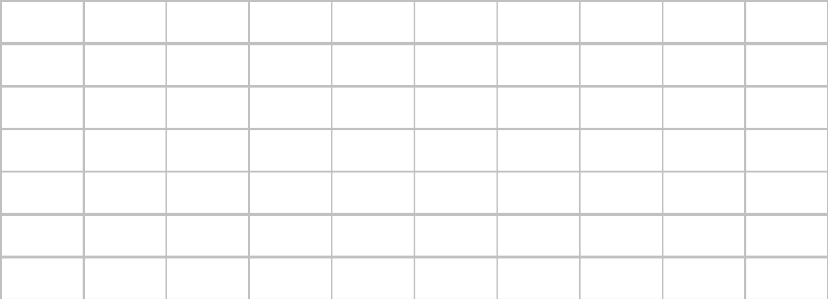
Sample Mean

Slide 30
Sample Mean

Slide 31
Median
For an odd number of observations:
26
18
27
12
14
27
19
7 observations
12
14
18
19
26
27
27
in ascending order
the median is the middle value.
Median = 19

Slide 32
Median
For an even number of observations:
26
18
27
12
14
27
30
19
8 observations
12
14
18
19
26
27
27
30
in ascending order
the median is the average of the middle two values.
Median = (19 + 26)/2 = 22.5

Slide 33
Median
Averaging the 35th and 36th data values:
Median = (475 + 475)/2 = 475

Slide 34
Mode
The mode of a data set is the value that occurs with
greatest frequency.
The greatest frequency can occur at two or more
different values.
If the data have exactly two modes, the data are
bimodal.
If the data have more than two modes, the data are
multimodal.

Slide 35
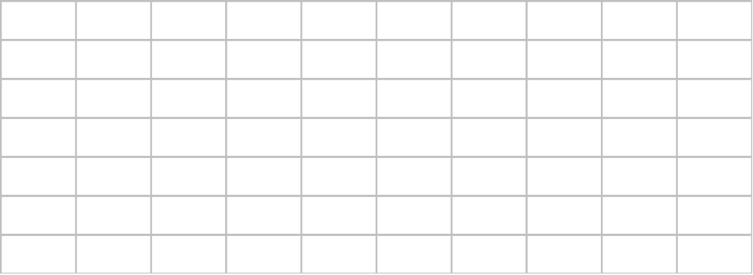
Mode
450 occurred most frequently (7 times)
Mode = 450

Slide 36
Percentiles
A percentile provides information about how the
data are spread over the interval from the smallest
value to the largest value.
Admission test scores for colleges and universities
are frequently reported in terms of percentiles.

Slide 37
Percentiles
The pth percentile of a data set is a value such that at least p percent of the items take on this value or less and at least (100 - p) percent of the items take on this value or more.

Slide 38
Percentiles
Arrange the data in ascending order.
Compute index i, the position of the pth percentile.
i = (p/100)n
If i is not an integer, round up. The p th percentile
is the value in the i th position.
If i is an integer, the p th percentile is the average
of the values in positions i and i +1.

Slide 39
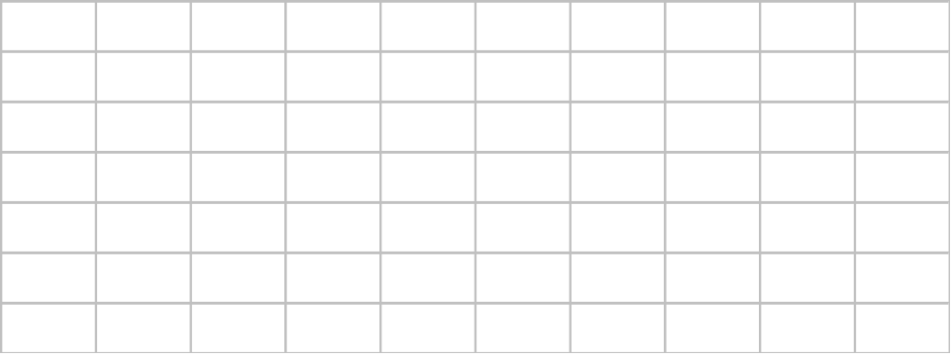
90th Percentile
i = (p/100)n = (90/100)70 = 63
Averaging the 63rd and 64th data values:
90th Percentile = (580 + 590)/2 = 585

Slide 40
90th Percentile
“At least 90%
of the items
take on a value
of 585 or less.”
“At least 10%
of the items
take on a value
of 585 or more.”
63/70 = .9 or 90%
7/70 = .1 or 10%

Slide 41
Quartiles
Quartiles are specific percentiles.
First Quartile = 25th Percentile
Second Quartile = 50th Percentile = Median
Third Quartile = 75th Percentile

Slide 42
Third Quartile
Third quartile = 75th percentile
i = (p/100)n = (75/100)70 = 52.5 = 53
Third quartile = 525

Slide 43
Range
The range of a data set is the difference between the
largest and smallest data values.
It is the simplest measure of variability.
It is very sensitive to the smallest and largest data
values.

Slide 44
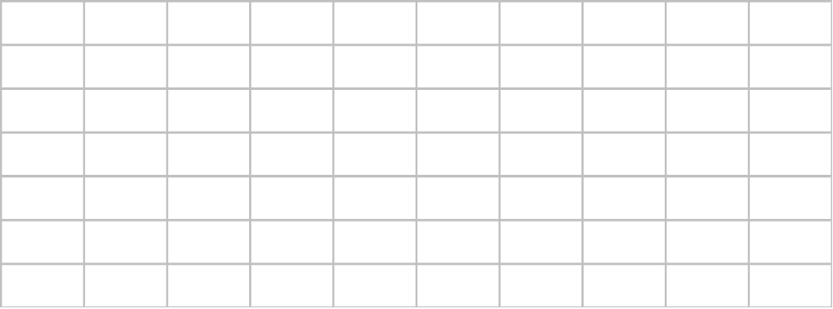
Range
Range = largest value - smallest value
Range = 615 - 425 = 190

Slide 45
Interquartile Range
The interquartile range of a data set is the difference
between the third quartile and the first quartile.
It is the range for the middle 50% of the data.
It overcomes the sensitivity to extreme data values.

Slide 46
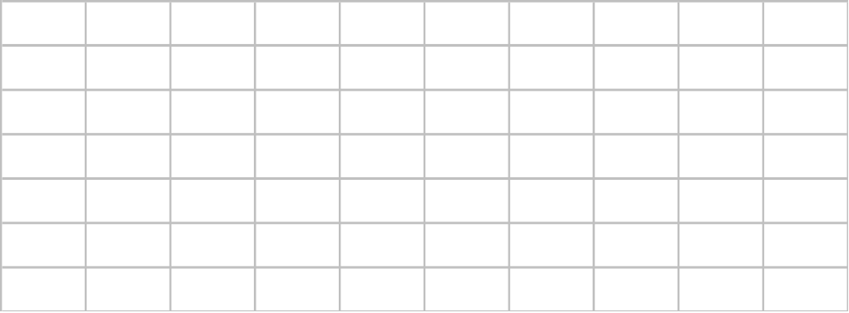
Interquartile Range
3rd Quartile (Q3) = 525
1st Quartile (Q1) = 445
Interquartile Range = Q3 - Q1 = 525 - 445 = 80

Slide 47
Five-Number Summary
1
Smallest Value
2
First Quartile
3
Median
4
Third Quartile
5
Largest Value

Slide 48
Five-Number Summary
Lowest Value = 425
First Quartile = 445
Median = 475
Third Quartile = 525
Largest Value = 615

Slide 49
Box Plot
A box is drawn with its ends located at the first and
third quartiles.
A vertical line is drawn in the box at the location of
the median (second quartile).
375
400
425
450
475
500
525
550
575
600
625
Q1 = 445
Q3 = 525
Q2 = 475

Slide 50
Box Plot
Limits are located (not drawn) using the interquartile range (IQR).
Data outside these limits are considered outliers.
The locations of each outlier is shown with the symbol * .
… continued

Slide 51
Box Plot
The lower limit is located 1.5(IQR) below Q1.
Lower Limit: Q1 - 1.5(IQR) = 445 - 1.5(80) = 325
The upper limit is located 1.5(IQR) above Q3.
Upper Limit: Q3 + 1.5(IQR) = 525 + 1.5(80) = 645
There are no outliers (values less than 325 or
greater than 645) in the apartment rent data.

Slide 52
Box Plot
Whiskers (dashed lines) are drawn from the ends of the box to the smallest and largest data values inside the limits.
375
400
425
450
475
500
525
550
575
600
625
Smallest value
inside limits = 425
Largest value
inside limits = 615

