Slide 1
Group 33: Sick Ideas Synergy Inventory Management System

Slide 2
Problem and Scope
Problem
Inventory system for small businesses
Market Inventory Management systems priced in the thousands
Scope
Node js
Typescript
CSS/HTML
Angular
Postgresql
Notes:
Purpose, scope, background information

Slide 3
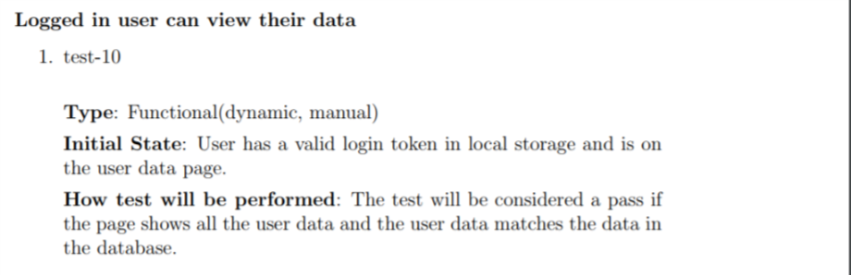
Testing
Unit Testing
Postman
Manual Testing

Slide 4
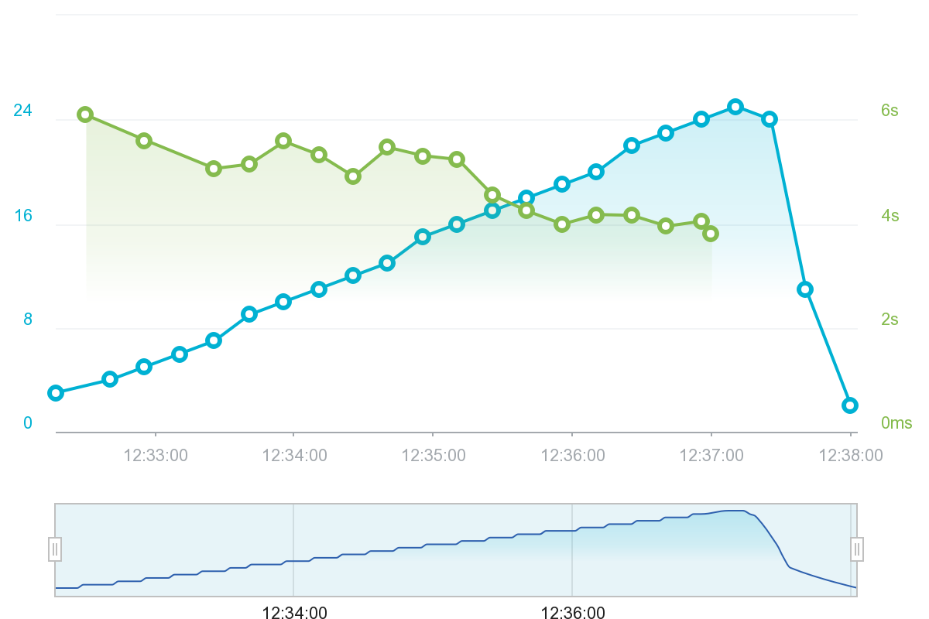
Measuring Performance
Number of users vs load times

Slide 5
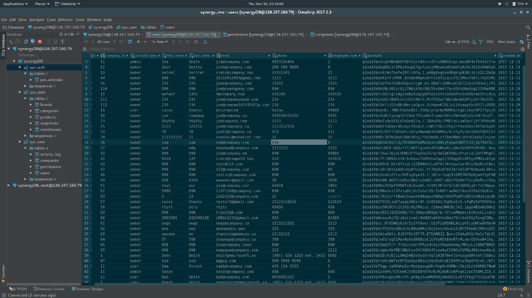
Security
Notes:
Hashing and encryption.

Slide 6
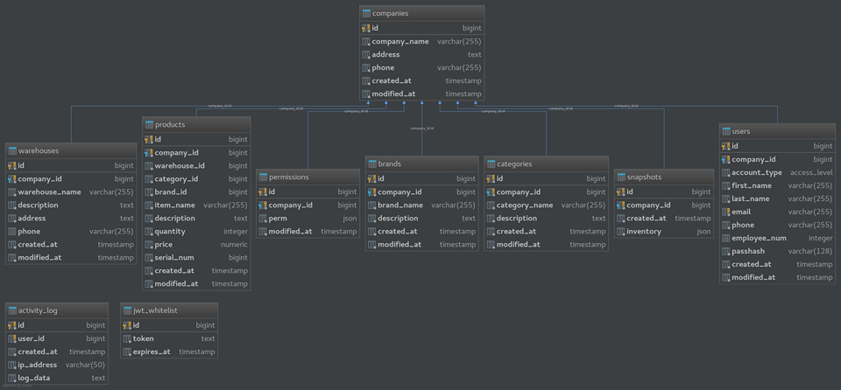
Database Schema
185,244 users
And a lot of users

Slide 7
^{Demo}
^{https://synergyims.me}

