Slide 1
Website Performance Optimization
Materials are from Udacity.com

Slide 2
How to make website run fast?
Critical Rendering Path
The sequence of steps the browser go through to convert the html, css and js to actual pixels on the screen, where we can optimize to make the webpage run fast.

Slide 3
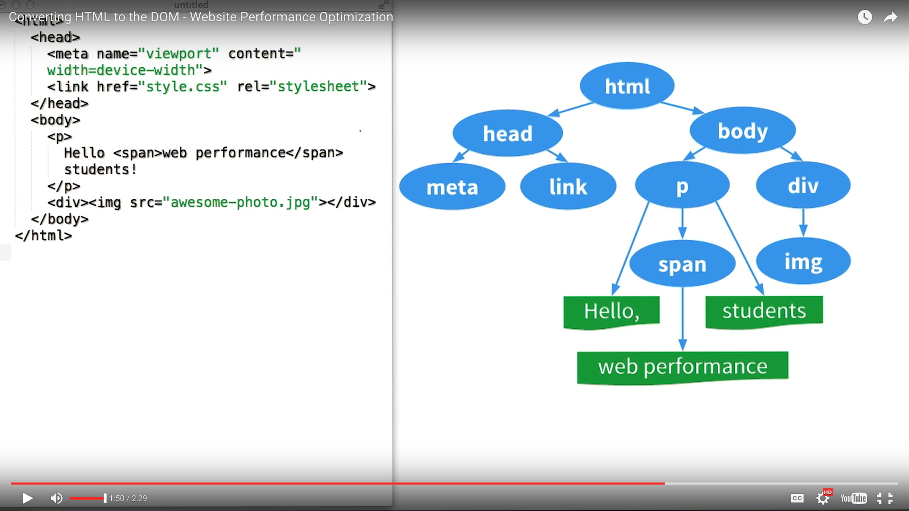
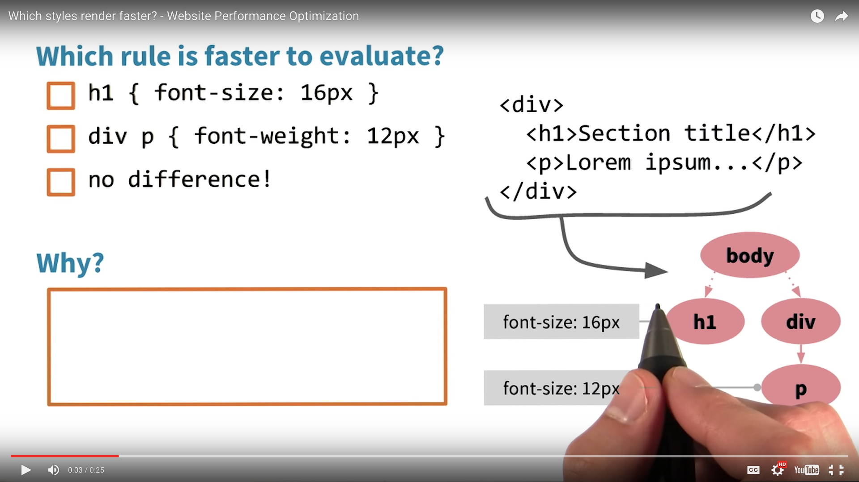
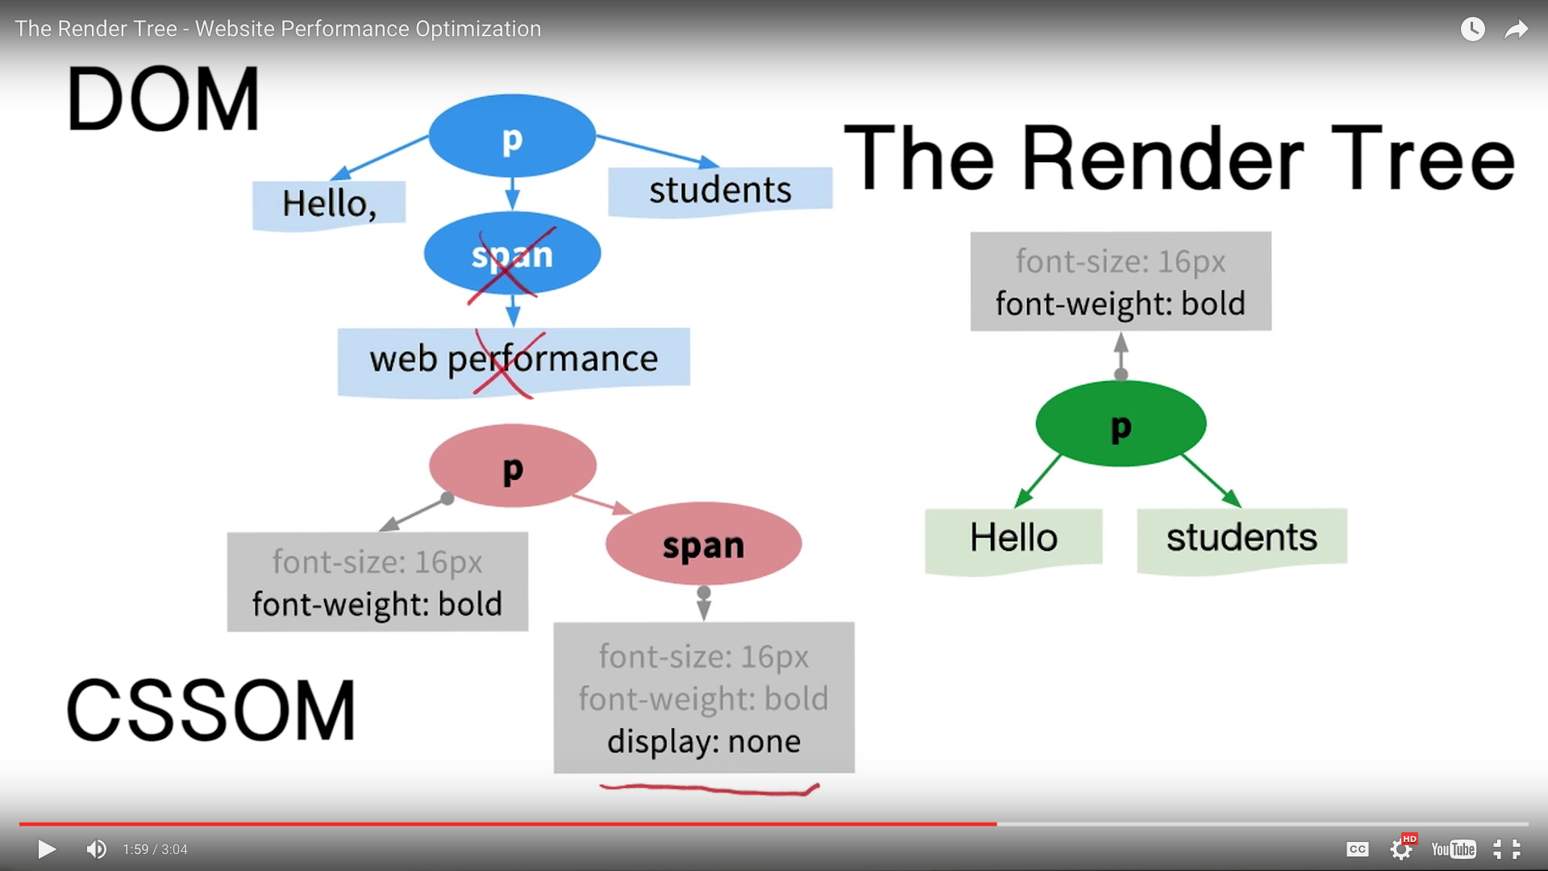
Look for patterns in the traces
DOMTree
CSSOM: inheritance, the less specific, the less work from browser
Layout
Paint
<meta name=“viewport” content=“width=device-width”>
Rotate your phone or resize the browser, “viewport” changes, every times it has to re-run layout

Slide 4
The procedure
Begin constructing the DOM by parsing HTML
Request CSS & JS resources
Parse CSS and construct the CSSOM tree
Execute JS
Merge DOM and CSSOM into the Render Tree
Run Layout, paint

Slide 5
Optimization of HTML
Minify the html: remove the comments so it won’t ship to browser https://developers.google.com/web/fundamentals/performance/optimizing-content-efficiency/optimize-encoding-and-transfer#minification-preprocessing--context-specific-optimizations
Compress the file https://developers.google.com/web/fundamentals/performance/optimizing-content-efficiency/optimize-encoding-and-transfer#text-compression-with-gzip
Cache https://developers.google.com/web/fundamentals/performance/optimizing-content-efficiency/http-caching
Unblocking CSS with Media Queries
Media Queries: https://developers.google.com/web/fundamentals/design-and-ui/responsive/fundamentals/
Separate the css into multiple files to speed up the rendering tree build and then use Media Query to download specific subsets of files: <link rel=“stylesheet” href=“style-print.css” media=“print”>

Slide 6
Javascript and the CRP
How to include the JS to the page?
Parser blocking if it modifies the DOM because it blocks, DOM construction when we encounter the script tag, especially the js is an external file
Sometimes css will block the rendering tree as well as the JS execution -> optimize CSS is important
For some JS scripts(such as analytics.js) that do not modify the DOM, we can ask the browser to load it after by using window.load() or by adding “async” tag
This way the js doesn’t block the DOM construction, CSSOM build, CRP.
Inline block always block the css object model. Usually you cannot use asyn on the inline script except for you put the js above the css

Slide 7
Minify, Compress, Cache (HTML, CSS, JS)
Minimize use of render blocking resource(CSS)
Use media queries on <link> to unblock rendering
Inline css
Minimize use of parser blocking resource(JS)
Defer JS execution
Use async attribute on <script>
https://developers.google.com/web/fundamentals/performance/critical-rendering-path/optimizing-critical-rendering-path

Slide 8
Need for pre-load feature from browser
http://andydavies.me/blog/2013/10/22/how-the-browser-pre-loader-makes-pages-load-faster/

Slide 9
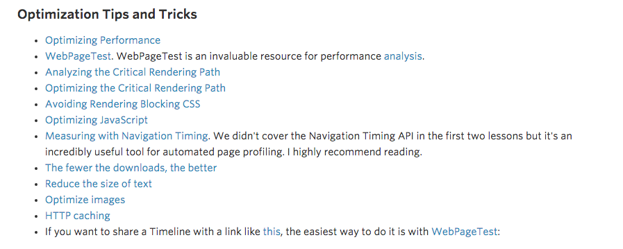
https://www.udacity.com/wiki/ud884

Slide 10
Browser Rendering Optimization - lesson 1 The CRP
Most devices refresh their screen 60 times per second, 60 frames per second 60 Hz, 60 fps
16.67ms/frame, 10ms/frame to avoid browser’s housekeeping work
http://jakearchibald.github.io/jank-invaders/
The browser makes a get request to the server.
No jank, smooth
What goes into one frame?
Vector image being rasterized into : image decode

Slide 11

Three ways the pipeline normally plays out for given frame
Visual change in JS, Style, layout, Paint and composite
Paint-only: background img, color. JS, Style, Paint and composite
Just composite: Js, Style and Composite
A web reference – css change associate to which process in the pipeline
http://csstriggers.com

Slide 12
Browser Rendering Optimization - lesson 2 App Lifecycles
Is it necessary to maintain 60fps? RAIL <-> LAIR
Response[1s]
Animate[10-12ms]
Idle [50ms]
Load[100ms]
How to take advantage of Idle time when users are reading the webpage? Which tasks should you handle during the post-load idle state? This is a great time to load any assets you think your users might access later. [ Image Assets, Videos, Comments sections, rather than News Texts and Basic, critical functionality]
Notes:
There are a lot of things you can do but the goal is not to maintain 60fps all the time. Here is the list of threshold for common users.

Slide 13
Thinking #perfmatters!
In the 50ms post-load idle phase, what tasks can you accomplish?
FLIPING UI animations
Starting below-the-fold async requests
Fetching images for below-the-fold content

Slide 14
Browser Rendering Optimization - lesson 3 Weapons of Jank Destruction
Chrome Dev Tool – Timeline
Test on various devices
Quit other apps
Go incognito
Focus on the cause of bottlenecks, not symptoms
Measure first, then optimize

Slide 15
Browser Rendering Optimization - lesson 4 Javascript
Javascript Compiler:
The Code you wrote may not be the code runs
Just In Time compiler (JIT) very complicated engine to make the code run fast
Load js as early as possible for the calculation and paint etc.
requestAnimationFrame [https://gist.github.com/paulirish/1579671] allow you to load JS as early as possible 4.4 PolyFill for IE9
Old time: setTimeout/setInterval

Slide 16
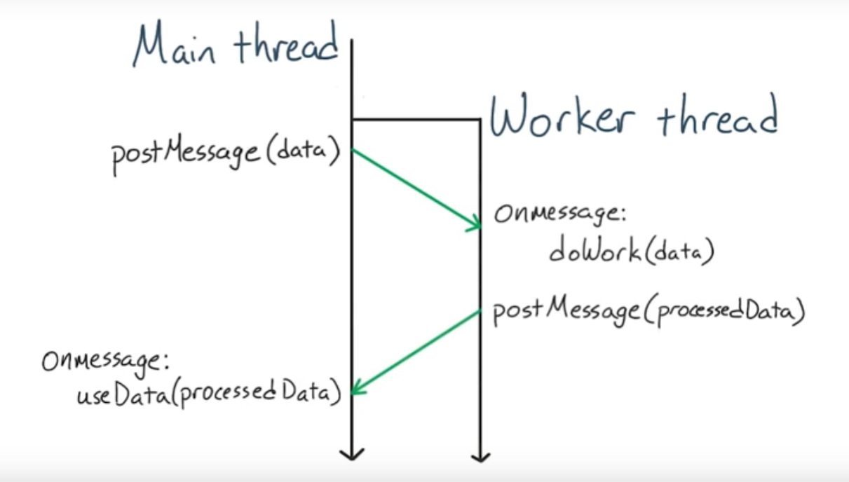
Web Worker
http://www.html5rocks.com/en/tutorials/workers/basics/#toc-inlineworkers
The Problem: JavaScript Concurrency
Two types: Dedicated Workers and Shared Workers
Interface to script to run in the background, different scope, different thread, won’t affect, or be affected by other thread
http://canaantt.github.io/web-workers-demo-master/
Notes:
The Problem: JavaScript Concurrency [order-independent]
There are a number of bottlenecks preventing interesting applications from being ported (say, from server-heavy implementations) to client-side JavaScript. Some of these include browser compatibility, static typing, accessibility, and performance. Fortunately, the latter is quickly becoming a thing of the past as browser vendors rapidly improve the speed of their JavaScript engines.
One thing that's remained a hindrance for JavaScript is actually the language itself. JavaScript is a single-threaded environment, meaning multiple scripts cannot run at the same time. As an example, imagine a site that needs to handle UI events, query and process large amounts of API data, and manipulate the DOM. Pretty common, right? Unfortunately all of that can't be simultaneous due to limitations in browsers' JavaScript runtime. Script execution happens within a single thread.
Developers mimic 'concurrency' by using techniques like setTimeout(),setInterval(), XMLHttpRequest, and event handlers. Yes, all of these features run asynchronously, but non-blocking doesn't necessarily mean concurrency. Asynchronous events are processed after the current executing script has yielded. The good news is that HTML5 gives us something better than these hacks!
Introducing Web Workers: Bring Threading to JavaScript
The Web Workers specification defines an API for spawning background scripts in your web application. Web Workers allow you to do things like fire up long-running scripts to handle computationally intensive tasks, but without blocking the UI or other scripts to handle user interactions. They're going to help put and end to that nasty 'unresponsive script' dialog that we've all come to love:
The goal is to stop Long running code from creating jank to the main thread

Slide 17
JS is GC
JavaScript is Garbage collected
Once the GC is running, nothing is running

Slide 18
Styles and Layout
Block Element Modifier (BEM)
Single class name, modulize, keep the selector matching simple

Slide 19
Compositing and Painting

