Slide 1
Qt Widgets vs Qt Quick
UI Development & Performance Scenarios
Can Ahmet Acar
Notes:
We will compare QtWidgets and Qtquick in other words qml using different cases.

Slide 2
Agenda
01
Shape Complexity
Custom, non-rectangular components
02
Rendering Performance
CPU vs GPU, on desktop and phone
03
Learning Curve & Development Speed
How fast a team gets productive
→
Conclusion
When to use which?
Notes:
I will make this comparison under three topics.
First, we will look at custom-shaped components.
Then, we will compare the rendering performance of Widgets and QML.
Finally, we will look at the learning curve and development speed.
At the end, I will sum up which one to choose, and when.

Slide 3
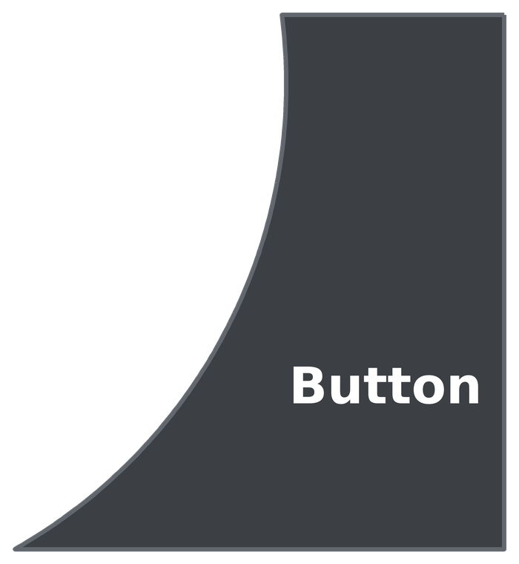
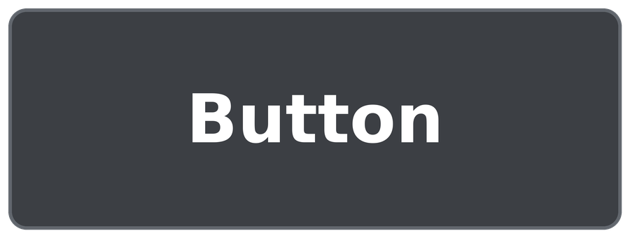
The Button Example
01
Most used control, simple in both
02
What if the shape changes?
→
QPushButton · Button {}
Notes:
Let us start with custom shape.
The button is most used component in widget and qml. It is very easy to use both side.
But if the changed, what happened ?
As you can see clearly on the screen one side is curved.
The widget and qml side let us drawing this shape. Lets compare how the draw the shape on each side.

Slide 4
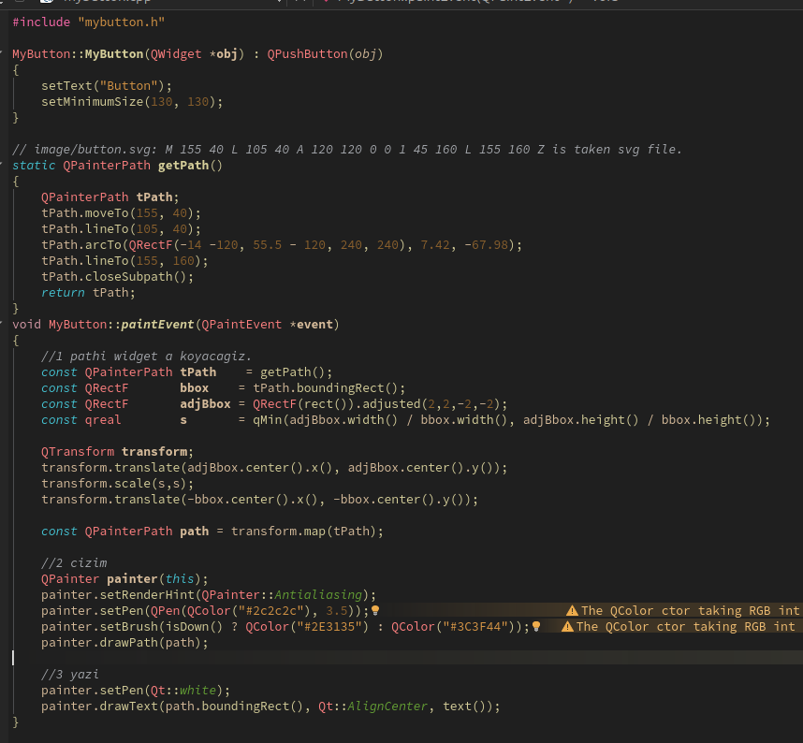
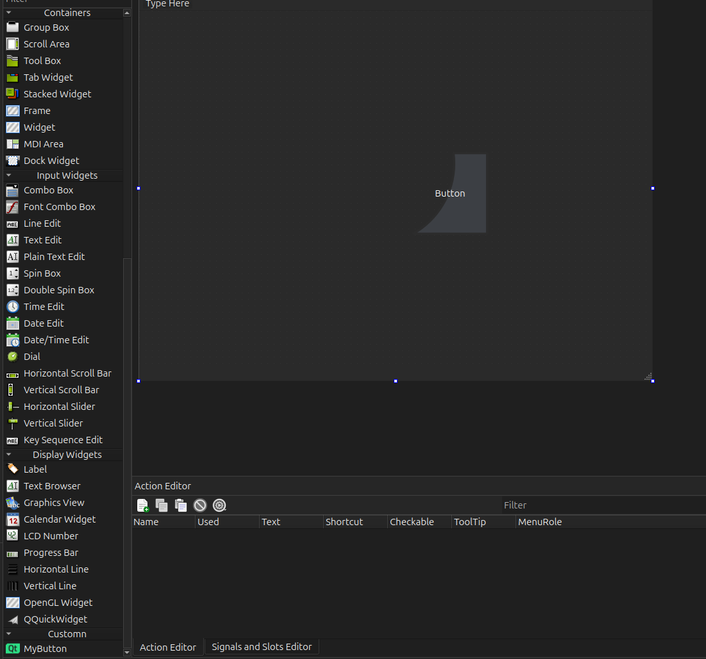
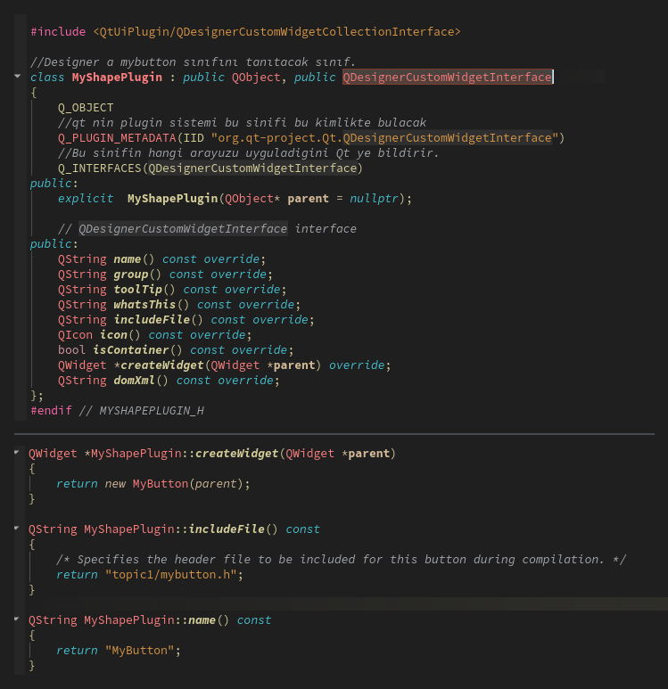
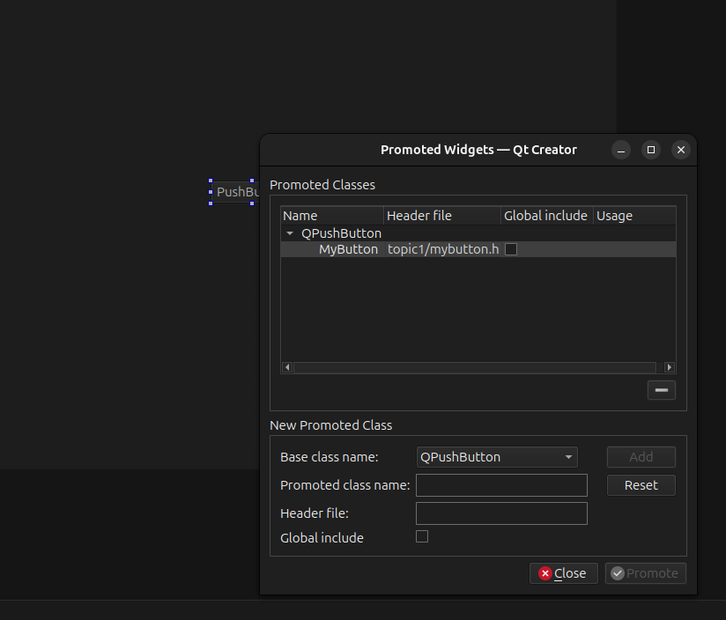
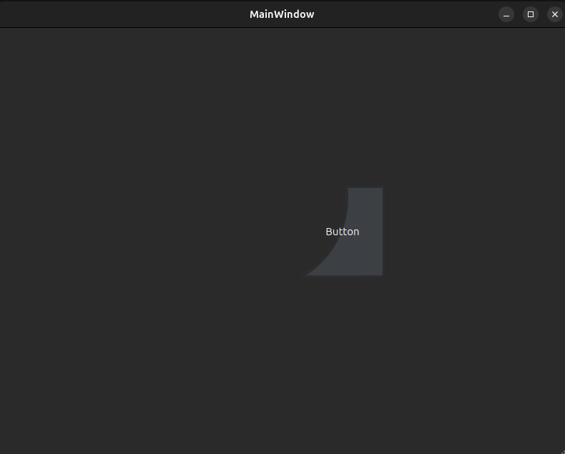
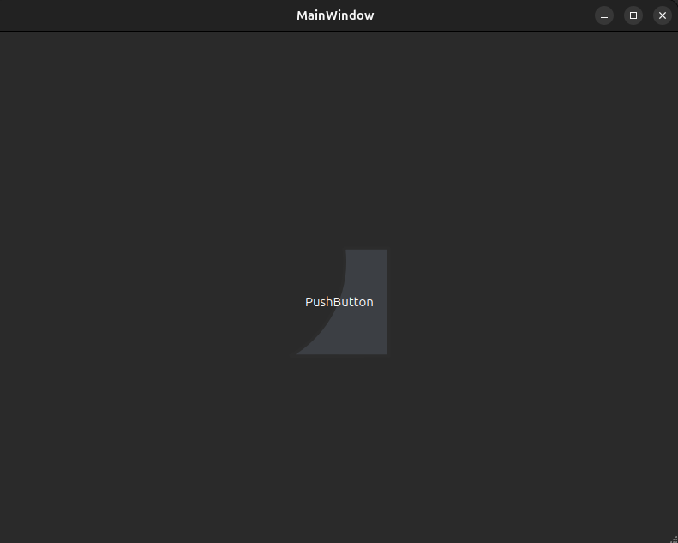
Custom Component (Widgets)
01
Method 1: Promote
Issue: shape not visible in Designer
02
Method 2: Plugin
Issue: the whole bounding box is clickable
Possible, but a lot of effort
Notes:
Before comparing, if you need a custom shape, we generally use an SVG file, because the SVG file has a path variable which is used for drawing.
The first method is Promote. A class which inherits QPushButton is created, and the class overrides the paintEvent method of QPushButton. The paintEvent method does the drawing process. And you can clearly see a QPainterPath, which is implemented using the path taken from the SVG file.
After doing this, we pass to Qt Designer, add a push button with drag and drop, and promote the button. Promote means linking a component to a C++ class. We don't see any changes on the Designer screen. But when we run the app, we can see our button is here.
If a developer uses the Designer screen, the developer wants to see the shape on the screen. This is an issue. How do we solve this problem? We use the plugin method.

Slide 5
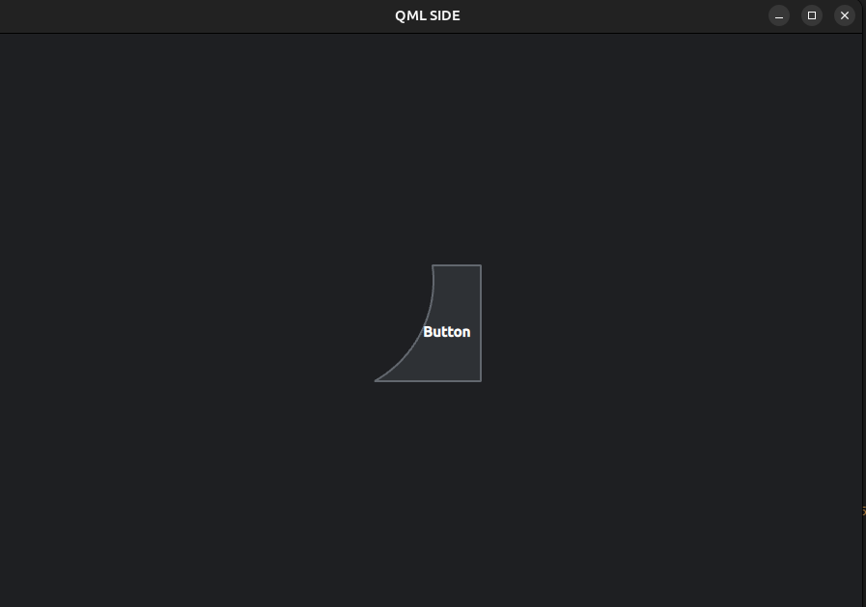
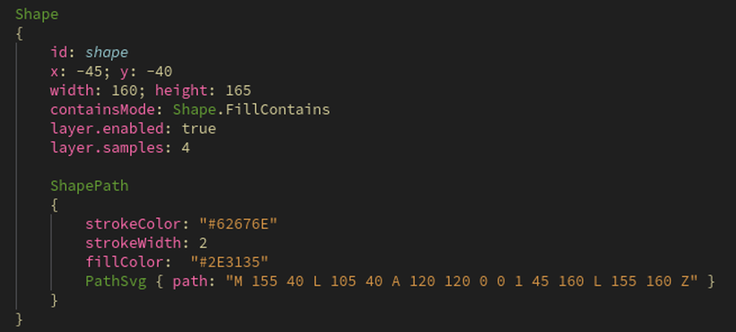
Custom Component (QML)
01
Copy the SVG path → PathSvg
02
Run: shape + click area OK
Widgets: 2 projects, ~150 lines
QML: ~40 lines
Notes:
Drawing is quite easy on the QML side. QML gives us the Shape component, and inside the Shape component we use PathSvg. We just paste the path text from the SVG file into PathSvg. Then we run the app, and you can clearly see our button is here. To sum up: on the Widgets side, this took about 150 lines of code and two projects. In QML, the same button is only about 40 lines. So if you need complex custom shapes, you should definitely use QML.

Slide 6
Rendering: CPU vs GPU
Source: doc.qt.io/qt-6/topics-ui.html
Feature | Qt Quick and Qt Quick Controls | Qt Widgets | Explanation
Hardware-accelerated graphics | Yes (GPU-accelerated via Qt Quick Scene Graph). | Partially (widgets render in software. OpenGL widgets possible but isolated). | Only Qt Quick provides built-in full-scene GPU acceleration.
Fluid animations and transitions | Yes (GPU-accelerated animations built-in). | Limited (supported via QPropertyAnimation, but not designed for fluid UI animation). | Qt Quick is designed for animated, modern UIs. Qt Widgets are not.
Graphical effects | Yes (shader-based blur, glow, drop shadow, color effects, and more). | Limited (basic effects via Qt GUI only). | Qt Quick offers rich, GPU-driven visual effects. Qt Widgets offer only simple CPU effects.
Notes:
The table taken qt offical website. Three row is related our topic.
First row hardware acceleration, The qt quick is running on GPU wihle Qt widget render in software which menans runnign on CPU.
Second row is animation. Qml is designed for animated and moder UIs. Widget can do animations but don’t designed for this. As you incerease load on cpu, fps drop. We will see fps drop in a example.
Third row is effects. Efecet like blurring, shadow is running on GPU for Qt quick. Qt widget have basic CPU effects. We have also a simple blur test.
The result from the table. Widget draw on CPU, QML Draw on GPU. Not lets see our exmaple.

Slide 7
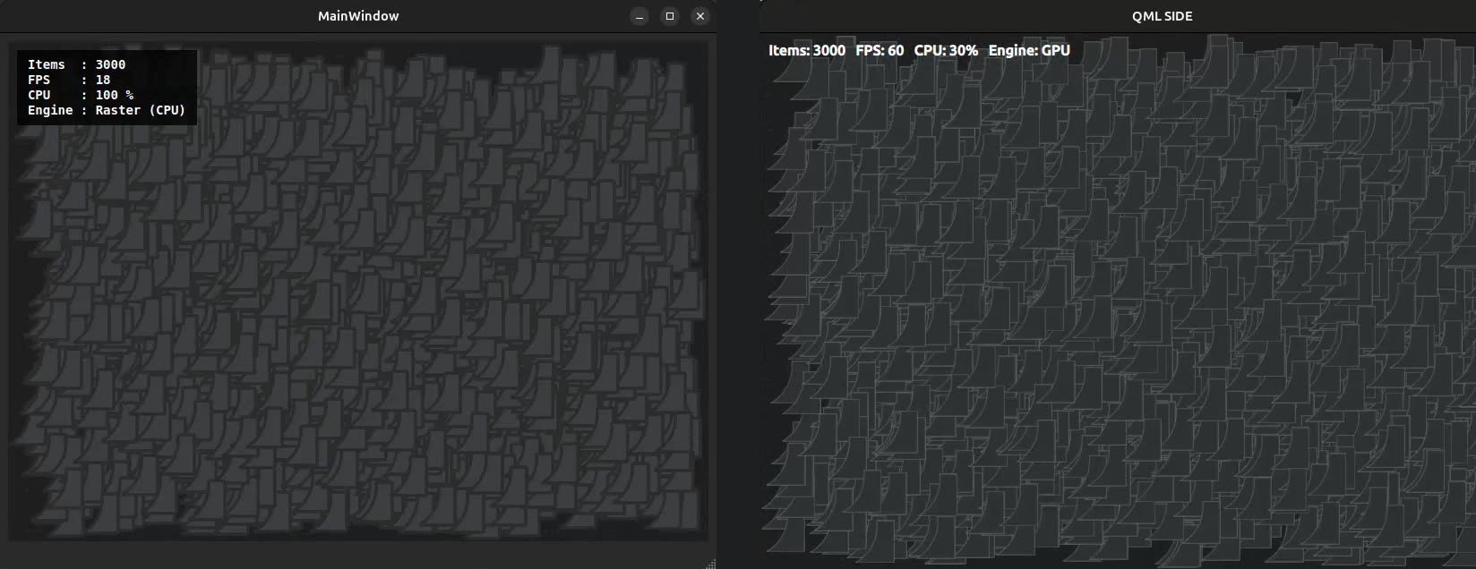
Under Load
7. slayt **Under Load** için son halini aşağıya koydum. Senin metnin, düzeltmeler ve "by itself" ile: > The example is related to animations. On the left side is Qt Widgets: with 3000 buttons, we get nearly twenty FPS, and the CPU usage is 100 percent. > > Calculating the positions and painting the pixels both run on the CPU. > > But on the QML side, the example is perfectly stable: we get 60 FPS, and the CPU usage is about 30 percent. > > QML splits the work into two big parts by itself: calculating the positions runs on the CPU, and painting the pixels runs on the GPU. > > The example shows that if the UI has animations, the developer should prefer QML.
Qt Widgets
Qt Quick (QML)
3000 buttons · 18 FPS · CPU 100%
3000 buttons · 60 FPS · CPU 31%
CPU: positions + paints every pixel (QPainter)
CPU: positions only → GPU: paints pixels
Notes:
7. slayt **Under Load** için son halini aşağıya koydum. Senin metnin, düzeltmeler ve "by itself" ile:
> The example is related to animations. On the left side is Qt Widgets: with 3000 buttons, we get nearly twenty FPS, and the CPU usage is 100 percent.
>
> Calculating the positions and painting the pixels both run on the CPU.
>
> But on the QML side, the example is perfectly stable: we get 60 FPS, and the CPU usage is about 30 percent.
>
> QML splits the work into two big parts by itself: calculating the positions runs on the CPU, and painting the pixels runs on the GPU.
>
> The example shows that if the UI has animations, the developer should prefer QML.

Slide 8
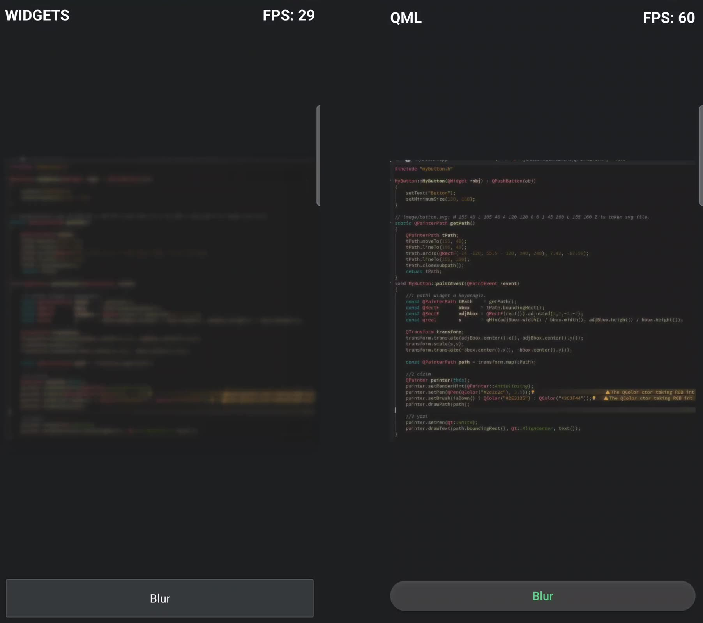
Blur on Android (Phone)
Source: doc.qt.io/qt-6/embedded-linux.html
“If your UI benefits from animations, … rendering effects, … you need to have GPU acceleration, and thus Qt Quick.”
Qt Widgets
Qt Quick (QML)
~30 FPS · CPU
60 FPS · GPU
Recorded at 60 Hz (the screen recorder can't capture 120 Hz). At 120 Hz, QML runs at 120 FPS.
Notes:
For complex UIs, using Qt Widgets on embedded targets is not recommended, because Qt Widgets use a software backend. Software backend means that the CPU handles all the drawing.
With the blur effect, we are getting nearly 30 FPS in the Widgets application, but we are getting 60 FPS in the QML application. Actually, the screen recorder is not fast enough for 120 Hz, so I changed my phone's screen rate to 60 Hz. Normally, the QML side gives 120 FPS.
If you are using an embedded system, QML gives better performance.

Slide 9
Learning Curve
Scenario: a USART parser tool — just a line edit and a button. Short deadline.
Qt Widgets
Qt Quick (QML)
• One language: C++
• Two languages: QML + C++
• Drag & drop QLineEdit + QPushButton
• Learn QML layouts
• Layout: one click in Designer
• Learn QML-to-C++ signals & slots
• Right-click → Go to slot: auto-generated
• Write the connections by hand
Notes:
Let's move on to the last topic: the learning curve.
Think about a developer who doesn't know anything about QML or Widgets.
But the developer must make an app which parses USART data and shows the data on the screen, and there is a short deadline.
The developer can make the app easily on the Widgets side, because drag and drop and the layout mechanism are very clear. And generating the signal connection is automated: right-click, Go to slot.
But on the QML side, the developer must know QML layouts, how to connect the signal and slot mechanism between QML and C++, and the Q_INVOKABLE and Q_PROPERTY keywords. Therefore, QML is more complex than Widgets for this app.

Slide 10
Conclusion: When to Use Which?
Choose Qt Quick (QML)
Choose Qt Widgets
• Animated, modern UI
• Classic desktop design
• Custom shapes and visual effects
• Complex tables, standard controls
• Embedded & mobile with a GPU
• Simple tools with a short deadline
Notes:
To sum up: if your app has animations, custom shapes or effects, or runs on an embedded device, choose QML. If your app is a classic desktop app with tables and standard controls, or a simple tool with a short deadline, choose Widgets. Thank you for listening. Any questions?

