Slide 1
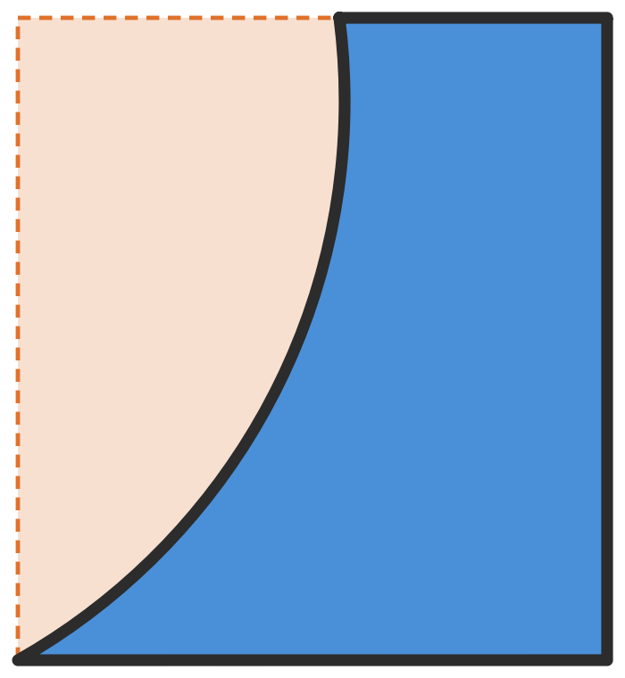
Qt Widgets vs Qt Quick
UI development across different use cases
Chapter 1 Shape Complexity
Notes:
Ten-minute talk, four comparisons. Today: chapter one, shape complexity. The shape on the right is the button we will build in both toolkits.

Slide 2
Four comparisons
1
Shape Complexity
Today
A button that isn't a rectangle
2
Data Load & UI Responsiveness
Large tables, frozen UIs and the render thread
3
Animation & 3D Capabilities
QPainter on the CPU vs the scene graph on the GPU
4
Learning Curve & Development Speed
Designer forms vs declarative bindings
Qt Widgets vs Qt Quick · 01 Shape Complexity
2
Notes:
Four chapters. Each one picks a concrete task and builds it both ways. Today we cover the first one.

Slide 3
01
Shape Complexity
Same button, two toolkits
Notes:
A rectangular button is a one-liner in both toolkits. Things change when the shape isn't a rectangle.

Slide 4
The task: a button that isn't a rectangle
SOURCE: image/button.svg
M 155 40 L 105 40 A 120 120 0 0 1 45 160 L 155 160 Z
1
Draw it from the SVG path
Straight edges plus one arc
2
Accept clicks only inside the shape
The empty corner belongs to the bounding box, not the button
3
Place it from the designer
Drag, drop and wire up clicked() like any other button
Button
Bounding box only: must not click
Qt Widgets vs Qt Quick · 01 Shape Complexity
4
Notes:
The shape comes from a designer's SVG. Three requirements: draw it from that path, ignore clicks in the orange area, and use it from the designer like a normal button.

Slide 5
Widgets: subclass it and paint it yourself
WIDGETS
1
Subclass QPushButton
2
Override paintEvent()
3
Override hitButton()
clicked(), text and focus come for free
Build a QPainterPath, scale it to rect(), draw it
Otherwise the empty corner still clicks
class MyButton : public QPushButton
{
Q_OBJECT
public:
explicit MyButton(QWidget *parent = nullptr);
protected:
void paintEvent(QPaintEvent *event) override; // draw the path
bool hitButton(const QPoint &pos) const override; // shape-aware hit test
};
Qt Widgets vs Qt Quick · 01 Shape Complexity
5
Notes:
Three overrides. paintEvent draws the path; hitButton is the one people forget, and without it the transparent corner still triggers clicked().

Slide 6
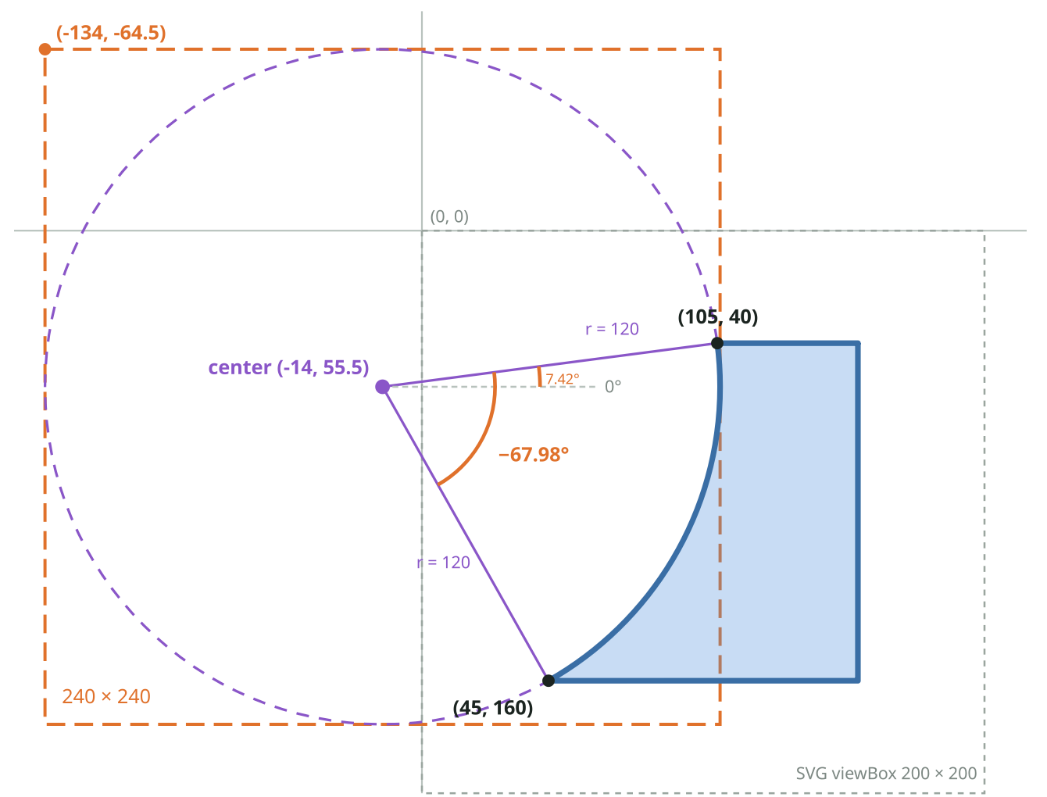
The SVG arc has to be translated by hand
WIDGETS
SVG: ENDPOINT FORM
A 120 120 0 0 1 45 160
End point, radius and two flags. The center and angles are implied.
QT arcTo(): CENTER FORM
arcTo(QRectF(-134, -64.5, 240, 240),
7.42, -67.98);
Square around the circle, start angle, sweep.
Someone has to solve for the center, then the angles.
Qt Widgets vs Qt Quick · 01 Shape Complexity
6
Notes:
SVG describes an arc by where it ends. Qt's arcTo wants the circle's bounding square and angles. The center (-14, 55.5) comes from the two circle equations; the angles from atan. Start 7.42 degrees, sweep minus 67.98, negative because it runs clockwise.

Slide 7
Getting it into Designer: Promote or plugin
WIDGETS
Promote
Designer plugin
Right click a QPushButton → Promote to…
QDesignerCustomWidgetInterface → .so
+
No extra project, just the .h/.cpp
+
Real shape in the Widget Box
–
Designer shows a plain rectangle
+
Custom properties in the Property Editor
–
Custom properties not editable
–
Separate project, same Qt and compiler
+
Change → rebuild the app
–
Change → rebuild, deploy, restart Creator
Qt Widgets vs Qt Quick · 01 Shape Complexity
7
Notes:
Promote is cheap but blind: you design against a rectangle. The plugin gives a true preview, but it's a second build artifact you deploy into Creator and restart for every change.

Slide 8
QML: declare it
QML
1
PathSvg
Item {
id: root
width: 110; height: 120
signal clicked()
Shape {
id: shape
x: -45; y: -40 // bbox (45,40) -> (0,0)
containsMode: Shape.FillContains
ShapePath {
strokeColor: "#2c2c2c"; strokeWidth: 3.5
fillColor: area.pressed ? "#2f6db0" : "#4a90d9"
PathSvg {
path: "M 155 40 L 105 40 A 120 120 0 0 1 45 160 L 155 160 Z"
}
}
}
MouseArea {
id: area
anchors.fill: parent
containmentMask: shape
onClicked: root.clicked()
}
}
The SVG path is pasted as-is. No center, no angles.
2
containmentMask
Clicks only inside the shape. Without FillContains the mask is still the bounding box.
3
One .qml file
Usable in the designer and at runtime the moment it is saved.
Qt Widgets vs Qt Quick · 01 Shape Complexity
8
Notes:
The SVG string goes straight into PathSvg. containmentMask plus FillContains gives the shaped hit area. QML isn't magic here: forget FillContains and the empty corner clicks again, same as forgetting hitButton.

Slide 9
Side by side
WIDGETS
QML
~70
~25
lines of C++
lines of QML
2 files + hand-computed arc geometry
1 file, SVG path used as-is
 | Widgets | QML
Draw from the SVG path | Convert the arc to center + angles | PathSvg, path pasted as-is
Click only inside the shape | Override hitButton() | containmentMask + FillContains
See it in the designer | Plugin (.so), or Promote (rectangle) | Works once the .qml file exists
Qt Widgets vs Qt Quick · 01 Shape Complexity
9
Notes:
Line counts are from the demo project: MyButton header and source including hitButton, versus the single ComplexButton.qml file.

Slide 10
TAKEAWAY
In QML a custom shape is a description. In Widgets it is a calculation.
Neither gives a shaped hit area for free: hitButton() in Widgets, containsMode: FillContains in QML.
Live demo click the empty corner on both buttons
Notes:
Demo: run both windows, click inside each shape, then click the empty corner. Neither reacts. Then mention what it took to get there in each toolkit.

