Slide 1
Any device (Mobile, Desktop, Virtual Assistant, In-person, Call Centre)
Channels
CDXP
API
Store
Service
Bus
Messaging
Bulk
Data
Gateway
Canadian Digital Exchange Platform
Identity
Point to Point
API
API
API
API
API
API
API
Monolithic Application
Feature A
Feature B
Feature C
Feature A
Feature B
Feature C
Feature D
Authentication and Authorization
Service Domain
Service Domain
App Server
App Server
Runtime
Runtime
Runtime
Runtime
Runtime
Data Store
Data Store
Data Store
Data Store
Data Store
Data Store
Data Store

Slide 2
Technology Lens
Users verified and granted appropriate level of assurance. Data encrypted at rest and in motion
Any device (Mobile, Desktop, Virtual Assistant, In-person, Call Centre)
Systems of
engagement
Channels
Technical Debt: Mainframe, Siebel, Lotus Notes, VB6
API Store publishes inventory of services
CDXP
Systems of
integration
API
Store
Service
Bus
Messaging
Bulk
Data
Gateway
Canadian Digital Exchange Platform
Sign in Canada (Pan Canadian Trust Framework)
API
API
API
API
API
API
Point to Point
API
Authentication and Authorization
Monolithic Application
Feature A
Feature B
Feature C
Feature A
Feature B
Feature C
Feature D
Service Domain
Service Domain
SaaS AI, Blockchain, and other emerging technologies
Systems of record
Runtime
Runtime
Runtime
Runtime
Runtime
App Server
App Server
Leveraging open source Vs. COTS when possible. Customization is least-preferred
Data Store
Data Store
Data Store
Data Store
Data Store
Data Store
Data Store
Outer Architecture*
Mostly hosted in the public cloud
Macroservices
Miniservices
Microservices

Slide 3
Citizen Lens
Future OneGC
Any device (Mobile, Desktop, Virtual Assistant, In-person, Call Centre)
Channels
CDXP
API
Store
Service
Bus
Messaging
Bulk
Data
Gateway
Current State CRA, ESDC Services
Near future IRCC TR
Canadian Digital Exchange Platform
Sign in Canada (Pan Canadian Trust Framework)
Point to Point
API
API
API
API
API
API
API
Monolithic Application
Feature A
Feature B
Feature C
Feature A
Feature B
Feature C
Feature D
Authentication and Authorization
Service Domain
Service Domain
App Server
App Server
Runtime
Runtime
Runtime
Runtime
Runtime
Data Store
Data Store
Data Store
Data Store
Data Store
Data Store
Data Store
Future tell us once for attributes

Slide 4
GC Department-Specific and GC Enterprise Lens
GC Employees verified and granted appropriate level of assurance. Data encrypted at rest and in motion
GC device (Mobile, Desktop, Virtual)
Channels
GC Key
CDXP
API Store publishes inventory of services
API
Store
Service
Bus
Messaging
Bulk
Data
Gateway
Canadian Digital Exchange Platform
GC Key
API
API
API
API
API
API
API
API
Publish Content
Generate Pay Slip
Contract Bid
EE Security Screen
Feature A
OAS
Feature C
HS Class
PSPC ISST
Authentication and Authorization
CMS & UXM
Runtime
Runtime
PSPC EPS
Runtime
Runtime
Runtime
Runtime
CBSA CARM
Runtime
Runtime
NextGen HR & Pay
ESCD BDM (+CPP, EI)
Data Store
Data Store
Data Store
Data Store
Data Store
Data Store
Data Store
Data Store
GC Enterprise (Back Office)
Program-Specific (Departmental Front Office)

Slide 5
Backup and references

Slide 6
*The outer architecture:
The architecture of the operating environment and distributed management ecosystem in which microservices are built, deployed and executed.
Standardizing the outer architecture across teams is key to scaling microservices adoption.
Basic features include:
Components to provide load balancing
Backing services to handle issues such as data persistence
(Gartner, How to Succeed With Microservices Architecture Using DevOps Practices, Published 22 January 2019 ID: G00360897)

Slide 7
Feedback from GC Chief Architect:
Programs, not Departmental silos
Privacy
Master Data Management
Feedback from GC CTO:
Desktop
Enterprise Infrastructure
Enterprise Apps (Back office) - Data
Security
Services (loaded term,) (OneGC, “Departmental” Programs) - Data
Front office – Data

Slide 8
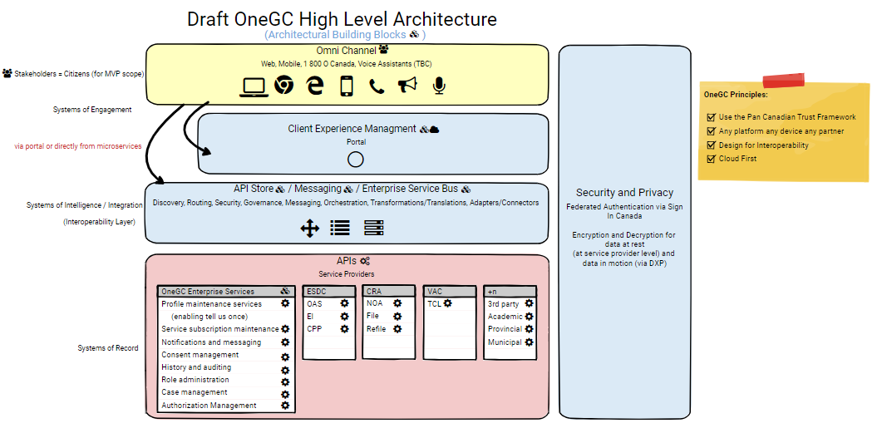

Slide 9
