Slide 1
Communicating page feedback Templates for sharing user feedback trends and insights

Slide 2
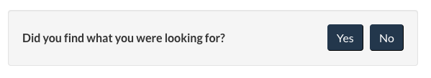
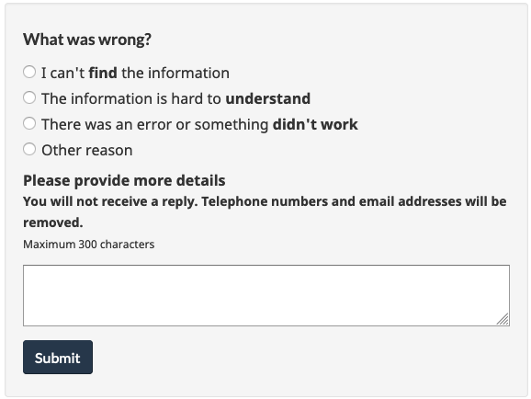
Help people understand how feedback is collected
The feedback form at the bottom of the web page invites visitors to:
indicate if they found what they were looking for (yes / no)
indicate a reason for why not with a description in their own words
30K+ Comments since December 7
64 Pages have a feedback form
Link to full list of pages collecting feedback

Slide 3
Template: A basic one page feedback data summary
55% of this week’s feedback was about [task] (up from 48% last week)
“Quotation from feedback to illustrate.”
FEEDBACK BY TASK | Comments | % of Total | Change
Task name 1 | 553 | 55 | ↑
Specific issue 1 | 200
Specific issue 2 | 100
Task name 2 | 158 | 15 | ↓
Specific issue 1
Task name 2 | 95 | 9 | ↔
Specific issue 1
HIGHLIGHTS
Feedback volume
Up 32% this week (739 -> 1022 this week)
Pages with most feedback
Page title 1
Page title 2
Top tasks
Task name 1
Task name 2
Task name 3
Date: November 9-14, 2020
Total comments: 1022

Slide 4
Template: High-level red flags and emerging issues
Top issues in web feedback December 20-31, 2021
Issue / questions | Type of problem | Page(s) affected
Issue 1 Description of the issue | Policy gap | Page title
Issue 2 Description of the issue | Policy gap | Page title
Highlight problems that go beyond the scope of your team’s work and need to be escalated - such as:
Policy gaps
Content gaps / incorrect information that require a subject matter expert
Technical issues

Slide 5
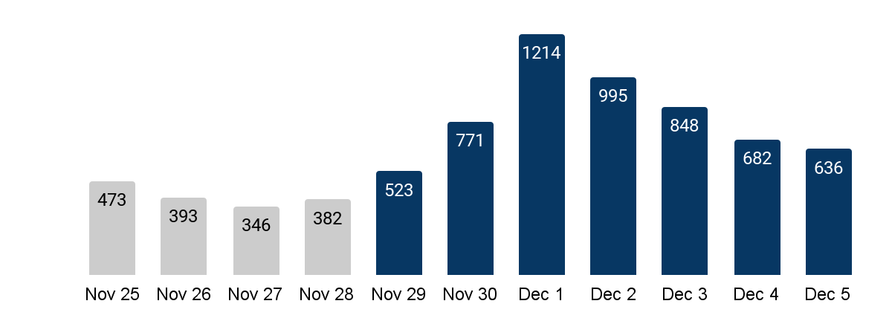
Template: Show a trend in volume of feedback
Feedback spiked when the new policy came into effect
Research questions this helps to answer
How many comments were received over a period?
Is the volume of feedback going up or down?
Did an announcement trigger more feedback?
Did making changes to a page reduce feedback?
Use bar or line charts to show trends and changes | Additional details to consider including
Across all pages, a group of pages, a single page Across feedback tagged with a specific issue If something is improving or becoming more urgent issue on a daily, weekly, or monthly basis | Main point as the title Annotate anomalies or notable insights on the timeline A sidebar with important dates: content changes, announcements, or decision points Overlaying the timeline with web traffic analytics

Slide 6
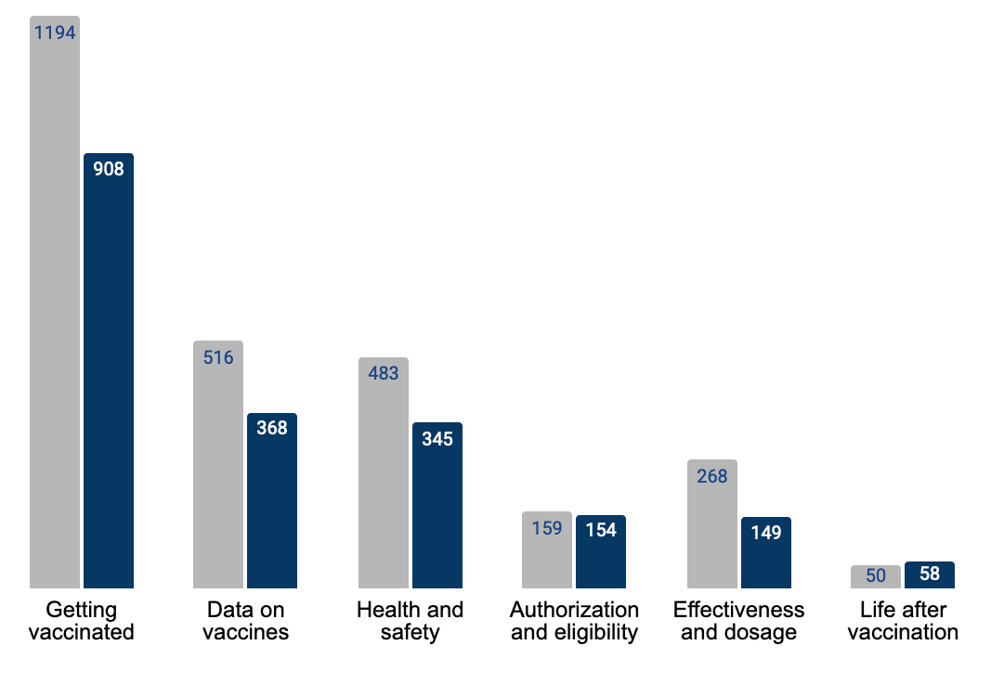
Template: Show trends in specific issues or tasks
People had trouble finding links to get vaccinated
Research questions this helps to answer
What issues are driving the majority of feedback? Did feedback increase or decrease when compared to a previous time frame?
Use bar charts to compare data by time frame
Across pages or tasks
Additional details to consider including
Main point as the title Comparisons to show if the page feedback has increased or decreased Annotate anomalies or notable insights on the chart Consider adding a link to your tagging strategy document
44% of all feedback

Slide 7
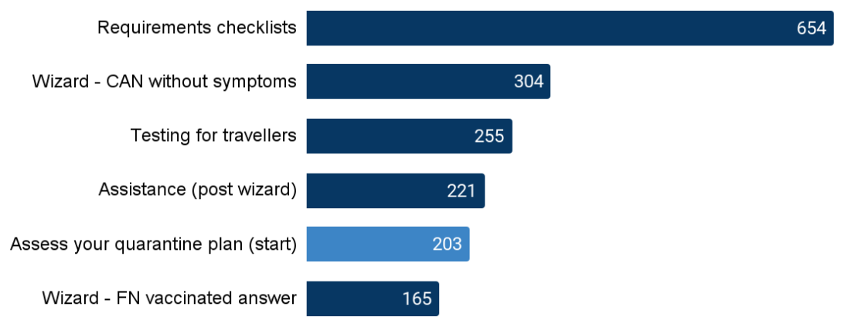
Template: Show pages that receive the most feedback
Short trips questions driving feedback on [x] page
Research questions this helps to answer
What pages received the most feedback? Where are the biggest problems happening?
Use bar charts or text to show
Volume of feedback by page Priority pages to focus on
Additional details to consider including
Main point as the title Comparisons to show if the feedback has increased or decreased Annotate anomalies or notable insights on the chart. Try using a highlight colour to emphasize the insight. Feedback examples to illustrate key issues
+423%

Slide 8
Template: Show pages that receive the most feedback
Another option to show page trends is a data table. This is a lot of data to process and may not be best for decks.
 | Week starting
Page title | 26-Aug | 2-Sep | 9-Sep | 16-Sep
COVID-19 vaccinated travellers entering Canada | 1199 | 1364 | 1191 | 897
COVID-19 Travel: Checklists for requirements and exemptions | 475 | 506 | 478 | 575
COVID-19: Travel, testing, quarantine and borders | 479 | 447 | 375 | 378
Voyageurs vaccinés contre la COVID-19 qui entrent au Canada | 160 | 234 | 207 | 133
Find out if you can travel to Canada – Foreign vaccinated | -- | 174 | 165 | 235
Flying to Canada: COVID-19 testing for travellers | 164 | 151 | 150 | 154
Find out if you can travel to Canada - Citizen without symptoms | 128 | 127 | 115 | 113
Mandatory quarantine or isolation | 139 | 117 | 110 | 118
Assistance with COVID-19 travel restrictions and requirements | 128 | 127 | 102 | 134
Boarding flights to and within Canada - | 89 | 88 | 93 | 120
Total | 3617 | 4158 | 3785 | 3769

Slide 9
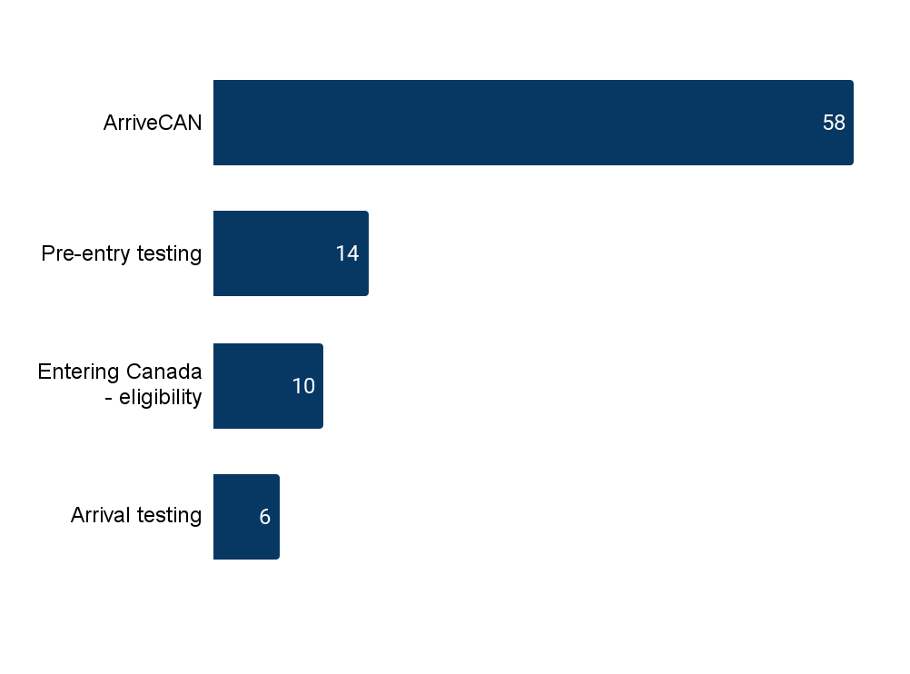
Template: Show the top issues on a page
Visitors reported technical difficulties with [X]
Research questions this helps to answer
What were the most common issues reported? What percentage of page feedback does the top issue get?
Use bar charts or text to show
Volume of feedback by issue Priority page issues to focus on
Additional details to include
Feedback examples to illustrate key issues Annotate anomalies or notable insights on the chart Data source details (total comments, date, etc.)
32% feedback
Total comments: xxx - Date range

Slide 10
Template: Showing specific issues with an emphasis on feedback
Task: Proof of vaccination Impact on people: People are looking for reassurance that they comply with new rules
Specific issues | Feedback examples | Comments
How to record a vaccine received outside of Canada | "I was vaccinated by a Canadian approved vaccine outside of Canada. How do I report that I have been vaccinated?” | 212
How to get a copy of their vaccination record | “Vaccine certificate. Where can I get mine.” | 134
Will there be a vaccination passport? | “I am looking for information on if Canada will have a digital passport for proof of vaccination” | 53

