Slide 1
Communicating GC TSS results and feedback Templates for sharing trends and insights

Slide 2

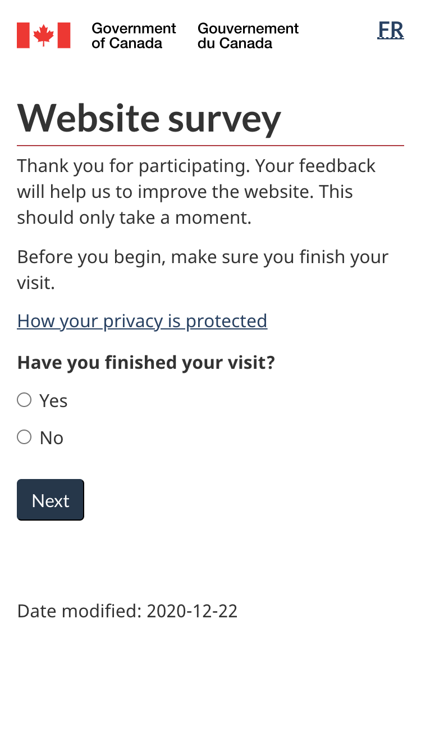
Help people understand how data is collected
GC Task Success Survey Website exit survey to identify and measure top tasks:
Runs continuously across all webpages
Offered to 10% of website visitors
Evaluates task completion, ease of use and satisfaction
A common starting point to:
Understand user needs
Measure current performance
Identify areas for improvement

Slide 3
Help tell your data story using these common templates

Slide 4
A basic one page survey data summary
55% of this [month/quarter/year] responses were about [task] (up from 48% last [date range])
“Quotation from feedback to illustrate.”
TOP TASKS | Responses | Comments | Completion score Q3 | Change from Q2
Task name 1 | 600 | 553 | 65% | ↑ 2%
Task name 2 | 320 | 158 | 70% | ↓ 3%
Task name 2 | 134 | 95 | 75% | ↔
HIGHLIGHTS
Contextual information example
Identify if an action or event impacted results for better or worse.
Pain points impacting [task]
Difficulty finding [x]
Password recovery
Work in progress or completed / Blockers
Example
Example
Responses by device type | % mobile | % desktop
Responses by language | % English | % French
Data source: July 1-September 30, 2021
Total survey responses to COVID tasks: 1022

Slide 5
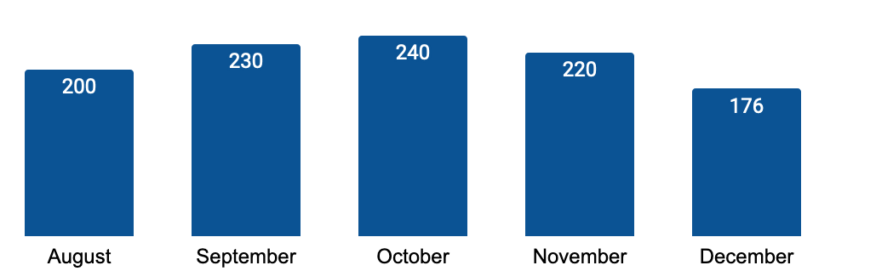
Show the trend in survey responses
Number of GC TSS responses by month for [theme / department / task]
Research questions this helps to answer
How many completed surveys were received?
Is the volume of responses going up or down?
Use bar or line charts to show trends and changes | Additional details to consider including
Across all tasks or by specific task | Annotate anomalies or notable insights on the timeline Overlaying the timeline with web traffic analytics (useful if traffic fluctuates by season)

Slide 6
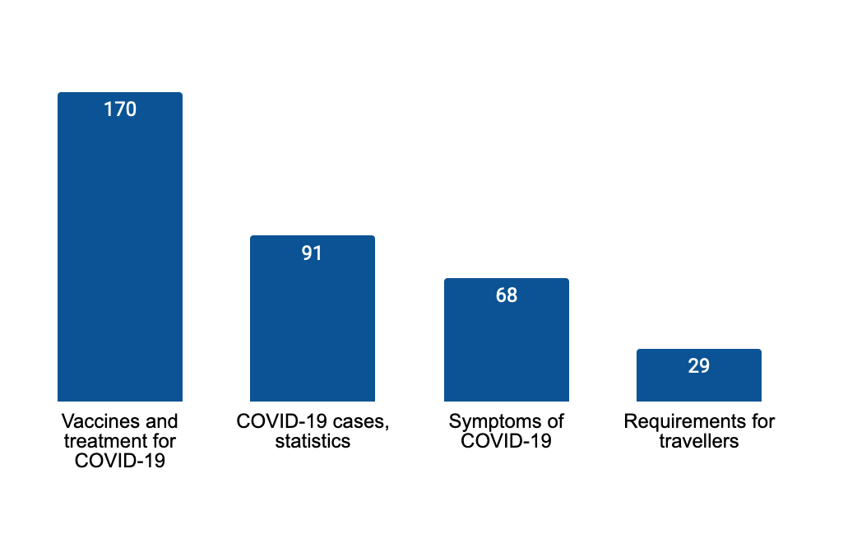
Show tasks that receive the most survey responses
Getting information about vaccines is the top COVID task
Research questions this helps to answer
What tasks received the most responses? Where are the biggest problems happening? Is ‘Other’ showing as a top task? If so, the task list may need to be optimized
Use bar charts or text to show
Volume of responses by task Priority tasks to focus on
Additional details to consider including
Main point as the title Comparisons with previous date ranges to show a change in volume Annotate anomalies or notable insights Feedback examples to illustrate key issues Data source details (total comments, date)
“How long do I have to wait
before I can get a booster?”
Date range: August 1-31, 2021
Total comments: 370
Example data only

Slide 7
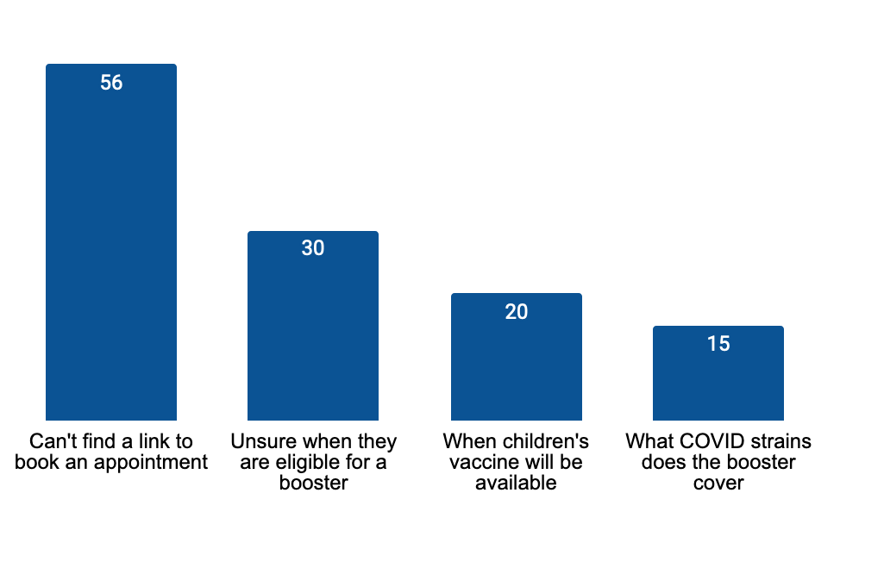
Show pain points in a specific task
Top issue in the getting vaccinated task feedback was finding an appointment booking link
Research questions this helps to answer
What are the pain points within a task? Did feedback increase or decrease when compared to a previous time frame?
Use bar charts to compare data by time frame
Across tasks or pain points
Additional details to consider including
Main point as the title Comparisons to show if the page feedback has increased or decreased Feedback examples to illustrate pain points Annotate anomalies or notable insights on the chart Scores for completion, satisfaction, ease
“Have been invited to get booster but can't find where to go to book an appointment ”
Date range: August 1 - 31, 2021 Task completion score: 70% Satisfaction score: 66% Ease score: 67% Example data only

Slide 8
Template: High-level red flags and emerging issues
Top issues in the GC Task Success Survey December 2021
Issue / questions | Type of problem | Task(s) affected
Issue 1 Description of the issue | Policy gap | Task name
Issue 2 Description of the issue | Policy gap | Task name
Highlight problems that go beyond the scope of your team’s work and need to be escalated - such as:
Policy gaps
Content gaps / incorrect information that require a subject matter expert
Technical issues

