Slide 1
Sample Course Name
Sample Course Module Name Author: Asst. Prof. Dr. Uğur CORUH

Slide 2
First Step to Python Programming
Week-1 (How to Use Python: Your First Steps)
Spring Semester, 2022-2023
Download DOC, SLIDE, PPTX

Slide 3
Outline
What Python is and why you should use it
How to Download and Install Python
The Basic Python Syntax

Slide 4
First Step to Python Programming

Slide 5
First Step to Python Programming
Why You Should Use Python Python, named after the British comedy group Monty Python, is a high-level, interpreted, interactive, and object-oriented programming language. Its flexibility allows you to do many things, both big and small. With Python, you can write basic programs and scripts and also to create complex and large-scale enterprise solutions
You can find Python everywhere in the world of computer programming. For example, Python is the foundation of some of the world’s most popular websites, including Reddit, Dropbox, and YouTube, to name a few. The Python web framework Django powers both Instagram and Pinterest.

Slide 6
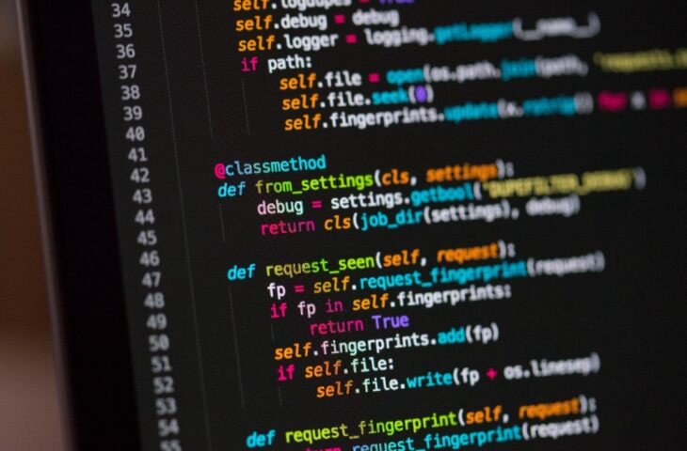
Compared to other programming languages, Python has the following features:
Interpreted: It’s portable and quicker to experiment with than compiled languages. Multiparadigm: It lets you write code in different styles, including object-oriented, imperative, and functional style. Dynamically typed: It checks variable types at runtime, so you don’t need to declare them explicitly. Strongly typed: It won’t let unsafe operations on incompatible types go unnoticed.
center h:325px

Slide 7
There’s a lot more to learn about Python. But by now, you should have a better idea of why Python is so popular and why you should consider learning to program with it.
- How to Download and Install Python: Python works on Linux, Mac, Windows, and several other platforms. It comes preinstalled on macOS and on most Linux distributions. However, if you want to be up to date, then you probably need to download and install the latest version.
bg right:50% h:300px

Slide 8
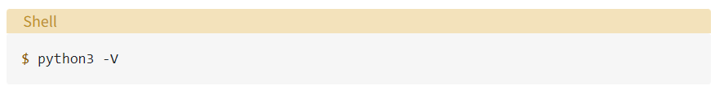
To check what Python version has been installed globally in your operating system, open the terminal or command line and run the following command: This command prints the version of your system’s default Python 3 installation. Note that you use python3 instead of python because some operating systems still include Python 2 as their default Python installation.
bg left:50% h:80px

Slide 9
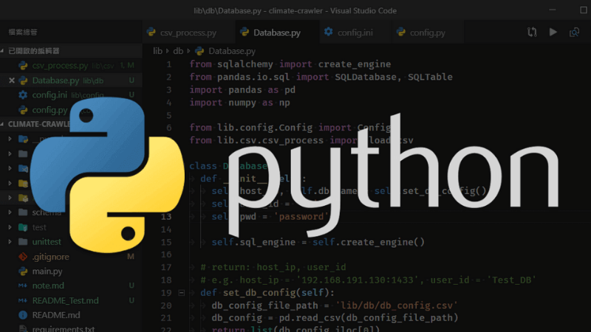
bg h:px

Slide 10
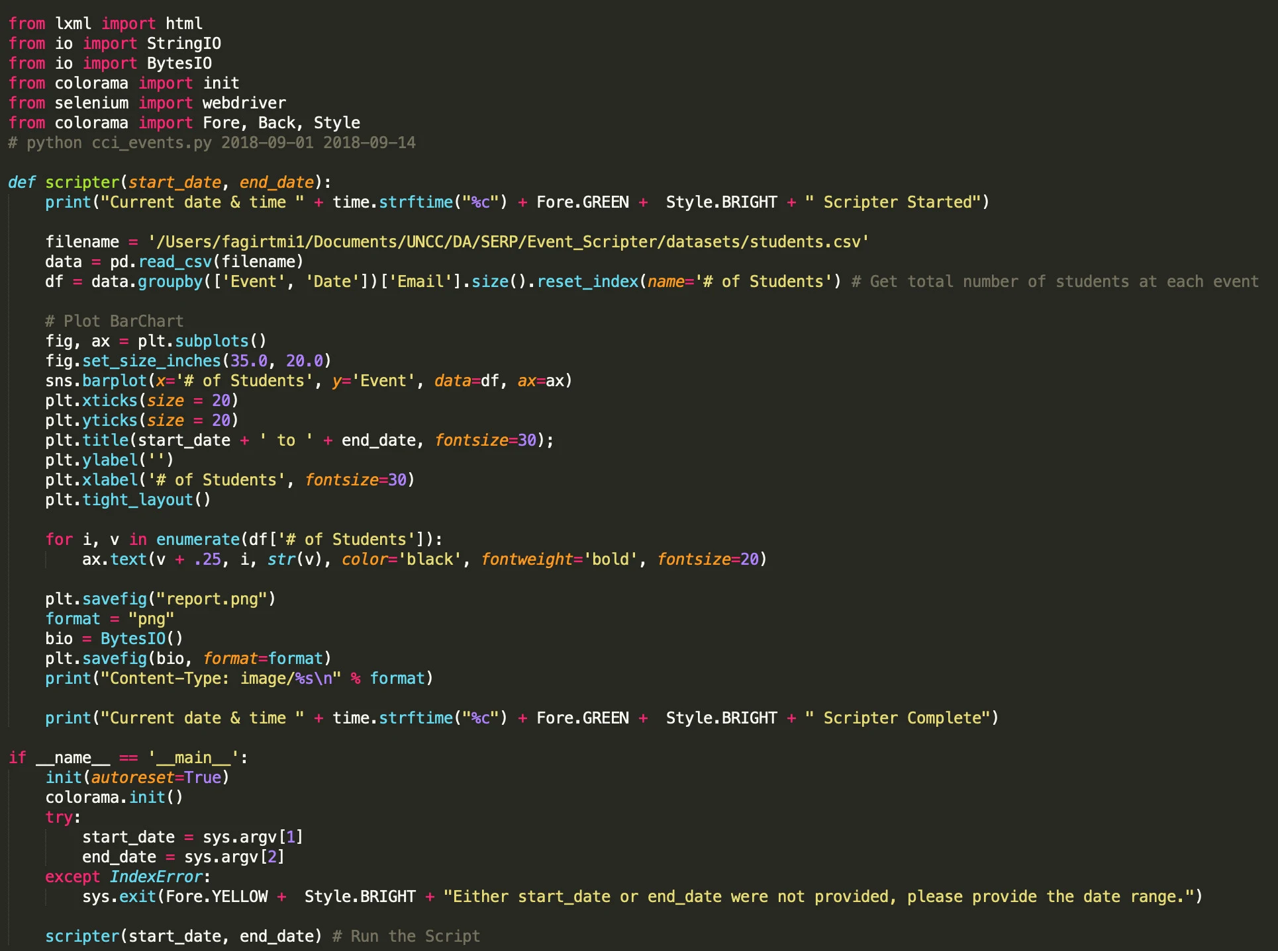
The Basic Python Syntax: The Python syntax is clear, concise, and focused on readability. Readability is arguably one of the more attractive features of the language itself. It makes Python ideal for people who are learning to program. In this section, you’ll learn about several important components of the Python syntax:
bg left:50% h:400px

Slide 11
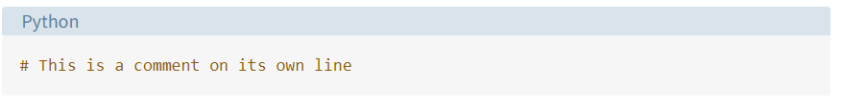
COMMENTS: Comments are pieces of text that live in your code but are ignored by the Python interpreter as it executes the code. You can use comments to describe the code so that you and other developers can quickly understand what the code does or why the code is written in a given way. To write a comment in Python, just add a hash mark (#) before your comment text:
bg left:50% h:80px

Slide 12
SEE YOU NEXT LESSON :)

Slide 13
References
https://realpython.com/python-first-steps/#the-basic-python-syntax
https://www.techinside.com/en-populer-programlama-dili-python-oldu/
https://www.abakuskitap.com/blog/icerik/python-ile-ne-yapabilirsiniz-pythonin-3-temel-kullanim-alani
https://www.fiverr.com/fatihagirtmis/do-python-programming-for-you

Slide 14
$End−Of−Week−1−Module$

