Slide 1



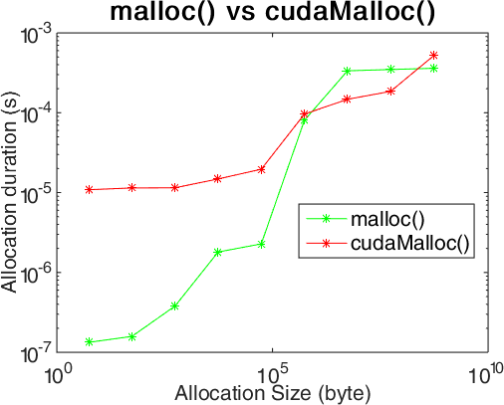
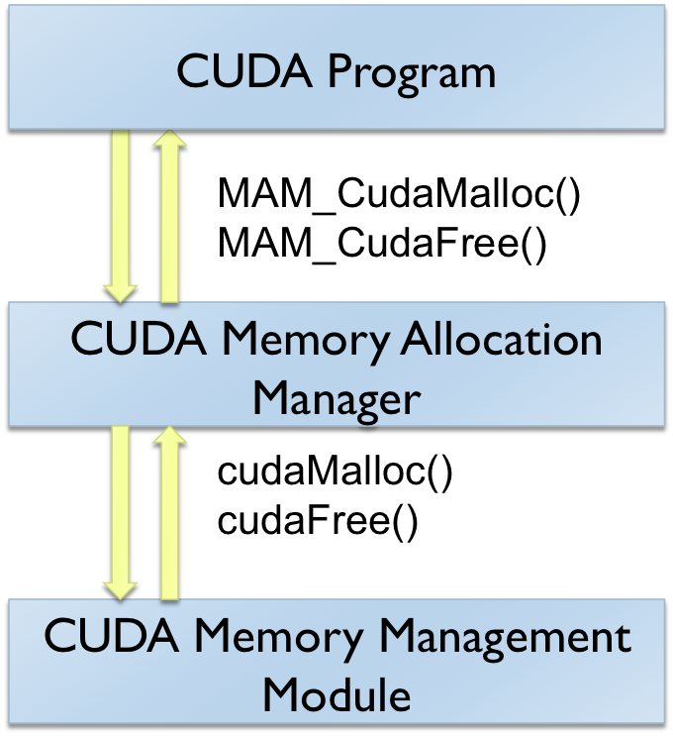
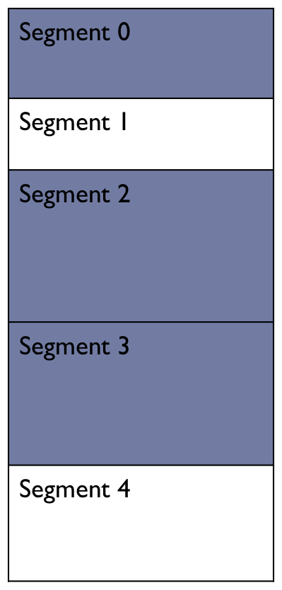
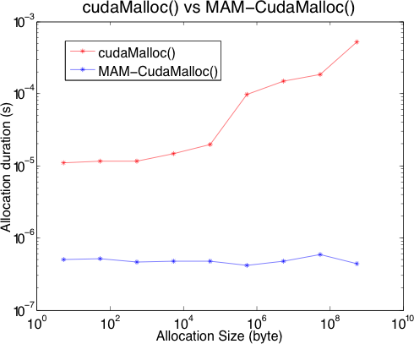
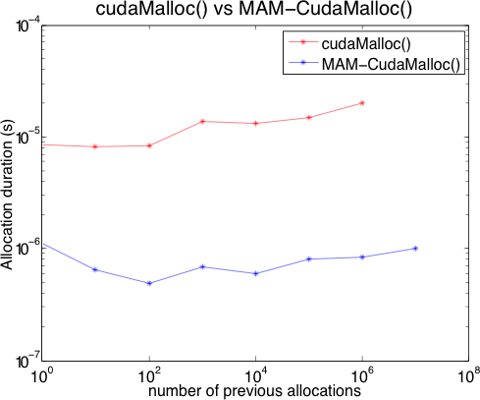
Computer Science and Engineering
MAM: A Memory Allocation Manager for GPUs
Can Aknesil
Computer Science and Engineering, Koç University, İstanbul
caknesil13@ku.edu.tr
Didem Unat
Computer Science and Engineering, Koç University, İstanbul
dunat@ku.edu.tr
Motivation
Data Structures in MAM
cudaMalloc() is slow especially when allocation size is large.
Applications requiring repetitive allocations may reduce the performance.
We develop a memory management library primarily for GPUs.
The Pointer Tree
Stores empty segments sorted according to their sizes.
Red-Black Tree is used.
The Size Tree-Dictionary
Stores empty segments sorted according to their sizes
Red-Black Tree is used.
Allocation Algorithm
procedure ALLOCATE
Find a best-fitting empty segment from the tree-dictionary O(log n)
Mark the segment as filled O(1)
if The segment perfectly fits O(1) then
Remove segment from tree-dictionary O(log n)
else
Resize it O(1)
Remove it from tree-dictionary O(log n)
Create a new empty segment O(1)
Insert it in pointer-tree & tree-dictionary O(log n)
end if
Return the base pointer of filled segment O(1)
end procedure
What is MAM ?
MAM is a C library that provides an abstraction layer between the programmer and the memory management module of CUDA environment.
MAM removes the overhead of memory allocation and deallocation.
Deallocation Algorithm
procedure DEALLOCATE
Find the segment in the pointer-tree O(log n)
Mark the segment as empty O(1)
Get previous and next segments O(log n)
if the previous segment is empty O(1) then
Remove the segment being newly emptied from
pointer-tree and tree-dictionary O(log n)
Destroy the segment being newly emptied O(1)
Resize previous segment O(1)
Replace it in tree-dictionary O(log n)
Assign it to the variable stored the destroyed
segment O(log n)
end if
// repeat the similar procedure for next segment.
end procedure
How to use MAM ?
WITHOUT MAM
WITH MAM
cudaMalloc(&ptr, size);
...
cudaFree(ptr);
MAM_Create();
MAM_CudaMalloc(&ptr, size);
...
MAM_CudaFree(ptr);
MAM_Destroy();
How MAM Works ?
For both algorithms,
Time complexity: O(log n)
Space complexity: O(n)
where n = number of segments
When MAM_Create() is called, a large continuous chunk of memory is allocated on the device.
The size of the chunk is expected to be greater than the total size of the memory that will be allocated by the CUDA program at a time instance.
During allocation and deallocation, MAM manipulates segments of the chunk by creating and destroying them.
Each segment is nothing but a small sized structure stored in the host memory.
Performance Results
struct segment {
void *basePtr;
size_t size;
char isEmpty;
/* data related to data
structures */
};
MAM performs better in the mesurement which is according to the allocation size. While the allocation duration of cudaMalloc() increases linearly, the duration of MAM_CudaMalloc() stays constant.
MAM performs better also in the measurement which is according to the number of previously allocated segments.
Blue: Segments being used
White: Empty segments

