Slide 1
Başarım 2017 MAM: A Memory Allocation Manager for GPUs
Can Aknesil, Didem Unat
Computer Science and Engineering

Slide 2
OUTLINE
Background
Motivation
What is MAM and how to use it?
How MAM works?
Performance results of MAM
Extensibility of MAM

Slide 3
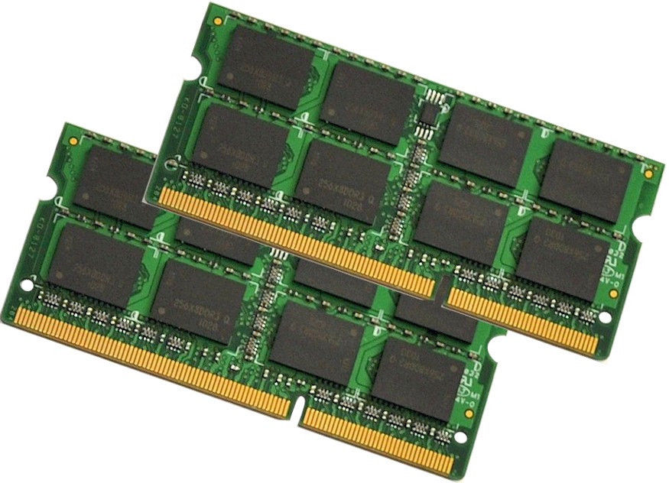
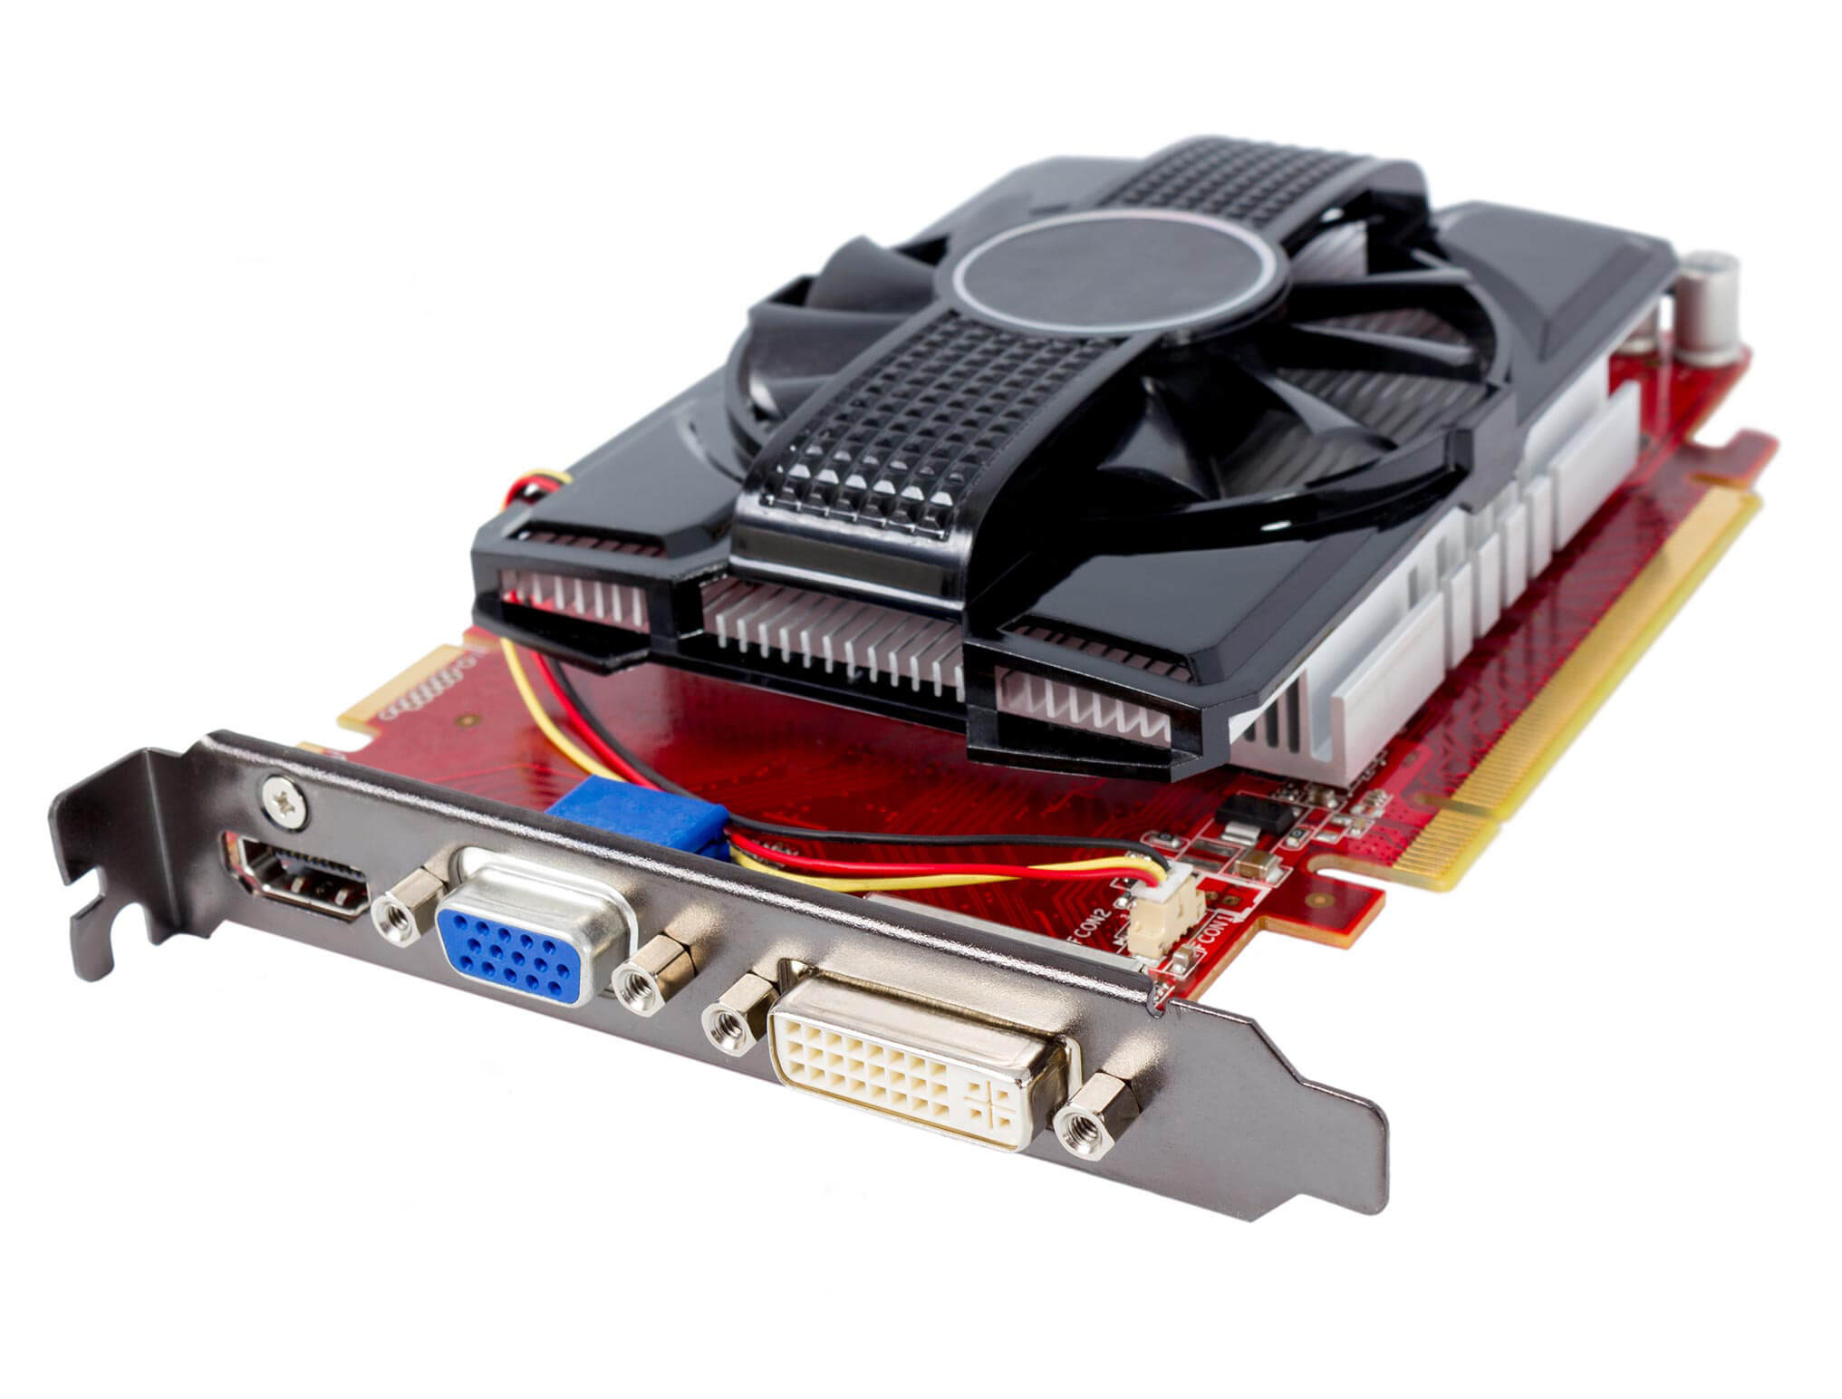
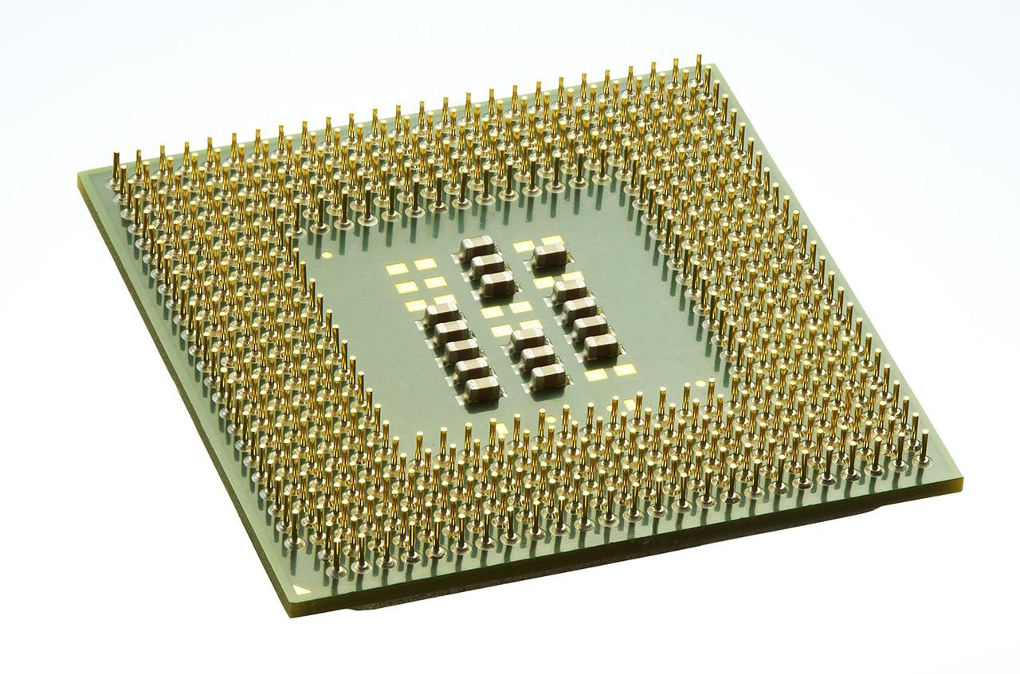
BACKGROUND: HOST VS DEVICE
Host: The CPU and the host memory (the memory that CPU uses).
Device: The GPU and the device memory (the memory that GPU uses).
HOST
DEVICE

Slide 4
BACKGROUND: GPU USAGE
Input data is copied from the host memory to the device memory.
The GPU computes the output.
Output data is copied back to the host memory.
Input data
Output data
HOST
DEVICE

Slide 5
BACKGROUND: HOST & DEVICE MEMORY ALLOCATION
Host memory allocation is performed via malloc() call (with C, C++).
Device memory allocation is performed via cudaMalloc() call (with CUDA).
HOST
DEVICE

Slide 6
MOTIVATION
cudaMalloc() is slow especially when allocation size is large.
Applications requiring repetitive allocations may reduce the performance.
We develop a memory management library primarily for GPUs.

Slide 7
MOTIVATION
Kernel: Linux 2.6.32-431.11.2.el6.x86_64,
GPU: Tesla K20m, NVCC: 7.0, V7.0.27

Slide 8
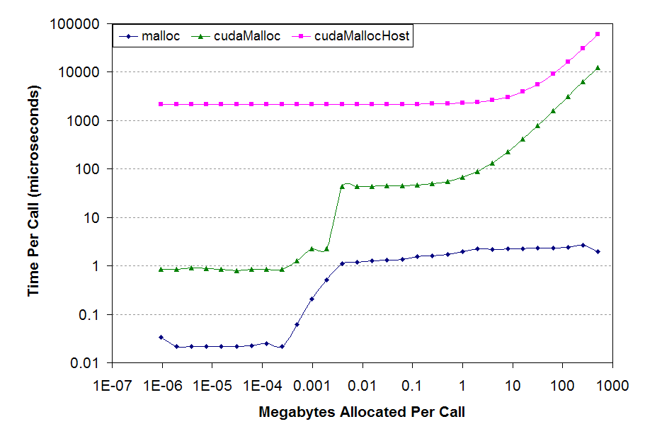
MOTIVATION
From: https://www.cs.virginia.edu/~mwb7w/cuda_support/memory_management_overhead.html

Slide 9
WHAT IS MAM?
MAM is a C library that provides an abstraction layer between the programmer and the memory management module of CUDA environment.
MAM removes the overhead of memory allocation.
MAM is thread-safe.
CUDA Program
MAM_CudaMalloc()
MAM_CudaFree()
CUDA Memory Allocation Manager
cudaMalloc()
cudaFree()
CUDA Memory Management Module

Slide 10
HOW TO USE MAM (general)
REGULAR
WITH MAM
cudaMalloc(&ptr, size);
...
cudaFree(ptr);
MAM_Create();
MAM_CudaMalloc(&ptr, size);
...
MAM_CudaFree(ptr);
MAM_Destroy();

Slide 11
HOW MAM WORKS?
Segment 0
When MAM_Create() is called, a large continuous chunk of memory is allocated on the device.
The size of the chunk is expected to be greater than the total size of the memory that will be allocated by the CUDA program at a time instance.

Slide 12
HOW MAM WORKS?
Segment 0
Segment 1
Segment 2
Segment 3
Segment 4
During allocation and deallocation, MAM manipulates segments of the chunk by creating and destroying them.
Each segment is nothing but a small sized structure stored in the host memory.
Blue: Segments being used
White: Empty segments

Slide 13
HOW MAM WORKS?
Segment 0
Segment 1
Segment 2
Segment 3
Segment 4
struct segment {
void *basePtr;
size_t size;
char isEmpty;
/* data related to data
structures */
...
};

Slide 14
DATA STRUCTURES IN MAM
Segment 0 (base = 0x00000000)
Segment 1 (base = 0x00A00000)
Segment 2 (base = 0x01000000)
Segment 3 (base = 0x24000000)
Segment 4 (base = 0x38000000)
POINTER-TREE:
Stores empty segments.
Sorted according to their base pointer.
Red-Black Tree is used.

Slide 15
DATA STRUCTURES IN MAM
Segment 0 (size = 10 MB)
Segment 1 (size = 6 MB)
Segment 2 (size = 20 MB)
Segment 3 (size = 20 MB)
Segment 4 (size = 15 MB)
EMPTY-SEGMENT-TREE-DICTIONARY:
Stores empty segments.
Sorted according to their sizes
Red-Black Tree is used.

Slide 16
HOW MAM WORKS? (ALLOCATION)
IF DESIRED SEGMENT SIZE DOESN’T PERFECTLY FIT TO ANY EMPTY SEGMENT, BEST FITTING EMPTY SEGMENT IS CHOSEN
IF DESIRED SEGMENT SIZE PERFECTLY FITS TO AN EMPTY SEGMENT
Segment 0
Segment 1
Segment 2
Segment 0
Segment 1
Segment 2
Segment 0
Segment 1
Segment 2
Segment 0
Segment 1
Segment 3
Segment 2

Slide 17
HOW MAM WORKS? (ALLOCATION)
Find a best-fitting empty segment from tree-dictionary;
//O(log(n))
Mark the segment as filled; //O(1)
If perfectly fits //O(1)
Remove it from tree-dictionary; //O(log(n))
Else
Resize it; //O(1)
Remove it from tree-dictionary; //O(log(n))
Create a new empty segment; //O(1)
Insert it in pointer-tree and tree-dictionary;
//O(log(n))
Return base pointer of filled segment; //O(1)
Time complexity: O(log(n))
Space complexity: O(n)
n = number of segments

Slide 18
HOW MAM WORKS? (DEALLOCATION)
IF NEIGBOURS ARE BEING USED
Segment 0
Segment 1
Segment 2
Segment 0
Segment 1
Segment 2
IF NEIGBOURS AREN’T BEING USED
Segment 0
Segment 1
Segment 2
Segment 0
Segment 1
Segment 2
Segment 0
Segment 2

Slide 19
HOW MAM WORKS? (DEALLOCATION)
Find the segment with pointer-tree; //O(log(n))
Mart it as empty; //O(1)
Get previous and next segments; //O(log(n))
If previous segment is empty //O(1)
Free the emptied segment; //O(1)
Remove it from pointer-tree and tree-dictionary;
//O(log(n))
Resize previous segment; //O(1)
Replace it in tree-dictionary; //O(log(n))
If next segment is empty //O(1)
Free the next segment //O(1)
Remove it from pointer-tree and tree-dictionary;
//O(log(n))
Resize previous (or emptied) segment; //O(1)
Replace it in tree-dictionary; //O(log(n))
Time complexity: O(log(n))
Space complexity: O(n)
n = number of segments

Slide 20
PERFORMANCE ANALYSIS OF MAM
We measured the performance of MAM in two ways:
In terms of the allocation size:
Created an histogram by measuring time elapsed of several allocations of random size until the chunk is nearly full.
In terms of the number of previously allocated segments:
We measured the time elapsed during the first allocation after allocated variable number of segments.
Note: Both of these measurements exclude the creation overhead of MAM environment.

Slide 21
PERFORMANCE RESULTS OF MAM
ACCORDING TO ALLOCATION SIZE
Kernel: Linux 2.6.32-431.11.2.el6.x86_64,
GPU: Tesla K20m, NVCC: 7.0, V7.0.27

Slide 22
PERFORMANCE RESULTS OF MAM
ACCORDING TO ALLOCATION SIZE
Kernel: Linux 2.6.32-431.11.2.el6.x86_64,
GPU: Tesla K20m, NVCC: 7.0, V7.0.27

Slide 23
PERFORMANCE RESULTS OF MAM
ACCORDING TO THE NUMBER OF PREVIOUSLY ALLOCATED SEGMENTS
Kernel: Linux 2.6.32-431.11.2.el6.x86_64,
GPU: Tesla K20m, NVCC: 7.0, V7.0.27

Slide 24
HOW TO USE MAM (alternatives)
SPECIFYING THE CHUNK SIZE DURING THE CREATION
MAM_Create(maxSize);
MAM_CudaMalloc(&ptr, size);
...
MAM_CudaFree(ptr);
MAM_Destroy();

Slide 25
HOW TO USE MAM (alternatives)
WITHOUT SPECIFYING THE CHUNK SIZE DURING THE CREATION
(The largest possible chunk allocation is done automatically)
MAM_Create_auto();
MAM_CudaMalloc(&ptr, size);
...
MAM_CudaFree(ptr);
MAM_Destroy();

Slide 26
HOW TO USE MAM (alternatives)
WITHOUT EXPLICIT CREATION
During the first call to MAM_CudaMalloc(), the largest possible chunk allocation is done automatically. (Lazy creation)
When all segments are deallocated, MAM destroys itself automatically.
MAM_CudaMalloc(&ptr, size);
...
MAM_CudaFree(ptr);

Slide 27
EXTENSIBILITY OF MAM
This presentation only covers performance comparison with CUDA memory management (cudaMalloc() and cudaFree()).
MAM is completely applicable to any situation where a contiguous allocation occurs. For example, pined memory allocation and host memory allocation.
MAM will work exactly the same way with any of these situations since it does not depend on allocation after it is created.

Slide 28
REFERENCES
[1] “CUDA Memory Management Overhead,” CUDA Memory Management Overhead. [Online]. Available: https://www.cs.virginia.edu/~mwb7w/cuda_support/memory_management_overhead.html. [Accessed: 14-Oct-2016].

Slide 29
THANK YOU FOR LISTENING

