Slide 1
CUDA Support for Snowflake
Can Aknesil – Computer Engineering Final Project

Slide 2
Outline
Introduction to stencil computing
About Snowflake
A Snowflake example code
Execution steps of Snowflake
Snowflake AST
CUDA backend structure
CUDA backend code generation

Slide 3
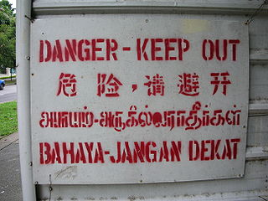

Stencil

Slide 4
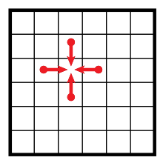
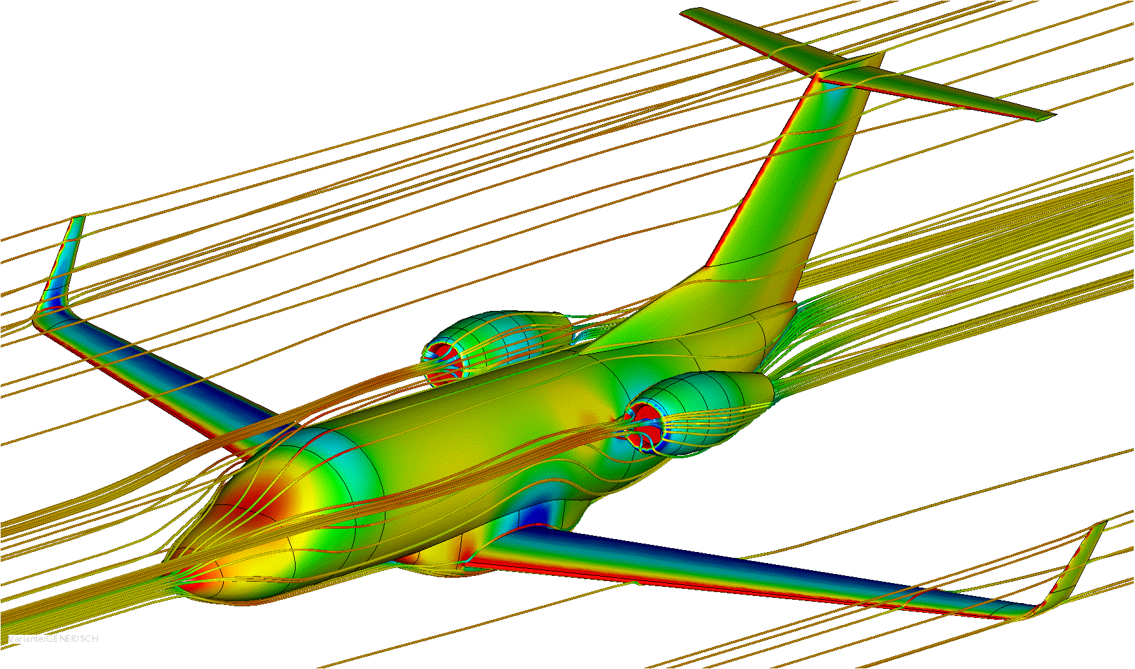
Stencil Computation

Slide 5
Snowflake
Domain Specific Language (DSL) for stencil computation.
Embedded in Python.
Just In Time (JIT) compilation or dynamic translation.
  To OpenCL, OpenMP, CUDA (my task)
Micro compiler
Aim of Snowflake:
  Performance portability across different platforms via translation to multiple programming models.
  One code (Snowflake) → multiple support (OpenCL, OpenMP, CUDA)

Slide 6
Snowflake Example
# create the stencil
wArr = WeightArray(ones((3, 3), dtype=float) / 9)
sC = StencilComponent("weight_array", wArr)
rD = RectangularDomain([(1, -1, 1)]*2)
s = Stencil(sC, "output", rD)
# compile
c = PythonCompiler()
# c = CCompiler()
# c = CUDACompiler()
callable = c.compile(s)
# execute
callable(output, input)

Slide 7
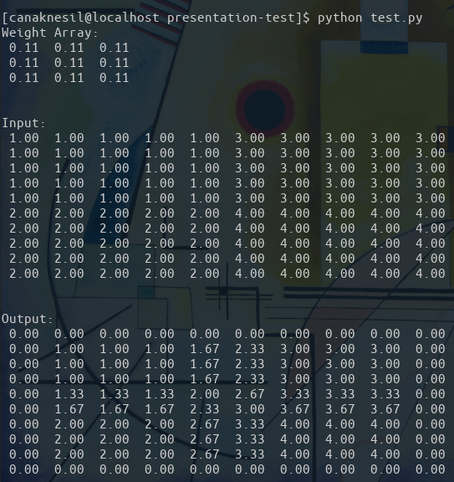
Snowflake Example
# create the stencil
wArr = WeightArray(ones((3, 3), dtype=float) / 9)
sC = StencilComponent("weight_array", wArr)
rD = RectangularDomain([(1, -1, 1)]*2)
s = Stencil(sC, "output", rD)
# compile
c = PythonCompiler()
# c = CCompiler()
# c = CUDACompiler()
callable = c.compile(s)
# execute
callable(output, input)

Slide 8
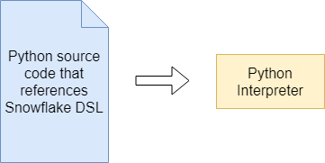
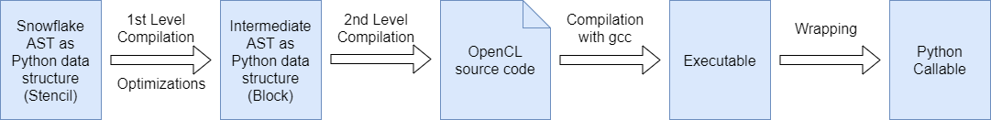
Snowflake Execution
# create the stencil
...
s = Stencil(sC, "output", rD)
# compile
c = CCompiler()
callable = c.compile(s)
# execute
callable(output, input)

Slide 9
Snowflake AST
Expression ::= Stencil(Expression, String, IterationSpace)
stencil(op_tree)
::= StencilGroup([Expression ...])
stencilGroup(body)
::= Expression {+, -, *, /} Expression
stencilOp(left right)
::= StencilConstant(Number)
stencilConstant(value)
::= StencilComponent(String, Weight)
stencilComponent(name weights)
IterationSpace ::= DomainUnion([IterationSpace …])
domainUnion(domains)
::= RectangularDomain(Array)
rectangularDomain()
Weight ::= WeightArray(Array)
weightArray(weights)
::= SparseWeightArray(Array)
sparceWeightArray(weights)

Slide 10
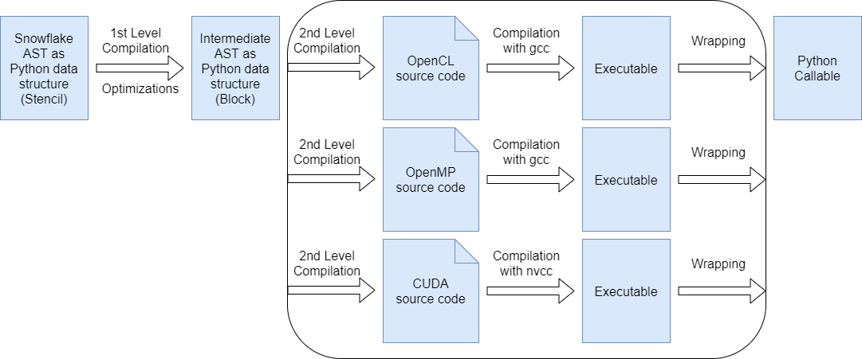
Snowflake Execution

Slide 11
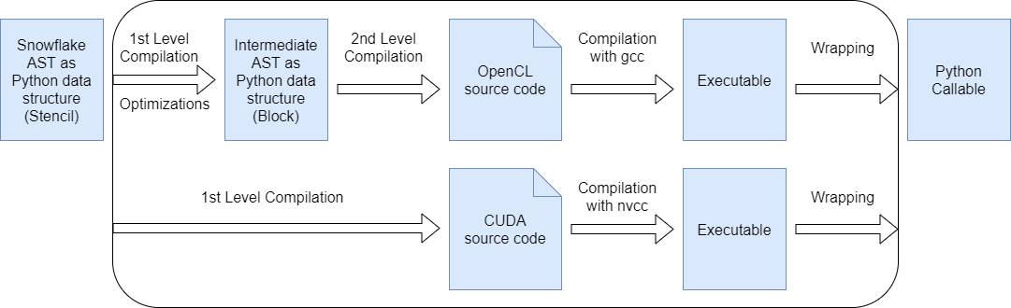
Snowflake Execution

Slide 12
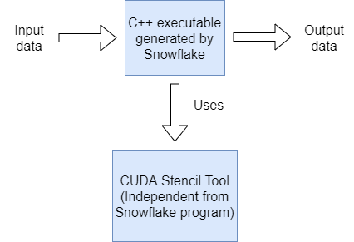
CUDA Backend

Slide 13
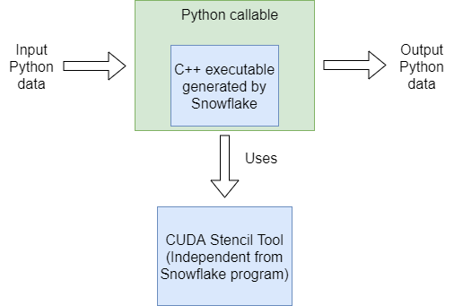
CUDA Backend

Slide 14
CUDA Stencil Tool
void applyStencil(float *in,
float *out,
int *arrSize,
float *wArr,
int *wArrSize,
int dim);

Slide 15
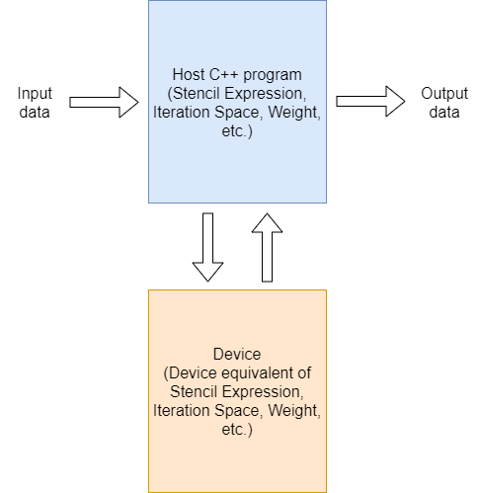
CUDA Backend code generation
Each item from Snowflake AST have a device equivalent. They are loaded to device memory once the callable is called.
They are hardcoded to the generated C++ code. Since weight arrays are not too large, they are not required to be used via stdio.
The input and output data is transferred via stdio.

Slide 16
The End
Thank you! Any questions???

Slide 17
References
Plane fluide dynamics image: https://www.termoflow.com/jobs/detail/bachelor-master-thesis-in-computational-fluid-dynamics-cfd-1
2d stencil image: https://en.wikipedia.org/wiki/Stencil_code
Real life stencil image: https://en.wikipedia.org/wiki/Stencil
N. Zhang, M. Driscoll, C. Markley, S. Williams, P. Basu, and A. Fox, “Snowflake: A Lightweight Portable Stencil DSL,” 2017 IEEE International Parallel and Distributed Processing Symposium Workshops (IPDPSW), pp. 795–804, 2017.

